Slide 1
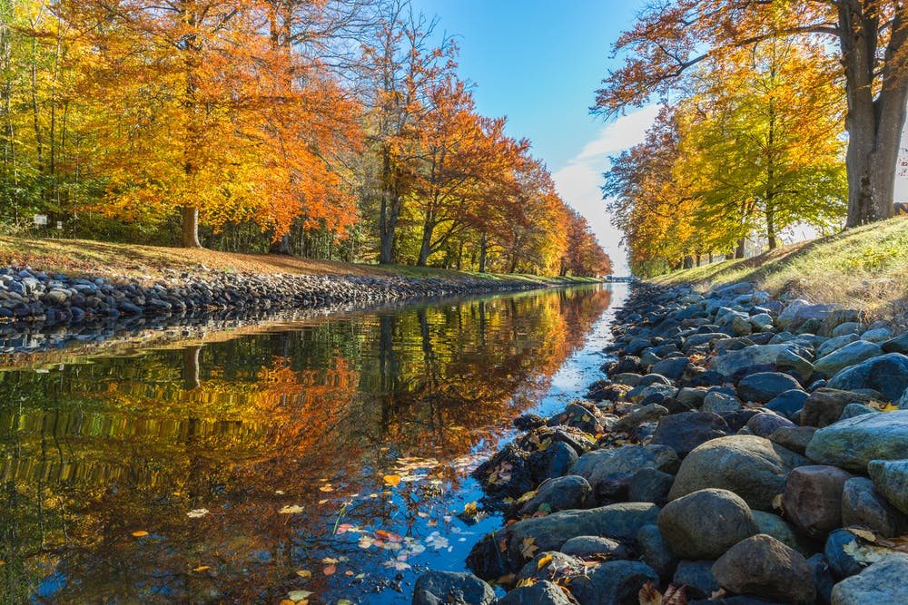
Unit 1: BACK TO SCHOOL
(Practice)

Slide 2
I.Complete the following dialogue.
Nga: Good morning. (1)…………………..
Tam:(2)………………………. My name’s Tam. Are you a new student?
Nga: Yes, I’m in class 7A.
Tam: (3) ………………………
Nga: I’m from Hue.
Tam: Who are you living with?
Nga: (4) ………………………….
Tam: Why are you unhappy?
Nga: (5) …………………………….
Tam: But you have new friends here.
Nice to meet you.
I live with my parents.
Because I miss my old friends.
Where are you from?
My name’s Nga.

Slide 3
I.Complete the following dialogue.
Nga: Good morning. (1) My name’s Nga.
Tam:(2) Nice to meet you. My name’s Tam. Are you a new student?
Nga: Yes, I’m in class 7A.
Tam: (3) Where are you from?
Nga: I’m from Hue.
Tam: Who are you living with?
Nga: (4) I live with my parents.
Tam: Why are you unhappy?
Nga: (5) Because I miss my old friends.
Tam: But you have new friends here.

Slide 4
II.Fill in appropriate word in the blank:
1. … class are you in?
A. Where B. How C. What
2. She doesn’t have … English Book.
some B. many C. any
Hanoi is a big city, but Ho Chi Minh City is … than Hanoi.
bigger B. the bigger C. the biggest
4. Her parents still live there … her grandparents.
A. and B. with C. than

Slide 5
Keys:
1.C 2.C 3.B

Slide 6
III.Write comparative sentences.
Lan/ tall/ Hoa
This book/ thick/ that book
The chair/ short/ the table
These boxes/ big/ those boxes
Miss Trang/ young/ her sister
These buildings/ high/ those buildings
The boys/ strong/ the girls
I/ old/ my brother.

Slide 7
Keys:
III.Write comparative sentences.
Lan is taller than Hoa.
This book is thicker than that book.
The chair is shorter than the table.
These boxes are bigger than those boxes.
Miss Trang is younger than her sister.
These buildings are higher than those buildings.
The boys are stronger than the girls.
I am older than my brother.

Slide 8
IV. Complete the sentences with much, many, a lot / lots .
My father never drinks ________ coffee for breakfast.
I don’t have ________ time to read.
Her new school has ________of students.
There are ________of orange juice in the jar.
This hotel doesn’t have ________ rooms.
He has ________ of money in his pocket.
There are too ________ pictures on the wall.
She drinks ________ of tea.

Slide 9
Keys:
IV. Complete the sentences with much, many, a lot / lots .
My father never drinks much coffee for breakfast.
I don’t have much time to read.
Her new school has a lot of students.
There are a lot of orange juice in the jar.
This hotel doesn’t have many rooms.
He has a lot of money in his pocket.
There are too many pictures on the wall.
She drinks a lot of tea.

Slide 10
V. Complete the dialogues.
Phong: Hello. My name is Phong.
Nam: Nice ________ ________ you, Phong.
I ________ Nam. ________you a ________ student?
Phong: Yes. I’m in ________ 7A
Nam: Oh. So ________ ________.
2. Ba: Hi, Nam.
Nam: ________, Ba ________ to ________you again.
This is ________ new classmate. ________ name’s Phong.
Ba: Nice ________ ________ you, Phong.
Phong: ________ ________ ________ ________, ________.

Slide 11
Keys:
V. Complete the dialogues.
Phong: Hello. My name is Phong.
Nam: Nice to meet you, Phong.
I am Nam. Are you a new student?
Phong: Yes. I’m in class 7A
Nam: Oh. So am I.
2. Ba: Hi, Nam.
Nam: Hi , Ba. Nice to see you again.
This is our new classmate. His name’s Phong.
Ba: Nice to meet you, Phong
Phong: Nice to meet you, too.

Slide 12
VI. Choose the best answers.
________class are you in? (Where, How many, What)
She doesn’t have ________ picture books. (some, many, lot of)
I like swimming and ________ does my sister. (so, too, but)
Her parents live ________ Ha Noi. (on, at, in)
Ha Noi is a big city, but it is ________ than Ho Chi Minh city. (the smaller, smaller, smallest)
I live ________25/ 3B Tran Phu Street. (in, at, on)
________ is it from here to school? – About two kilometers. (How far, How high, How long)
Minh ________ television every night. (watchs, watches, watching)

Slide 13
Keys:
What
many
so
smaller
at
How far
watches

Slide 14
VII. Supply the correct forms of the verbs in brackets:
Hoa __________ (have) a lot of friend in Hue.
Nam and Trang always __________ ( visit) their grandparents on Sundays.
My father __________ (travel) to London next month.
My mother __________ ( listen) to the radio every day.
She __________ ( not, live) with her parents.
Lan __________ ( brush) her teeth now.
The children __________ (like) to play in the yard.
Nga __________ (talk) in the meeting next Monday?

Slide 15
Keys:
has
visit
will travel
listens
does not live
is brushing
like
will talk

Slide 16
VIII. Rearrange the words to make correct sentences:
see/ you/ again/ nice/ to.
our/ classmate/ is/ this/ new.
have/ any/ doesn’t/ in/ she/ friends/ Ha Noi.
new/ has/ students/ her/ school/ a lot of.
with/ her/ lives/ Hoa/ in/ uncle and aunt/ Ha Noi.

Slide 17
Keys:
VIII. Rearrange the words to make correct sentences:
Nice to see you again.
This is our new classmate.
She doesn’t have any friends in Ha Noi.
Her new school has a lot of students.
Hoa lives with her aunt and uncle in Ha Noi.

Slide 18

Homework
Learn by heart the vocabularies and structures in Unit 1.
- Prepare Unit 2. A – Telephone numbers.

