Slide 1
UNIT 2 – GRADE 7
Personal information
A. Telephone numbers

Slide 2
VOCABULARY
-telephone directory (n) :
danh bạ điện thoại
-call (v):
gọi
-soon (adv):
sớm
-start (v):
bắt đầu
-last (v):
kéo dài

Slide 3
STRUCTURES
1.What is your telephone number?
My telephone number is 38 950 963
2.Will you be free tomorrow?
Yes, I will.
No, I won’t.
3.When will she be back?
She’ll be back at about six o’clock.

Slide 4
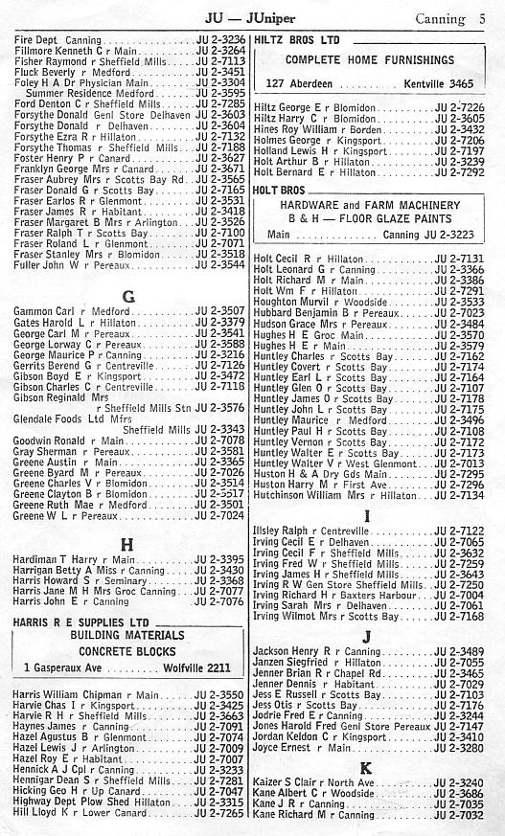
A1.Read.
TELEPHONE DIRECTORY
Where is this page from?
→ It’s from a telephone directory

Slide 5


Telephone Directory
It is a book that tells you someone’s number.

Slide 6
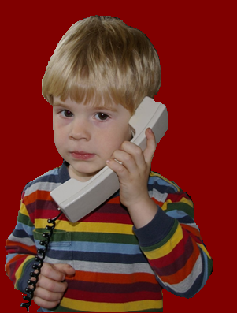
In English we usually say telephone number like this:
0 = oh (zero is sometimes also used)
63 = six three (NOT sixty-three)
66 = double six
666 = six double six
Ex: 8 237 789
Stop after reading the area code (8) and then read after three numbers

Slide 7
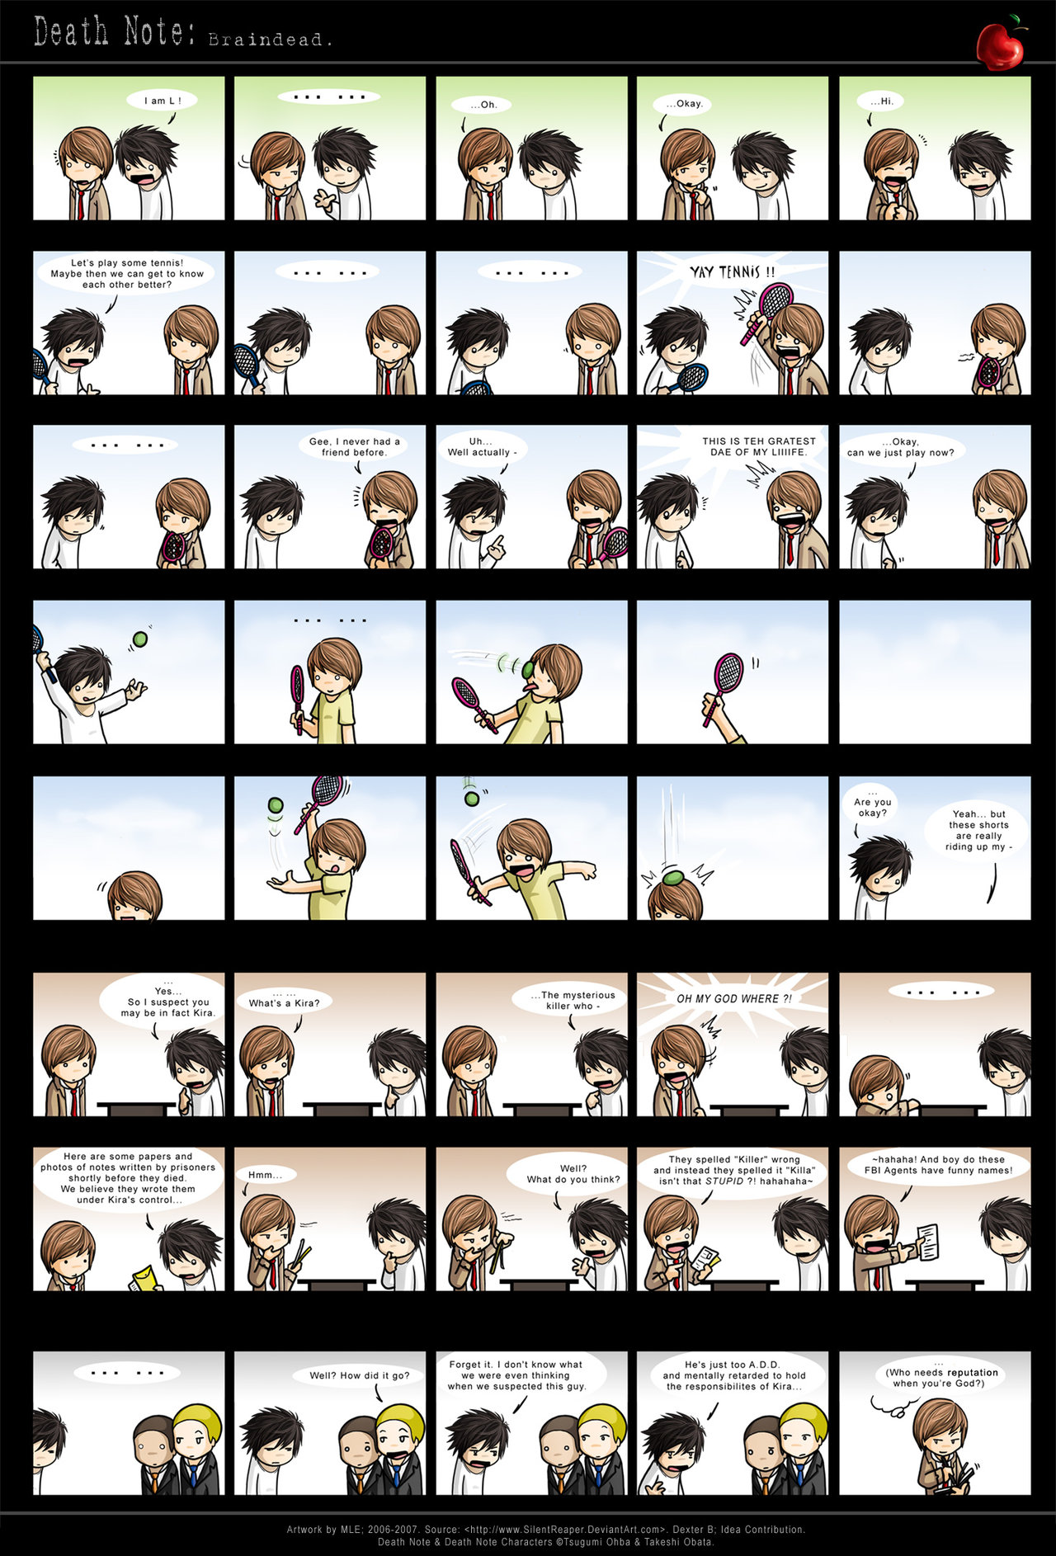
Practice with a partner. Say the telephone number for these people
Dao Van An
Pham Viet Anh
Pham Thanh Ba
d) Dinh Thi Bang
e) Vu Thanh Bat
f) Bui Ngoc Bich
For example:
Tell me An’s number, please!
Wait…
Here, 8 237 789

Slide 8


A2. Listen and write the telephone numbers.
8 251 654
8 250 514
8 521 936
8 351 793
8 237 041
8 821 652

Slide 9
A3.Listen.
Lan: Excuse me, Hoa.
Hoa: Yes, Lan .
Lan : What’s your telephone number?
Hoa : 8 262 019
Lan : Thanks. I’ll call you soon.

Slide 10
Now ask your classmate and complete the list.
Name | Address | Telephone number
Hoa
12 Tran Hung Dao Street.
8 262 019
Lan: Excuse me, Hoa.
Hoa: Yes, Lan .
Lan: What’s your address?
Hoa: 12 Tran Hung Dao Street.
Lan : What’s your telephone number?
Hoa : 8 262 019
Lan : Thanks. I’ll call you soon.

Slide 11
A4. Listen and read.Then answer the questions
Phong: Hello. This is 8 537 471.
Tam:Hello. Is this Phong?
Phong: Yes. Who’s this?
Tam:It’s me ,Tam. Will you be free tomorrow evening?
Phong : Yes, I will.
Tam: Would you like to see a movie?
Phong: Sure . What time will it start?
Tam: It’ll start at seven o’clock. Let’s meet at 6.45.
Phong: Where will we meet?
Tam: We’ll meet in front of the movie theater.
Phong : Great. I’ll see you tomorrow. Don’t be late!
a. Who will meet tomorrow?
b. What will they do?
c. What time will they meet?
d. Where will they meet?
Phong and Tam will meet tomorrow.
They will see a movie.
They will meet at 6.45.
They will meet in front of the movie theater.

Slide 12
A5.Listen. Then write the answers.
a) Telephone number:
b) They will see:
c) They will meet at:
d) They will go by:
8 545 545
a movie
Lan’s house
bus

Slide 13
A6. Read. Then answer.
a. Who is calling?
b. Who is answering the phone?
c. Who are they talking about?
d. When will she be back?
e. When will Phong call her again?
Han:Hello. This is 8 674 758.
Phong:Hello. Is that Lan?
Han: No. This is her sister, Han. Who’s calling?
Phong : This is Phong. Can I speak to Lan?
Han: I’m sorry. She’s out at the moment.
Phong : When will she be back?
Han: She’ll be back at about six o’clock.
Phong: All right. Please tell her I’ll call again after six.
Han: Ok. I’ll tell her. Goodbye.
Phong: Bye.
Phong is calling.
Han is answering the phone.
They are talking about Lan.
She will be back at about six o’clock.
Phong will call again after six.

Slide 14
Homework
Learn new words by heart.
Revise the structures.
- Prepare vocabularies and structures for part B. My birthday.

