Slide 1
Tuesday, March 1st , 2022
Unit 12. LET’S EAT
A. What shall we eat? (cont)
New words:
-vegetable stall (n):
-on display (phr):
-spinach (n):
-ripe (adj):
-slice (v):
-green pepper (n):
-boil (v):
-heat (v):
-stir-fry (v):

Slide 2
-soy sauce (n):
-selection (n):

Slide 3
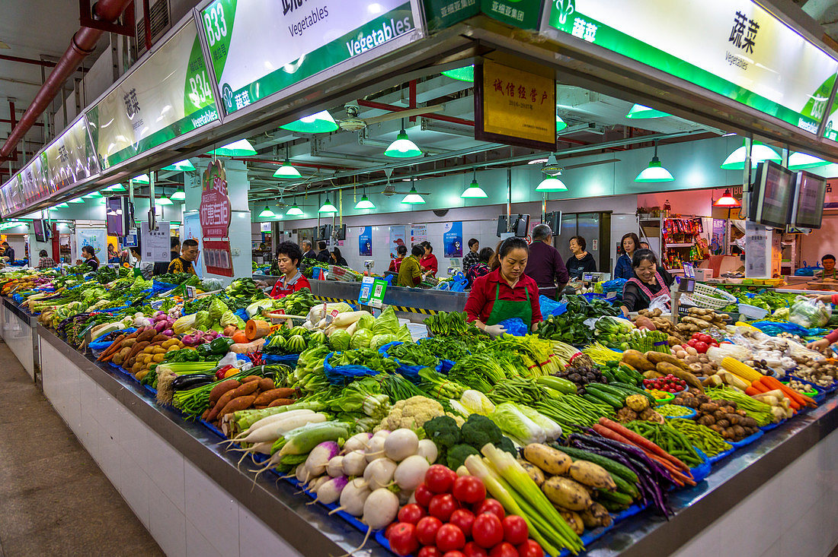
-vegetable stall (n):

Slide 4
Display : to show something to people

Slide 5
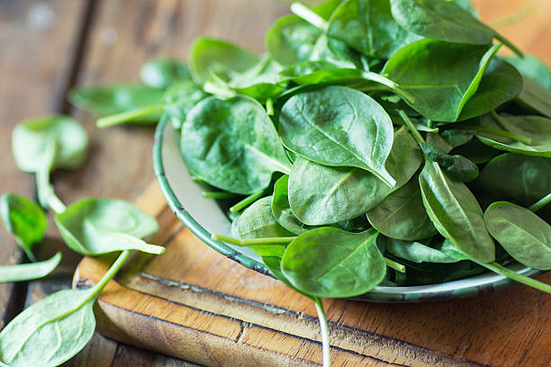
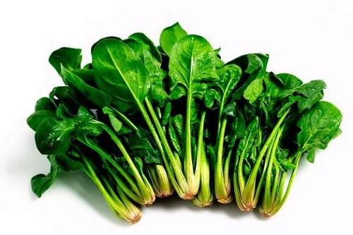
-spinach (n):

Slide 6
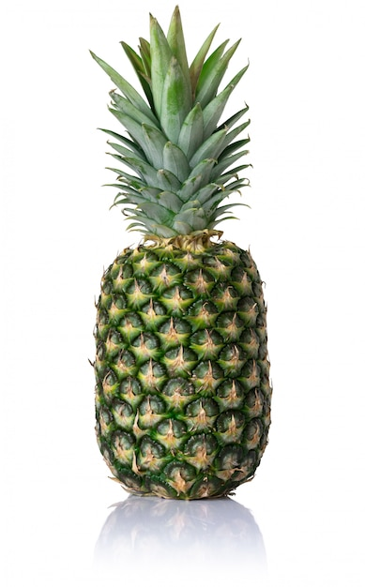
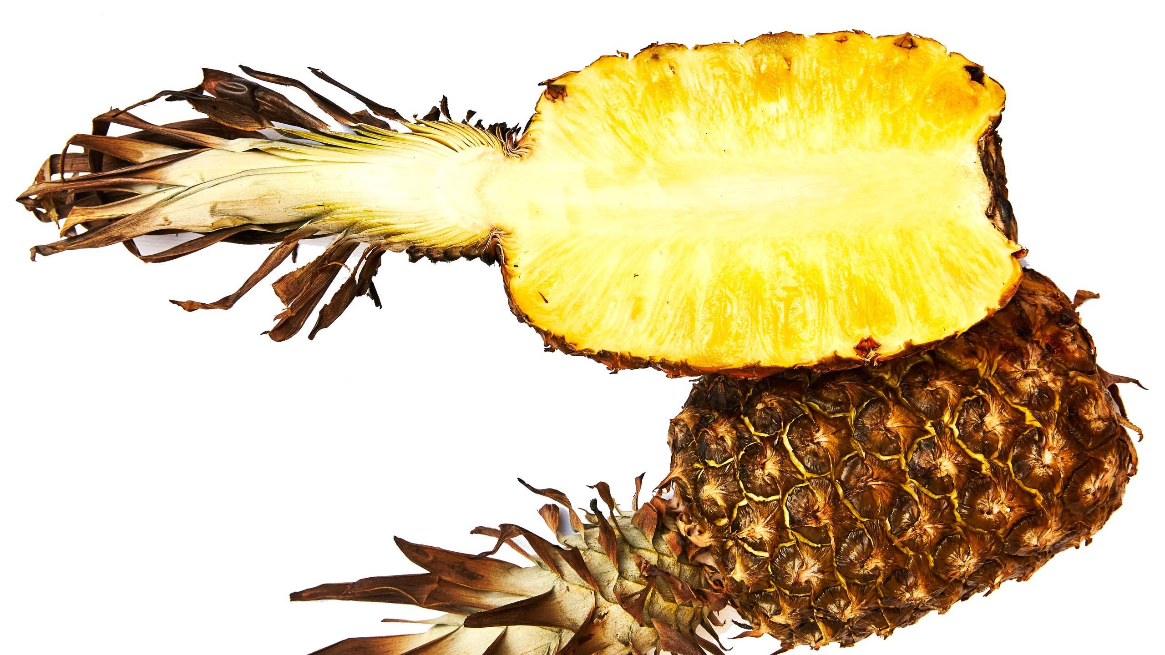
-ripe (adj):

Slide 7
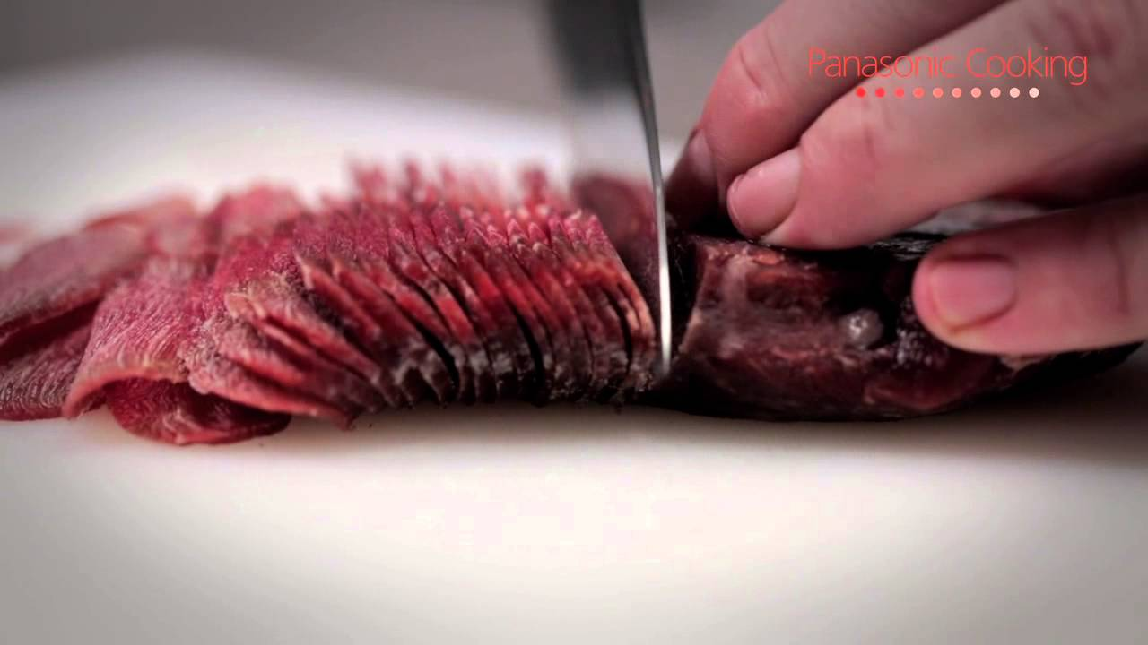
-slice (v):

Slide 8
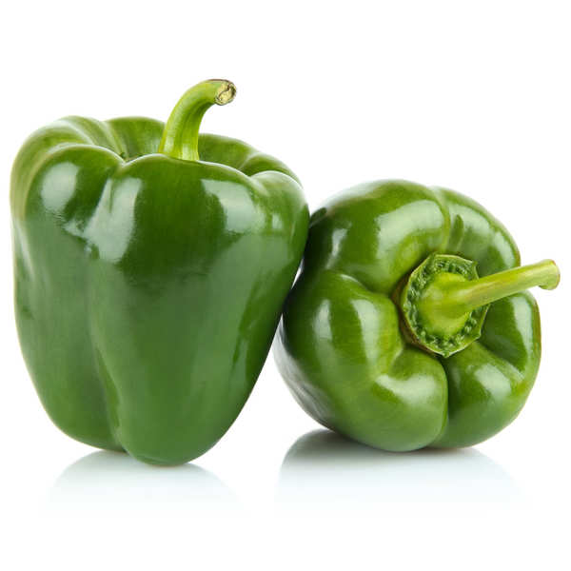
-green pepper (n):

Slide 9
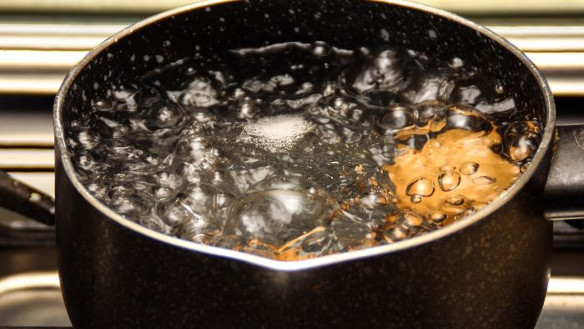
-boil (v):

Slide 10
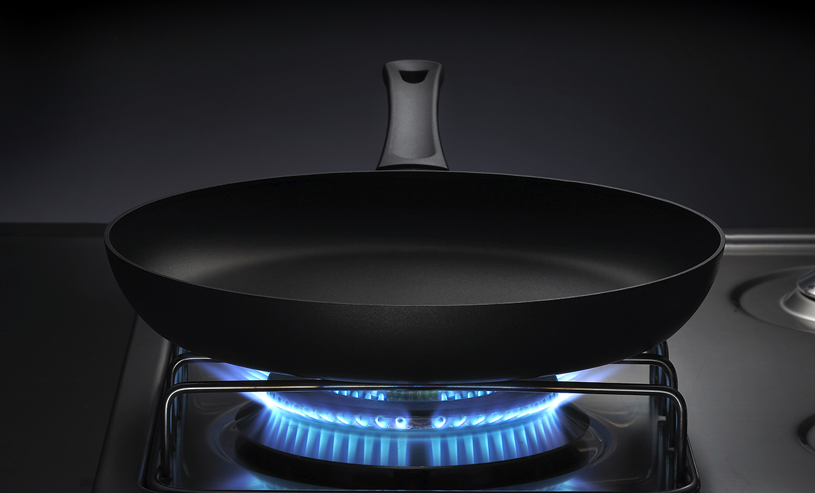
-heat (v):

Slide 11
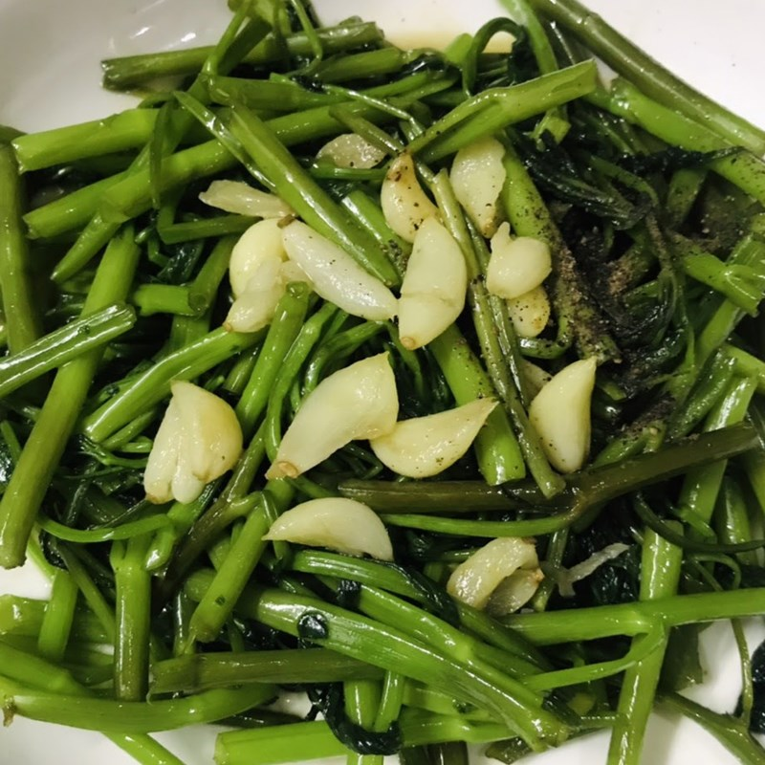
-stir-fry (v):

Slide 12
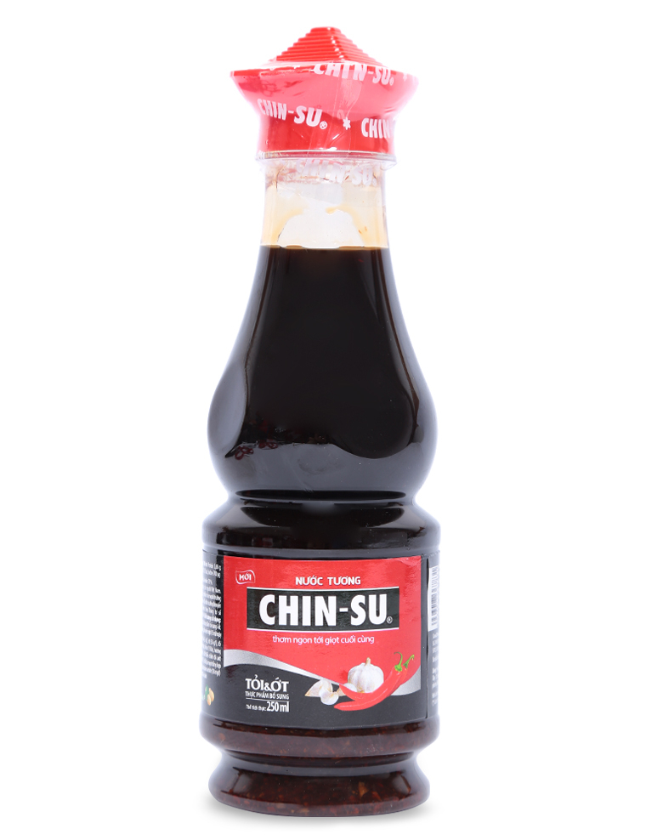
-soy sauce (n):

Slide 13
Selection = choice

Slide 14
New words:
-vegetable stall (n): quầy rau củ
-on display (phr): trưng bày
-spinach (n): rau chân vịt
-ripe (adj): chín
-slice (v): thái mỏng
-green pepper (n): ớt chuông xanh
-boil (v): luộc
-heat (v): làm nóng
-stir-fry (v): xào
-soy sauce (n): nước tương
-selection (n): sự lựa chọn

Slide 15

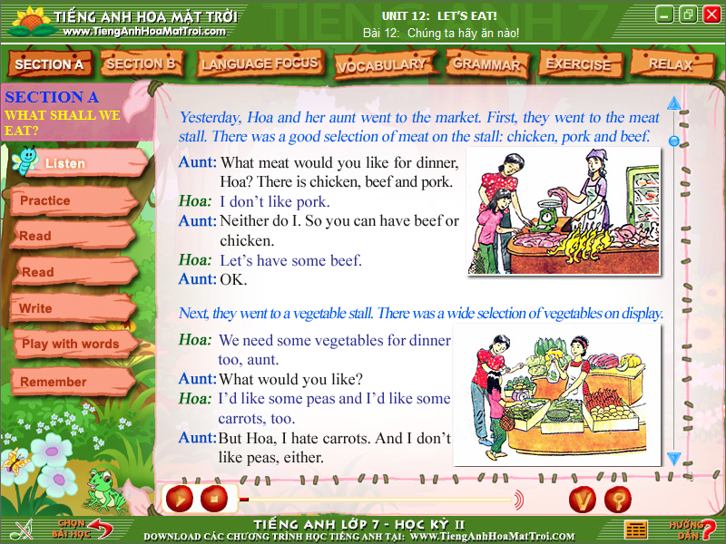
Who are they ?
They are Hoa and her aunt.
They were at the market. What did they buy ? Let’s predict.

Slide 16
Open prediction
Food Hoa and
her aunt bought

Slide 17
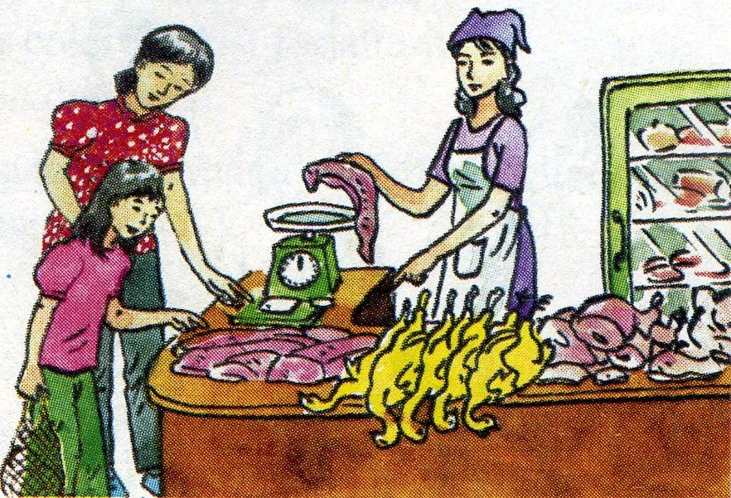

2. Listen and read. Then practice with a partner:
Yesterday, Hoa and her aunt went to the market. First, they went to the meat stall. There was a good selection of meat on the stall: chicken, pork and beef.
Aunt:
What meat would you like for dinner, Hoa?
There is chicken, beef and pork.
I don’t like pork.
Neither do I. So you can have beef or chicken.
Let’s have some beef.
OK.
Hoa:
Aunt:
Hoa:
Aunt:

Slide 18
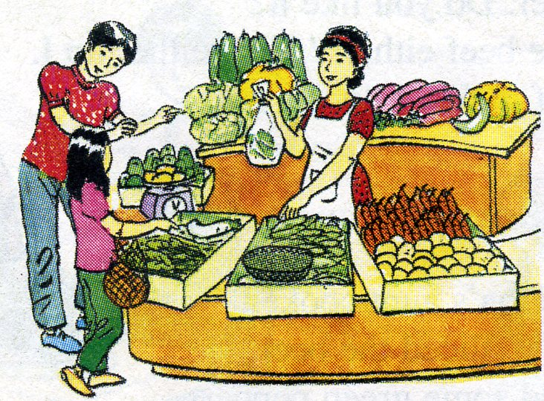
2. Listen and read. Then practice with a partner:
Next, they went to a vegetable stall. There was a wide selection of vegetables on display.
We need some vegetables for dinner too, aunt.
What would you like?
I’d like some peas and I’d like some carrots, too.
But Hoa, I hate carrots. And I don’t like peas, either.
What about spinach and cucumbers? I like them.
So do I. They’re my favorite vegetables.
OK. Let’s get some of those.
Hoa:
Aunt:
Hoa:
Aunt:
Hoa:
Aunt:

Slide 19
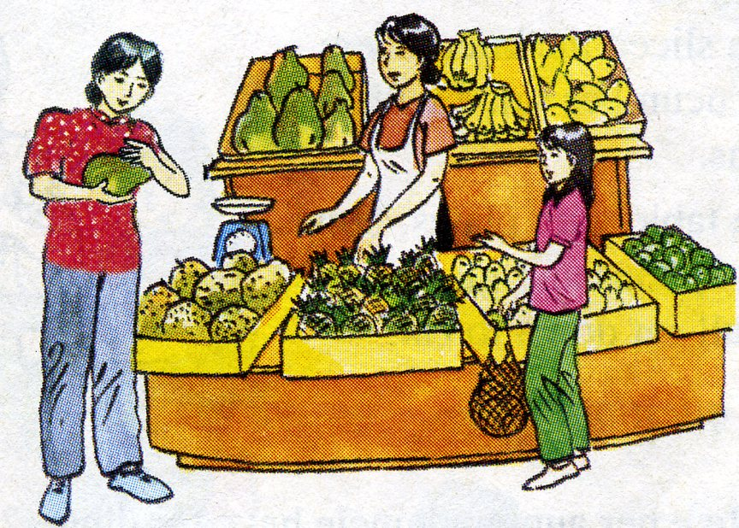
2. Listen and read. Then practice with a partner:
Finally, Hoa and her aunt stopped at a fruit stall.
Hoa:
We need some fruits, aunt.
What shall we buy?
Let’s buy a papaya and a pineapple.
They aren’t ripe. Neither are the bananas.
Let’s buy some oranges then.
OK. Can you smell the durians? I don’t like them.
Neither do I. I hate durians.
Aunt:
Hoa:
Aunt:
Hoa:
Aunt:
Hoa:

Slide 20
2. Listen and read. Then practice with a partner:
Yesterday, Hoa and her aunt went to the market. First, they went to the meat stall. There was a good selection of meat on the stall: chicken, pork and beef.
Aunt: What meat would you like for dinner, Hoa?
There is chicken, beef and pork.
Hoa: I don’t like pork.
Aunt: Neither do I. So you can have beef or chicken.
Hoa: Let’s have some beef.
Aunt: OK.

Slide 21
2. Listen and read. Then practice with a partner:
Next, they went to a vegetable stall. There was a wide selection of vegetables on display.
Hoa: We need some vegetables for dinner too, aunt.
Aunt: What would you like?
Hoa: I’d like some peas and I’d like some carrots, too.
Aunt: But Hoa, I hate carrots. And I don’t like peas, either.
Hoa: What about spinach and cucumbers? I like them.
Aunt: So do I. They’re my favorite vegetables.
OK. Let’s get some of those.

Slide 22
2. Listen and read. Then practice with a partner:
Hoa: We need some fruits, aunt.
Aunt: What shall we buy?
Hoa: Let’s buy a papaya and a pineapple.
Aunt: They aren’t ripe. Neither are the bananas.
Hoa: Let’s buy some oranges then.
Aunt: OK. Can you smell the durians? I don’t like them.
Hoa: Neither do I. I hate durians.
Finally, Hoa and her aunt stopped at a fruit stall.

Slide 23
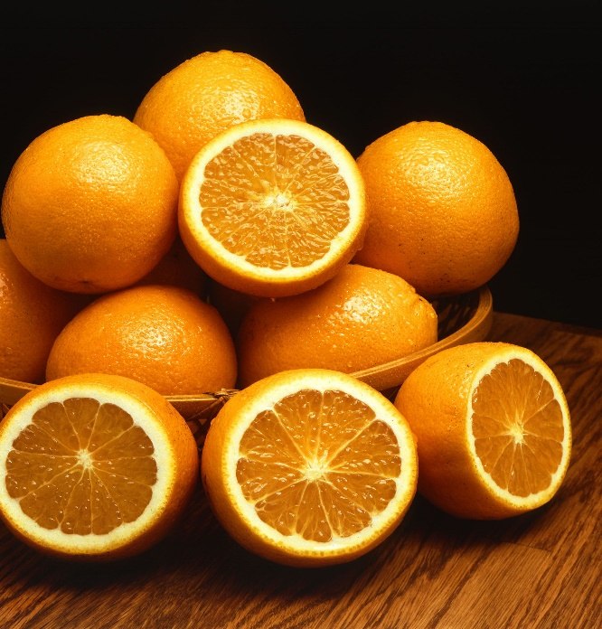
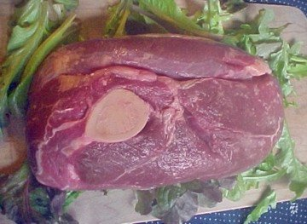
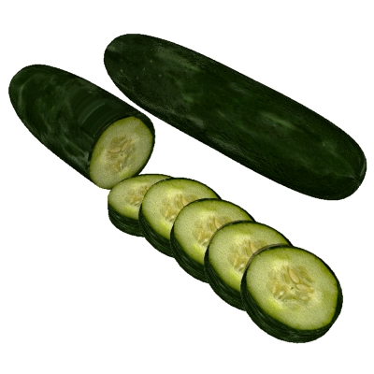
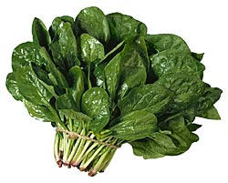
What did Hoa and her aunt buy at the market?
*. Write a list they bought:
beef
spinach, cucumbers
oranges

Slide 24
2. Gap- fill :
meat – display – oranges – market – beef – vegetable – finally - spinach
Yesterday ,Hoa and her aunt went to the (1) ………. .First they went to the (2) ………stall . There was a lot of meat : chicken , pork and beef. But they only bought (3) ……..Next , they went to a (4) ……………stall . There were a lot of vegetables on (5)……… , they bought (6)……...... and cucumbers. (7) .…......... they stopped at a fruit stall and they decided to buy (8)…………
market
meat
beef
vegetable
display
spinach
Finally
oranges

Slide 25
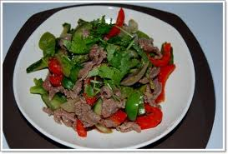
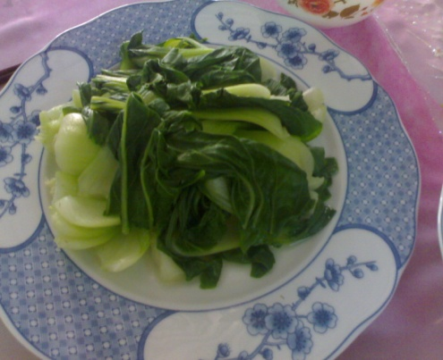
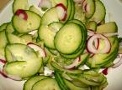
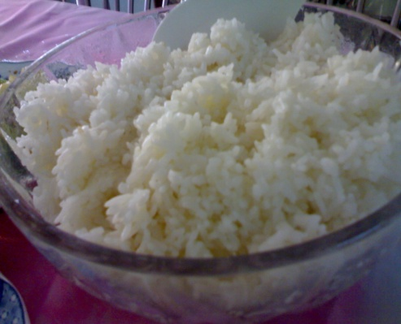
a) What did Hoa, her aunt and uncle have for dinner?
Write the menu.
They had stir-fried beef , boiled spinach, cucumber salad and rice.

Slide 26
b) Here is the recipe Hoa’s aunt used.
Add the missing verbs. Then match the instructions to the pictures.
1/ Slice the beef.
2/ ..........the green peppers and onions.
Slice
3/ ..........the pan.
Heat
4/ ............... the beef.
Stir- fry
5/ ..... ..some soy sauce to the dish.
Add
6/ ........ rice.
Cook
7/ ........ salt to the spinach.
Add

Slide 27
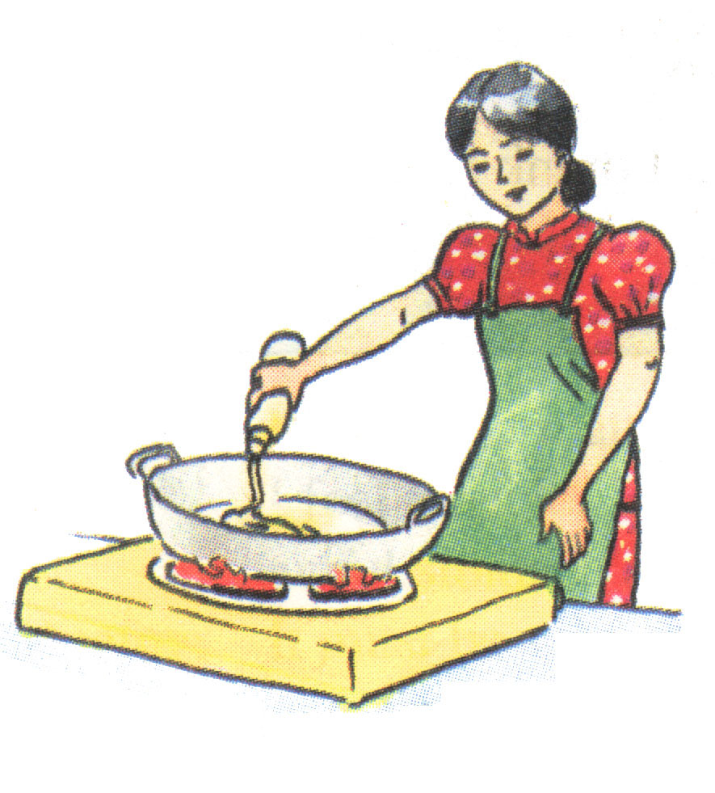
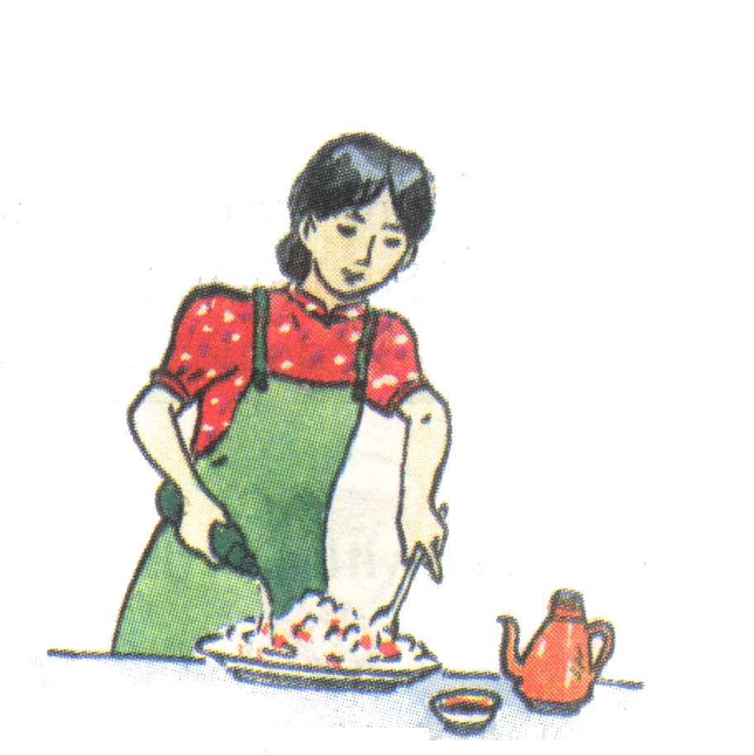
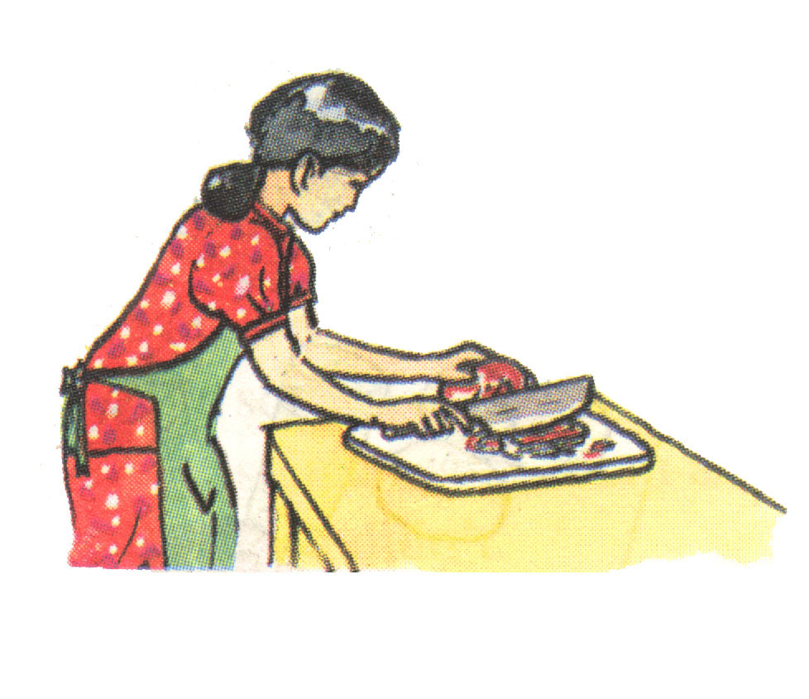
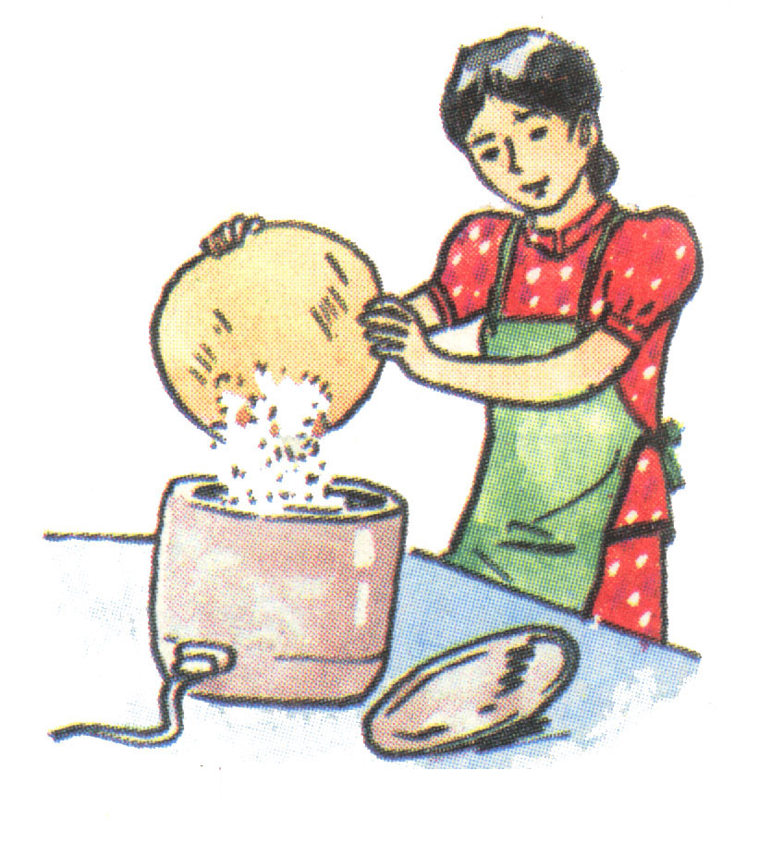
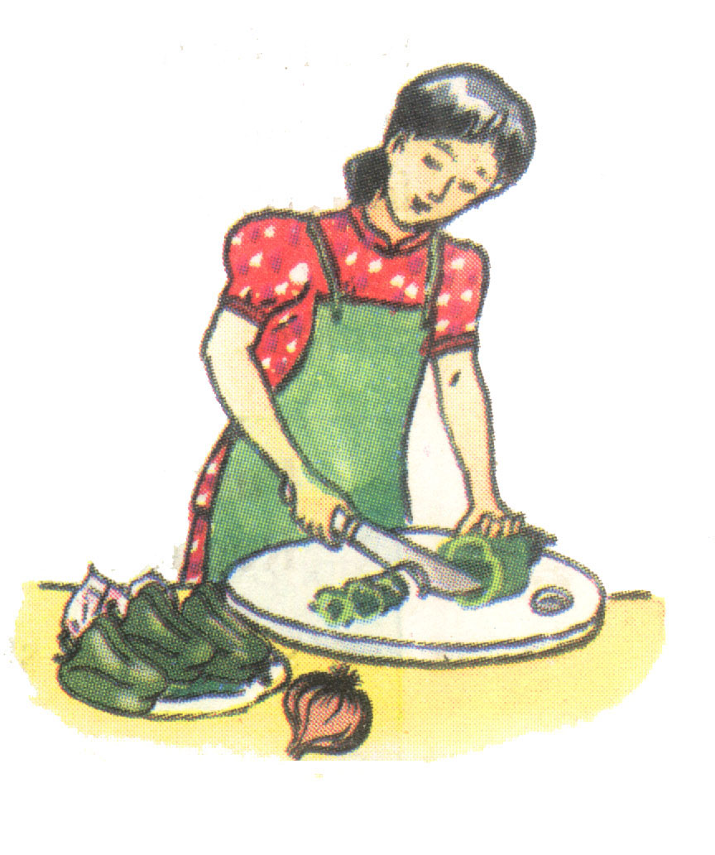
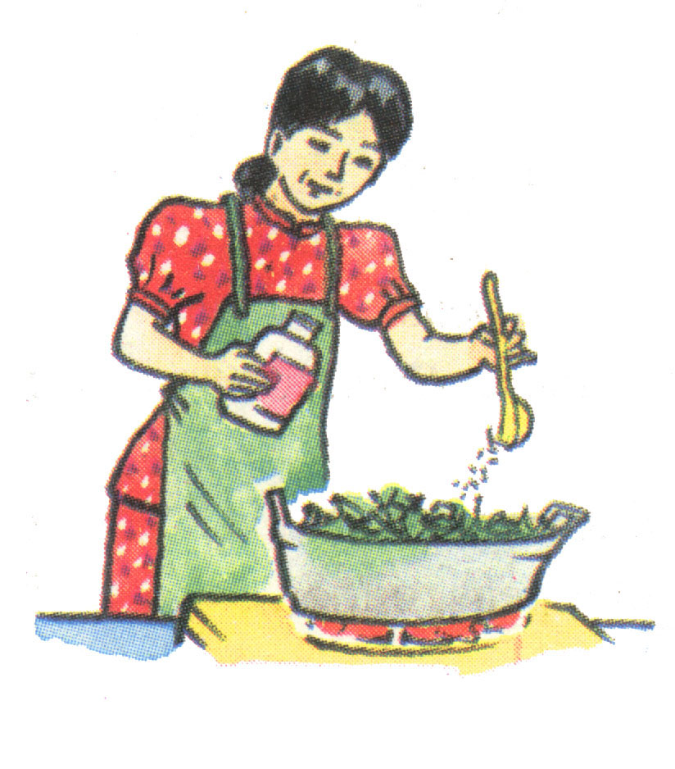
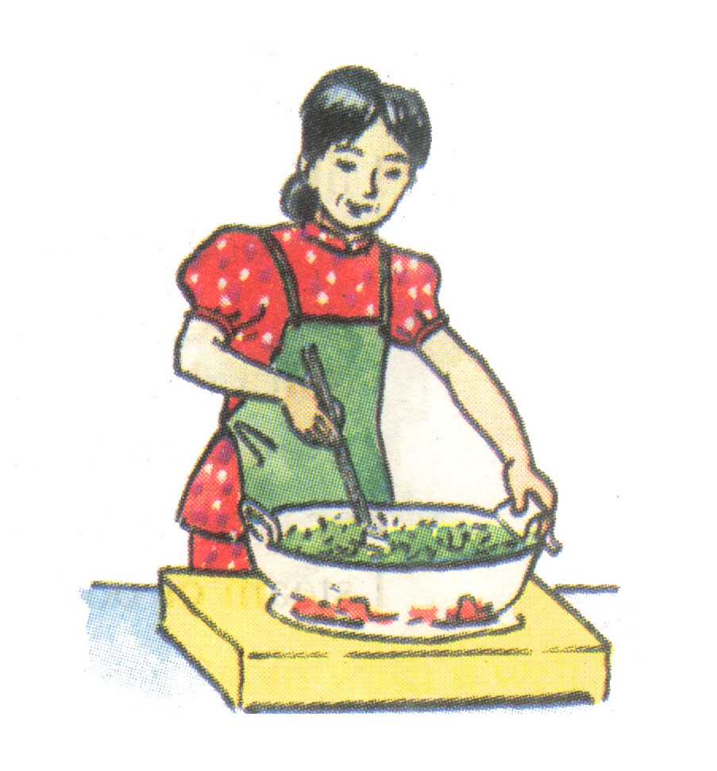
a)
* Now match the instructions to the pictures.
1) Slice the beef.
2) Slice the green peppers and onions.
3) Heat the pan.
4) Stir-fry the beef.
b)
5) Add some soy sauce to the dish.
6) Cook rice.
7) Add salt to the spinach.
c)
e)
f)
g)
d)

