Slide 1
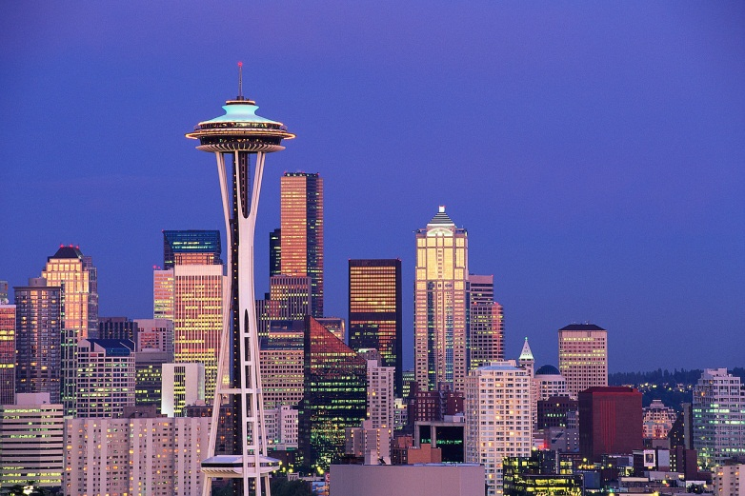
Exploring Seattle
Expanding the Restaurants Tour

Slide 2


Restaurants Tours
Tour in New York and London very successful
Set up for Seattle exclusively
  Categorize by food type or location
  Determine if there is a demand here also
    Very popular with Canadian market
      marks popular places for eating
    Check tourism for stats on interests
Contact restaurant owners about special groups or tours

Slide 3
Food Network Shows
Diners, Drive-ins & Dives
  Host: Guy Fieri
Man vs Food
  Host: Adam Richman
The Best Thing I Ever Ate
  Host: Variety of Famous Celebrity Chefs
Crave
  Host: Troy Johnson

Slide 4
Diners, Drive-ins & Dives
Bizzaro Italian Café
2305 24th Ave E
Georgia’s Greek
323 NW 8^{5th} St
Big Star Diner
305 Madison Ave N
Mike’s Chili Parlor
1447 NW Ballard Ave
Pam’s Kitchen
5000 University Way NE
Slim’s Last Chance
5606 1st Ave S
Voula’s Offshore Café
658 NE Northlake Way
http://www.foodnetwork.com/diners-drive-ins-and-dives/index.html

Slide 5
Man vs Food
Beth’s Café
7311 Aurora Ave N
Red Mill Burgers
312 N 67th St
The Crab Pot
1301 Alaskan Way
http://www.travelchannel.com/tv-shows/man-v-food/articles/man-v-food-nation

Slide 6
The Best Thing I Ever Ate
Dahalia Lounge
2001 4th Avenue
Fran’s Chocolates
1300 E Pike St
Le Pichet
1933 1st Ave
Lola
2000 Fourth Ave
Purple Café &Wine Bar
323 Parkplace Ctr
Revel
403 N. 36th St
Serious Pie
316 Virginia St
Toulouse Petit
601 Queen Anne Ave N
http://www.foodnetwork.com/the-best-thing-i-ever-ate/index.html

Slide 7
Crave
J and D's Foods
309 S Cloverdale St # A13
The 5 Point Cafe
415 Cedar St
Theo Chocolate
3400 Phinney Ave N
West Five
4539 California Ave SW
Beechers
1601 5th Ave NW
http://www.foodnetwork.com/crave/index.html

