Slide 1
Tuesday, March 1st , 2022
Unit 12. LET’S EAT
B. Our food
New words:
-probably (adv): chắc là
-dirt (n): bụi bẩn
-medicine (n): thuốc

Slide 2
II.Structures:
1.It must be something you ate.
2. It is probably the spinach.
3. The dirt can make you sick.
4. I ate spinach, but Mom and Dad didn’t.

Slide 3
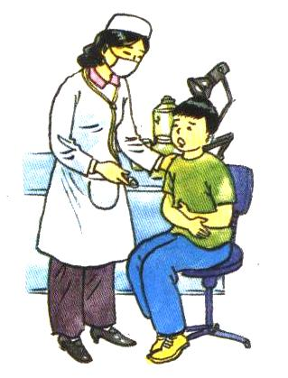

Doctor : What’s the matter, Ba?
doctor
Ba : I feel terrible. I have an awful
stomachache.
Doctor : It must be something you eat.
Are your Mom and Dad OK?
Ba
Ba : Yes. They’re fine.
Doctor : What did you eat last night ?
Ba : We ate fish, rice and soup. I also
ate spinach, but Mom and Dad didn’t.
Doctor : So it was probably the spinach.
Did your Mom wash it well?
Ba : She didn’t wash it. I did.
Doctor :Spinach is very good for you, but you must wash it carefully. Vegetables often have dirt from the farm on them. That dirt can make you sick. I’ll give you some medicine to make you feel better.
Ba : Thanks, doctor.

Slide 4

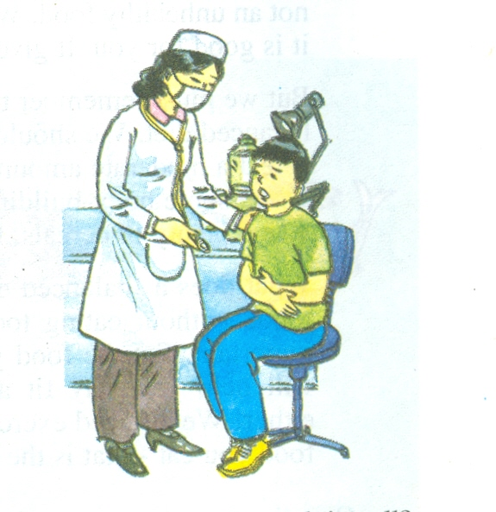
True – false statements
(F)
1. Ba had a headache.
2. He was at the doctor’s.
3. He ate spinach, but his
parents didn’t.
4. His mum washed the
spinach.
5. Vegetables often have
dirt on them.
6.That dirt can’t make him
sick.
(T)
(T)
(F)
(T)
(F)

Slide 5
Now complete the story.
doctor’s
sick
Ba went to the (1) ……………. because he was (2)……….. The doctor (3) …………… Ba some questions. Ba said he (4)……….. some (5)…………….last night. The doctor said he must (6) …………. the spinach (7)………. ……. . ……. . (8) …………….. can be dirty. The dirt can (9) …………. people sick. (10)……………………… gave Ba some (11)…………... to make him feel better.
asked
had
spinach
wash
more carefully
Vegetables
make
She/ the doctor
medicine

Slide 6
Match a question in column A with its answer in column B
A | B
1. Where did Ba go? 2. Why did he meet the doctor? 3. Did he eat meat ? 4. What did he eat last night? 5. What did the doctor say ? 6. Can vegetables be dirty? 7. Can the dirt make people sick? 8. What did the doctor give Ba? | a. Yes, it can . b. No, he didn’t. c. Yes, they can. d. He went to the doctor’s. e. She said he must wash the spinach more carefully. f. He ate some spinach last night . g. Because he was sick. h. She gave him some medicine.
1-d 2-g 3-b 4-f 5-e 6-c 7-a 8- h

