Slide 1



WELCOME!


Slide 2
Unit 4: OUR PAST
Lesson 4: WRITE (P42 – 43)
graze (v):
master (n):
servant (n):
tie (v):
straw (n):
wisdom (n):
escape (v):
stripe (n):
New words:

Slide 3
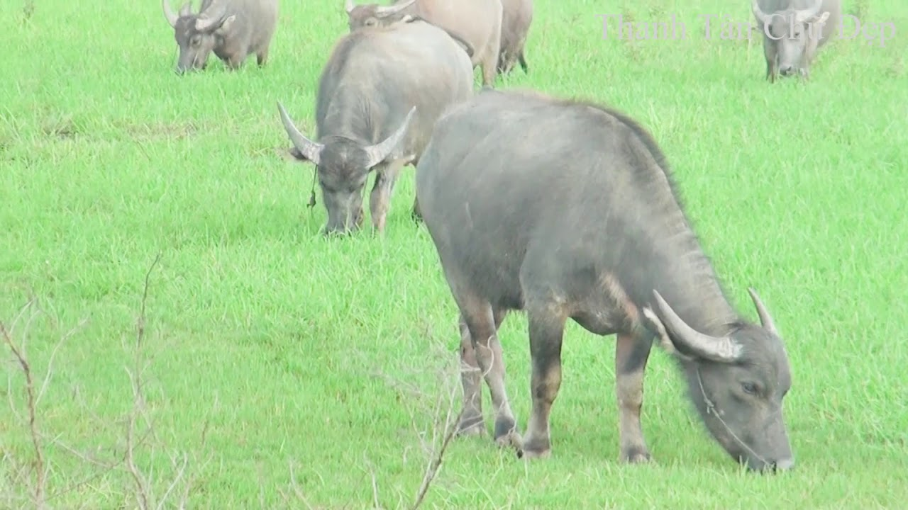
New words:
graze (v):

Slide 4
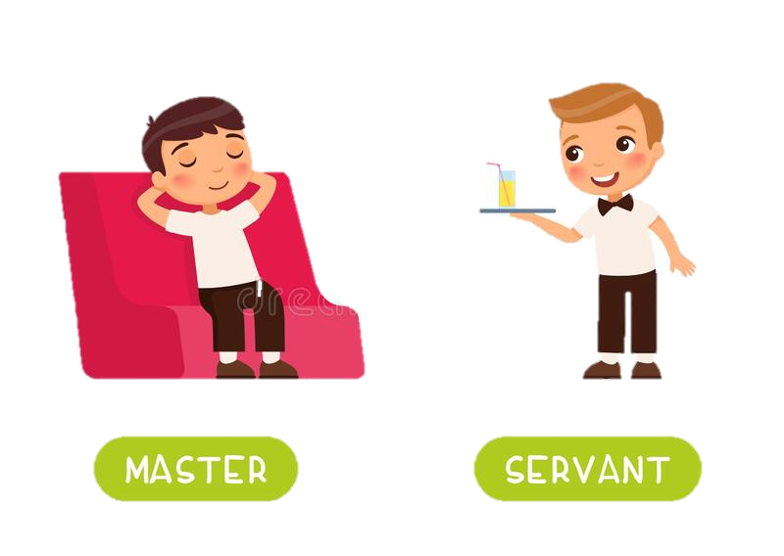
New words:

Slide 5
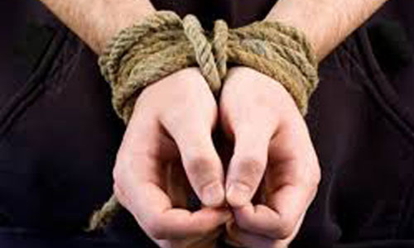
New words:
tie (v):

Slide 6
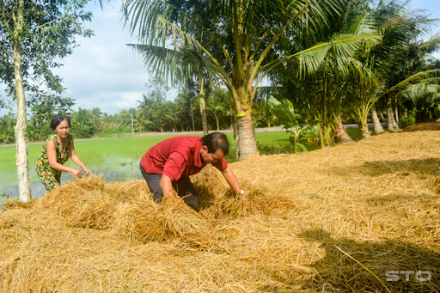
New words:
straw (n):

Slide 7

New words:
wisdom (n):

Slide 8
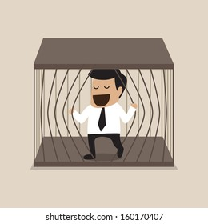
New words:
escape (v):

Slide 9
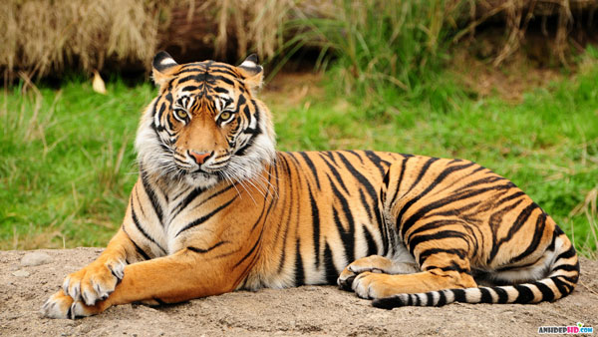
New words:
stripe (n):

Slide 10
Unit 4: OUR PAST
Lesson 4: WRITE (P42 – 43)
graze (v): gặm cỏ
master (n): người làm chủ
servant (n): người hầu
tie (v): trói buộc
straw (n): rơm rạ
wisdom (n): trí khôn
escape (v): trốn thoát
stripe (n): sọc, vằn
New words:

Slide 11
THE SIMPLE PAST
* Cách dùng: Diễn tả một hành động, sự việc đã diễn ra tại một thời điểm cụ thể, hoặc một khoảng thời gian trong quá khứ và đã kết thúc hoàn toàn ở quá khứ.
* Cấu trúc:
Câu khẳng định | Câu phủ định | Câu nghi vấn
S + V-ed/ V2 (+O) Ví dụ: - She came back last Friday. - She visited Hue 2 weeks ago. | S + did not/ didn’t + V(bare inf.) (+O) Ví dụ: - She didn’t come back last Friday. | (Từ để hỏi) + did + S + V(bare inf.) (+O) ….? Ví dụ: - When did she come back?
* Dấu hiệu: yesterday (hôm qua), last night (tối qua), last week (tuần trước), last month (tháng trước), last year (năm ngoái), … ago (cách đây), at, on, in… (at 6 o’clock, on Monday, in June,…), when + mệnh đề chia thì quá khứ đơn (khi…) (when I was a kid,…), …

Slide 12
Task 1: Match the verb in column A and its past form in column B.
A | B
go be want leave light say escape appear | a. wanted b. escaped c. lit d. said e. was/ were f. appeared g. left h. went

Slide 13
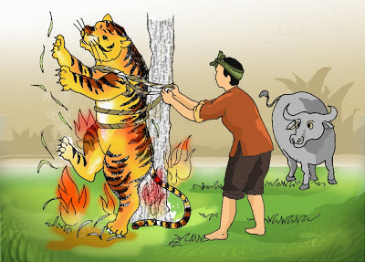
HOW THE TIGER GOT HIS STRIPES

Slide 14
1. Complete the story. Use the verbs in the box.
HOW THE TIGER GOT HIS STRIPES
One day, as a farmer was in his field and his buffalo (0) __________ nearby, a tiger (1)__________. The tiger wanted to know why the strong buffalo was the servant and the small man (2) ______ the master. The farmer (3) ________ he had something called the wisdom, but he (4) _______ it at home that day. He (5)_______ to get the wisdom, but before that he (6)________ the tiger to the tree with a rope because he didn’t want it to eat the buffalo. When he returned, the farmer brought some straw with him. He said it was his wisdom. He (7) _______ the straw and the fire (8)________ the tiger. The tiger (9) _________, but it still has black stripes from the burns today.
was grazing
appeared
was
said
left
went
tied
burned
lit
escaped
burned
escaped
went
was
appeared
left
lit
tied
was grazing
said

Slide 15
Answer these questions:
Where was the man?
What was the buffalo doing when the tiger appeared?
What did the tiger want to know?
What did he do before going home?
What did he do when he returned?

Slide 16
Answer these questions:
Where was the man?
He was in the field.
2. What was the buffalo doing when the tiger appeared?
It was grazing nearby.

Slide 17
Answer these questions:
3. What did the tiger want to know?
The tiger wanted to know why the strong buffalo was the servant and the small man was the master.
4. What did he do before going home?
He tied a tiger to a tree with a rope because he didn’t want it to eat the buffalo.

Slide 18
Answer these questions:
5. What did he do when he returned?
When he returned, he lit the straw to burn the tiger.

Slide 19
2. Now imagine you are the man. Use the given words to write a story. Start like this:
One day / I / field
2. buffalo / graze / tiger / come
3. It / ask / why / strong buffalo / my servant / and I / its master
4. I / tell / tiger / I / have / wisdom
5. tiger / want / see / it
6. I / tell / it / I / leave / wisdom / home
7. Then I / tie / tiger / tree / rope / I / didn’t / want / eat / buffalo
8. I / go / get / straw / and / burn / tiger
9. tiger / escape / still have / black stripes
→ One day as I was in the field and …

Slide 20
2. Now imagine you are the man. Use the given words to write a story. Start like this:
One day / I / field
2. buffalo / graze / tiger / come
my buffalo was grazing nearby, a tiger came.
3. It / ask / why / strong buffalo / my servant / and I / its master
It asked why the strong buffalo was my servant and why I was its master.
4. I / tell / tiger / I / have / wisdom
I told the tiger that I had something called wisdom.
5. tiger / want / see / it
→ One day as I was in the field and …

Slide 21
2. Now imagine you are the man. Use the given words to write a story. Start like this:
One day as I was in the field and my buffalo was grazing nearby, a tiger came. It asked why the strong buffalo was my servant and why I was its master. I told the tiger that I had something called wisdom.
5. tiger / want / see / it
The tiger wanted to see it,
6. I / tell / it / I / leave / wisdom / home
but I told it I left my wisdom at home that day.
7. Then I / tie / tiger / tree / rope / I / didn’t / want / eat / buffalo
Then I tied the tiger to a tree with a rope because I didn't want it to eat my buffalo.

Slide 22
2. Now imagine you are the man. Use the given words to write a story. Start like this:
One day as I was in the field and my buffalo was grazing nearby, a tiger came. It asked why the strong buffalo was my servant and why I was its master. I told the tiger that I had something called wisdom. The tiger wanted to see it, but I told it I left my wisdom at home that day. Then I tied the tiger to a tree with a rope because I didn't want it to eat my buffalo.
8. I / go / get / straw / and / burn / tiger
I went to get some straw which I said was my wisdom and burned the tiger.
9. tiger / escape / still have / black stripes
The tiger escaped, but it still has black stripes from the burns today.

Slide 23
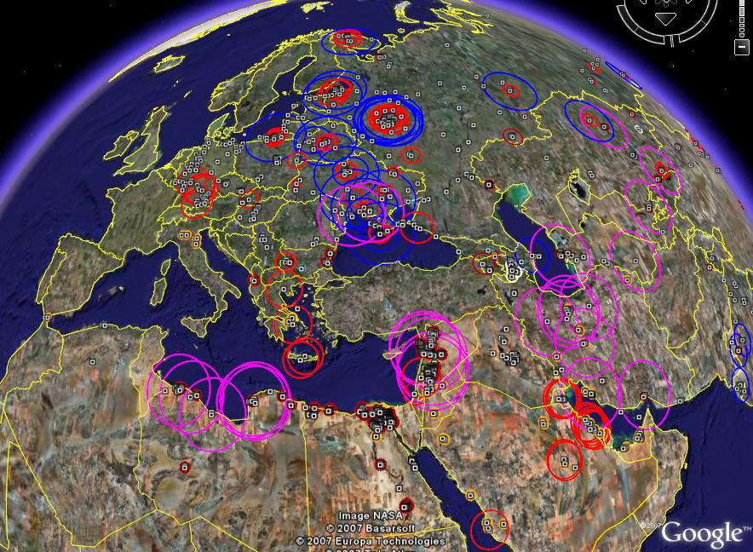
GOODBYE
SEE YOU LATER


