Slide 1
unit 2: making Arrangement
Language Focus

Slide 2
Grammar
Adverbs of place
Structures with “be going to”

Slide 3
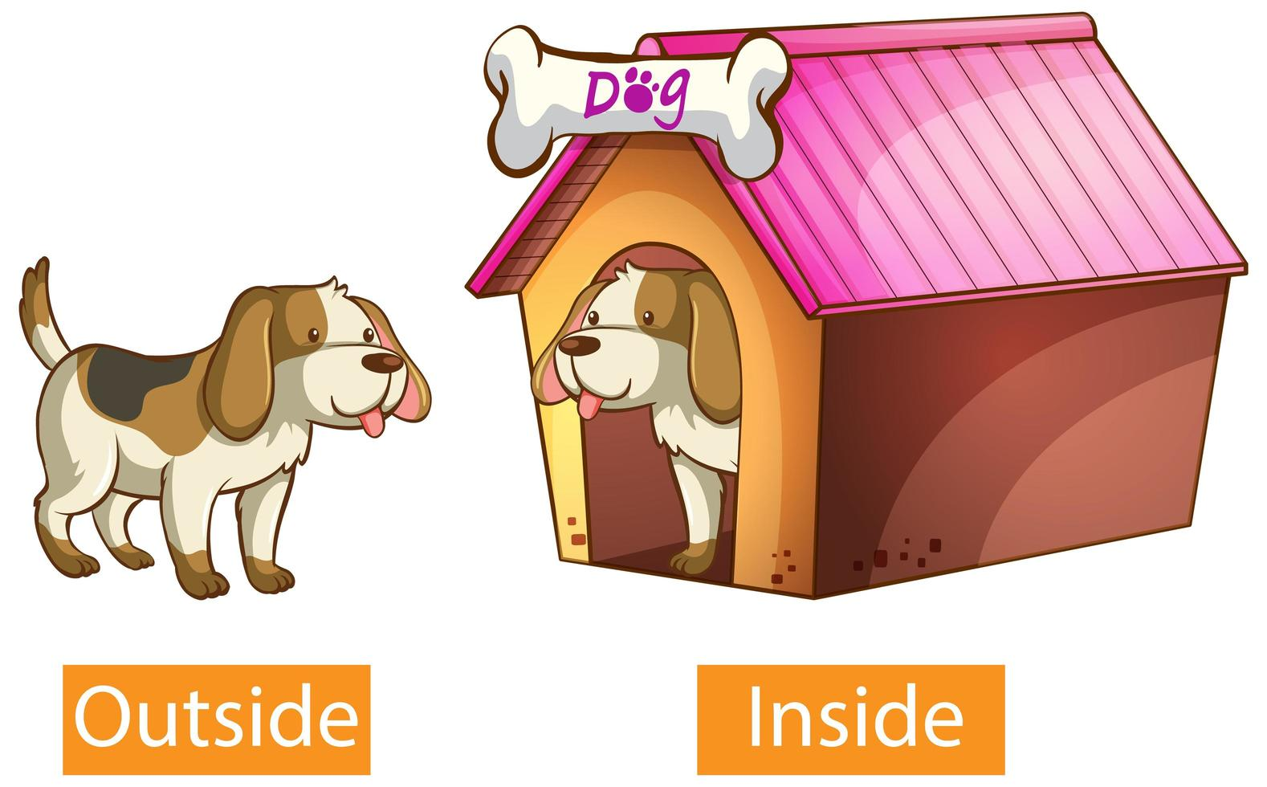


adverbs of place

Slide 4
practice
Outside
Inside
There
Here
Upstairs
Downstairs
Ở đây
Bên ngoài
Bên trong
ở đó
Tầng dưới
Tầng trên

Slide 5
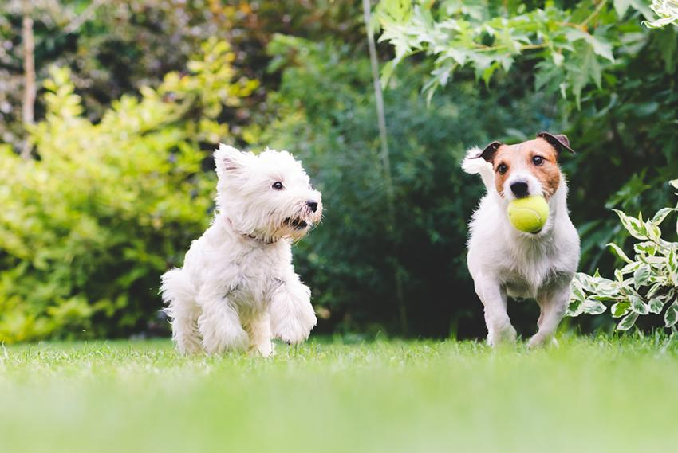
Rules of adverbs of place
Adverbs of place are usually placed after the main verb.
Two dogs are playing outside.

Slide 6
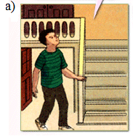
Task 1: Complete the speech bubbles. Use each adverb in the box once.
Ba is playing hide and seek with his cousin, Tuan.
Where is Tuan?
I think he’s upstairs
outside
inside
there
here
upstairs
downstairs

Slide 7
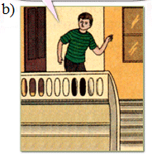
Task 1: Complete the speech bubbles. Use each adverb in the box once.
Ba is playing hide and seek with his cousin, Tuan.
outside
inside
there
here
upstairs
downstairs
No. He isn’t _____________
here

Slide 8
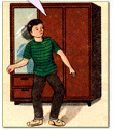
Task 1: Complete the speech bubbles. Use each adverb in the box once.
Ba is playing hide and seek with his cousin, Tuan.
outside
inside
there
here
upstairs
downstairs
He isn’t ____________ and he isn’t upstairs
downstairs

Slide 9
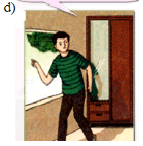
Task 1: Complete the speech bubbles. Use each adverb in the box once.
Ba is playing hide and seek with his cousin, Tuan.
outside
inside
there
here
upstairs
downstairs
Perhaps he’s ______________
outside

Slide 10
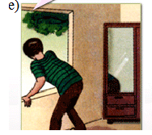
Task 1: Complete the speech bubbles. Use each adverb in the box once.
Ba is playing hide and seek with his cousin, Tuan.
outside
inside
there
here
upstairs
downstairs
No he isn’t ______________
there

Slide 11
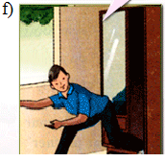
Task 1: Complete the speech bubbles. Use each adverb in the box once.
Ba is playing hide and seek with his cousin, Tuan.
outside
inside
there
here
upstairs
downstairs
I’m not outside. I’m ______________
inside

Slide 12

Be going to
S + am/is/are + going to + V(bare).
S + am/is/are+ not + going to + V(bare).
FORM :
Am/Is/Are+ S + going to + V(bare) ?

Slide 13
Be going to
intentions – future plans (kế hoạch trong tương lai
Sophie is going to buy some things for the baby.
USE
predictions for the future (dự đoán cho tương lai)
I feel terrible. I think I am going to be sick.

Slide 14

Task 2: Work with a partner.
Say what people are going to do.
Ex: Nga has a movie ticket.
→ She is going to see a movie.

Slide 15

a. Quang and Nam bought new fishing rods yesterday.
→ They are going to go fishing.
b. Trang’s mother gave her a new novel this morning
and she has no homework today.
→ She is going to read the new novel.
c. Van has a lot of homework in Math and she is going to have Math at school tomorrow.
→ She is going to do her homework.
d. Mr. Hoang likes action movies very much and there’s an interesting action movie on TV tonight.
→ He is going to watch an action movie on TV tonight.
e. Hien’s friend invited her to his birthday party.
→ She is going to give him a birthday present.

Slide 16
Homework:
Learn structures by heart.
Prepare Unit 3: At home
Getting started - Listen.

