Slide 1
unit 3: at home
LANGUAGE FOCUS

Slide 2

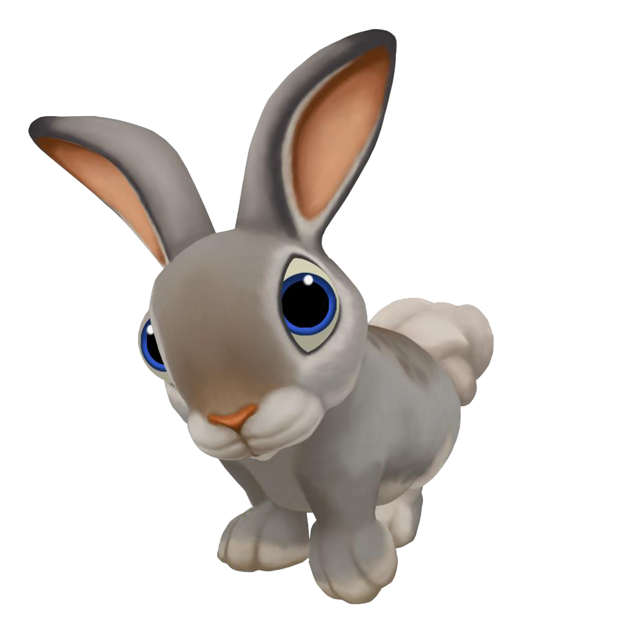

MODAL VERBS

Slide 3

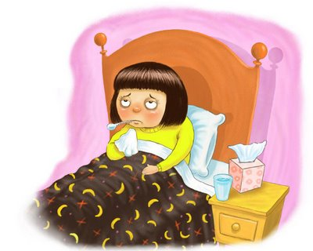
MUST
FORM
S + MUST + Vbare
Oh! You have a fever! You must stay at home and rest.

Slide 4
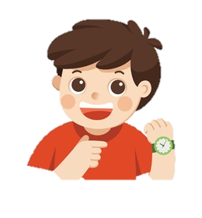
MUST
To say that it is necessary to do something
We can use must to talk about the present or the future.
USE
I must go now. It’s too late

Slide 5
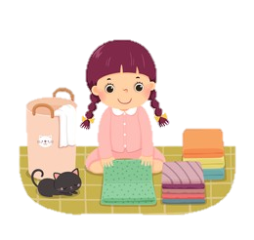
Have to
FORM
S + have to + Vbare
I can’t come to movie with you, Lan. I have to do my chores

Slide 6
Have to
To say that it is necessary to do something
We can use have to in all tenses
USE
I have to go now. It’s too late

Slide 7
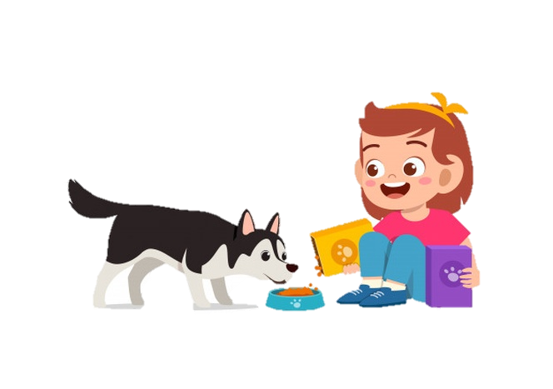
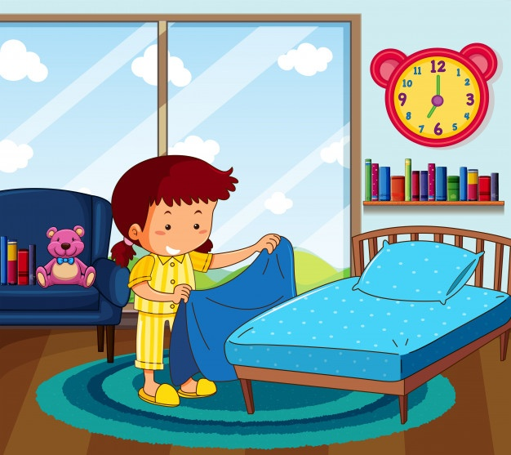
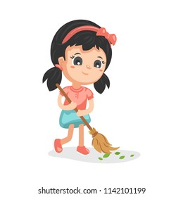
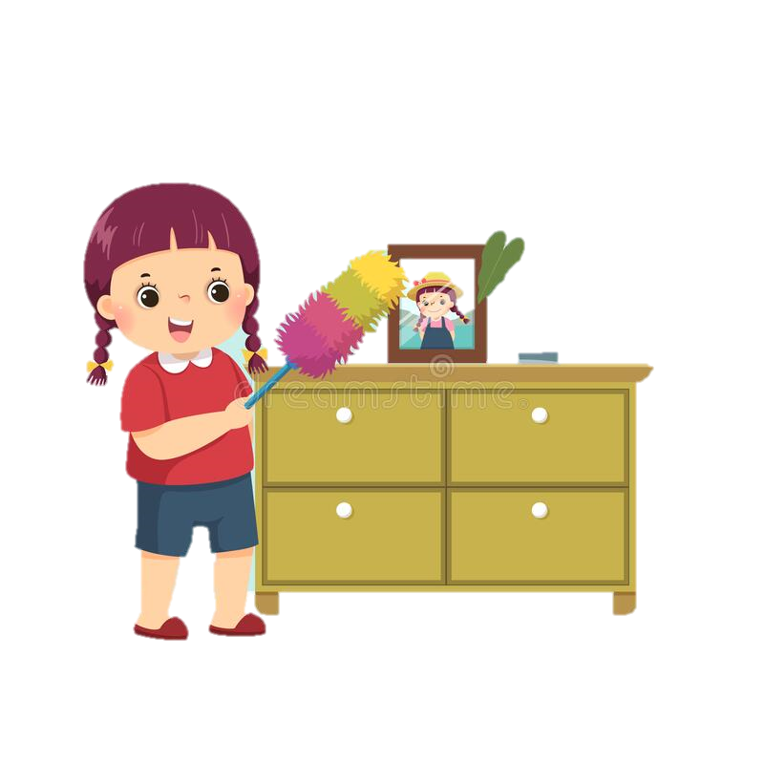

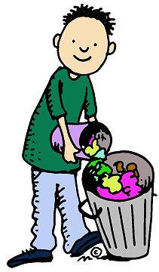
VOCABULARY
feed the dog
sweep the floor
tidy the bed
clean the fish tank
dust
empty the garbage

Slide 8
Task 1
Complete the dialogue. Use must or have to and the verbs in the box.
Nga: Can you come to the movies, Lan?
Lan: No. I ……………….my chores.
Nga: What do you have to do?
Lan: I.………………………..my bedroom. Then I …..……………… the living-room and I ………………………….. the kitchen floor, too.
Nga: That won’t take long. What else?
Lan: I………………………. the fish tank and then I……………….………the garbage. Finally, I….……………………the dog.
Nga: Ok. Let’s start. Then we can go out.
feed
empty
tidy
sweep
clean
dust
have to do
must/have to tidy
must/have to dust
must/have to sweep
must/have to clean
must/have to empty
must/have to feed

Slide 9
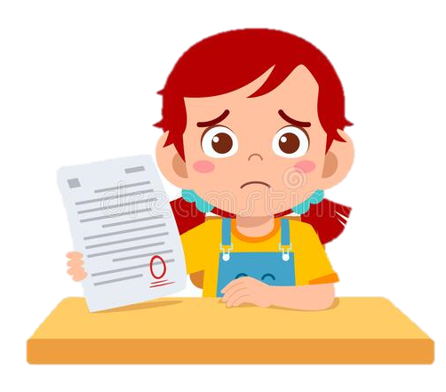

Look at the situation
Hoa is very sad because she failed her English test.
What should you say to advice her?
You should study harder.
or You ought to study harder.
Should / ought to: thường dùng để cho lời khuyên hay lời đề nghị
Should not / ought not to: không nên

Slide 10

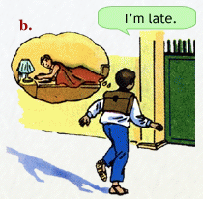
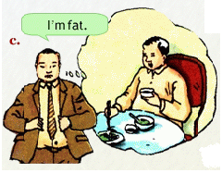
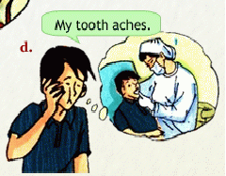
Use “ought to” to give advice for these people.
You ought to get up earlier.
You ought to eat more fruit and vegetables
You ought to go to the dentist’s.

Slide 11
look at the example
You do your homework and nobody helps you.
You say “ I do my homework myself”
Ba drew that picture.
We say “He drew it himself”
Notes:
Đại từ phản thân (Reflexive pronouns) chỉ rõ hành động của động từ được thực hiện vào ngay chủ ngữ, Đại từ phản thân chỉ ràng, tác nhân vừa là chủ ngữ vừa là bổ ngữ.

Slide 12
Match a pronoun with a suitable reflexive pronoun.
Pronouns
I
You
We
They
He
She
It
Reflexive pronouns
Yourself/ Yourselves
Themselves
Herself
Himself
Itself
Ourselves
Myself

Slide 13
Complete these dialogues
  a) Miss Lien: Did someone help Ba draw that picture?
  Bao: No, he did it __________________.
  b) Nga: The repairman can’t fix the washing machine until tomorrow.
  Mrs. Linh: Come on. We’ll have to try and do it (1) ___________________
  c) Aunt Thanh: What’s the matter, Hoa?
  Hoa: I cut (2) _____________________
  Aunt Thanh: Let me see. Oh, it’s all right.
  You didn’t cut (3) __________________ badly.
  d) Lan: Why are you crying, Nga?
  Nga: I just watched the movie Romeo and Juliet.
  The boy killed (4) __________________ and then the girl killed (5) _________________ as well.
  Lan: Why did they kill (6) _______________?
  Nga: It’s a long story.
  e) Mr. Nhat: Boys and girls, you’ll do this experiment this afternoon.
  Students: Will you come to help us?
  Mr.Nhat: Yes, I will. But you’ll have to do it (7) _____________ first.
ourselves
myself
yourself
himself
herself
themselves
yourselves

Slide 14
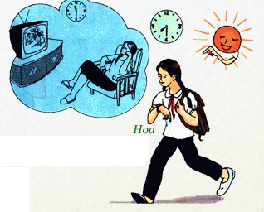
Look at the picture and answer
What’s the matter with Hoa?
Why did Hoa go to school late this evening?
She’s late for school.
Because she watched TV late last night.
Notes:
Why …?: ask for reasons
Because … : give reasons

Slide 15
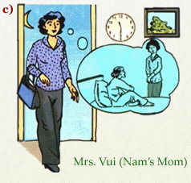
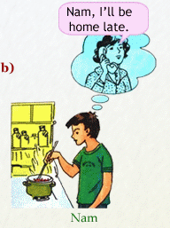
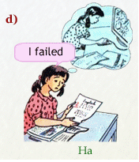
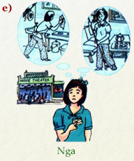
Look at these pictures and give situations
Mrs. Vui was home late.
Nam had to cook dinner.

Nga didn’t go to the movies.
Ha failed her English test.

Slide 16
Homework
Learn grammar notes by heart.
Write all exercises into your notebooks.
Prepare the next lesson (Unit 4: Our Past – Listen and Read)

