Slide 1
unit 3: at home
Write

Slide 2





vocabulary
a wardrobe
a towel rack
a jar
a folder
a vase of flowers

Slide 3
* Checking Vocabulary
- a wardrobe :
Tủ quần áo
1
- a towel rack :
2
Giá móc khăn
- a jar :
3
Cái lọ , bình
- a folder :
hồ sơ ,cặp giấy tờ
4
Lọ hoa
- a vase of flowers :
5

Slide 4




Slide 5
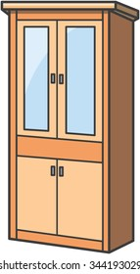

on the left of : ở bên trái của ……
the bed is
of
on the
the wardrobe

Slide 6
on the right of : ở bên phải của ……
the wardrobe is
of
on the
the bed .

Slide 7

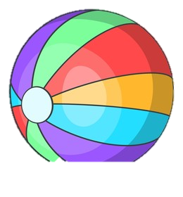
There is a cat above a ball.
above

Slide 8
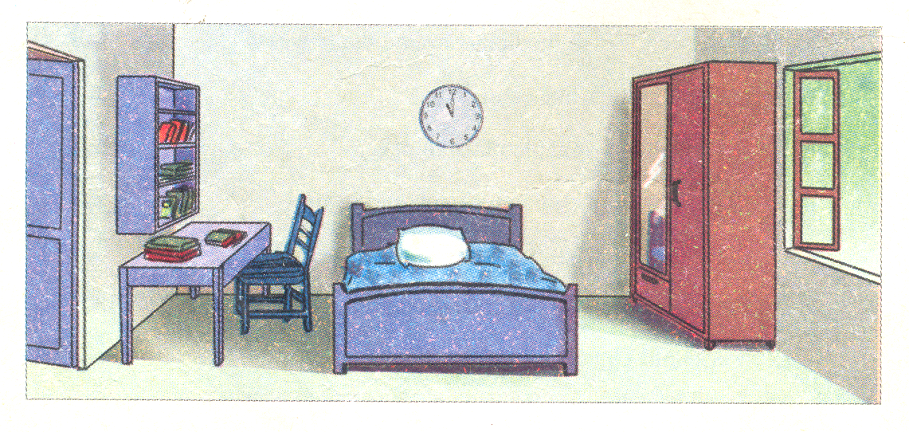
READ
This is Hoa’s bedroom. There is a desk on the left of the room. On the desk there are many folders, and above the desk there is a bookshelf. There is a bed near the desk. On the right side of the room, there is a window. There is a wardrobe beside the window. The wardrobe is opposite the desk.

Slide 9
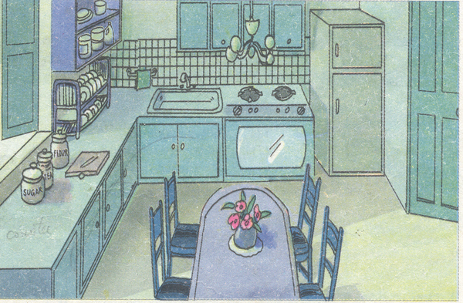
* Write a description of this kitchen
1. This / Hoa’s kitchen
- This is Hoa’s kitchen
2. There /refrigerator/right corner/room
- There is a refrigerator in the right corner of the room.
3. Next to / refrigerator / there/a stove
- Next to the refrigerator there is a stove

