Slide 1

Unit 6
AFTER SCHOOL
Section A:
WHAT DO YOU DO?
A- 3

Slide 2
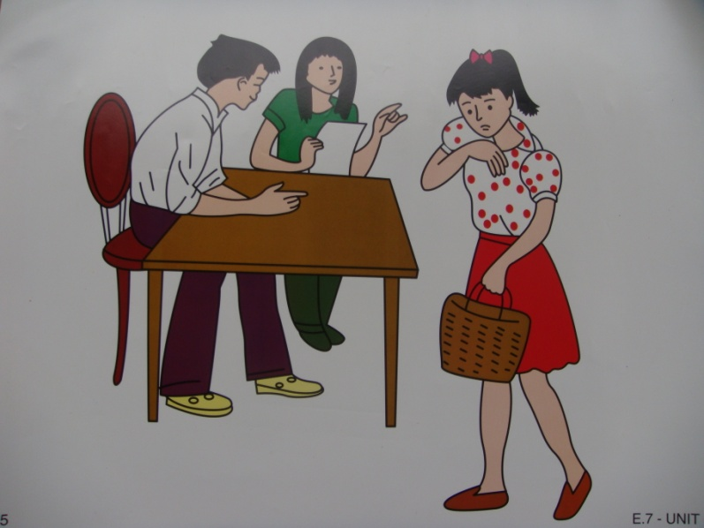
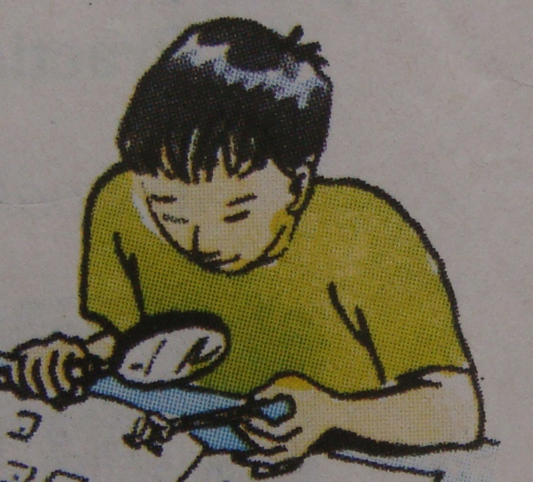
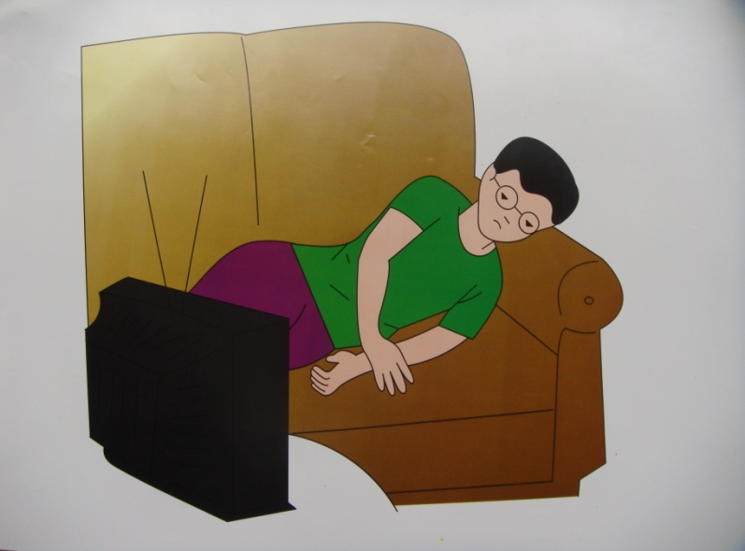
NGA
BA
NAM

Slide 3
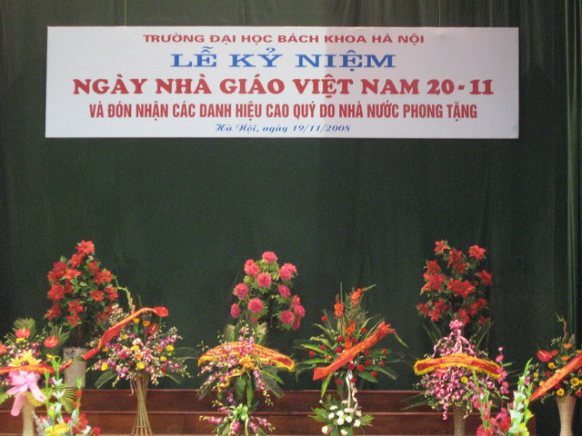
NGA
rehearse(v):
diễn tập
Rehearse a play : tập kịch
Anniversary(n)
Lễ kỉ niệm

Slide 4
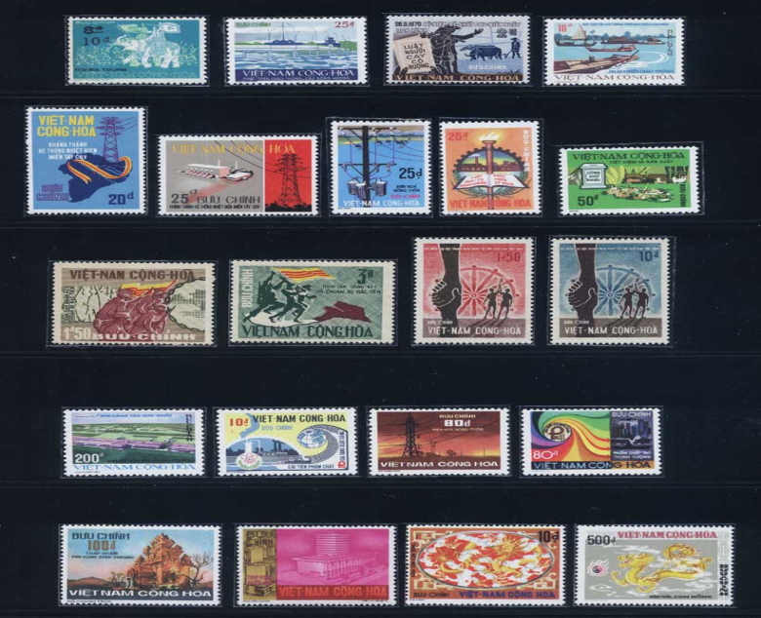
BA
Collect (v)
Sưu tầm
Collector (n)
Ba is the president of the stamp collector’s club
President(n):
Chủ tịch

Slide 5

Nam is not very sporty.
Sport (n)
Sporty (adj)
Ham mê thể thao
Comic (n)
Truyện tranh

Slide 6
Vocabulary
rehearse(v): diễn tập, tập
Anniversary(n): lễ kỉ niệm
President(n): chủ tịch
Collect(v): sưu tầm
Collector(n): người sưu tầm
Sporty(adj): ham mê thể thao
Comic(n): truyện tranh

Slide 7


CHECKING VOCABULARY
MATCHING
Rehearse
President
Sporty
Comic
anniversary
Collect
Chủ tịch
Truyện tranh
Lễ kỉ niệm
Sưu tầm
Ham mê thể thao
Diễn tập

Slide 8
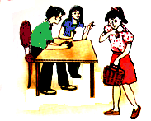
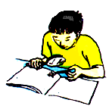
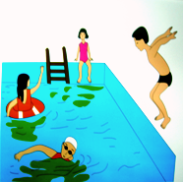
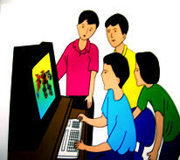
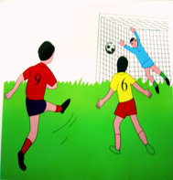
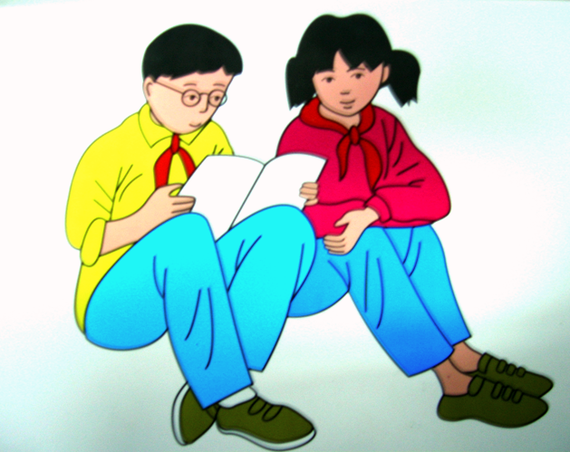
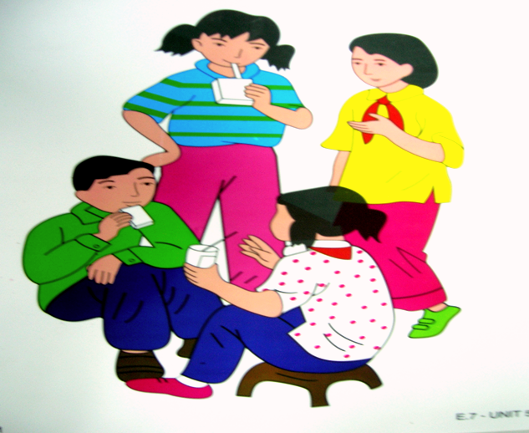
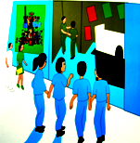
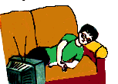
Acting is Nga’s favorite pastime. She is a member of the school theater group. At present, her group is rehearsing a play for the school anniversary celebration
Ba is the president of the stamp collector’s club. On Wednesday afternoon , he and his friends get together and talk about their stamps. If they have any new stamps, they usually bring them to school. Ba’s American friend, Liz, gives him a lot of American stamps.
Nam is not very sporty. In the afternoon, he usually goes home and watches videos. Sometimes he reads a library book or comics, but most of the time he lies on the couch in front of the TV. He never plays games.
Read 2

Slide 9
Check true (T) ot false (F)
1) Nga, Ba, Nam are students in class 7A.
2) They like sports very much.
3) Nga’s favorite pastime is jogging.
4) Ba likes collecting stamps.
5) Nam plays soccer every afternoon.
6) Nam usually watches TV.
T
F
F
T
F
T

Slide 10



GUESSING
Nga’s favorite pastime is……………….
swimming b. reading c. acting
Ba likes …………………….
Collecting stamps
playing games
going fishing
3) Nam is not interested in………………
Comics b. sports c. plays

Slide 11

3. Read. Then answer the questions
a. What is Nga’s theater group doing?
Her theater group is rehearsing a play
for the school anniversary celebration
b. How does Ba get American stamps?
He gets American stamps from Liz ,
his American friend
c. When does the stamp collector’s club meet?
The stamp collector’s club meets on Wednesday afternoon
d. How often does Nam play games?
He never plays games

Slide 12
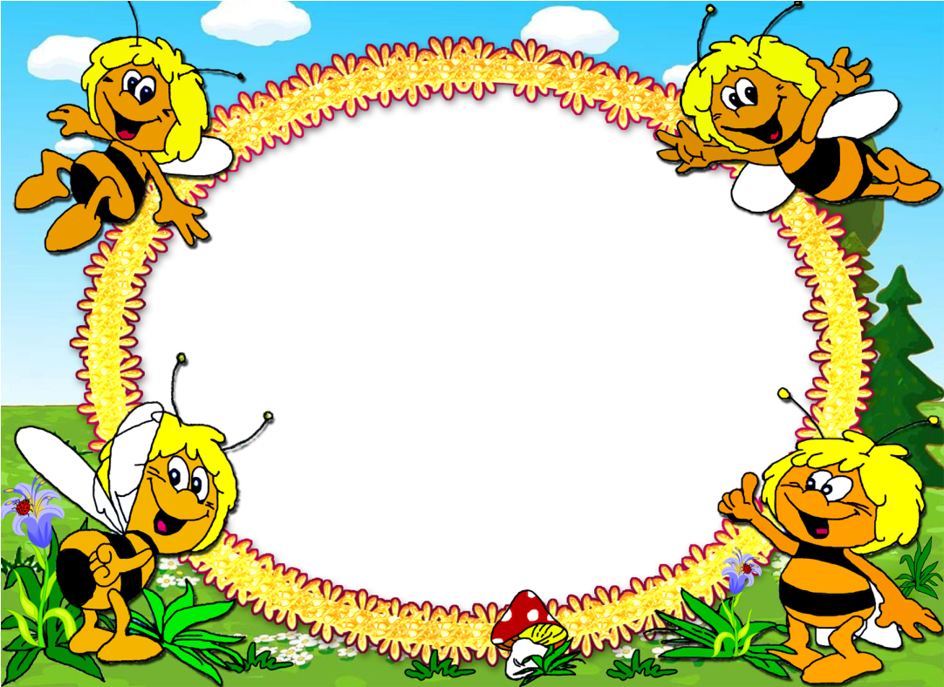
THANK YOU VERY MUCH
GOODBYE!
HAVE A GOOD DAY!

