Slide 1


Slide 2
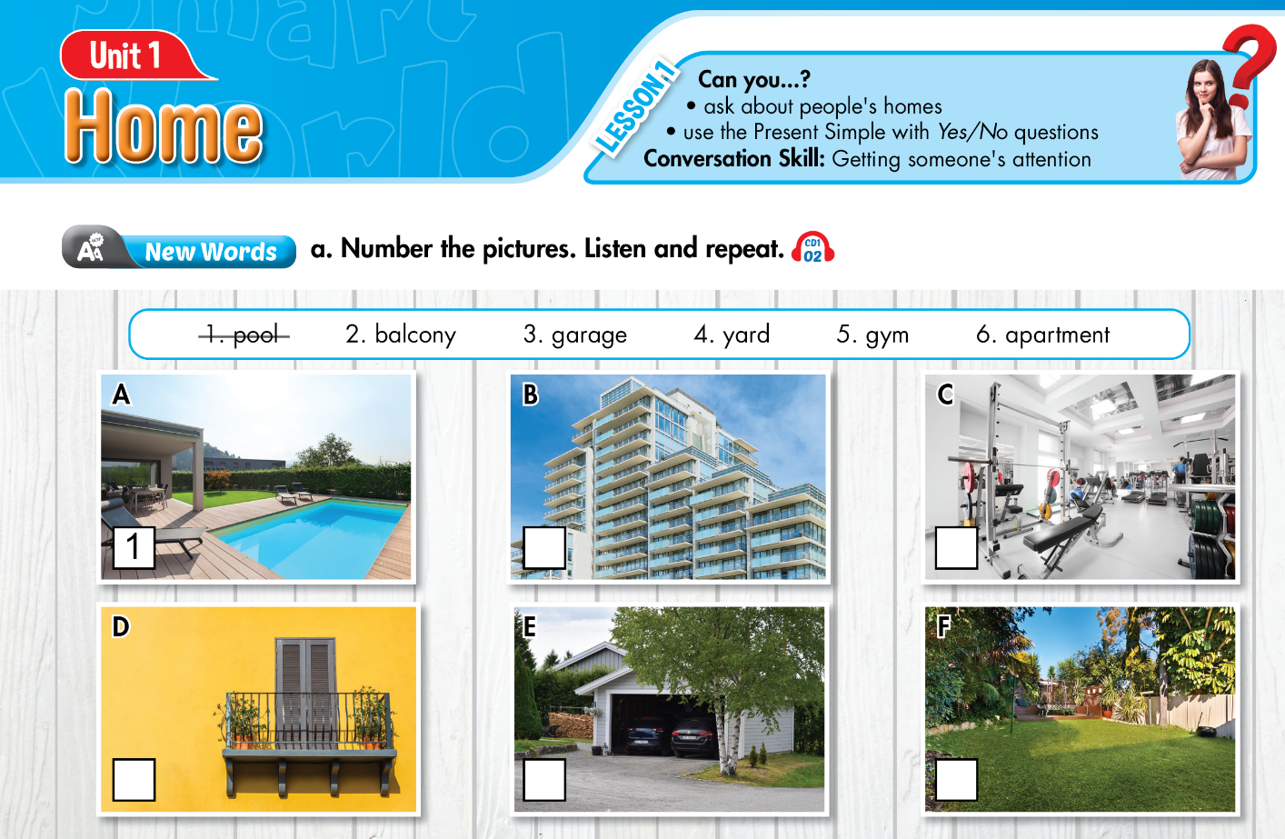

Lesson 1
6
5
2
3
4
Notes:
Click on the words, they will move and match up with the pictures.

Slide 3
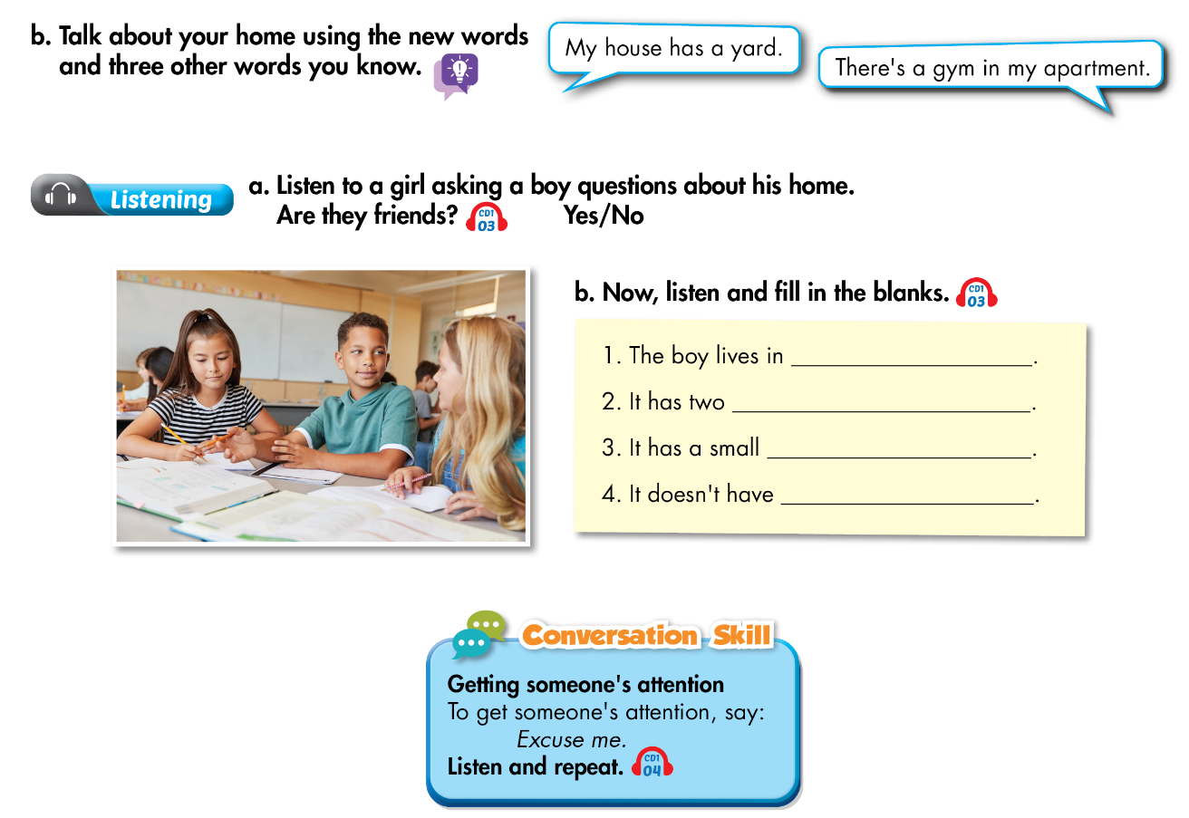
Lesson 1
an apartment
bedrooms
pool
garage

Slide 4
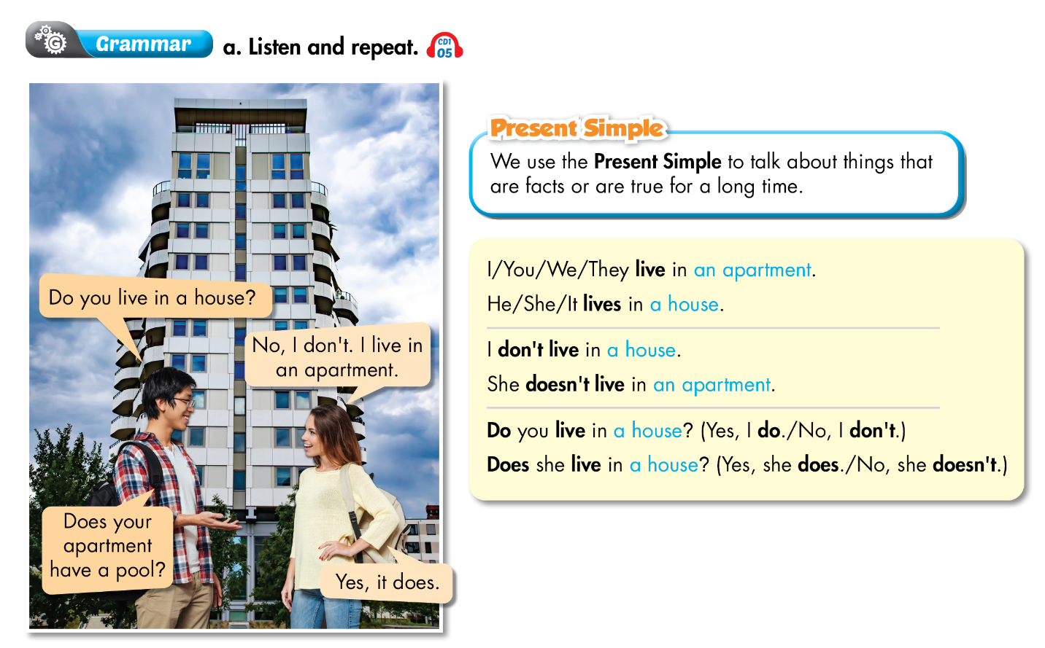
Lesson 1

Slide 5
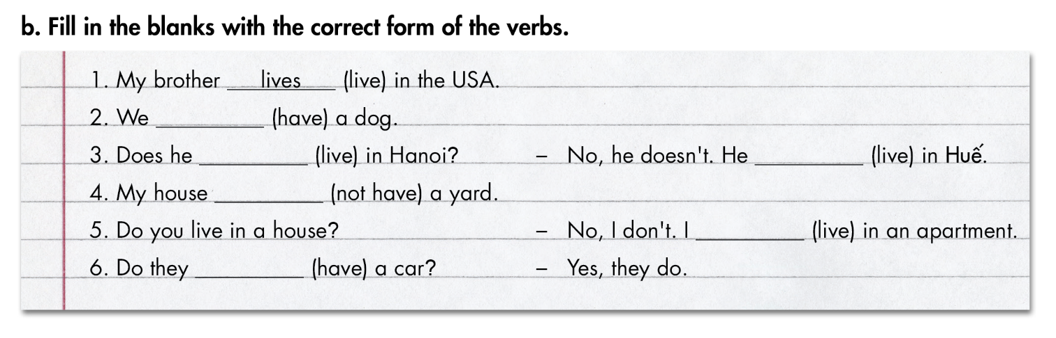
Lesson 1
have
live
lives
doesn’t have
live
have

Slide 6
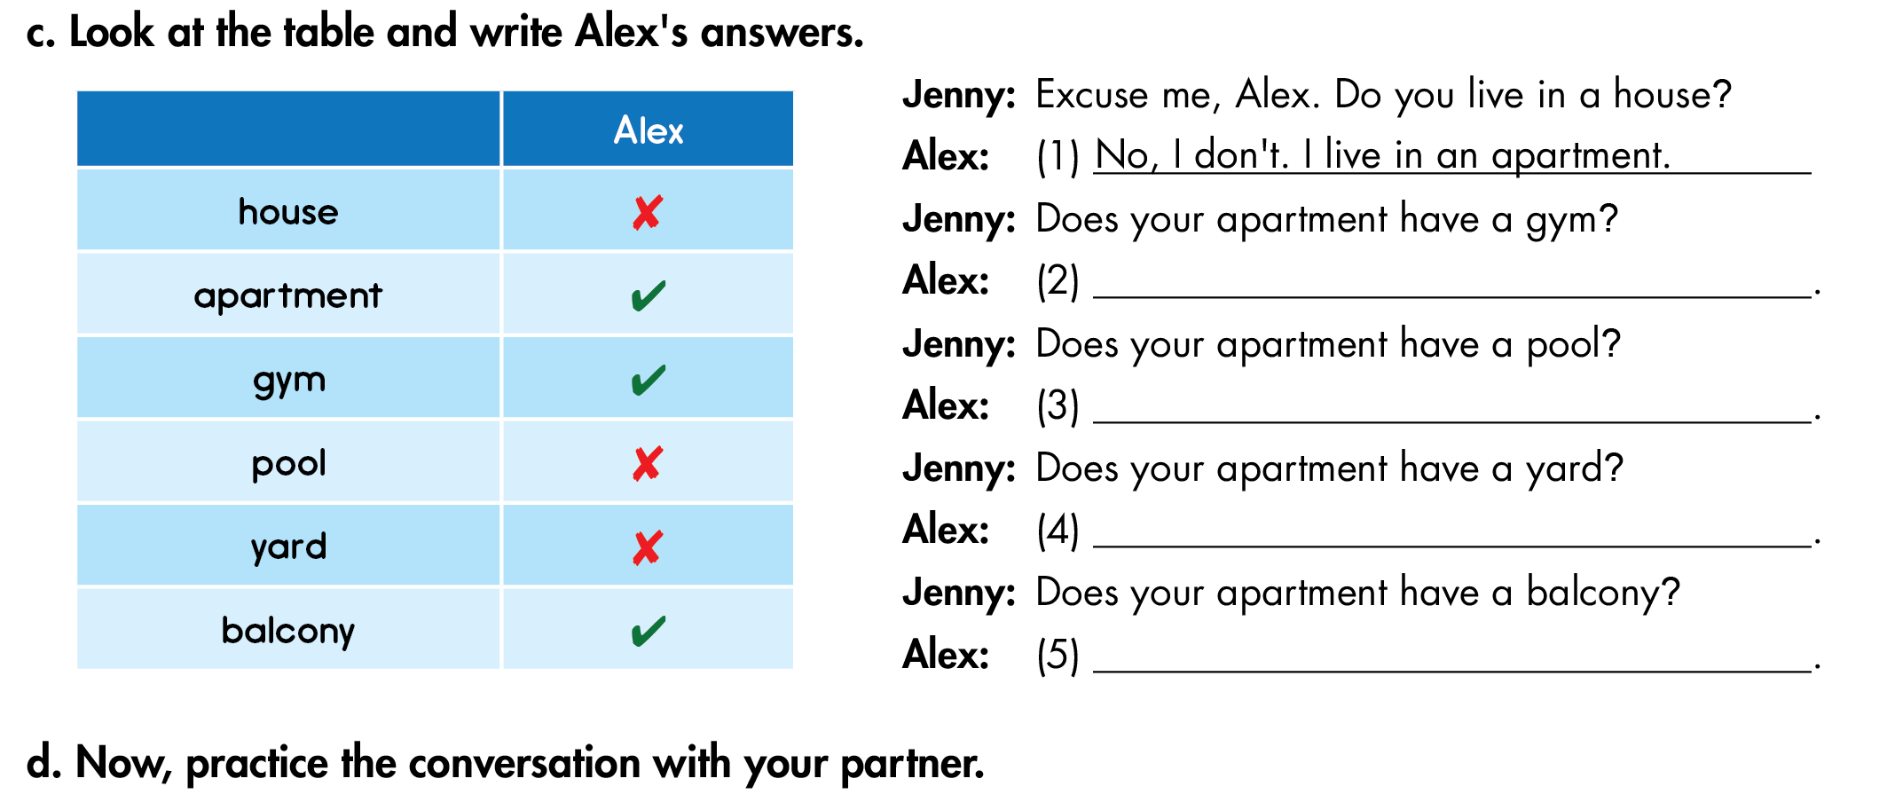
Lesson 1
Yes, it does.
No, it doesn’t.
No, it doesn’t.
Yes, it does.

Slide 7
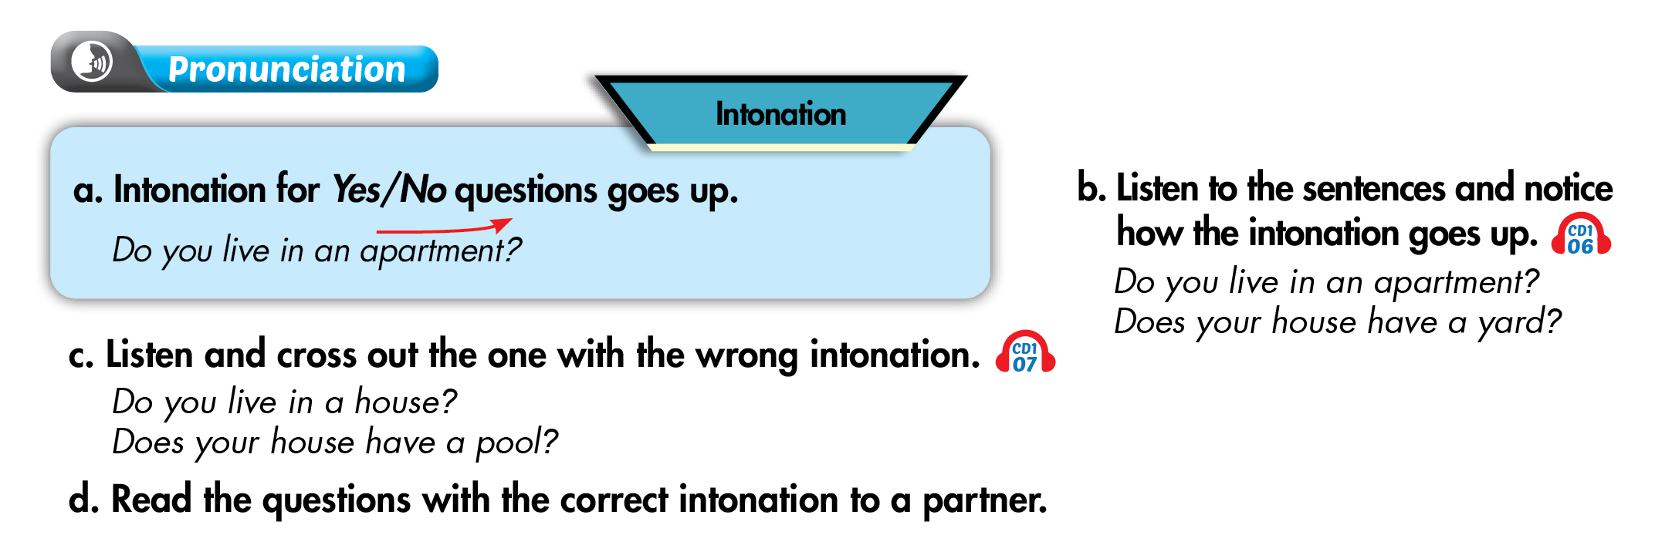
Lesson 1

Slide 8
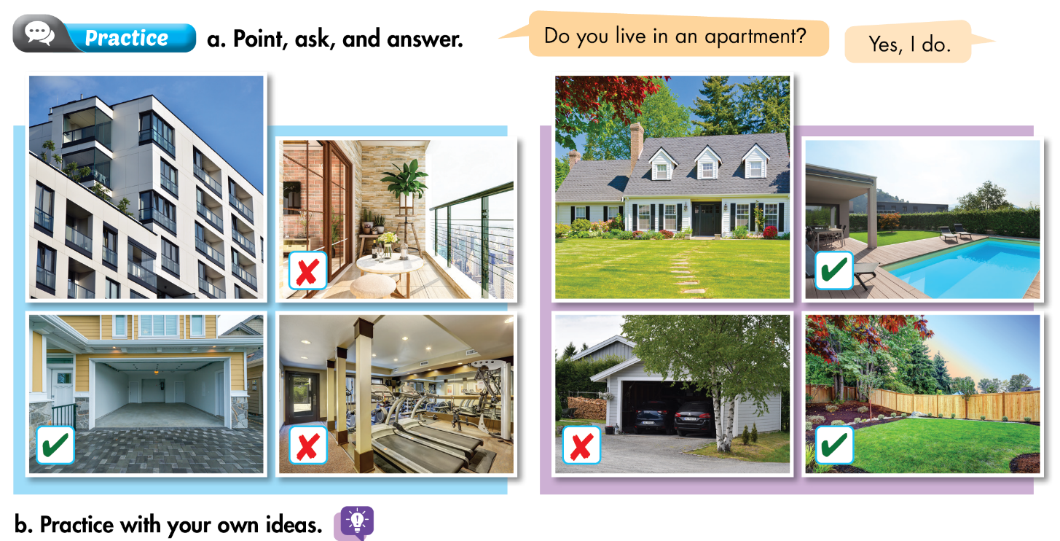
Lesson 1

Slide 9
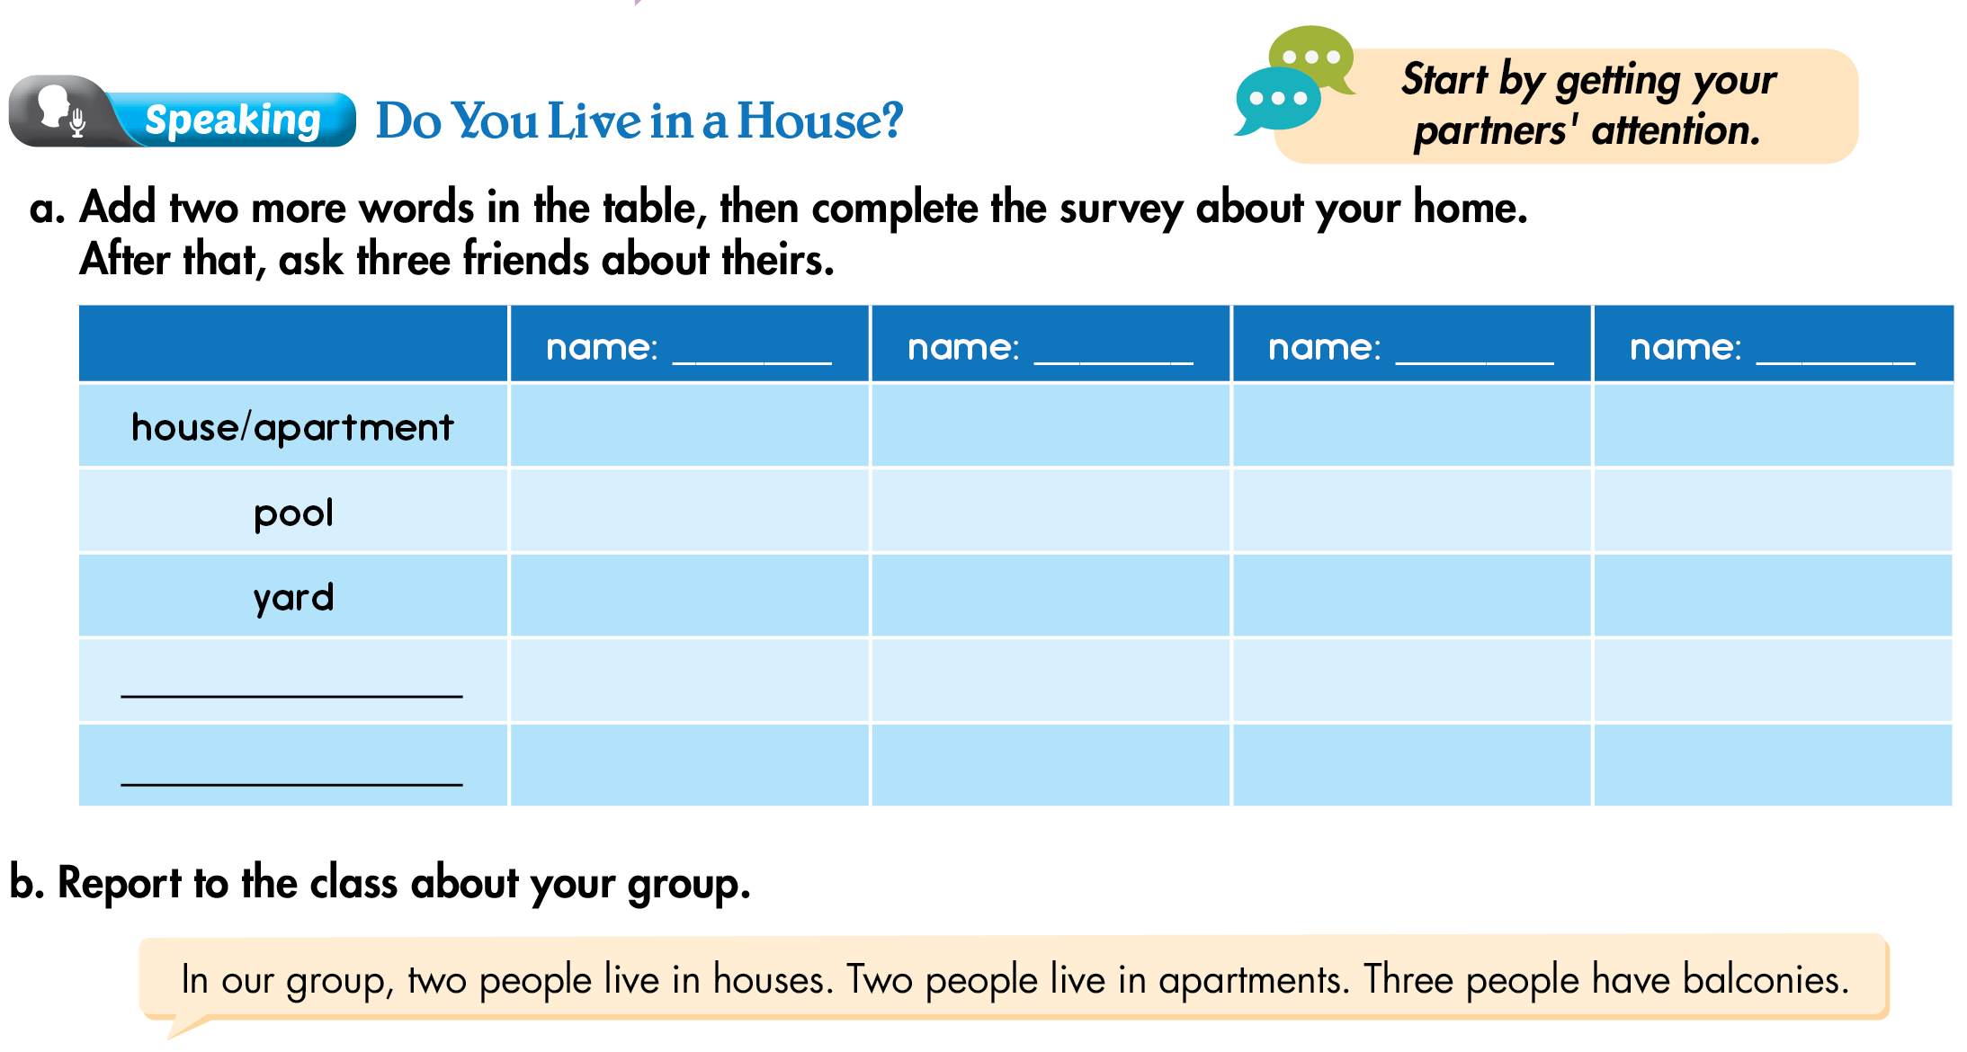
Lesson 1

Slide 10
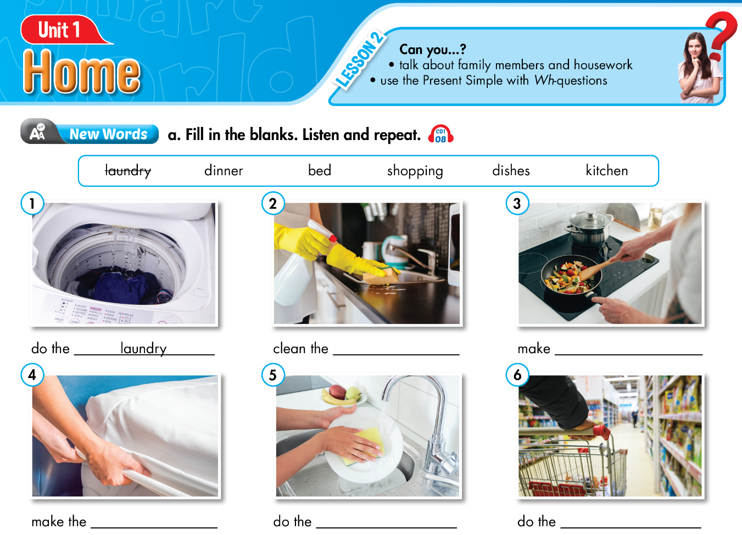
Lesson 2
kitchen
dinner
bed
dishes
shopping

Slide 11
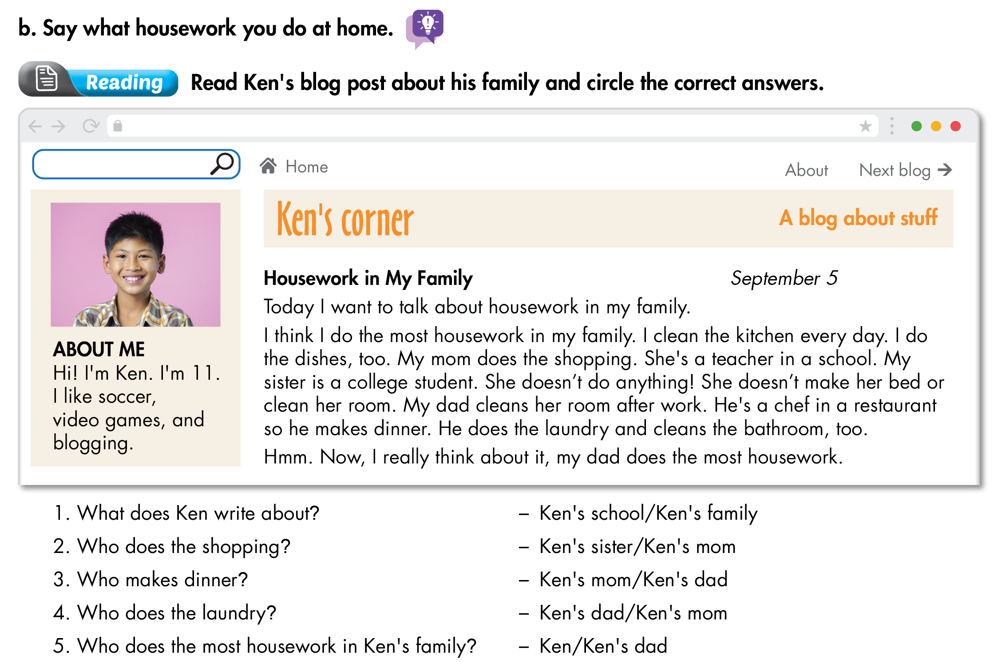
Lesson 2

Slide 12
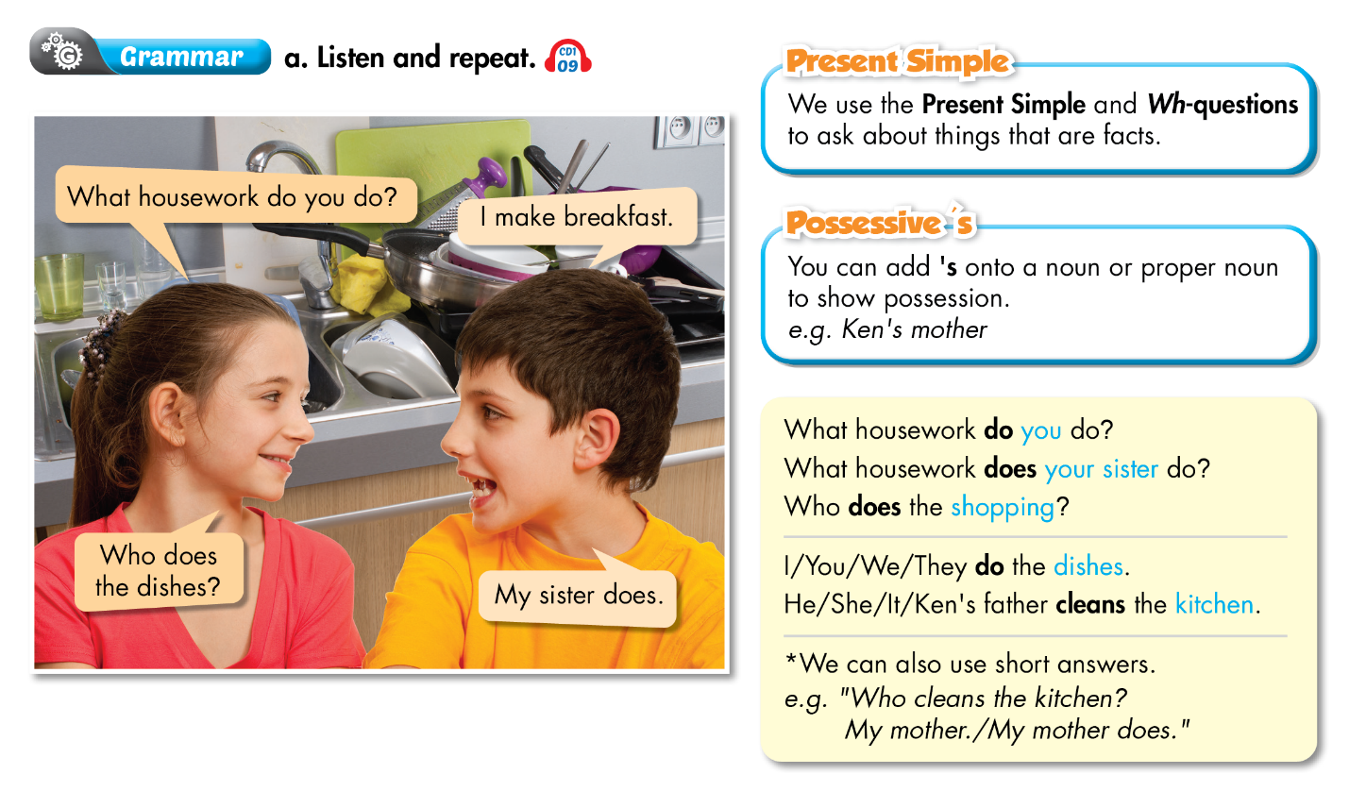
Lesson 2

Slide 13
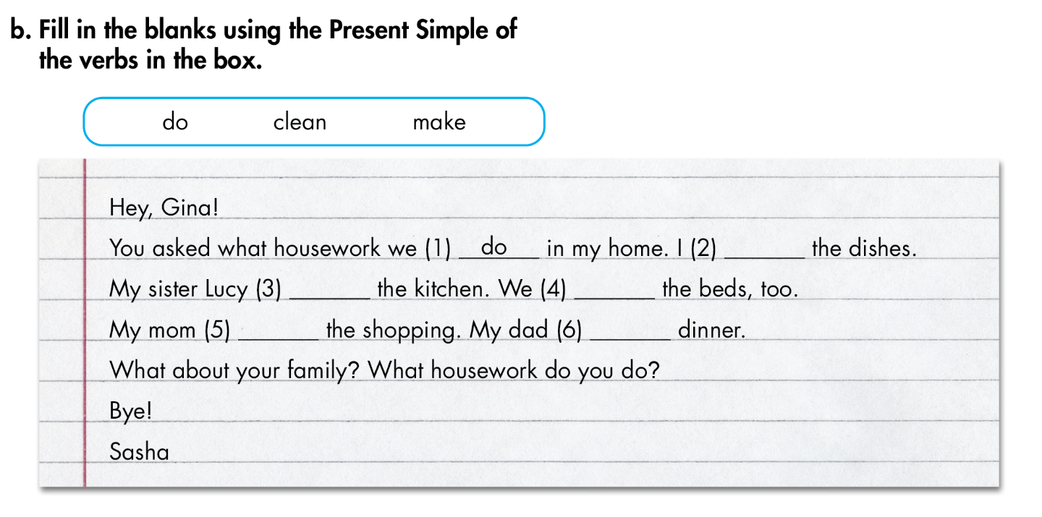
Lesson 2
do
cleans
make
does
makes

Slide 14
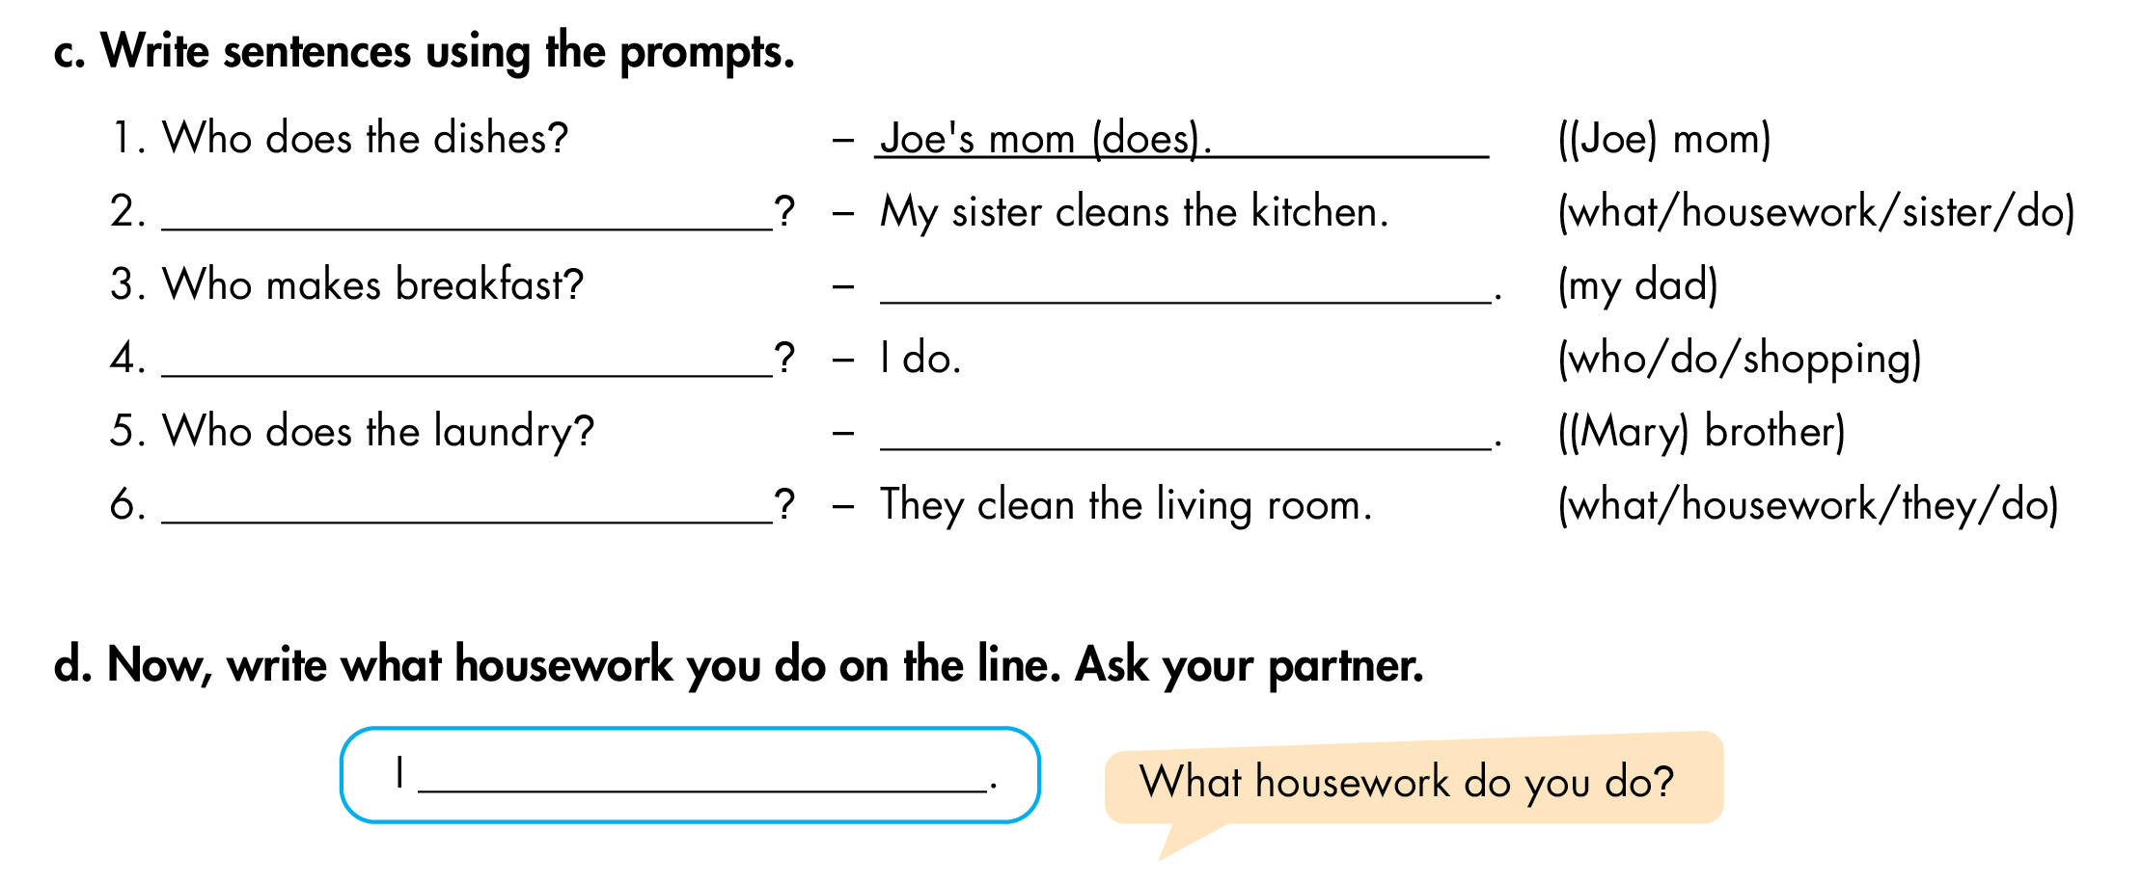
Lesson 2
What housework does your sister do
My dad (does)
Who does the shopping
Mary’s brother (does)
What housework do they do

Slide 15
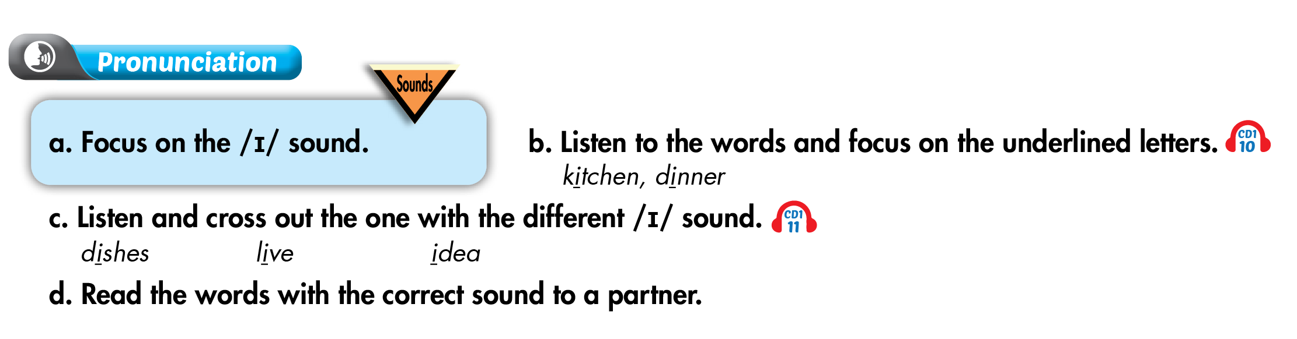
Lesson 2

Slide 16
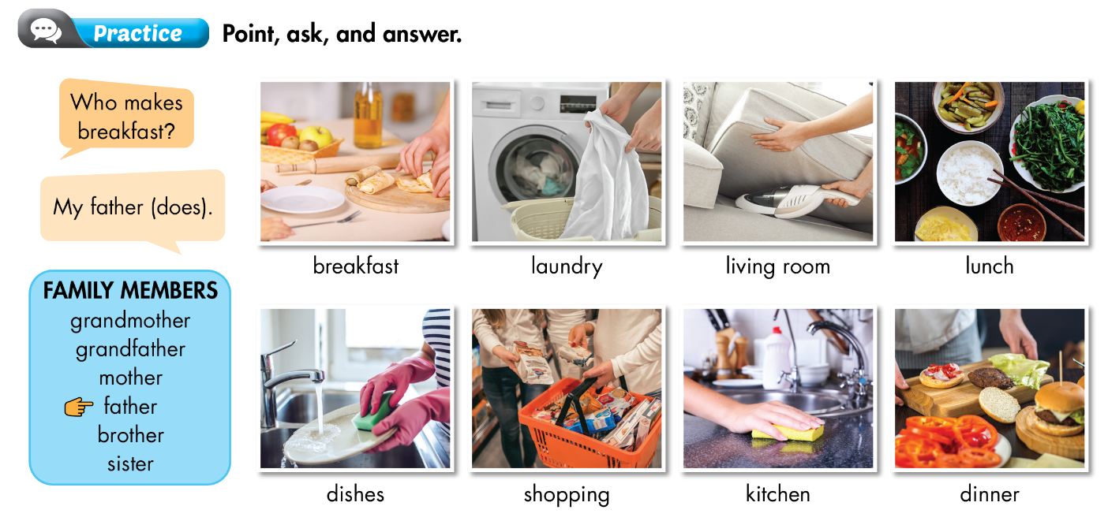
Lesson 2

Slide 17
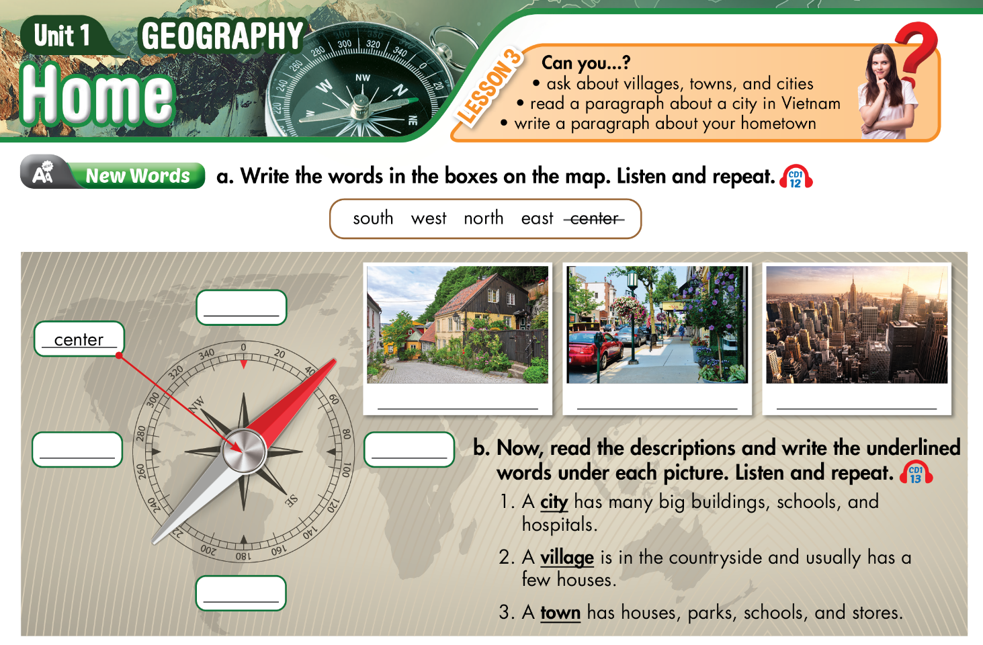
Lesson 3
north
village
town
city
west
east
south

Slide 18
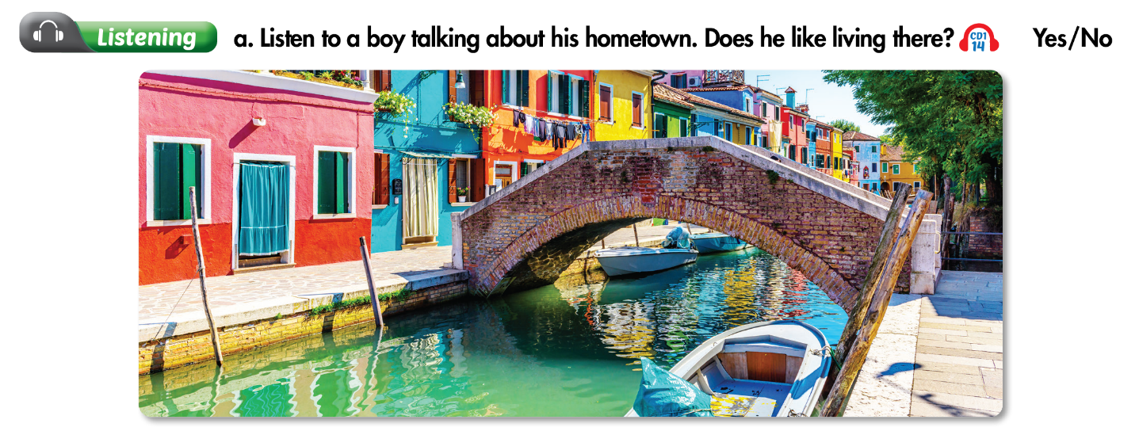
Lesson 3

Slide 19
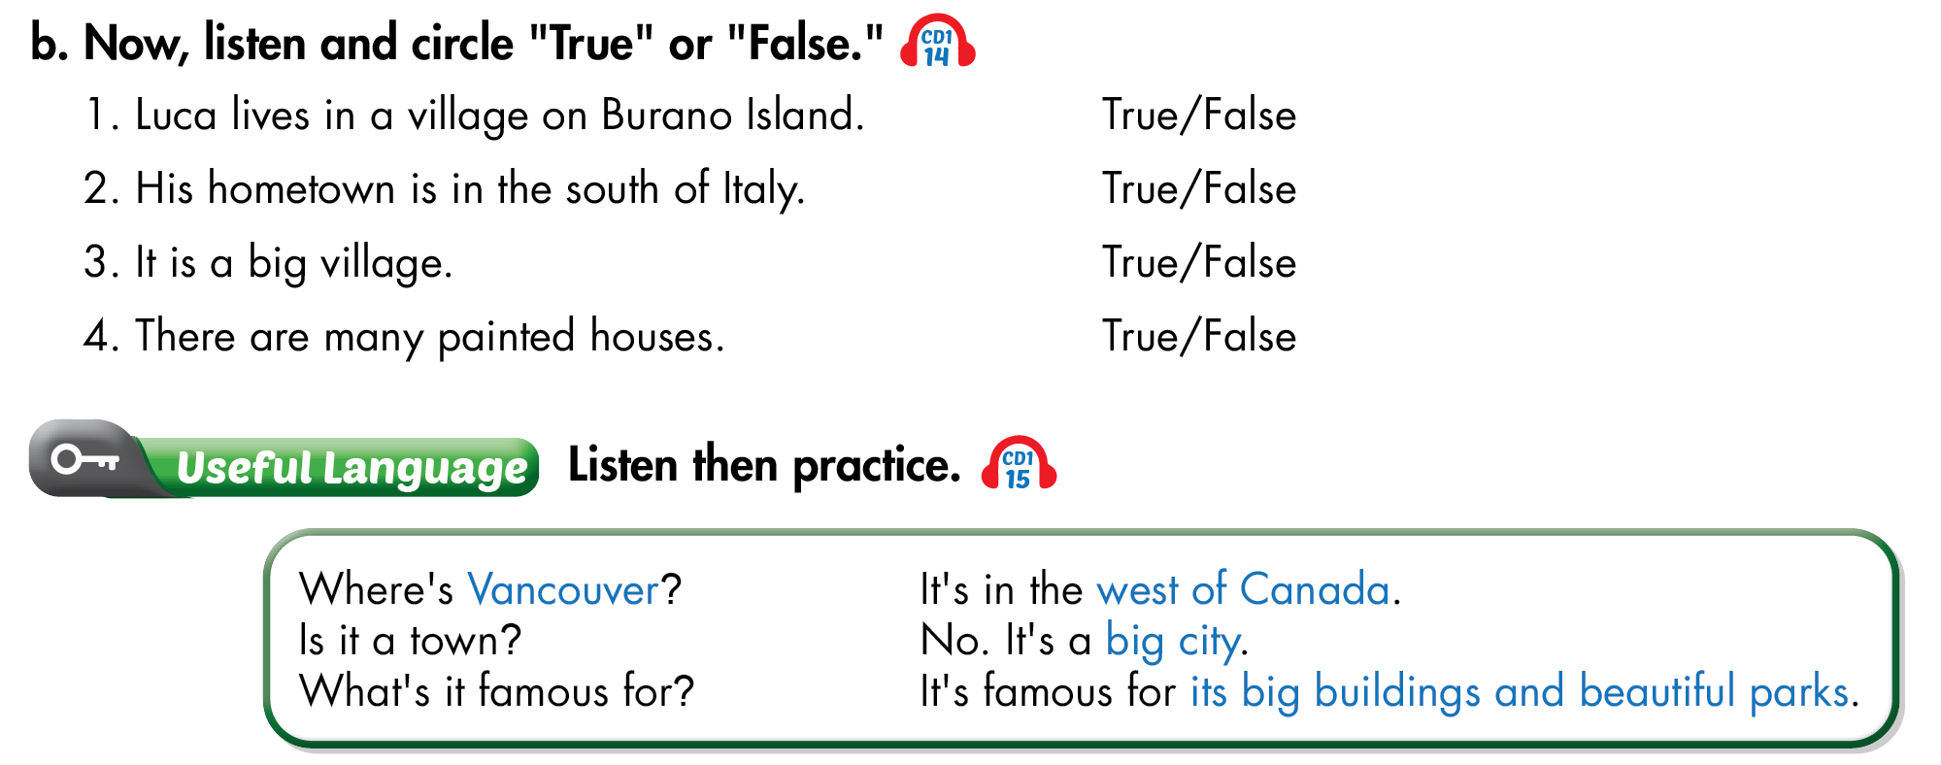
Lesson 3

Slide 20
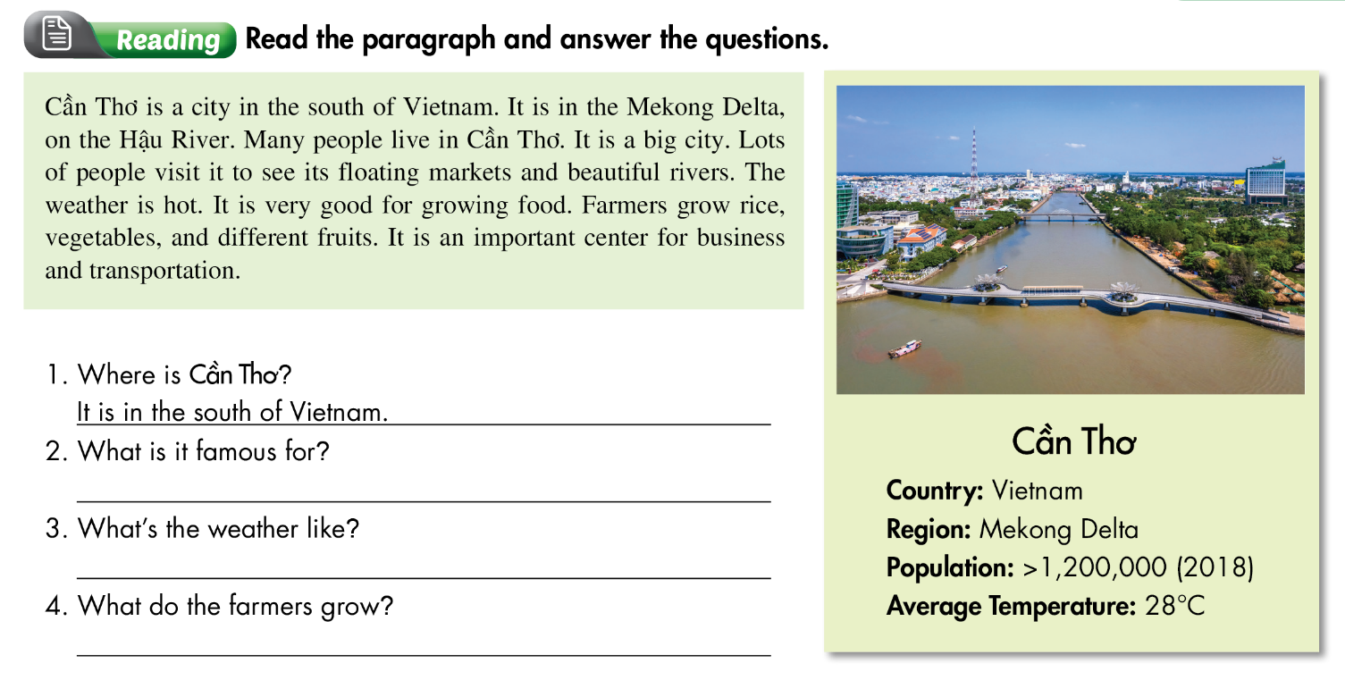
Lesson 3
It is famous for floating markets and beautiful rivers.
It’s hot.
They grow rice.

Slide 21
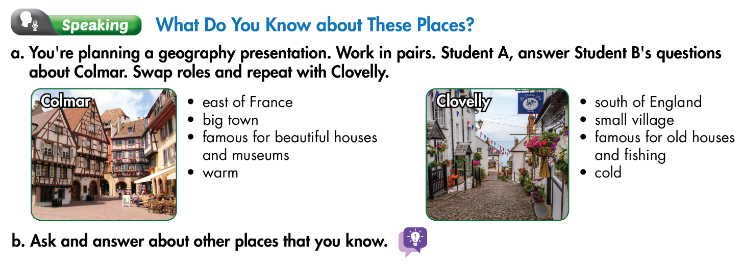
Lesson 3

Slide 22
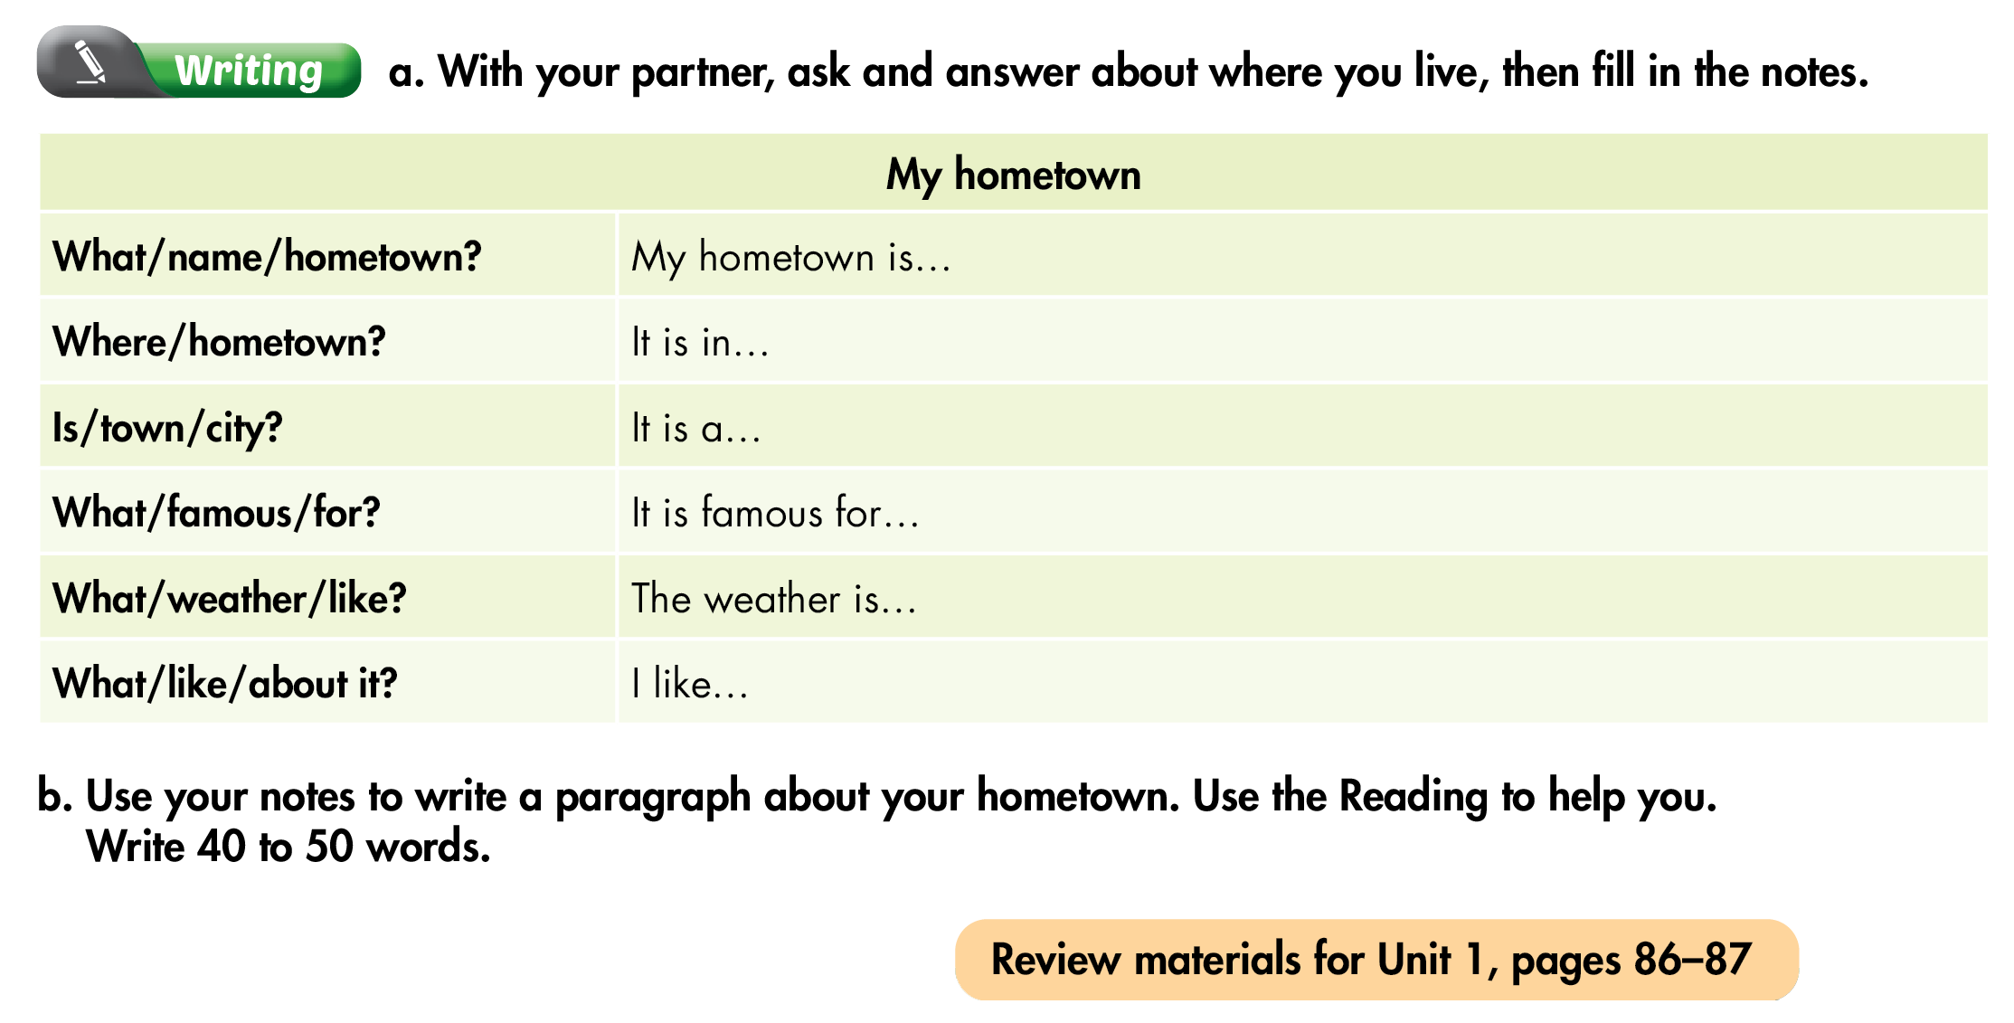
Lesson 3

Slide 23
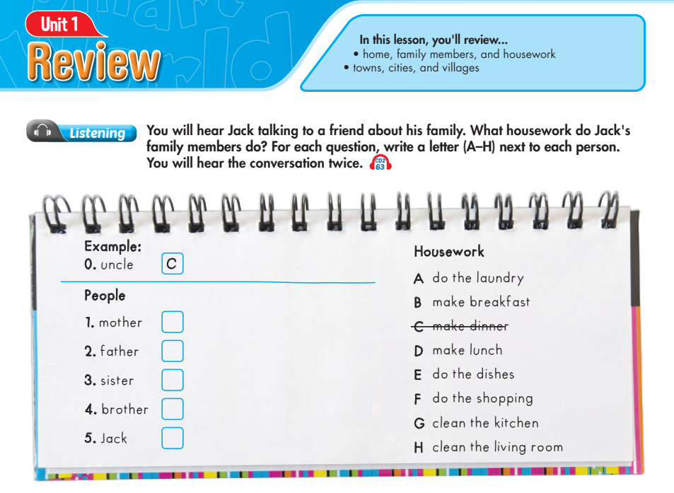
Lesson 1
A
F
G
E
B

Slide 24
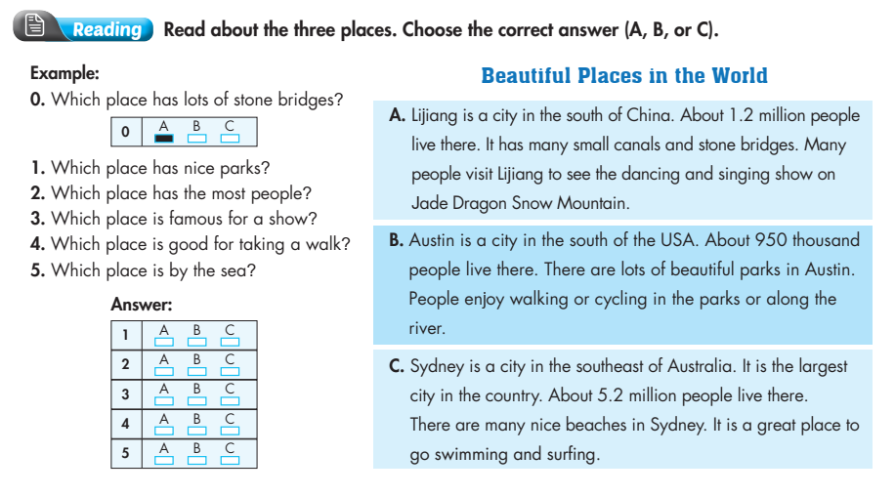
Review

Slide 25
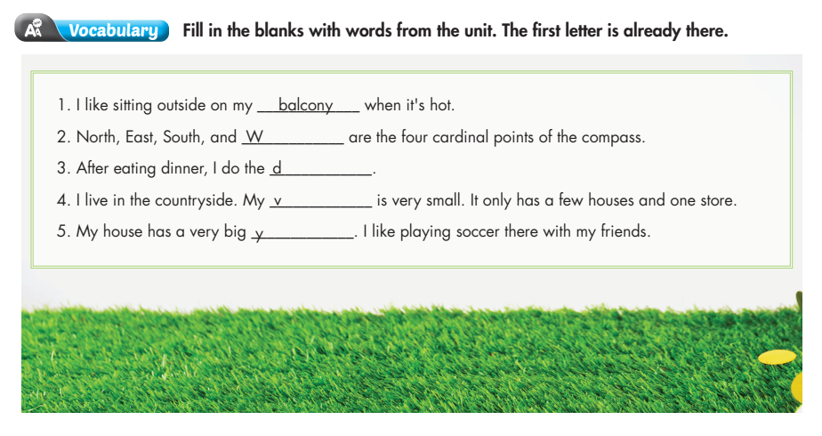
Review
est
ishes
illage
ard

Slide 26
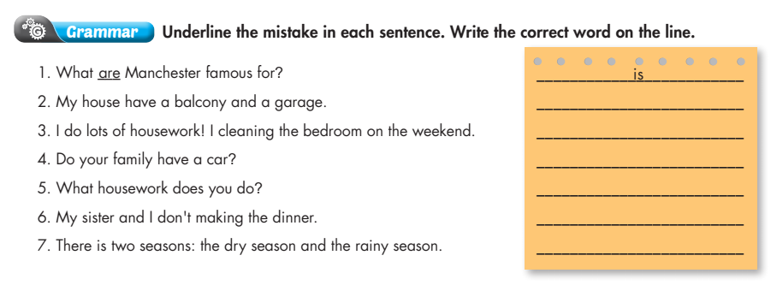
Review
has
clean
Does
do
make
are

Slide 27
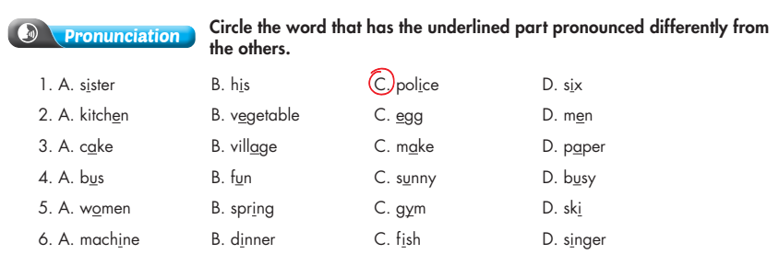
Review

