Slide 1


WELCOME TO OUR CLASS

Slide 2
Tuesday, September 7th 2021
UNIT 1: BACK TO SCHOOL
SECTION A: FRIENDS
LESSON: A1,2

Slide 3

* Warm up : Listen and complete the dialogue
HOA
NAM
Good
is Hoa
_______morning . My name ________
HOA
to meet
Nice ________ you , Hoa . My name is Nam . Are you a _____________ ?
new student
NAM
class 7A
Yes. I’m in ________ .
so am I
Oh,_________ .

Slide 4
I. New words :
1. ‘Different ( Adj.) :
Khác nhau
2. ‘Happy ( Adj.) ≠
Un‘happy : buồn , không vui
3. miss (v) :
Nhớ
4. ‘classmate (n):
bạn cùng lớp

Slide 5
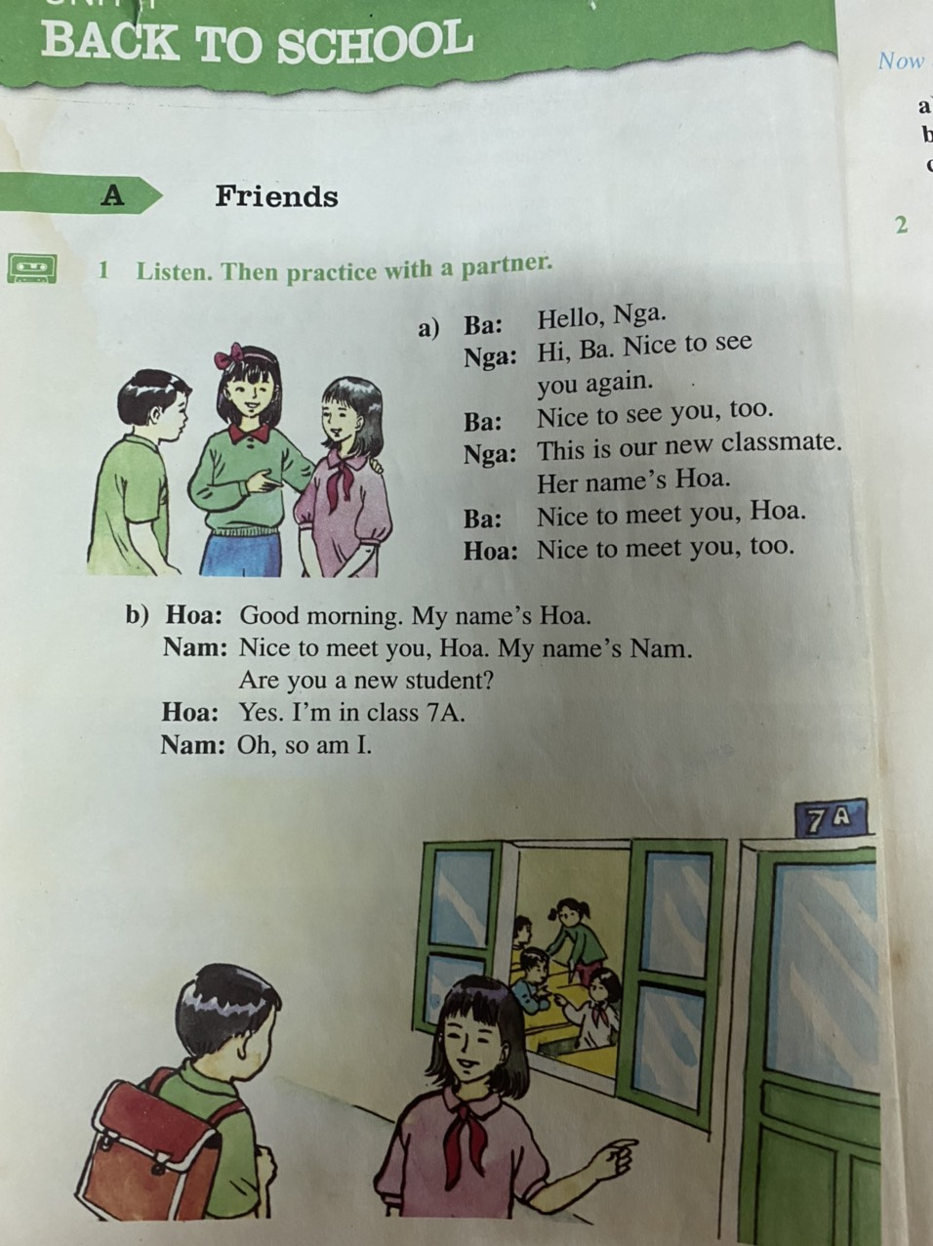

Slide 6

Hoa is a new student in class 7A. She is from Hue and her parents still live there. She lives with her uncle and aunt in Ha Noi.
Hoa has lots of friends in Hue. But she doesn’t have any friends in Ha Noi. Many things are different. Her new school is bigger than her old school. Her new school has a lot of students. Her old school doesn’t have many students.
Hoa is unhappy. She misses her parents and her friends.

Slide 7

II. True / False Prediction :
Hoa’s family lives in Hue .
Hoa doesn’t have any friends in Hanoi
Her old school has a lot of students .
Hoa lives with her friends in Hue .
Hoa is a new friend of Nga .
T
T
F
F
T

Slide 8
* Correcting the False sentences :
3. Her old school has a lot of students .
Her ____ school has a lot of students .
4. Hoa lives with her friends in Hue .
Hoa lives with her _____________ in Ha Noi .
new
uncle and aunt

Slide 9
* QUESTIONS :
Where is Hoa from ?
Who is she staying with ?
Does she have a lot of friends in Hanoi ?
How is her new school different from her old school ?
Why is Hoa unhappy ?

Slide 10
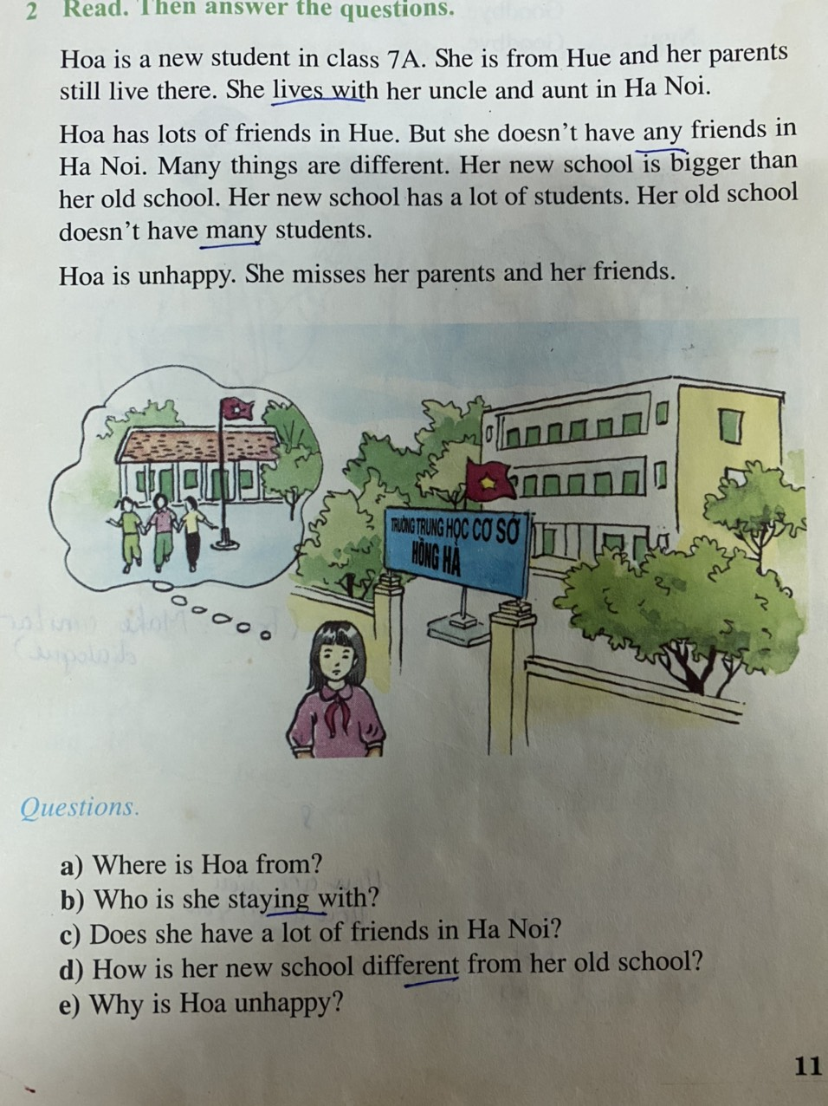

Slide 11

1. Where is Hoa from ?
She is from Hue .

Slide 12
2. Who is she staying with ?
Her uncle and aunt in Hanoi .

Slide 13
3. Does she have a lot of friends in Ha Noi ?
No, she doesn’t .

Slide 14
4. How is her new school different from her old school ?
It is bigger than her old school .

Slide 15
5. Why is Hoa unhappy ?
Because she misses her parents
and her friends .

Slide 16
* Answer Key :
Hoa is from Hue .
Her uncle and aunt in Ha Noi .
No, she doesn’t .
It is bigger than her old school .
Because she misses her parents and her
friends

Slide 17
Unit1 Back to school
A4: Listen. Complete the dialogue.(P.12,13 )
A How are you today? E Just fine K So am I.
B How are you? F Not bad L Me, too
C How is everything? G Pretty good
D How about you? H Ok
a, Mr Tan: Hello Lien (1) ………………………….?
Miss Lien: (2) ……….., thanh you (3)………………….., Tan?
Mr Tan: (4)………., but I’m very busy.
Miss Lien: (5)…….
How are you today?
Just fine
How about you?
Not bad
So am I.
How is everything
b, Nam: Good afternoon, Nga (6)……………………?
Nga: (7)……………….....thanks. (8)……………………?
Nam: (9)…, Thanks.
Nga: I’m going to the lunch room.
Nam: Yes,(10) ………
Pretty good
How about you
Ok
So am I.

Slide 18
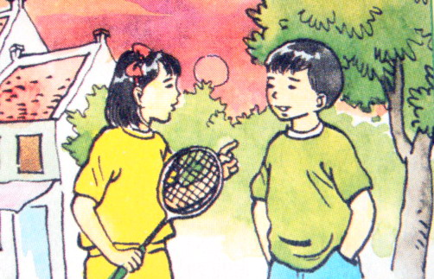
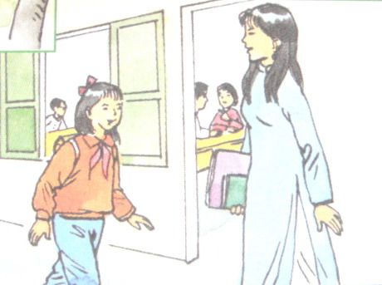
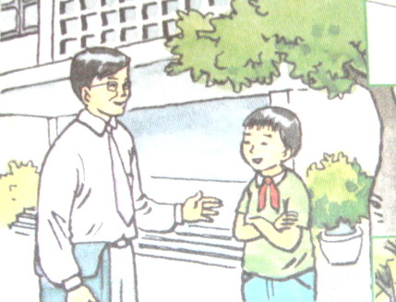
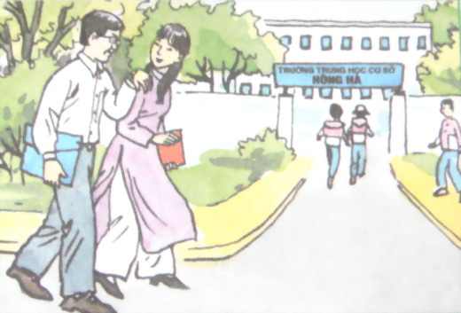

Unit1 Back to school Lesson 1: A1,3,4,5 (Page 10-13)
A5: Listen. Write the letters of the dialogues in the order you hear.(P.13 )
Key
1 – c
2 – b
3 – d
4- a
a
b
d
c

Slide 19

IV. At home :
Learn by heart new words and read the text many times .
Answer the questions again .
Prepare B1 – B2 – B3 .

Slide 20

Thanks for your attention

