Slide 1

Welcome to our English class !
English 8

Slide 2
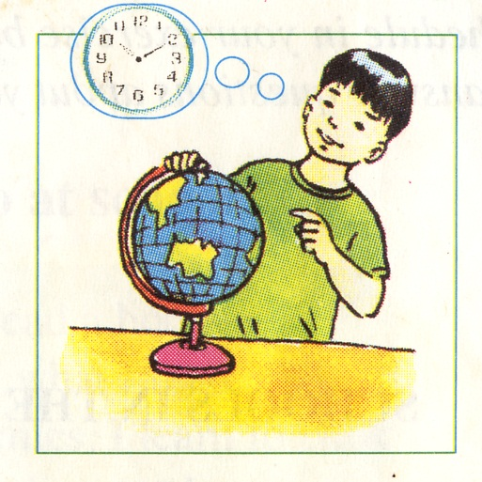
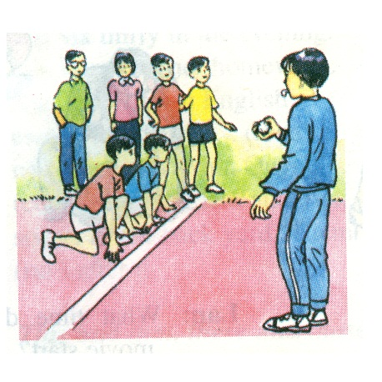

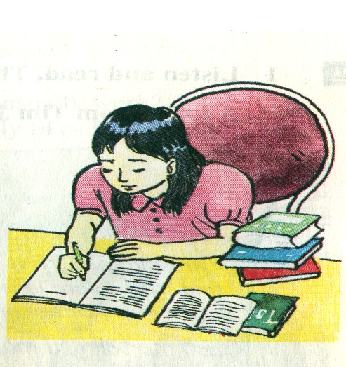
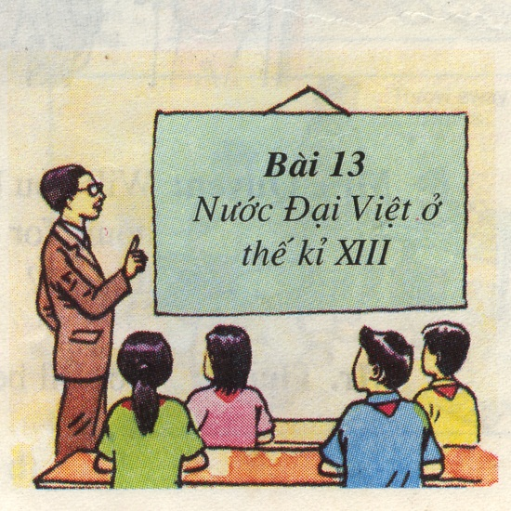
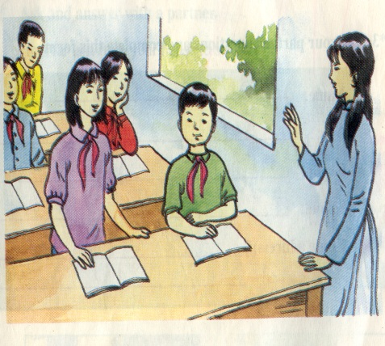
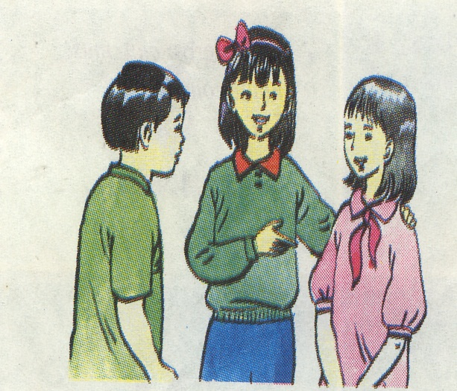
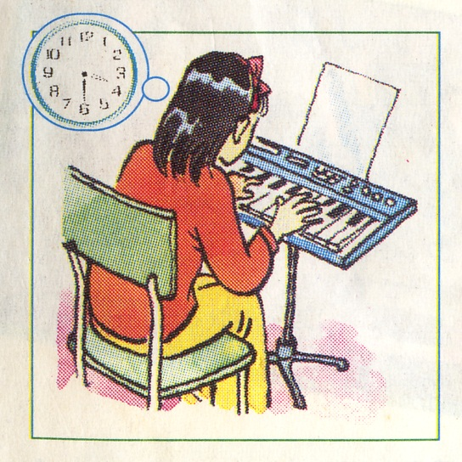
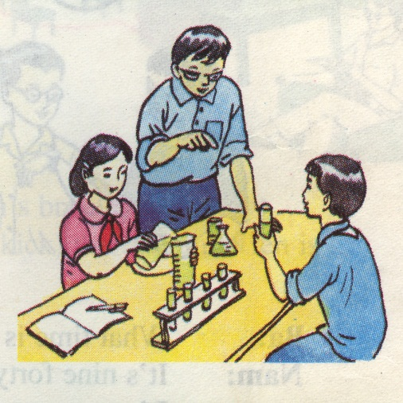
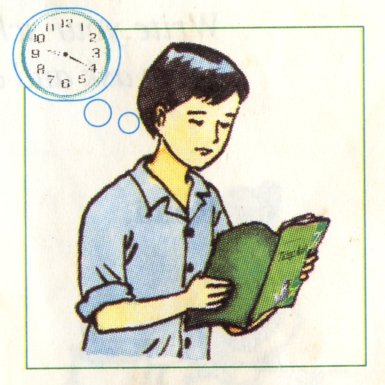
Cross Words
What are they doing ?
What does she do?
What subject do they have ?
What subject does he learn?
What is she doing?
What subject does he learn?
What subject do they have?
Who are they ?
What subject does she learn?
What subject do they have?
1
P
H
Y
S
I
C
A
L
E
D
U
C
A
T
I
O
N
2
R
E
A
D
I
N
G
3
T
E
A
C
H
E
R
4
C
H
E
M
I
S
T
R
Y
A
5
E
N
L
I
S
H
B
G
6
W
R
I
T
I
N
G
7
G
E
O
G
R
A
P
H
Y
8
H
I
S
T
O
R
Y
9
S
T
U
D
E
N
T
S
10
M
U
S
I
C
L | E | A | R | N | W | O | R | D | S

Slide 3




Which words do you want to learn?
DON’T KNOW | WORDS | KNOW
1. underline
2. highlight
3. mother tongue
4. make a list
5. folktale
6. revise
7. stick
8. come across
9. necessary
10. pride
11. report card

Slide 4


LEARNING ENGLISH
Friday, November 12th , 2021
I/ VOCABULARY
1. underline (v):
Ex: She is very beautiful
2. highlight (v):
3. mother tongue(n):
= first language

Slide 5


LEARNING ENGLISH
Friday, November 12th , 2021
I/ VOCABULARY
School
teachers (pl.n)
students (pl.n)
classes pl.n)
blackboards (pl.n)...
4. make a list ( v):
5. revise (v):
revision (n):

Slide 6
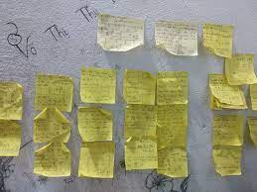
LEARNING ENGLISH
Friday, November 12th , 2021
I/ VOCABULARY
6. stick (v) :
7. come across (phr.v):
8. necessary (adj)
necessity (n):
need (v):
= meet/ encounter
≠ unnecessary (adj)

Slide 7
Checking vocabulary: Complete the sentences with the given words
mother tongue
highlight
underline
revise
highlighting
necessary
1. It’s better for us to ________ the important words in our lessons.
2. Lan grew up in Viet Nam, so her ____________ is Vietnamese.
3. You have to ________ the old lesson for the Mid term test.
4. Sleep is ________ to health.
5. Remember to ________ your notes so that you remember the most important parts.

Slide 8
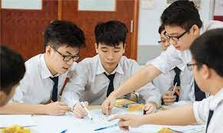

II/ Structures: Phrases of purpose: so as to / in order to/ so that
Ex1: They study hard in order to pass the exam.
= so as to
= so that they can pass the exam.
Ex 2: She wore warm clothes in order not to get cold.
= so as not to
= so that she couldn’t get cold

Slide 9

Task 1: Listen to the 1st passage and choose the best answers
1. Language learners learn words in.......................
A. the same way B. different ways C. only one way
2. Some language learners write the meaning of new words in their .......................
A. mother tongue B. second language C. foreign language
3. Write one or two example sentences with each .......................
A. new word B. meaning C. structure

Slide 10
Task 2: Read the 2nd and 3rd passage and answer True/ False.
1. Some learners write many words and its use on a small piece of paper.
2. They stick it somewhere in their house.
3. Many learners try to learn all new words they come across.
each word
False
True
don’t try
False

Slide 11
Task 3: Read the 3rd 4th passage and answer the questions
1. Why don’t some learners learn all the new words they come across?
2. How many days can you learn ten words? What ways?
3. What is necessary in learning words?
Because they only want to learn important words.
Two days
Ways | The first day | The second day
1
2
5 words
5 words
10 words
revision
Revision is necessary in learning words.

Slide 12
Task 4: Read the passage and choose the word to fill in the blanks (I learn smart world- Grade 9 - SB - theme 6/p54 )
improve
well
much
review
revision
when
a
many
How to get better at studying English
There are many different ways to (1) ...................... your reading, writing, listening and speaking skills (2) ......... you study another language. It’s easy to make (3)........ mistake when you write a letter or speak for the first time. You can get a friend who speaks the language (4) ......... and record them on your phone. Then you can play it back at home and (5)............. how they pronounce different words. Another tip (6)............ language teachers share is to label things you use a lot, like your book or backpack. This will help you when you try to translate English words into your own language in the future.

Slide 13
Discussion
How should you learn words?

Slide 14








Learn English on the internet
Do grammar exercises
Write English as much as possible
Learn by heart all the
new words and texts
Read English books
Listen to English tapes

Slide 15


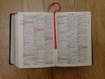

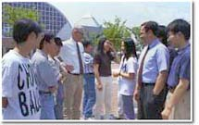
……..
Learn to sing English songs
Watch English TV programs
Use dictionary for reading
Read English newspapers
Talk with foreigners

Slide 16
HOMEWORK: Choose the best one (A, B, C or D) to complete the sentence.
1. He ________ a piece of paper on the wall to remember the words better. A. sticks B. ties C. decides D. cooks
2. We should learn this poem ________.
A.by mind B. by soul C. by heart D. by head
3. He does morning exercises regularly ________ improve his health.
A. in order for B. in order that C. so that D. so as to
4. You can try different ways of ________ a new language. A. learn B. learning C. to learn D. learned
5. _________ is studying again something that you’ve learnt, before an exam.
A. Revision B. Experiment C. Practice D. Semester

