Slide 1

UNIT 1: MY FRIENDS
LESSON 1:
GETTING STARTED
LISTEN AND READ

Slide 2
drinking coffee
shopping
chatting
playing sport
WHAT DO YOU OFTEN DO WITH YOUR FRIENDS ?
reading book
watching film
dicussing
travelling
doing homework

Slide 3
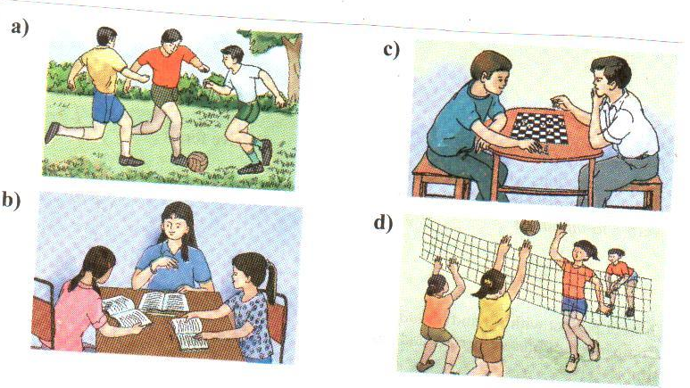
DESCRIBE THESE PICTURES
- What are the boys/girls doing?
- What are their favorite activities ?
- When do they often play these games?

Slide 4
Thursday, September 9th, 2021
Unit 1: MY FRIENDS
Lesson 1: Getting started + Listen and read
I.Vocabulary
- (to) seem (v)
- smile (n)
- enough (adv)
- next-door (adj)
- a photograph (n)
→ photographer (n)
photography (n)
photographic (adj)

Slide 5

I. Vocabulary
smile (n)
-> smile (v)
Ex: She smiles happily .
She has a graceful smile.
v
n

Slide 6
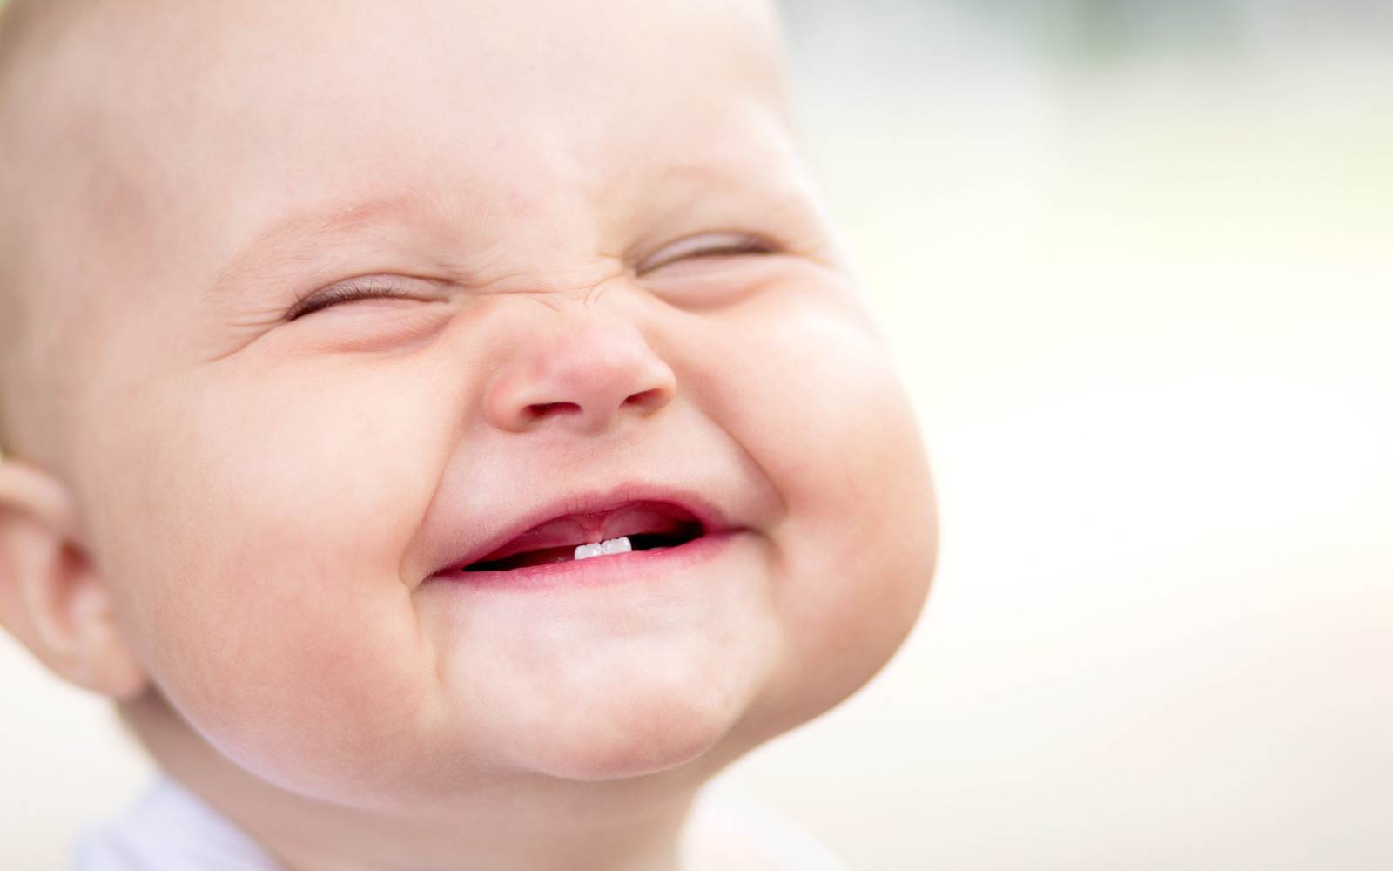
seem (v) = may be
Ex: You seem happy.

Slide 7

Next- door (adj)
Ex: He is my next-door neighbor.

Slide 8
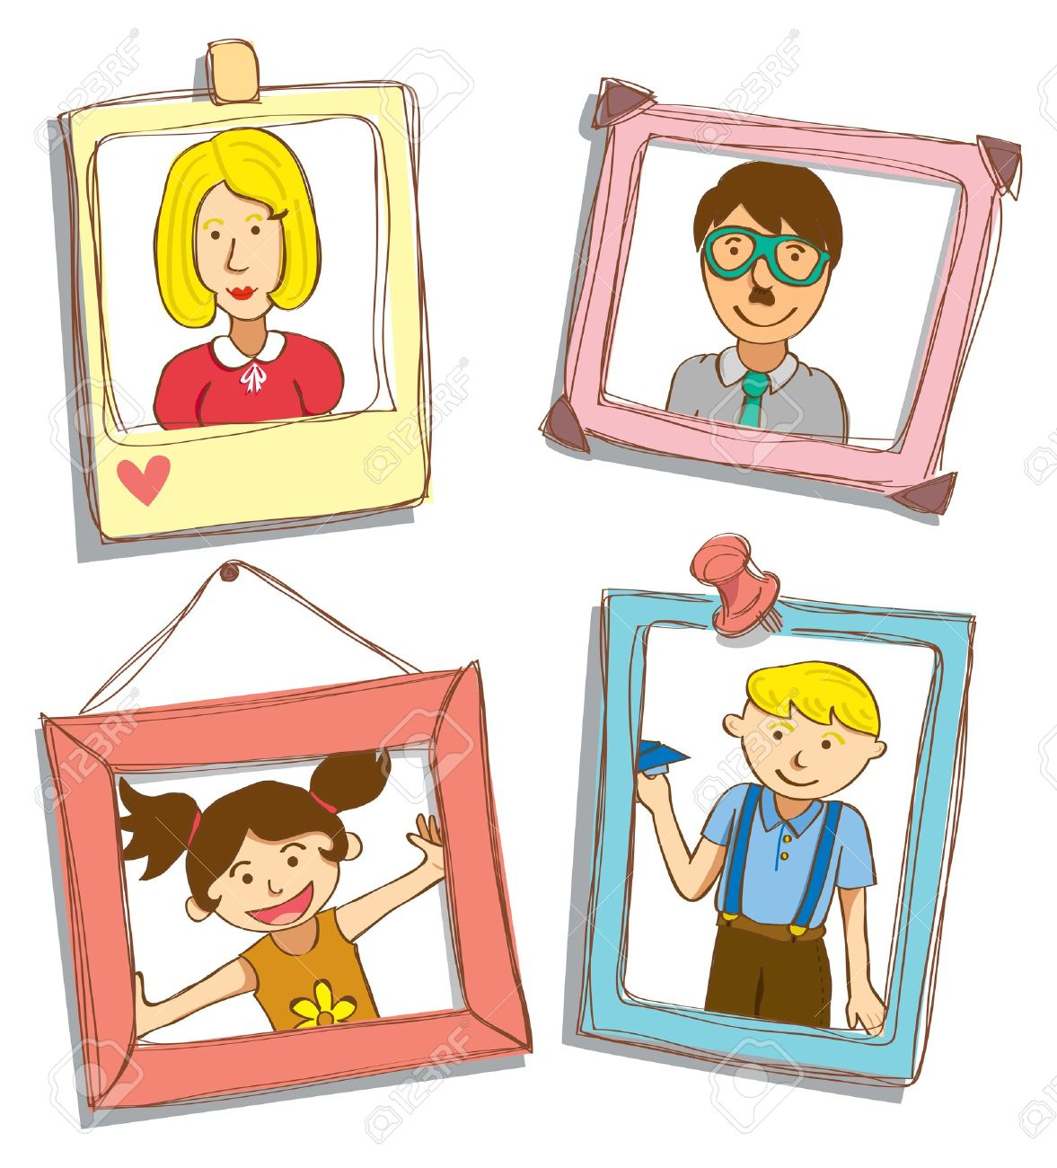
photograph (n)
-> photographer (n)
->photography (n)
->photographic (adj)

Slide 9
Checking Vocabulary
* Matching
1.(to) seem
a.nụ cười
2.smile
b.dường như
3.enough
c. kế bên
4.Next - door
d.tấm ảnh
5.a photograph
e.đủ

Slide 10
Hoa: Hello, Lan.
Lan: Hi, Hoa. You seem happy.
Hoa: I am. I received a letter from my friend Nien today.
Lan: Do I know her?
Hoa: I don’t think so. She was my next-door neiahbor in Hue.
Lan: What does she look like?
Hoa: Oh. She’s beautiful. Here is her photograph.
Lan: What a lovely smile! Was she your classmate?
Hoa: Oh, no. She wasn’t old enough to be in my class.
Lan: How old is she?
Hoa: Twelve. She’s going to visit me. She’ll be here at Christmas. Would you like to meet her?
Lan: I’d love to.

Slide 11
Answer the following questions.
a) Where does Nien live?
→ She lives in Hue.
b) Does Lan know Nien?
→ No. she doesn't .
c) Which sentence tells you that Hoa is older than Nien?
→ “She wasn't old enough to be in my class.”
d) When is Nien going to visit Hoa?
→ She is going to visit Hoa at Christmas.

Slide 12
II. Grammar:
Model sentence
She wasn’t old enough to be in my class.
+ be(not)
+enough
S
+adj
+to-V
đủ (không đủ) cái gì để làm gì...

Slide 13

Andy is not tall. He can’t join the police.
Andy is not tall enough to join the police.
Form: S + be (not) adjective + enough + to V …

Slide 14
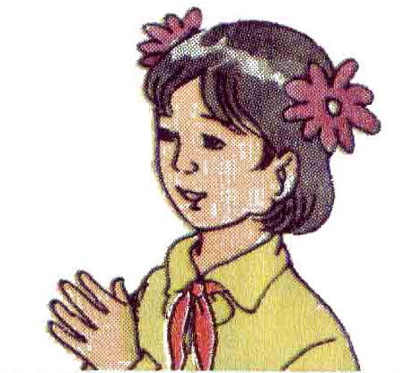
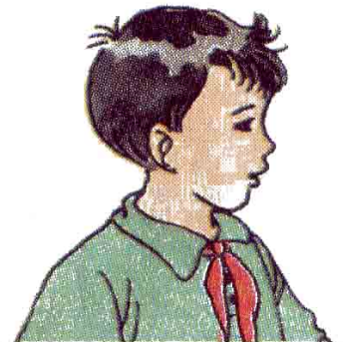
He isn’t strong enough to be a weight lifter.
He isn’t strong. He can’t be a weight lifter

Slide 15
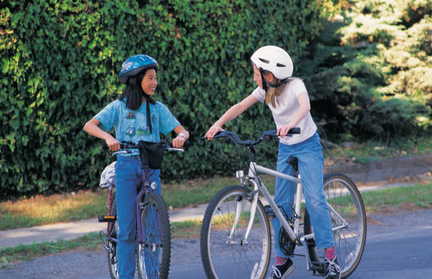

They are old enough to cycle safely.
They are 13 years old. They can cycle safely.

Slide 16
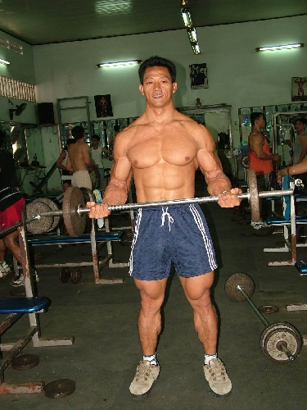
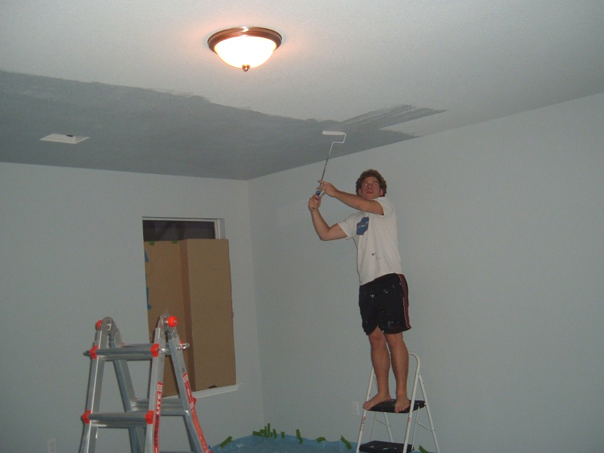
a. He/strong/do/that work.
He is strong enough to do that work.
b. He/not/ tall/ reach /the ceiling.
He isn’t tall enough to reach the ceiling.

Slide 17

HOMEWORK
Học thuộc từ vựng và ngữ pháp
Làm bài tập A, B
Chuẩn bị Unit 1_Read

Slide 18
HOMEWORK
A. Sắp xếp các từ sau thành câu hoàn chỉnh.
enough/ Jane/ stay/ to/ alone/ old/ isn’t/ at home.
He/ carry/ that/ strong/ enough/ suitcase/ is/ to.
She/ beautiful/ become/ to/ and intelligent/ is/ enough/ Miss World.
Mr. Robert/ rich/ a house/ isn’t/ enough/ to/ buy.
This coat/ wear/ warm/ winter/ in/ isn’t/ to/ enough

Slide 19
HOMEWORK
B. Sử dụng “(not) adjective + enough + to V” để kết hợp 2 câu sau.
Ex: He is strong. He can lift this box.
→ He is strong enough to lift this box.
My sister is old. She can drive a car.
The radio isn’t small. You can’t put it in your pocket.
The weather was good. We could go camping.
She isn’t old. She can’t get married yet.
The water wasn’t clean. We couldn’t swim in it.

Slide 21
Thursday, September 16th , 2021
UNIT 1: MY FRIENDS
Lesson: Read
I. Vocabulary
character (n):
sociable = outgoing (adj):
generous (adj):
generosity (n):
generously (adv):
volunteer (n) (v):
→ voluntary (adj):
→ voluntarily (adv):
tính cách
hòa đồng, dễ gần
hào phóng, rộng lượng
tính hào phóng, sự rộng lượng
1 cách hào phóng
tình nguyện viên, làm việc tình nguyện
tự nguyện, tự ý
1 cách tự nguyện, tự ý

Slide 22
orphanage (n):
orphan (n) (v):
- hard-working (adj):
reserved (adj):
joke (n):
sense of humor (n):
→ humorous (adj)
annoy = get tired of (v)
trại mồ côi
trẻ mồ côi
chăm chỉ
kín đáo, dè dặt
chuyện đùa
khiếu hài hước
hài hước
làm bực mình, làm phiền

Slide 23
Verb | Noun | Adjective | Adverb | Meaning
 | generosity | generous | generously
volunteer | volunteer | voluntary | voluntarily
be orphaned | orphanage orphan
humor | humor | humorous | humorously
……….. | ……….. | ……….. | ………..

Slide 24

READ
Ba is talking about his friends.
I am lucky enough to have a lot of friends. Of all my friends, Bao, Khai, Song are the ones I spend most of my time with. Each of us, however, has a different character.
Bao is the most sociable. He is also extremely kind and generous. He spends his free time doing volunteer work at a local orphanage, and he is a hard-working student who always gets good grades.
Unlike Bao, Khai and Song are quite reserved in public. Both boys enjoy school, but they prefer to be outside the classroom. Song is our school’s star soccer player, and Khai likes the peace and quiet of the local library.
I am not as outgoing as Bao, but I enjoy telling jokes. My friends usually enjoy my sense of humor. However, sometimes my jokes annoy them.
Although we have quite different characters, the four of us are very close friends.

Slide 25
2/14
a) How does Ba feel having a lot of friends?
b) Who is the most sociable?
c) Who likes reading?
d) What is a bad thing about Ba’s jokes ?
e) Where does Bao spend his free time ?
f) Do you and your friends have the same or different character ?

Slide 26






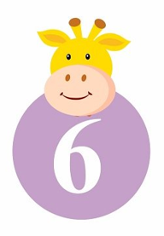



LUCKY NUMBER

Slide 27
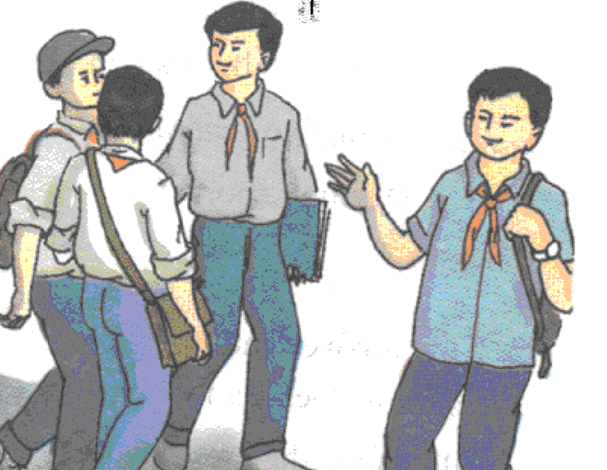
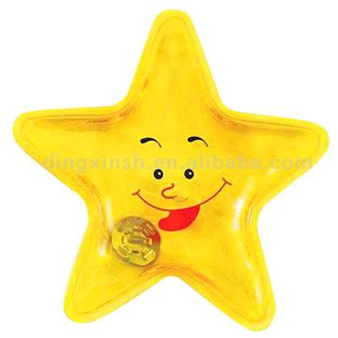
a. How does Ba feel having a lot of friends ?
→ He feels lucky.

Slide 28
b. Who is the most sociable ?
→ Bao is the most sociable .

Slide 29
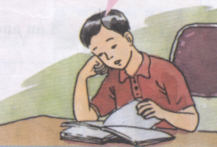
c. Who likes reading ?
→ Khai likes reading.

Slide 30
d. What is a bad thing about Ba’s jokes ?
→ They sometimes annoy his friends.

Slide 31
e. Where does Bao spend his free time ?
→He spends his free time doing volunteer work at a local orphanage .

Slide 32
f. Do you and your friends have the same or different character ?
We have the same characters
( We have quite different characters )

Slide 33
Lucky number!!!

Slide 34
Lucky number!!!

Slide 35
True ( T ) or false ( F)
Statements | T | F
1. Bao is sociable and generous.
2. Bao spends his free time doing volunteer work at a local orphanage
3. Khai and Song are outgoing
4. Ba is reserved and he likes the peace and quite of the local library
5. Bao, Khai, Song and Ba are close friends

Slide 36
True ( T ) or false ( F)
Statements | T | F
1. Bao is sociable and generous.
2. Bao spends his free time doing volunteer work at a local orphanage.
3. Khai and Song are outgoing.
4. Ba is reserved and he likes the peace and quite of the local library.
5. Bao, Khai, Song and Ba are close friends.
T
T
reserved
F
F
Khai
T

Slide 37
* Talking about the character of Ba’s friends :
Song Khai Bao
-reserved
-enjoys school
-a school’s star player
- reserved
- enjoys school
- likes reading
-sociable, kind, generous
-a volunteer
- a hard-working student

Slide 38
HOMEWORK
Học thuộc từ vựng và ngữ pháp
Chuẩn bị Unit 1_Language Focus

Slide 40
Thursday, September 23rd , 2021
UNIT 1: MY FRIENDS
Lesson: Language Focus
I. Simple Tense
Simple Present Tense
Simple Past Tense
1. Tobe
S + am/ is/ are + .....
S + am/ is/ are + not ..…
Am/ is /are + S +...... ?
2. Verb
S + V_{bare}/V_{s/es}
S + don’t/ doesn’t + V_{bare}
Do/ Does + S + V_{bare} + ...?
1. Tobe
S + was/ were + .....
S + was/ were + not +...
Was/ Were + S +...... ?
2. Verb
S + V_{2/ed}
S + didn’t + V_{bare}
Did + S + V_{bare} + ...?

Slide 41
Simple Present Tense
Simple Past Tense
Daily habit
Truth/ fact
Every (day, night, week, month, year…).
Always, usually, often, sometimes, never.
Habit in the past
Something happened
Yesterday.
Last (night, week, month, year...).
ago.

Slide 42
*Exercise1: Complete the paragraphs. Use the correct form of the verb in brackets
Hoa (0)……….(live) in Hue last year, but now she (1)……….(live) in Ha Noi. Yesterday, Hoa’s friends Nien (2)………(send) Hoa a letter. Nien (3)………(be) Hoa’s neighbor when Hoa lived in Hue. She (4)……….(be) younger than Hoa.
Lan (0)……(be) Hoa’s best friends. The two girls (1)……….(be) in the same class at Quang Trung school. Last year, Hoa (2)………(come) to the school for the first time. Lan (3)………… (show) her around and (4)………………..(introduce) her to many friends.
lived
lives
sent
was
is
is
are
came
showed
introduced

Slide 43
*Exercise 2: Complete the dialogue. Use the correct form of the verbs in the box
Ba is helping his young cousin Tuan with some homework
Ba: What do you know about the sun, Tuan ?
Tuan: The sun (0)………….in the east and (1)………in the west.
Ba: Can you tell me anything about the other planets?
Tuan: I know something about the earth. It (2)…………around the sun.
Ba: Yes, and the moon (3) …………around the Earth.
Tuan: Where is Mars, Ba?
Ba: It (4)……near the sun.
Tuan: No, it’s silly! That (5)……Mercury. Mars (6)……near the Earth.
be
move
set
rise
go
rises
sets
goes
moves
is
is
is

Slide 44
II. (Not) adjective + enough + to-infinitive
S + be (not) adj + enough + to V …
They are 13 years old. They can cycle safely.
They are old enough to cycle safely.

Slide 45
*Exercise 4: Complete the dialogues. Use ( not) adj + enough
Hoa: Can you put the groceries in your bag?
Lan: No. It is ……………………….to carry every thing.
b) Hoa: Is Ba going to drive his father’s car?
Lan: Don’t be silly! Ba is……………………… to drive a car.
Hoa: Do you need any help?
Lan: No, thanks. I’m ………………….to lift this box.
Hoa: Why don’t you join our English Speaking Club?
Lan: I don’t think my English is ………………. to be a member.
not big enough
not old enough
strong enough
good enough

Slide 46

Học thuộc từ vựng và ngữ pháp
Làm bài tập A, B
Chuẩn bị Unit 2_Getting Started + Speak

Slide 47
A. Complete these sentences. Use the correct tense of the verbs in brackets:
1. He always……… to work by car. Yesterday he…………. to work by car, too. (go)
2. They always…….. up early. This morning they……… up late. (get)
3. I………… a letter to Jane every week. Last week I………….. two letters. (write)
4. She……… her friends every evening. She……. them yesterday evening, too. (meet) 5. They……. a new car every year. Last year they………. a new car, too. (buy)
6. I…….an orange every day. Yesterday I……. two oranges. (eat)
7. We usually……. shopping on Monday. We………. shopping last Monday, too. (go)

Slide 48
B. Use the correct form of the words in brackets
Vietnamese people are very warm and________________. (friend)
La Hill is a ______________ writer. (humor)
I’m ______________sorry for coming late. (extreme)
I love the ____________of the atmosphere in the countryside. (peaceful)
Bao is very _____________, kind and generous. (social)
Each of my friend has a _________________ character. (difference)
We are good friends although each of us has a different ____________. (characteristic)
He spends most of his time doing charity work. He’s a ______________ man. (social)
He has a sense of _____________ because he often tells jokes. (humorous)

