Slide 1
Thursday, September 23rd , 2021
Unit 2: MAKING ARRANGEMENTS
Lesson: Getting started & Speak
I. Vocabulary
- an answering machine (n)
- a mobile phone (n)
- a fax machine (n)
- a public telephone (n)
- a telephone directory (n)
- an address book (n)
- arrange (v)
- hold on (v)
- introduce (v)
- agree # disagree (v)

Slide 2
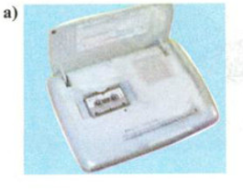
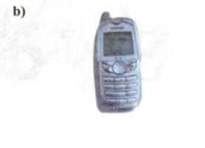
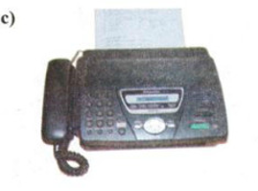

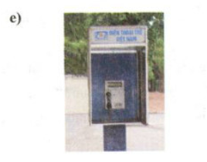
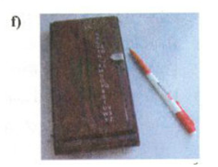
MATCHING
a fax machine
an address book
a telephone directory
a public telephone
a mobile phone
an answering machine
an answering machine
a mobile phone
a fax machine
a telephone directory
a public telephone
an address book

Slide 3
Thursday, September 23rd , 2021
Unit 2: MAKING ARRANGEMENTS
Lesson: Getting started & Speak
I. Vocabulary
- an answering machine (n)
: máy trả lời tự động
- a mobile phone (n)
: điện thoại di động
- a fax machine (n)
: máy fax
- a public telephone (n)
: điện thoại công cộng
- a telephone directory (n)
: danh bạ điện thoại
- an address book (n)
: sổ tay thông tin liên lạc
- arrange (v)
: sắp xếp, thu xếp
→ Making arrangements: lên kế hoạch
- hold on (v)
: chờ máy, chờ chút
- introduce (v)
: giới thiệu
- agree # disagree (v)
: đồng ý # không đồng ý

Slide 4
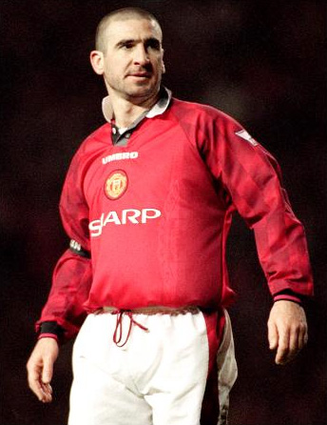
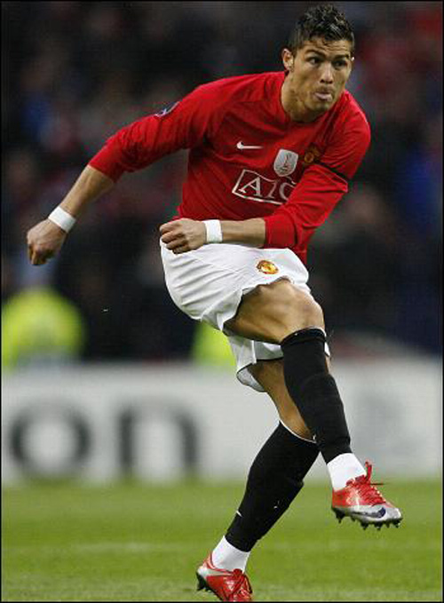
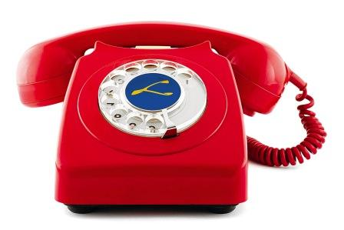
Speak
Dialogue:
Eric
adam

Slide 5
1. Put the sentences in the correct order to make a complete conversation
4
a) I’m fine. I’m going to a pop concert at the City Concert Center tonight. Would you like to come?
b) Hello, 9 210 752
c) It’s The Kids in Town. You like it, don’t you?
d) Bye
e) Yes. What time can we meet?
f) Hello. Can I speak to Eric, please? This is Adam.
g) That’s fine. See you at 7.15. thank you, Adam.
h) Bye, Eric
i) Which band is it?
j) Hello, Adam. How are you?
k) Is 7.15 OK? The concert starts at 7.45. Let’s meet inside the center, at the café corner.
1
6
11
7
2
9
10
5
3
8

Slide 6
Speak
Eric: Hello, 9 210 752
Adam: Hello. Can I speak to Eric, please? This is Adam.
Eris: Hello, Adam. How are you?
Adam: I’m fine. I’m going to a pop concert at the City Concert Center tonight. Would you like to come?
Eric: Which band is it?
Adam: It’s The Kids in Town. You like it, don’t you?
Eric: Yes. What time can we meet?
Adam: Is 7.15 OK? The concert starts at 7.45. Let’s meet inside the center, at the café corner.
Eric: That’s fine. See you at 7.15. thank you, Adam.
Adam: Bye, Eric
Eric: Bye

Slide 7
2. Complete the dialogue (SGK/ 20, 21)
Ba: Hello, 8 257 012
Bao:
Ba: Hello, Bao. How are you?
Bao:
Ba: Great. Me too.
Bao:
Ba: I’m sorry. I can’t play chess tonight. I’m going to do my homework.
Bao:
Ba: Yes. Tomorrow afternoon is fine.
Bao:
Ba: At the Central Chess Club? OK. Let’s meet at the front door.
Bao:
Ba: Great. See you tomorrow afternoon at 2.00 o’clock.
Hello. Can I speak to Ba, please? This is Bao.
I’m fine. Thanks. How are you?
Can you play chess tonight?
What about tomorrow afternoon?
I’ll meet you at the Central Chess Club
Is 2.00 OK?

Slide 8
Monday, September 27th , 2021
Unit 2: MAKING ARRANGEMENTS
Read
I. Vocabulary
Scotsman (n):
emigrate (v):
→ emigration (n):
→ emigrant (n):
deaf-mute (n):
patient (n):
patient (adj):
transmit (v):
experiment (v):
experiment (n):
người Scotland
xuất cảnh, di cư
sự di cư
người di cư
tật vừa câm vừa điếc
bệnh nhân
kiên nhẫn
truyền tín hiệu
làm thí nghiệm
cuộc thí nghiệm

Slide 9
speech (n):
invent (v):
→ invention (n):
→ inventor (n):
distance (n):
lead to (v):
assistant (n):
conduct (v):
device (n):
message (n):
demonstrate (v):
→ demonstration (n):
→ demonstrator (n):
countless (adj):
exhibition (n):
commercial (adj):
giọng nói, lời nói
phát minh
sự phát minh
người phát minh
khoảng cách
dẫn đến
người giúp đỡ, phụ tá
thực hiện, tiến hành
thiết bị, dụng cụ, máy móc
thông điệp, lời nhắn
trình bày
sự trình bày
người trình bày
vô số, rất nhiều
cuộc triển lãm
buôn bán, thương mại

Slide 10
II. Complete the sentences with the suitable words in the box.
invention exhibition was born emigrated deaf – mutes countless
exhibition
1. There is a photo ..……............ in Van Ninh today.
2. Neil Amstrong, the first person went on the moon, …..……....... in the USA.
3. Lan ………………… to England to live with her father.
4. You can’t count hair on your head because there is …………….... hair.
5. Alexander G. Bell was a famous inventor. His ……….……… is the first telephone.
6. Peter and Tom are ………………… They can’t speak and hear.
was born
emigrated
countless
invention
deaf-mutes

Slide 11

1/22 (SGK): True or False?
T
F
Edinburgh, Scotland.
a. Alexander G. Bell was born in the USA.
b. He worked with deaf-mute patients in a hospital in Boston.
at Boston University.
c. Thomas Watson was Bell’s assistant.
d. Bell and Watson introduced the telephone in 1877.
1976.
e. Bell experimented with ways of transmitting speech
between deaf-mutes over a long distance.
between deaf-mutes
f. Bell demonstrated his invention at a lot of exhibitions.

Slide 12
2/22 (SGK): Put the events in the correct order
Alexander Graham Bell … a) went to live in the United States b) successfully demonstrated his invention. c) worked with Thomas Watson. d) was born in Scotland. e) went to live in Canada f) invented the telephone. g) worked with people who could neither speak nor hear
3-
6-
5-
1-
2-
7-
4-

Slide 13
3. Answer the questions.
1. When was Alexander Graham Bell born?
→ He was born on March 3, 1847.
2. Where was he born?
→ He was born in Edinburgh.
3. Was he a Scotsman ?
→ Yes, he was.
4. Who did he work with at Boston University?
→ He worked with deaf-mutes at Boston University.
5. When did he invent the first telephone?
→ He invented the first telephone in 1877.

Slide 14
Monday, September 27th , 2021
Unit 2: MAKING ARRANGEMENTS
Language Focus
II. Grammar:
1. “Be going to-infinitive”:
Usage:
A. Dùng để chỉ dự định hoặc kế hoạch trong tương lai.
Ex: We bought the tickets and we are going to spend our holiday in Nha Trang this year.
(Chúng tôi đã mua vé và năm nay chúng tôi sẽ đi nghỉ ở Nha Trang.)
Ex: Mary saved enough money and she is going to buy a new dress.
(Mary đã tiết kiệm đủ tiền và cô ấy sẽ mua một cái đầm mới.)
Khẳng định: S + am/is/are + going to + V_{bare} Phủ định: S + am/is/are (not)+ going to + V_{bare} Nghi vấn: Am/is/are + S + going to + V_{bare}?

Slide 15
B. Dùng để nói về dự đoán chắc chắn xảy ra
Ex: Look, there are lots of dark clouds in the sky. I think it is going to rain.
(Nhìn kìa, có rất nhiều mây đen trên bầu trời, tôi nghĩ trời sẽ mưa đấy.)
Ex: Lan is having a bad cold. I think she is going to be absent today.
( Lan đang bị cảm lạnh, tôi nghĩ cô ấy sẽ vắng mặt ngày hôm nay)

Slide 16
→ They are going to go fishing.
1/25 (SGK). Work with a partner. Say what the people are going to do.
a. Quang and Nam bought new fishing rods yesterday.
b. Trang’s mother gave her a new novel this morning and she has no homework today.
→ She is going to read a new novel.
c. Van has a lot of homework in Math and she is going to have Math at school tomorrow.
→ She is going to do her homework in Math.
d. Mr. Hoang likes action movies very much and there’s an interesting action movie on TV tonight.
→ He is going to watch an action movie on TV tonight.
e. Hien’s friend invited her to his birthday party.
→ Hien is going to give him a birthday present.

Slide 17
2. Adverbs of place: Trạng ngữ chỉ nơi chốn
- here (ở đây) ≠ there (đằng kia)
- inside (ở trong) ≠ outside (ở ngoài)
- upstairs (trên lầu) ≠ downstairs (dưới lầu)
Ex: We live here.
It’s there, right in front of you!
The guests had to move inside when it started to rain.

Slide 18
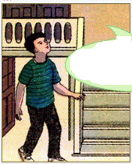
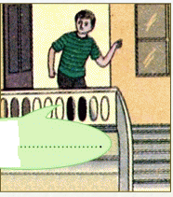
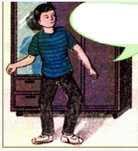
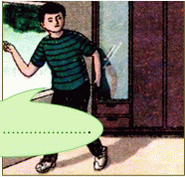
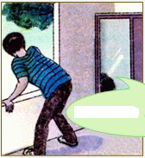
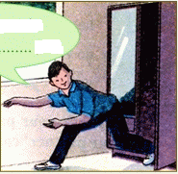
3/26 (SGK). Complete the speech bubbles. Use each adverb in the box.
Ba is playing hide and seek with his cousin, Tuan.
outside
inside
there
here
upstairs
downstairs
a)
b)
c)
He isn’t
…...............and he isn’t upstairs.
Where is Tuan?
I think he’s
.…………
No, he isn’t ...............
d)
e)
f)
I’m not outside.
I’m ............, Ba
No, he isn’t
............
Perhaps he’s .................

Slide 19

Học thuộc từ vựng và ngữ pháp
Chuẩn bị Unit 3_Getting Started + Read

