Slide 1

UNIT 2
LANGUAGE FOCUS

Slide 2

01
WARM UP ACTIVITY

Slide 3
PRESENT PERPECT

Slide 4
Form:
S+ have/has + V3/V(ed)….
S+ have/has +not+ V3/V(ed)….
have/has +S+ V3/V(ed)….?
Nga: Come and see my photo album.
Nam: Lovely! Who’s this girl?
Nga: Ah! It’s Lan, my old friend.
Nam: How long have you made friend with her?
Nga: I’ve made friend with her for six years.
Nam: Have you seen her recently?
Nga: No, I haven’t seen her since 2003.
How long have you made friend with her?
I have made friend with her for six years.
I haven’t seen her since 2003.

Slide 5

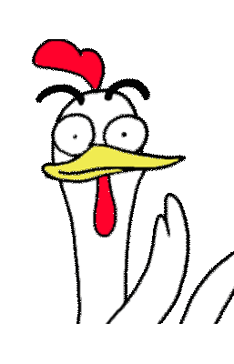
Practice:
https://create.kahoot.it/share/unit2-grade-9/4a2abd7f-c9c6-4a43-b7d3-ddbd37efcdc0

Slide 6


PASSIVE VOICE

Slide 7

1/ Simple present tense.
They grow rice in tropical countries
Active : S + Vs/ es + O ………
is grown in tropical country
Rice……………………………………..
→ Passive: S + is / are / am + V3/( ed )+ by O

Slide 8

2/ Simple past tense.
They made jean cloth completely from cotton in the 18th century.
Active : S + Ved/ V2 + O ………
was made completely from cotton in the 18th
Jean cloth…………………………………………..
→ Passive: S + was/were + V3( ed ) + by O

Slide 9

3/ Present perfect tense
They have just introduced a new style of jeans in the USA
Active : S + have / has +V3(ed) + O ………
has just been introduced in the USA
A new style of jeans……………………………………….
→ Passive: S + have /has + been + V3( ed )+ by O

Slide 10

4/modal verbs, have to, be going to
We can solve the problem.
Active : S + MD + V (inf) + O ………
can be solved by us.
The problem……………………………….
Passive: → S + MD + be + V3( ed )+ by O

Slide 11

Practice
https://create.kahoot.it/share/4-test-yourself-on-the-passive-voice/edca1554-c36c-4484-81fc-ba93676af260

Slide 12


