Slide 1


Slide 2


Slide 3

COUNTDOWN !!
0
1
2
3
4
5
6
7
8
9
10
11
12
13
14
15
16
17
18
19
20
21
22
23
24
25
26
27
28
29
30
31
32
33
34
35
36
37
38
39
40
41
42
43
44
45
46
47
48
49
50
51
52
53
54
55
56
57
58
59
60

Slide 4
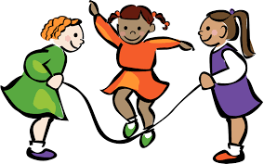
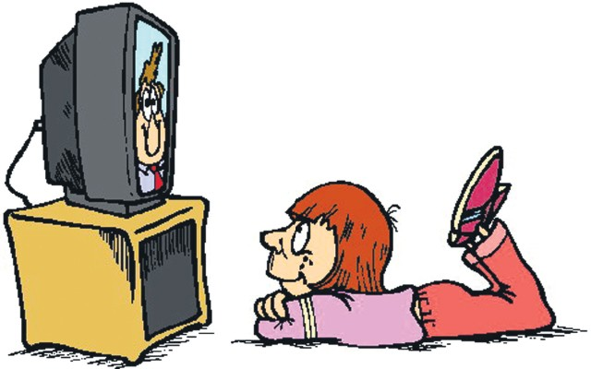

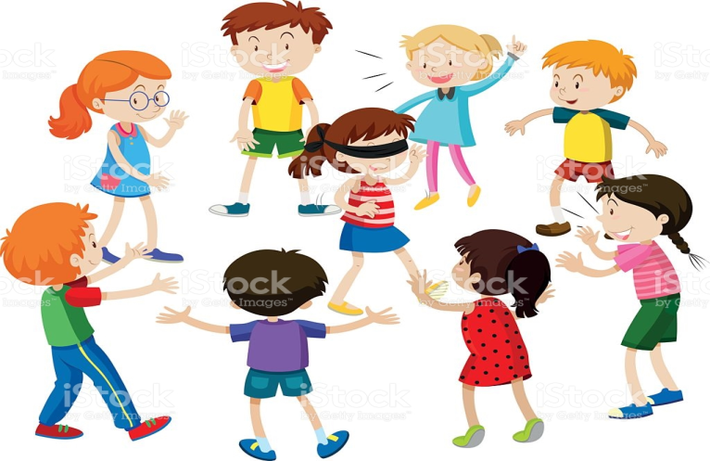
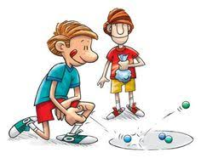
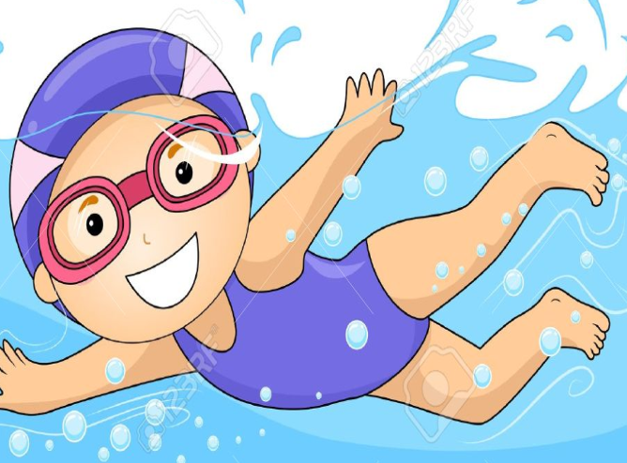
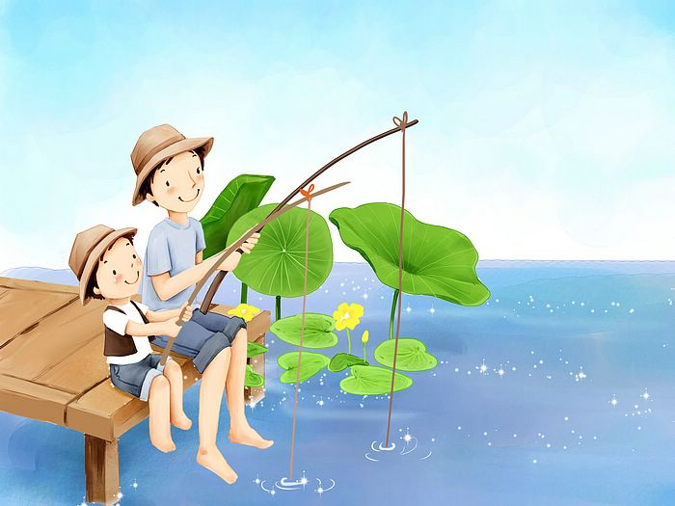

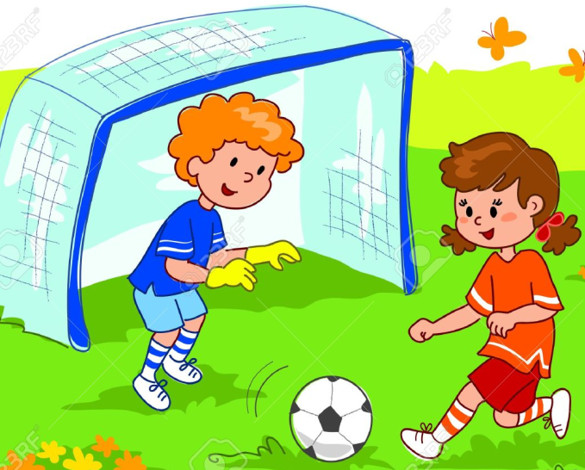
SKIP ROPE
WATCH TV
READ BOOK
PLAY BLINDMAN’S BLUFF
PLAY MARBLES
SWIM
GO FISHING
CHAT
PLAY SOCCER

Slide 5
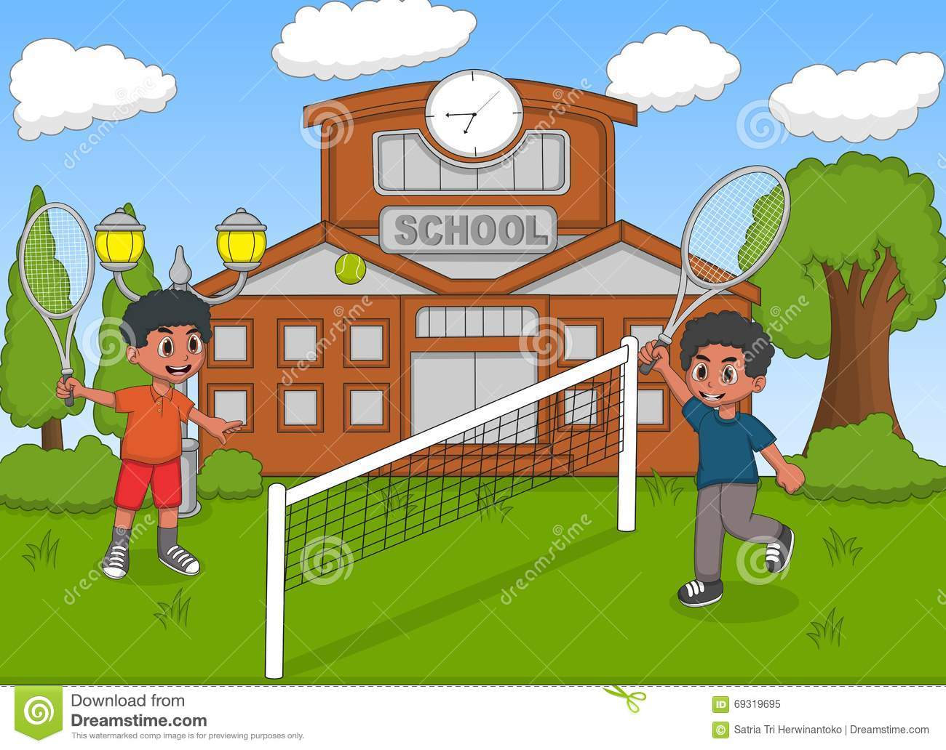

Unit 6. after school
A
What do you do?

Slide 6

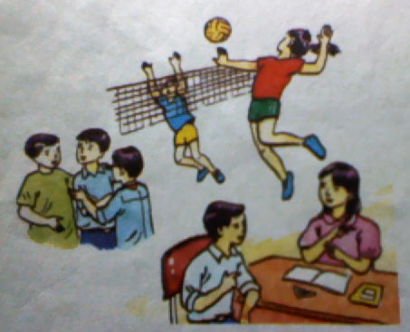
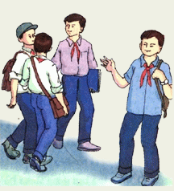
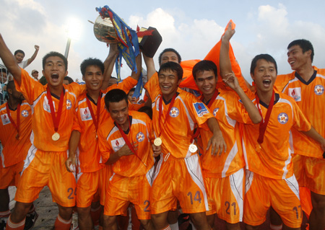
Unit 6 : AFTER SCHOOL Lesson 1 : A- What do you do? A1 ( page 60 - 61)
I. New words:
1. Listen. Then practice with a partner.
(to) invite:
mời
Minh: Hello, Hoa. What are you doing? Hoa: Hi, Minh. I’m doing my math homework. Minh: You work too much, Hoa. You should relax. It’s half past four and tomorrow is Sunday. Hoa: OK. What should we do? Minh: Let’s go to the cafeteria and get a cold drink. Hoa: Good idea! Where is Ba? Let’s invite him, too. Minh: Oh, Ba is in the music room. He’s learning to play the
guitar. He practices everyday after school. Hoa: Minh, what do you usually do after school? Minh: I usually meet my friends. We often do our homework
together . Hoa: Do you play sports? Minh: Oh, yes. I play volleyball for the school team .We always need more players. Why don’t you come along ? Hoa: Yes, maybe I will. I enjoy playing volleyball.
(to) practice:
luyện tập
Together (adv) :
cùng nhau
Team (n) :
đội
(to) come along:
đi cùng
Maybe ( adv ) :
có lẽ
invite
practices
Hoa
together
team
come along
maybe
Minh

Slide 7
Unit 6 : AFTER SCHOOL Lesson 1 : A- What do you do? A1 ( page 60 - 61)
I. New words:
Matching :
(to) invite:
(to) practice:
Together (adv):
Team (n) :
(to) come along:
Maybe ( adv ) :
có lẽ
mời
đi cùng
đội
cùng nhau
luyện tập

Slide 8

II.Model sentences
Advice (lời khuyên):
Ex: You should relax.
You should sleep before 10 p.m.
You should get up early.
You shouldn’t smoke.
Should/ Shouldn’t + V (nên/không nên...)

Slide 9
2. Suggestion (lời đề nghị)
Ex: Let’s go fishing
Let’s listen to music
Let’s + V...(chúng ta hãy...)
Ex: Why don’t you come along?
Why don’t you do your homework?
Why don’t you + V...?
(tại sao bạn không....?)

Slide 10
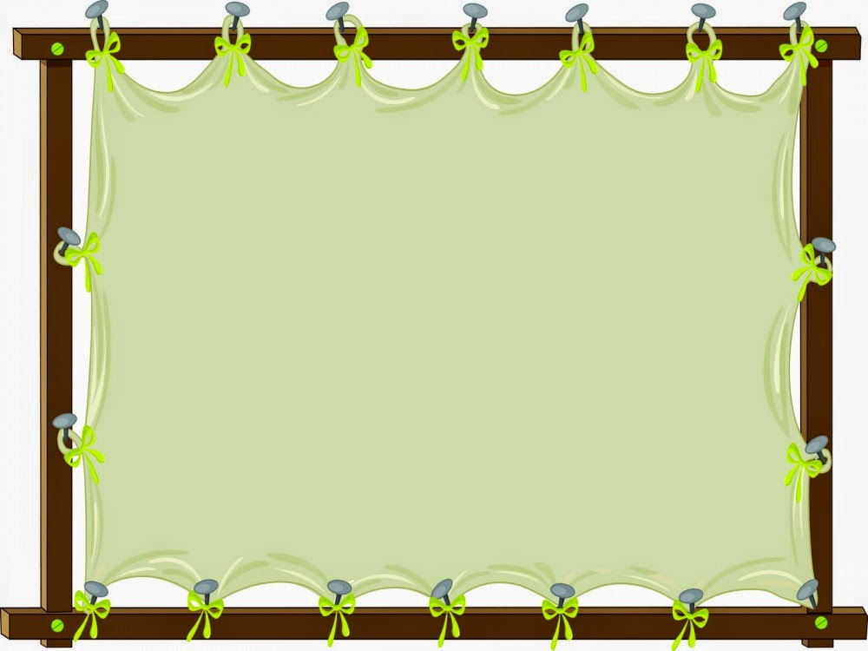
How can we reply?
Agree
OK
Good idea!
Great!
Disagree
Sorry, I can’t..
I afraid I can’t....

Slide 11
Write advice and suggestion for these sentences:
It’s hot.
→ Let’s
2. It’s 12:00. I’m so hungry.
→Why don’t you
3. I go to bed at 11 p.m.
→You should
4. I have got a toothache.
→You shouldn’t
go swimming
have lunch?
go to bed early.
eat a lot of candies

Slide 12
1. Listen. Then practice with a partner
Minh: Hello, Hoa. What are you doing? Hoa: Hi, Minh. I’m doing my math homework. Minh: You work too much Hoa. You should relax.
It’s half past four and tomorrow is Sunday. Hoa: OK. What should we do? Minh: Let’s go to the cafeteria and get a cold drink. Hoa: Good idea! Where is Ba? Let’s invite him, too. Minh: Oh, Ba is in the music room. He’s learning to
play the guitar. He practices everyday after school. Hoa: Minh, what do you usually do after school? Minh: I usually meet my friends.
We often do our homework together. Hoa: Do you play sports? Minh: Oh, yes. I play volleyball for the school team. We always need more players. Why don’t you come along? Hoa: Yes, maybe I will. I enjoy playing volleyball.

Slide 13
1. T/ F statements
Hoa is doing her English homework.
b. Minh wants to go to the cafeteria.
c. Ba is in the living room.
d. Hoa likes playing volleyball.
F
→ Hoa is doing her Math homework.
T
F
→ Ba is in the music room.
T

Slide 14
5
4
3
1
0
2
Answer the question
What is Hoa doing ?
…………
⬧
A
She is watching TV.
B
She is reading books.
C
She is doing her math homework.
Notes:
14

Slide 15
5
4
3
1
0
2
Answer the question
b. What are Minh and Hoa going to do ?
………..
⬧
A
They are going to get a cold drink in the cafeteria.
B
They are going to play video games.
C
They are going to see a movie.
Notes:
15

Slide 16
5
4
3
1
0
2
Answer the question
c. Where is Ba ?
……….
⬧
A
He's in the classroom.
B
He's in the movie theater.
C
He's in the music room
Notes:
16

Slide 17
5
4
3
1
0
2
Answer the question
d.What is he doing ?
……………
⬧
A
He's learning English.
B
He's learning to play the guitar.
C
He's listening to music.
Notes:
17

Slide 18
5
4
3
1
0
2
Answer the question
e. What does Minh do after school ?
……………
⬧
A
He usually plays soccer.
B
He usually watches T.V.
C
He usually meets his friends.
Notes:
18

Slide 19
5
4
3
1
0
2
Answer the question
f. What sports does Hoa like playing?
……………
⬧
A
She likes playing volleyball.
B
She likes playing soccer.
C
She likes playing tennis.
Notes:
19

Slide 20
Complete the summary
Period 33: Unit 6 : AFTER SCHOOL Lesson 1 : A- What do you do? A1 ( page 60 - 61)
What do you do after school?
half past four
Minh meets Hoa at (1) ……………… in the afternoon on Saturday.
is doing her (2) …… homework. Minh invites Hoa to go to the
(3) ………… and get a cold drink.
After school, Ba practices playing the (4) ……… in the music room, and
Minh usually (5) ……… his friends. Hoa enjoys playing (6) ……….........
math
cafeteria
guitar
meets
volleyball

Slide 21
* Choose the best answer.
Period 31: Unit 6 : AFTER SCHOOL Lesson 1 : A- What do you do? A1 ( page 60 - 61)
Why don/t we …… to school now ?
A. go B. going C. goes D. went
2. Should we ……… a song now ?
A. sang B. to sing C. sings D. sing
3. Let/s …….. in and play some computer games.
A. coming B. come C. came D. comes
4. Why don/t we go swimming ?
A. Not B. I don/t like C. Sorry very much D. Ok
5. What are you doing ? – We are ………… English.
learning B. learned C. learnt D. to learn
6. Let/s try to learn English well.
A. Yes, I maybe B. I/d like C. That’s great idea. D. Yes, I do

Slide 22
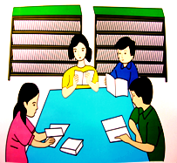
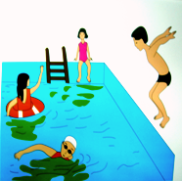
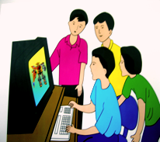
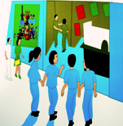
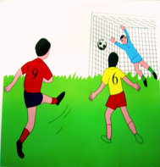
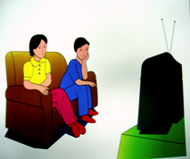
Unit 6. After school – Lesson 2. A2
A 2. PRACTICE WITH A PARTNER.
* Look at these activities. Label the pictures.
1
2
3
1.
2.
3.
Reading/ studying
in the library
Swimming in the pool
Playing computer games
4
5
6
4.
Going to the movies
5.
Playing soccer
6.
Watching TV

Slide 23
Unit 6. After school – Lesson 2. A2
A2b. Write a sentence for each day of the week. Use these adverbs:
A2. b) Ask and answer.
always usually often sometimes never
What do you usually do after school?

Slide 24
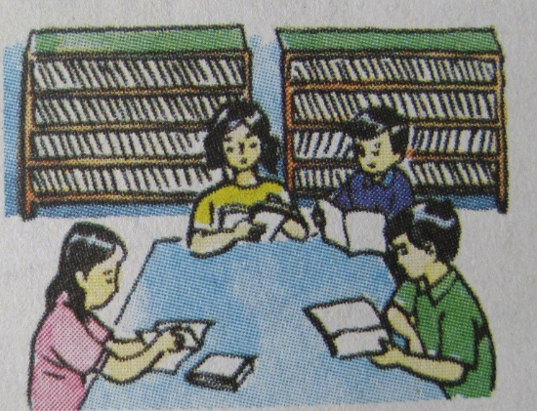
Unit 6. After school – Lesson 2. A2
A2b. Write a sentence for each day of the week. Use these adverbs:
A2b. Write a sentence for each day of the week. Use these adverbs:
A2. b) Ask and answer
always usually often sometimes never
On Mondays, I often do my homework with Hoa after school.
On Tuesdays, I sometimes go swimming with my friends after school.
On Wednesdays, I never…………….
*Now ask and answer questions using “How often....?”
EX:-What do you do after school?
- I study in the library.
How often do you study in the library after school?
B. I always/ usually/ sometimes study in the library after school.

Slide 25


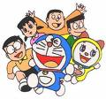

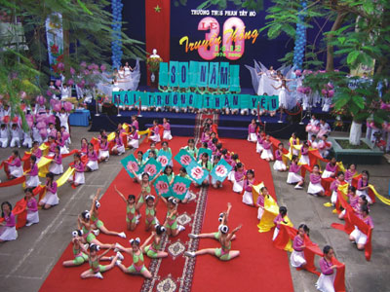

Unit 6: AFTER SCHOOL Lesson 2 : A3
1. Vocabulary:
Truyện Đô-rê mon
- rehearse (v) :
diễn tập
- anniversary (n) :
lễ kỉ niệm
- comic (n):
truyện tranh
- collect (v) :
thu nhặt, thu gom
- sporty (a):
yêu thể thao
Lịch tập buổi tối
- pastime (n):
trò tiêu khiển

Slide 26
2.True / false statements.
Nga, Ba and Hoa are students in class 7A.
2. Nam isn’t very sporty.
3. Nga’s favorite pastime is jogging.
4. Ba likes collecting stamps.
5. Liz gives Nga a lot of American stamps
6. Nam usually watches TV.

Slide 27
The students of class 7A enjoy different activities after school hours.
Acting is Nga’s favorite pastime. She is a member of the school theater group. At present, her group is rehearsing a play for the school anniversary celebration
Ba is the president of the stamp collector’s club. On Wednesday afternoon, he and his friends get together and talk about their stamps. If they have any new stamps, they usually bring them to school. Ba’s American friend, Liz, gives him a lot of American stamps.
Nam is not very sporty. In the afternoon, he usually goes home and watches videos. Sometimes she reads a library book or comics, but most of the time he lies on the couch in front of the TV. He never plays games.

Slide 28
True / false statements.
Check
Nga, Ba and Hoa are students in class 7A.
2. Nam isn’t very sporty .
3. Nga’s favorite pastime is jogging.
4. Ba likes collecting stamps.
5. Liz gives Nga a lot of American stamps
6. Nam usually watches TV.
T
T
F
acting
T
F
Ba
T

Slide 29
The students of class 7A enjoy different activities after school hours.
Acting is Nga’s favorite pastime. She is a member of the school theater group. At present, her group is rehearsing a play for the school anniversary celebration
Ba is the president of the stamp collector’s club. On Wednesday afternoon, he and his friends get together and talk about their stamps. If they have any new stamps, they usually bring them to school. Ba’s American friend, Liz, gives him a lot of American stamps.
Nam is not very sporty. In the afternoon, he usually goes home and watches videos. Sometimes she reads a library book or comics, but most of the time he lies on the couch in front of the TV. He never plays games.

Slide 30




*Questions
a. What is Nga’s theater group doing?
b. How does Ba get American stamps?
c. When does the stamp collector's club meet?
d. How often does Nam play games?

Slide 31
a. What is Nga’s theater group doing?
Her group is rehearsing a play for
the school anniversary celebration.

Slide 32




b. How does Ba get American stamps?
Ba gets American stamps from Liz,
his American friend.

Slide 33



c. When does the stamp collector's
club meet?
The stamp collector's club meets on
Wednesday afternoon.

Slide 34



d. How often does Nam play games?
He never plays games.

Slide 35
HOMEWORK
Learn new words by heart.
Redo EX A1, A2.
-Practice asking and answering, using structure “How often...?”

