Slide 1
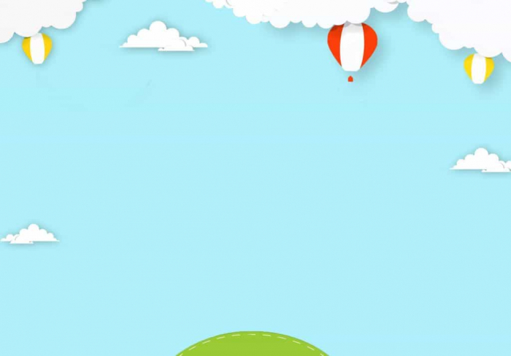
Unit 6
Period 34
After School
B1: Let’s go!

Slide 2


Slide 3
Students look at the following items and tell the job

Slide 4

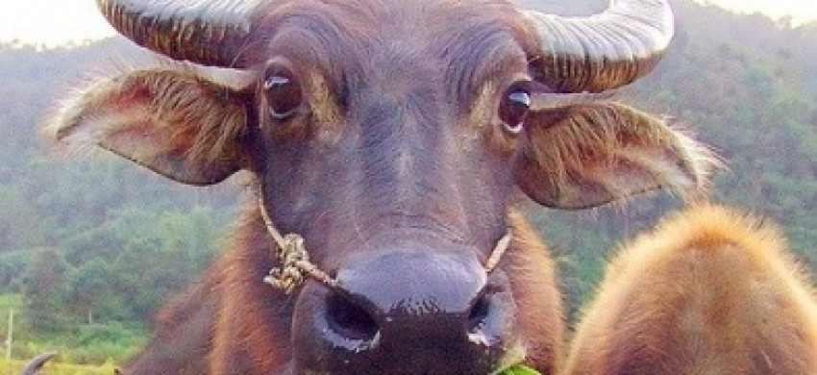


Slide 5
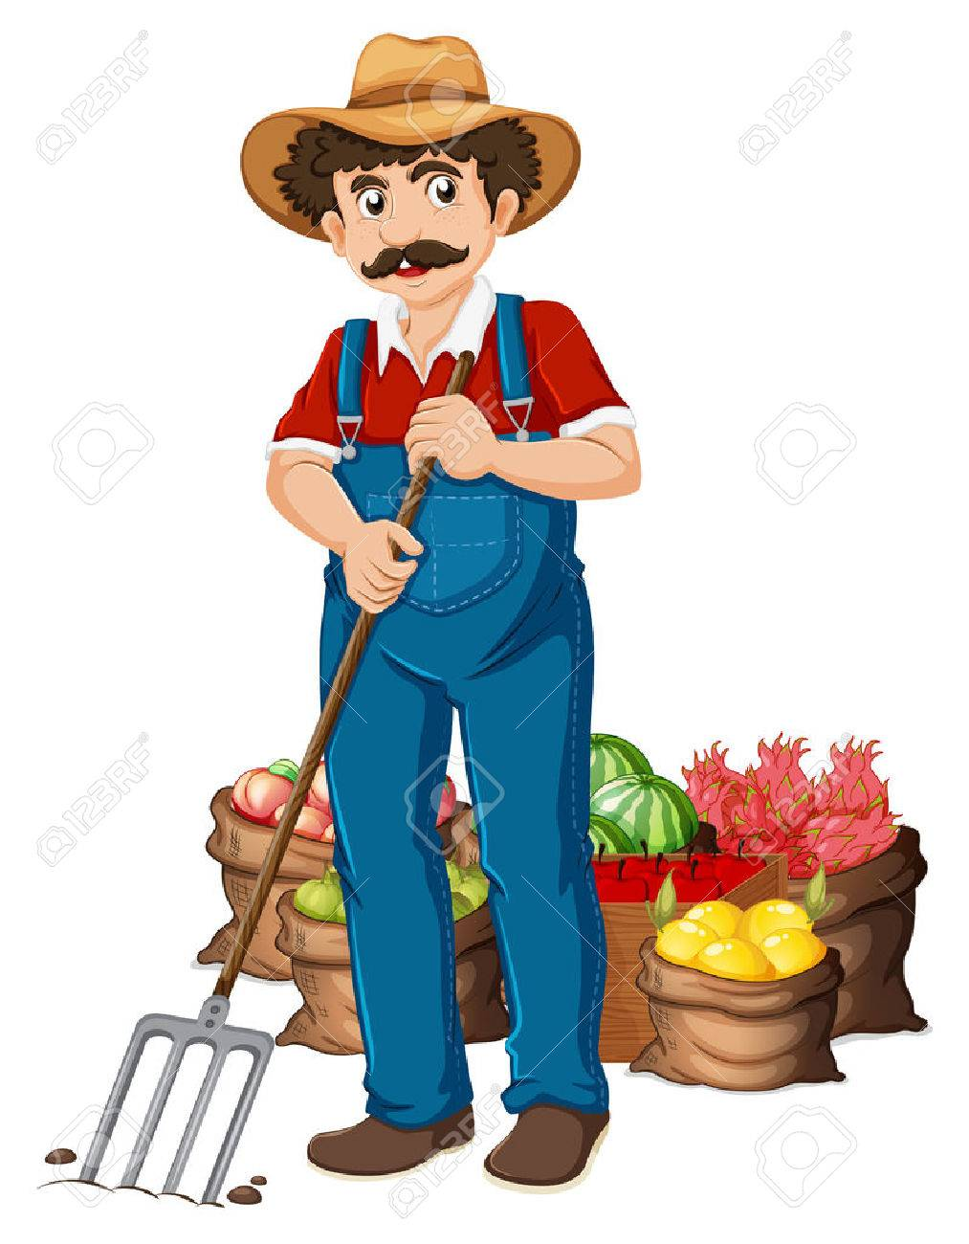

Slide 6
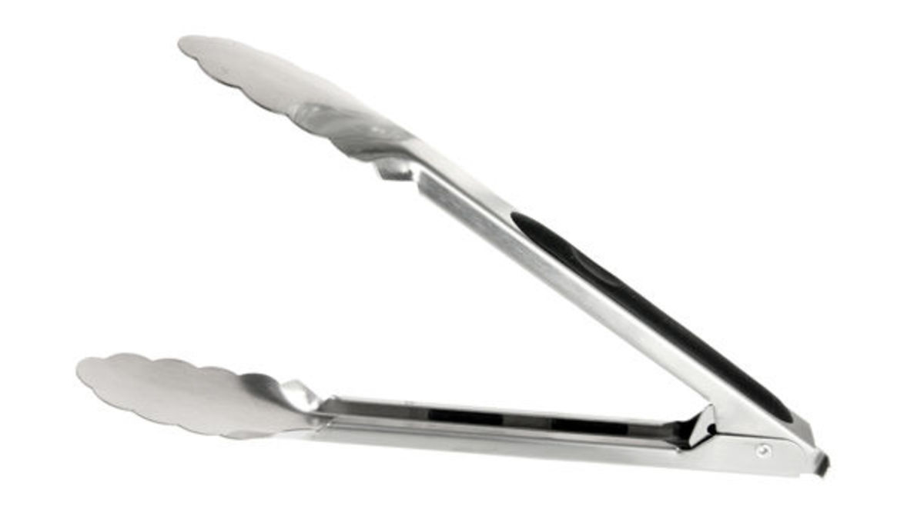
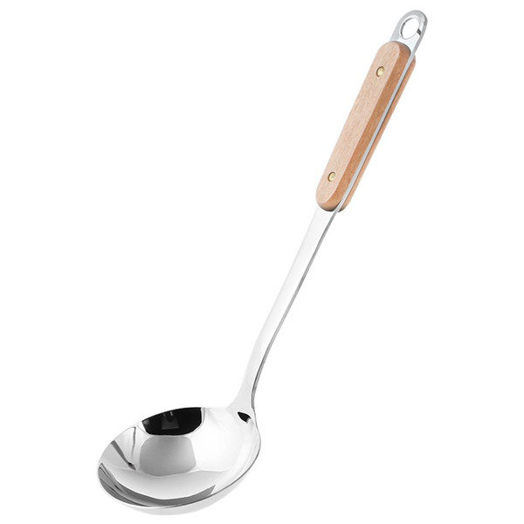


Slide 7


Slide 8


Slide 9

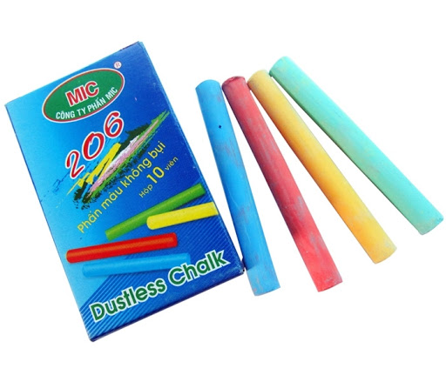
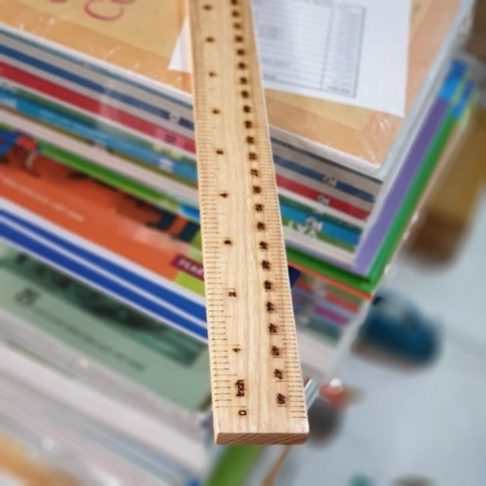

Slide 10


Slide 11


Unit 6
Period 34
After School
B1: Let’s go!

Slide 12
Introduce the new words

Slide 13

assignment

Slide 14

relax

Slide 15


Slide 16
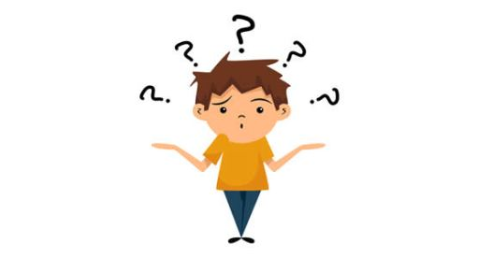
Come on

Slide 17

UNIT 6: AFTER SCHOOL
B1: Let’s go!
1. Vocabulary
- (an) assignment
= homework: bài tập về nhà
relax
Thư giãn
- Come on:
Đi nào
fun
Thư giãn

Slide 18
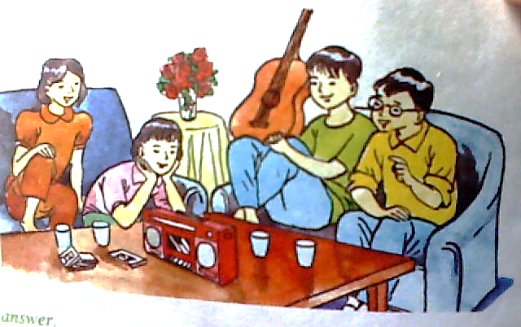
Who are they ?
Nam
Hoa
Ba
Lan

Slide 19

X
X
X
X
X
Listen. Then answer True (T) or False (F)?
Statements | True | False
a. Nam wants to go to the movies. b. There are some good movies on at the moment. c. Lan wants to listen to some music at her house. d. Hoa doesn’t have too many assignments. e. Today is Sunday.

Slide 20

UNIT 6: AFTER SCHOOL
B1: Let’s go!
Vocabulary
Listen. Then practice in groups of four
Ba : What should we do this evening?
Nam: What about going to the movies?
Lan: There aren’t any good movies
on at the moment. Let’s go to
my house. We can listen to
some music.
Hoa: I’m sorry, Lan. I can’t come. I have too man assignments.
Nam: Hoa! It is Sunday tomorrow. Why don’t you relax ?
Ba: Come on. Let’s go to Lan’s house.
Lan: Are you going to come, Hoa? It’ll be fun.
Hoa: Ok. I’ll come. Thanks.
Nam: Great ! Now you ‘re learning to relax.
listen

Slide 21
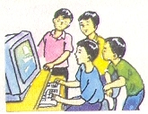
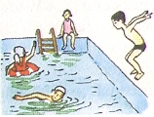
UNIT 6: AFTER SCHOOL
B1: Let’s go!
1. Vocabulary
2. Listen. Then practice in groups of four
3. Model sentences :
Suggestions:
+ Responses :
Agree :
- Good idea !
Disagree :
- Sorry, I can’t.
- No, I don’t like
What about + V- ing + ... ?
- Yes, Let’s.
Ok. I’ll come.
Great
Let’s + infinitive + .....
Why don’t you + infinitive ?
* Practice:
1. S1 : Let’s go swimming.
play badminton
a, Word cue drill:
S 2 :Yes, let’s / good idea !
b, Make suggestions using the pictures:
2. S1 : Why don’t you join us ?
S2 : Sorry, I can’t
3. S1 : Let’s study in the library.
S2 : Yes, let’s
4. S1: What about watching TV ?
S2 : No, I don’t like
1. Let’s / go/ swimming v
2. Why /join / us ? x
3. Let’s / study / library. v
4. What / watch / T V ? x

Slide 22

UNIT 6: AFTER SCHOOL
B1: Let’s go!
1. Vocabulary.
2. Listen. Then practice in groups of four.
3. Model sentences.
4. Answer
c. What does Lan want to do?
b. Why doesn’t Lan want to go to the movies?
d. Why doesn’t Hoa want to go to Lan’s house?
a. What does Nam want to do?
e. What day is it?
He wants go to the movies.
Because she has too many assignments
Because there aren’t any good movies on at the moment.
She wants to listen to some music at her house
It’s Saturday

Slide 23

The answers:
He wants to go to the movies.
Because there aren’t any good movies on at the moment.
She wants to listen to some music.
Because Hoa has too many assignments.
It is Saturday.

Slide 24

- Learn by heart new words.
- Write 5 sentences with: Let’s + V (bare infinitive)
Why don’t we / you + V (bare infinitive) ?
- Prepare: unit 6 – B 2- page 65

Slide 25

LANGUAGE
FOCUS 2 .

Slide 26
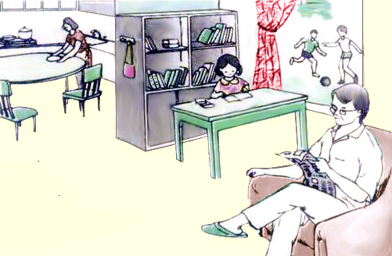
1.Complete the passage:
It is six thirty in the evening. Lan (do) …...…............ her homework. She (write) ……...…… an English essay.
Liem and Tien
Mrs Quyen
is doing
LAN
is writing
Mr Thanh
Mr.Thanh (read)……………. a newspaper and Mrs. Quyen (cook) ……………… dinner.
is reading
is cooking
are playing
Liem and Tien, Lan’s brothers, (play) ……………… soccer in the back yard. Liem (kick) ………………the ball and Tien (run) …………………after it.
is kicking
is running
What is Mrs. Quyen doing?
What is Mr. Thanh doing?
What is Lan doing?
What are Liem and Tien doing?
_She is doing her homework.
- She is cooking dinner.
- They are playing soccer.
-He’s reading a newspaper.

Slide 27
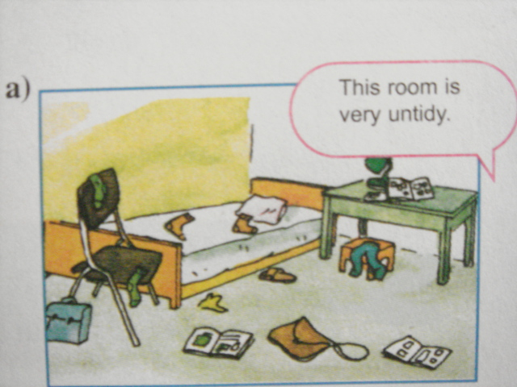


2
This / that, these / those
This room is very untidy.

Slide 28
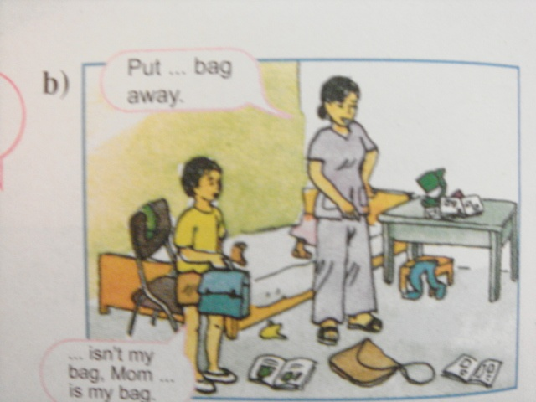

Gap-fill
Put…………… bag away
this
………. isn’t my bag. Mom. …………is my bag.
That
This

Slide 29
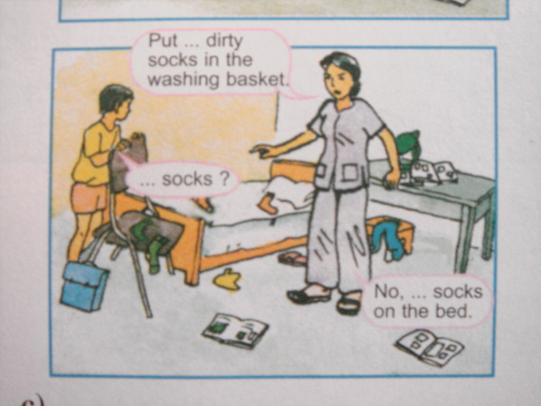
Gap-fill
Put …………..dirty socks in the washing basket.
those
.………. socks ?
These
No, …………. socks on the bed.
those

Slide 30
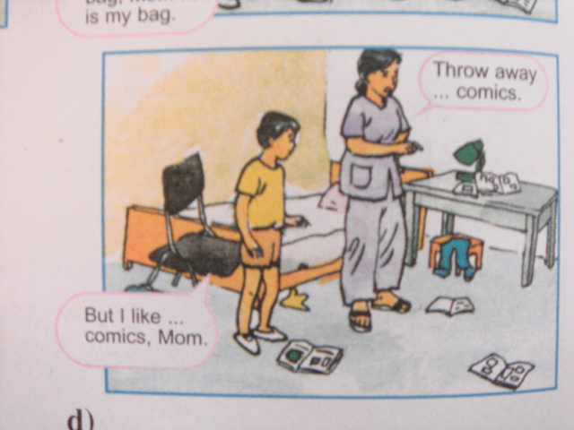

Gap-fill
Throw away…………… comics
those
But I like …………. comics, Mom.
these

Slide 31

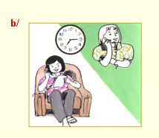
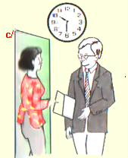
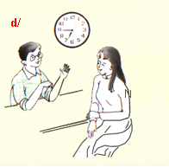
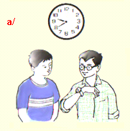
3.Telling the time
Miss Lien: Can you come to school early tomorrow ?
Nam : Yes, Miss Lien. I’ll come at .……………………………………………..
Mrs. Quyen: Will you be home for dinner tonight?
Mr. Thanh: No. I’ll be home at ………………………………
Lan : What time does the movie start ?
Hoa : It starts at ..............................................
Ba: What time is it ?
Nam: It’s nine forty.
It’s twenty to ten.
fifteen to seven
six forty-five
haft past ten
fifteen past seven

Slide 32
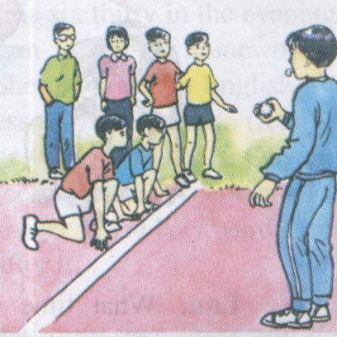
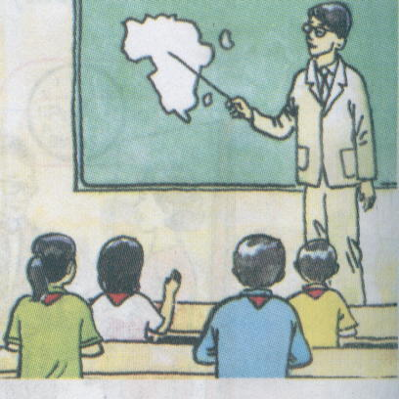
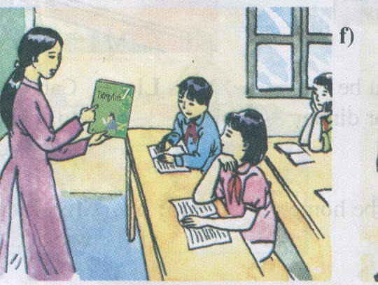
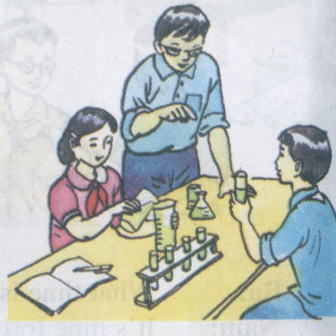
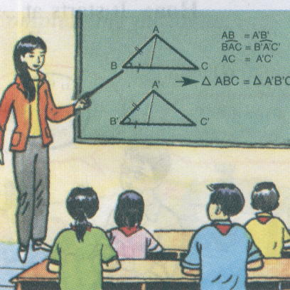
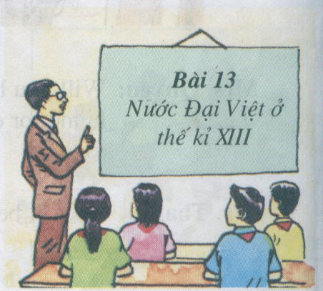
4.Vocabulary: Subjects
1
2
3
Physical Education
Geography
English
4
5
6
Chemistry
Math
History

Slide 33
5. Adverbs of frequency
 | Mon | Tues | Wed | Thurs | Fri | Sat | Sun
Go cafeteria
Ride bike to school | V
Practice guitar after school | V | V | V | V | V | V | V
Do homework evening | V | V | V | V | V
Play computer games | V | V | V
* Write sentences about Ba
a. Ba never goes to the cafeteria at lunch time.
b. Ba .......................rides his bike to school.
seldom
always
c. He ...................practices playing the guitar after school.
usually
d. He .............does his homework in the evening.
e. He ...................plays computer games.
often

Slide 34


6.Making suggestions
Let’s Should we ? Would you like to..? | go play watch come | swimming✓ tables tennis✗ basketball✓ volleyball✓ movies✓ soccer✗ my house✗ | Ok I’m sorry, I can’t I’d love to

Slide 35
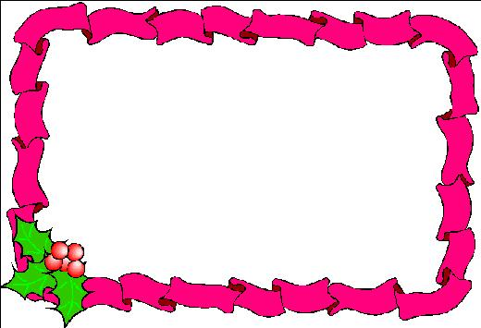
HOMEWORK
Learn new words and grammars by heart.
Do all exercises in Unit 6.
Prepare the next revision lesson.
+ The present simple/ progressive
+ The simple future/ near future.
+Suggestions.
+ Vocabulary.
- Revise : Unit 4 – Unit 6

Slide 36


