Slide 1


UNIT 7: THE WORLD OF WORK
LESSON 1 : A1

Slide 2

with their definitions
1. during (prep): throughout the course or duration of (a period of time)
2. (to) work hard: always doing a lot of work
3. (to) last: continue for a specified period of time
4. almost (adv): Near to in quantity or amount
5. school year (n) the months of the year during which school is open and attendance at school is required

Slide 3
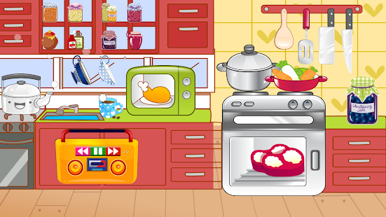
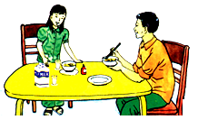
WHAT ARE THEY TALKING ABOUT ?

Slide 4

Uncle: Eat your breakfast, Hoa. It’s half past six. You’ll be late for school
Hoa: I won’t be late, uncle. I’m usually early. Our classes start at 7.00
Uncle: And what time do your classes finish?
Hoa: At a quarter past eleven. Then in the afternoon I do my homework. That takes about two hours each day.
Uncle: You work quite hard, Hoa. When will you have a vacation?
Hoa: Our summer vacation starts in June. It lasts for almost three months.
Uncle: What will you do during the vacation?
Hoa: I’ll go and see my Mom and Dad on their farm. I always like helping them. They work very hard, but we have fun working together.

Slide 5

Answer the questions
A. What time do Hoa’s classes start ?
B. What time do they finish ?
C. For how many hours a day does Hoa do her homework ?
D. What will Hoa do during her vacation ?
E. When does your school year start ?
F. When does your school year finish ?

Slide 6

Team A
Team B
1
2
3
4
10
20
30
40
50
10
20
30
40
50
5
6
7
8
page 16

Slide 7
What time do Hoa’s classes start ?
They start at 7 o'clock.

Slide 8
What will Hoa do during her vacation?
She’ll go and see Mom and Dad on their farm.
or: She’ll go and see her parents on their farm.

Slide 9



Slide 10
When does your school year start ?
It starts in August

Slide 11
For how many hours a day does Hoa
do her homework?
That takes two hours each day.

Slide 12
What time do Hoa’s classes finish?
They finish at
a quarter past eleven

Slide 14
When does your school year finish ?
It finishes in May.

Slide 15
Language notes
It takes Hoa two hours each day to do her homework.
+ Form:
It takes + someone + time + to do s.thing
Lan / Hoa / me / him / her / them / us

Slide 16
* Vocabulary:
Unit 7: THE WORLD OF WORK
Lesson 2: A2
A. A student’s work
A2. Read.Then answer the question.
‘
Independence Day (n)
Christmas ( n)
Easter ( n)
New Year’s Eve (n)
Thanksgiving (n)
: ngày Quốc Khánh
: lễ Giáng Sinh
: lễ Phục Sinh
: đêm giao thừa
: lễ Tạ Ơn
‘
‘
‘

Slide 17


A letter from America
June 1
Dear Hoa,
Hi! How are you? I'm fine. Thanks for your letter. I like hearing about how students live in Viet Nam. I find it really interesting
I think you have fewer vacations than American students. Is that true? Our longest vacation is in the summer. Do you have a long summer vacation, too? We don't have a Tet holiday, but we celebrate the New Year on January 1. Our most important vacations are Easter, 4th of July, Thanksgiving and Christmas. We usually spend time with our families on these vacations.
What other vacations do you have? What do you like doing during your vacations? Please write soon and tell me.
Your friend,
Tim

Slide 18
*Answer key for the questions
a. Summer vacation is the longest in America.
b. During his vacation, Tim spends time with his family.
c. Vietnamese students have fewer vacations than American students.

Slide 19
THE WORLD OF WORK
Lesson3: A student’s work ( A4 )
Unit 7:
Pre - reading
Pre – teach:
- life (n):
cuộc sống
- typical (adj):
điển hình
- review (v):
ôn tập
- definitely (adv):
chắc chắn
- lazy (adj):
lười biếng

Slide 20
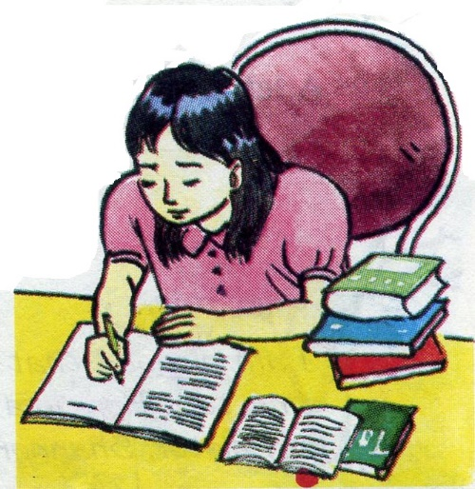
Open your book and read the text
Many people think that students have an
easy life : We only work a few hours a
day and have long vacations. They don’t
know we have to work hard at school and at home.
Take a look at a typical grade 7 student like Hoa. She has five periods a day, six days a week. That is about 20 hours a week - fewer hours than any worker. But that is not all. Hoa is a keen student and she studies hard. She has about 12 hours of work every week . She also has to review her work before tests. This makes her working week about 45 hours. This is more than some workers. Students like Hoa are definitely not lazy!

Slide 21
THE WORLD OF WORK
Lesson 3: A student’s work(A4 )
Unit 7:
Questions:
Why do some people think that students have an easy life?
b. How many hours a week does Hoa work ? Is this fewer than most workers ?
c. How many hours a week do you work ?
Is that more or fewer than Hoa ?
d. Does the writer think students are lazy ?

Slide 22
a. Why do some people think that students have an easy life ?
Because they only work a few hours a day and have long vacation

Slide 23
b. How many hours a week does Hoa work ? Is this fewer than most workers ?
Hoa works 20 hours a week. It is fewer than most workers’ work.

Slide 24
c. How many hours a week do you work ? Is that more or fewer hours than Hoa ?
I work about (15 hours a week).That is fewer than Hoa

Slide 25
d. Does the writer think students are lazy ?
No, he doesn’t

Slide 26

Model sentences:
- We only work a few hours a day.
- I want to drink a little milk.
Notes :
- a few + N (đếm được )
- a little + N ( không đếm được)

Slide 27
Post - reading
Discuss about your work:
a. How many hours a week do you work?
b. Is that more or fewer than Hoa?
c. Do you review your lesson before tests?
d. Do you think you work hard?

Slide 28
HOMEWORK
Learn new words
Do exercises in workbook
- Prepare B1

