Slide 1
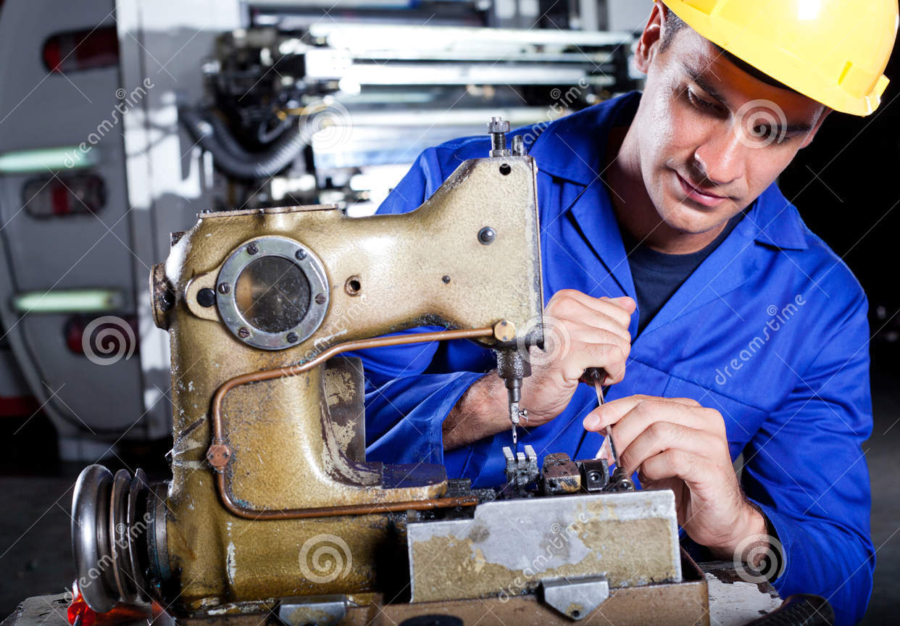
UNIT 7: THE WORLD OF WORK
B: The worker
Vocabulary
mechanic
machine

Slide 2
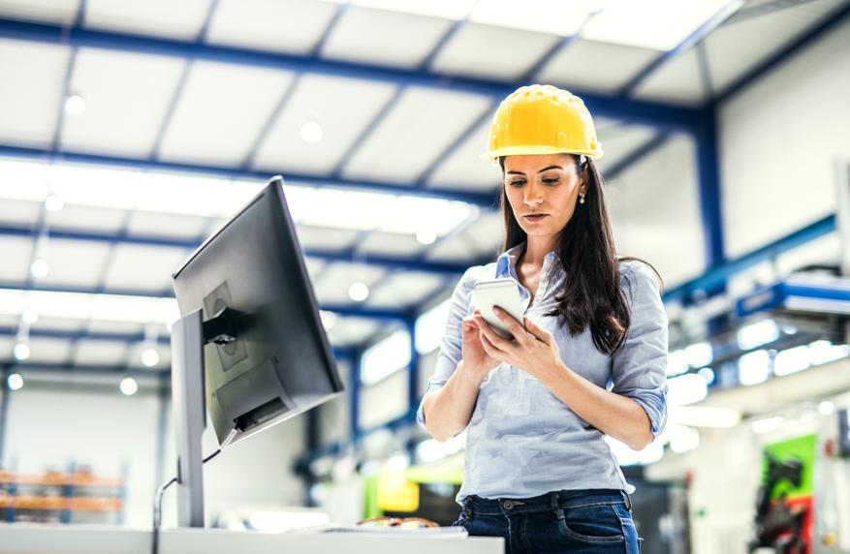

UNIT 7: THE WORLD OF WORK
B: The worker
Vocabulary
morning shift
night shift

Slide 3
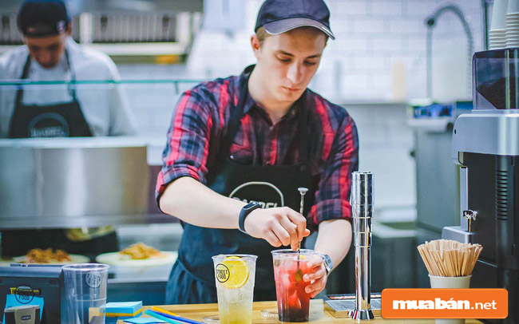
UNIT 7: THE WORLD OF WORK
B: The worker
Vocabulary
He works part-time at a restaurant

Slide 4
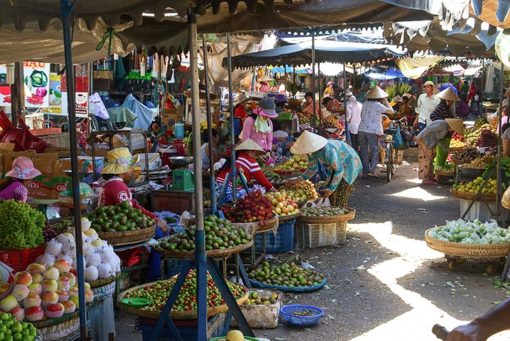
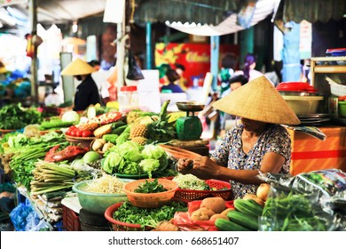
UNIT 7: THE WORLD OF WORK
B: The worker
Vocabulary
local market

Slide 5
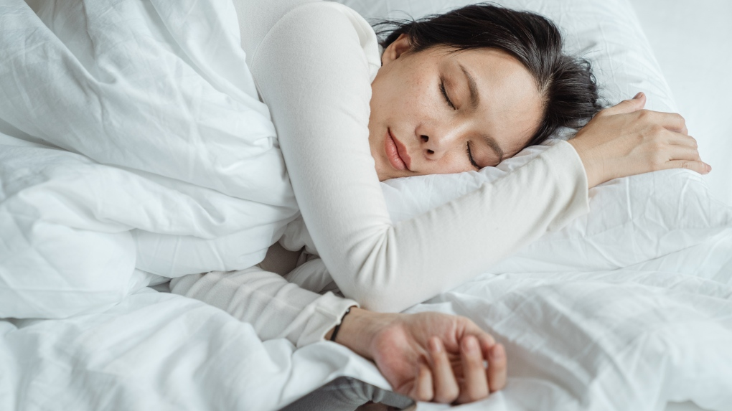
UNIT 7: THE WORLD OF WORK
B: The worker
Vocabulary
I usually get up late on my day off

Slide 6
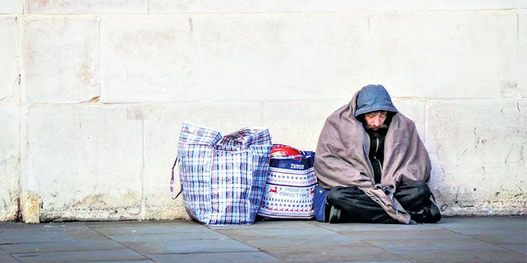
UNIT 7: THE WORLD OF WORK
B: The worker
Vocabulary
homeless

Slide 7
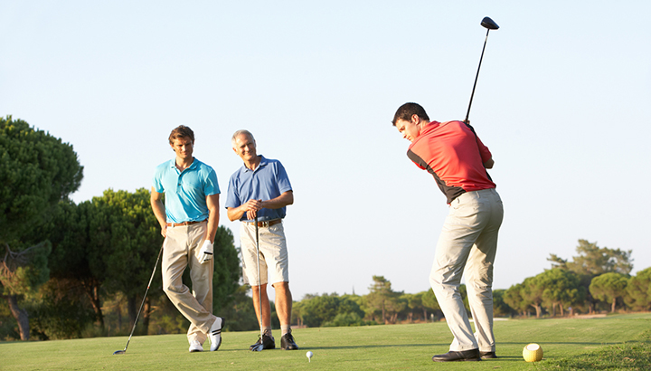
UNIT 7: THE WORLD OF WORK
B: The worker
Vocabulary
They sometimes play golf in the morning

Slide 8

UNIT 7: THE WORLD OF WORK
B: The worker
B1. Listen and read
Dear Hoa,
I am pleased that you and your family are well. I am fine, too. Here is a photo of me, my mom and dad, and my sister, Shanon. Can you send me a photo of you?
Let me tell you more about my parents.
My mom works at home. She takes care of the family. Three mornings a week, she works part time at a local supermarket. She and other women also cook lunch for homeless people once a week.
My dad is a mechanic. He repairs machines in a factory. He works five days a week for about 40 hours, sometimes in the morning and sometimes in the afternoon. He prefers the morning shift. He has fewer days off than my Mom. However , when he has an afternoon free, he plays golf.
Dad gets about seven public holidays each year .He also has a three-week summer vacation. We always go to Florida on vacation. We have a great time and dad plays more golf.
Please write soon and tell me more about your family.
Best wishes,
Tim
A letter from Tim Jones

Slide 9

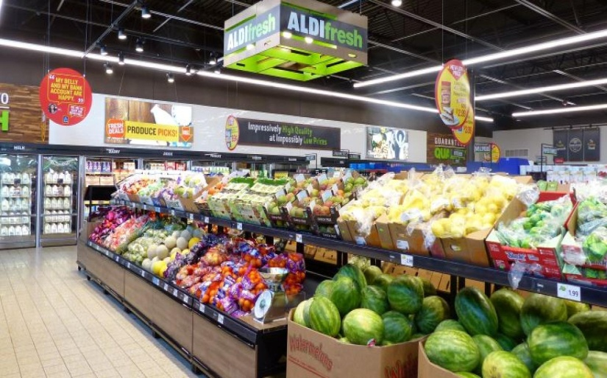
UNIT 7: THE WORLD OF WORK
B: The worker
Choose a picture and answer the questions
A
B
1.Where does Mrs. Jones work ?
→ She works at a local supermarket
Notes:
9

Slide 10
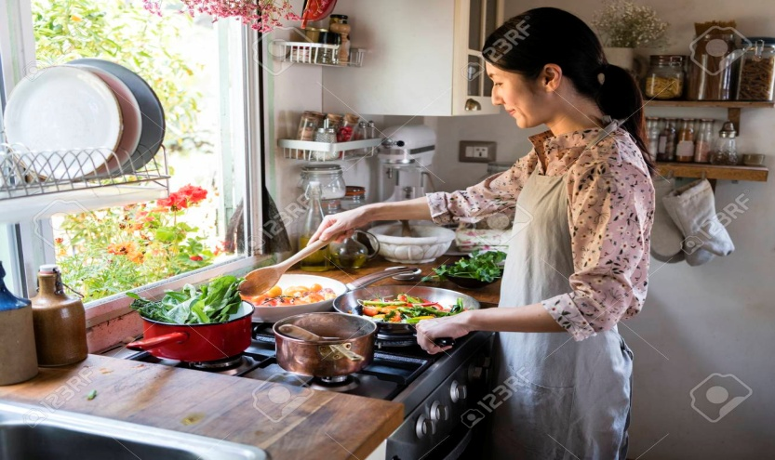

UNIT 7: THE WORLD OF WORK
B: The worker
Choose a picture and answer the questions
A
B
2. What does she do for homeless people?
→ She cooks lunch for homeless people
Notes:
10

Slide 11
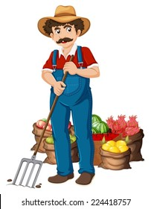
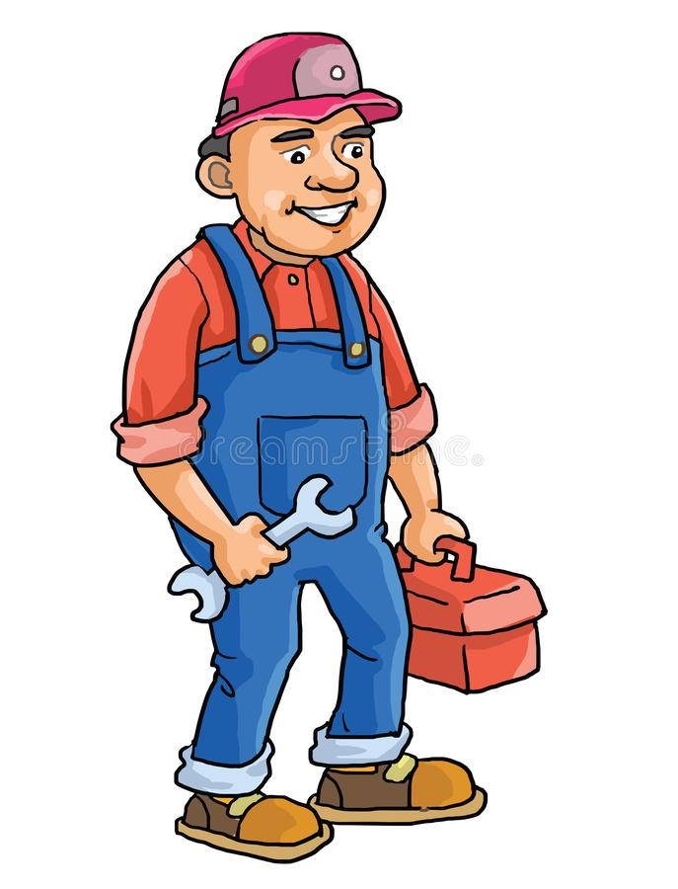
UNIT 7: THE WORLD OF WORK
B: The worker
Choose a picture and answer the questions
A
B
3. What is Mr. Jones’ job?
→ He is a mechanic
Notes:
11

Slide 12


UNIT 7: THE WORLD OF WORK
B: The worker
Choose a picture and answer the questions
A
B
4. How many hours a week does he usually work ?
→ He usually works 40 hours a week
Notes:
12

Slide 13

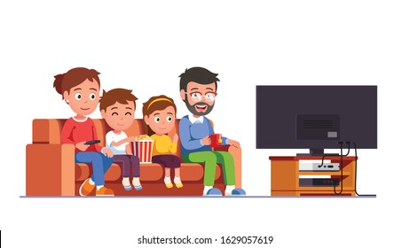
UNIT 7: THE WORLD OF WORK
B: The worker
Choose a picture and answer the questions
A
B
5. How do you know the Jones family likes Florida ?
→ They always go to Florida on vacation because they have a great time
Notes:
13

Slide 14
Remember
Comparison of countable noun :
Tim’s father has fewer days off than his mother.
Tim’s mother has more days off than his father
Compound adjectives :
A break lasts twenty minutes -> A twenty – minute break
A summer vacation lasts three months -> A three - month summer vacation

Slide 15
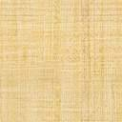
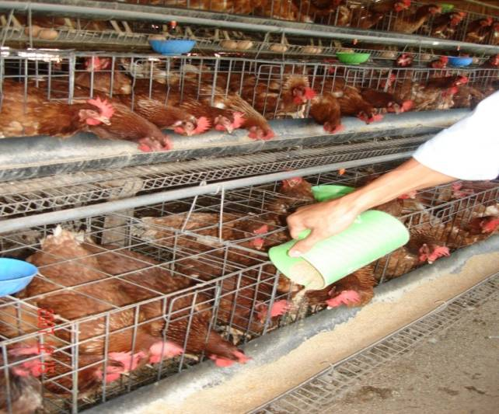
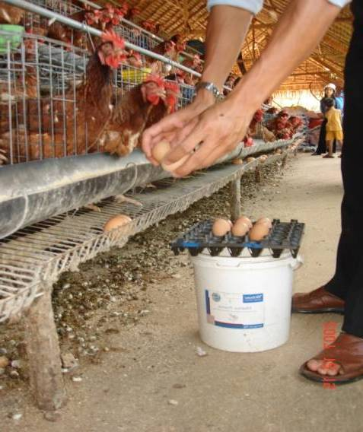
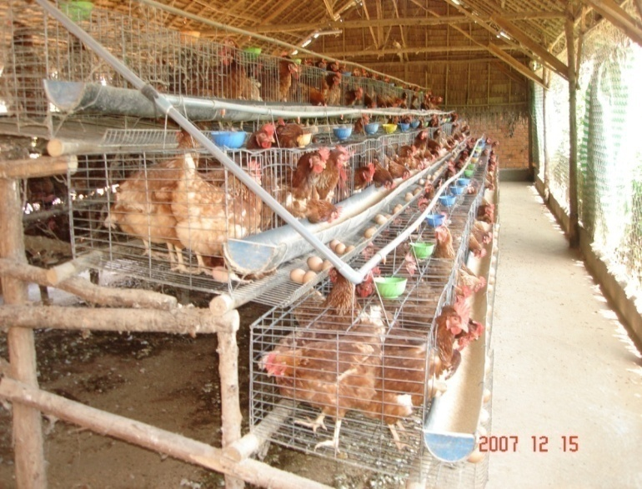
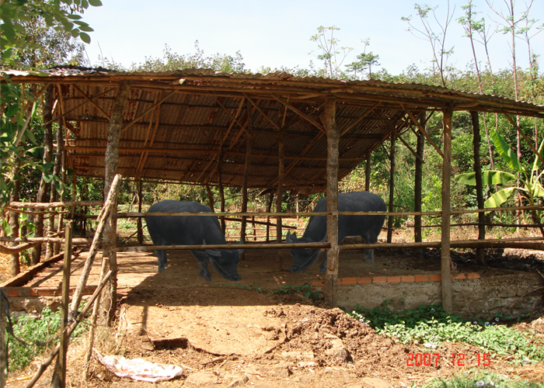
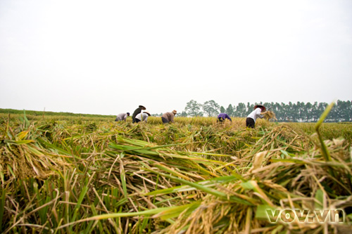
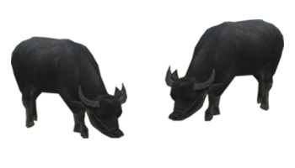
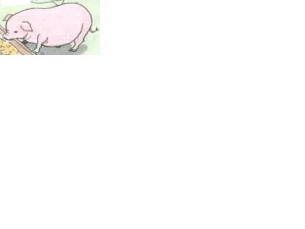
- Unit 7: The World of Work B. The worker – B2
* New words :
1. feed (v):
Cho ăn
2. collect eggs (v):
Thu lượm trứng
3. chicken coop ( n ) :
Chuồng gà
4. buffalo shed ( n ) :
Chuồng trâu
5. main crop ( n ) :
Vụ mùa chính
6. real (adj):
Thực sự
7. rest (v)
Nghỉ ngơi
8. Buffalo (n)
Con trâu
9. Pig (n)
Con lợn, con heo

Slide 16

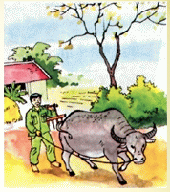
Unit 7: The World of Work B. The worker – B2,3
Mr. Tuan
a farmer
Hoa’s father, Mr. Tuan is a farmer.

Slide 17
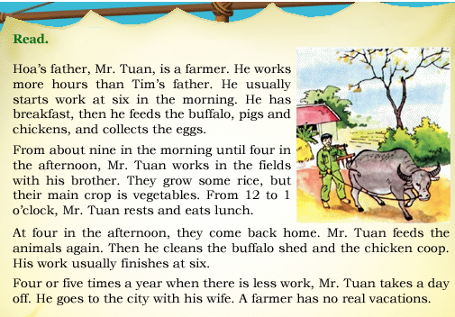
Unit 7: The World of Work B. The worker – B2,3
* Questions
1. What does Mr. Tuan usually do in the morning?
2. What does Mr. Tuan usually do from 12 to 1.00?
3. After the come back home, does Mr. Tuan clean the buffalo shed and chicken coop?
4. How many times does Mr. Tuan take off a year?

Slide 18
Unit 7: The World of Work B. The worker – B2,3
* Answer Key
What does Mr. Tuan usually do in the morning?
→ He has breakfast, then he feeds the buffalo, pigs and chickens, and collects the eggs.

Slide 19
Unit 7: The World of Work B. The worker – B2,3
* Questions
2. What does Mr. Tuan usually do from 12 to 1.00?
→ From 12 to 1.00, Mr. Tuan rests and eats lunch.

Slide 20
Unit 7: The World of Work B. The worker – B2,3
* Questions
3. After the come back home, does Mr. Tuan clean the buffalo shed and chicken coop?
→ Yes, Mr. Tuan cleans the buffalo shed and chicken coop.

Slide 21
Unit 7: The World of Work B. The worker – B2,3
* Questions
4. How many times does Mr. Tuan take off a year?
→ Mr. Tuan takes 4 or 5 times off a year.

Slide 22
UNIT 7: THE WORLD OF WORK
B: The worker
B4. Listen and take notes
Name | Job | Hours per week | Amount of vacation
Peter
Susan
Jane
Phong
doctor
70
4 weeks
nurse
50
3 weeks
shop assistant
35
1 week
factory worker
48
2 weeks

Slide 23
HOMEWORK:
- Learn the new words and the grammar by heart.
- Do exercises in the workbook.
- Prepare for the next lesson: Unit 8: A1 ; A2

