Slide 1
UNIT 8 PLACES
A. ASKING THE WAY

Slide 2


Identify how to ask for and give directions to some places, the distance between two places
Identify and learn new words related to the topic
Practice asking and answer about the directions and distance

Slide 3
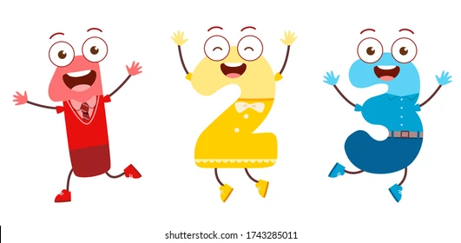

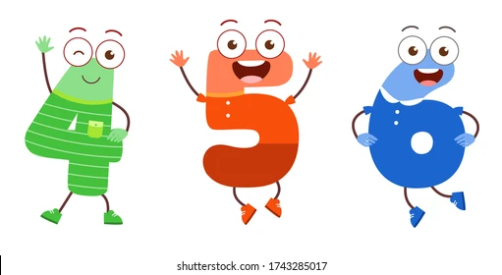
OUTLINE
Warm-up
Vocabulary
Presenting
Practice
Homework

Slide 4


Warm-up
Guessing the places
A place where you can buy many things like clothes, food, toys...

Slide 5

Warm-up
Guessing the places
A place you can buy books.
bookstore

Slide 6
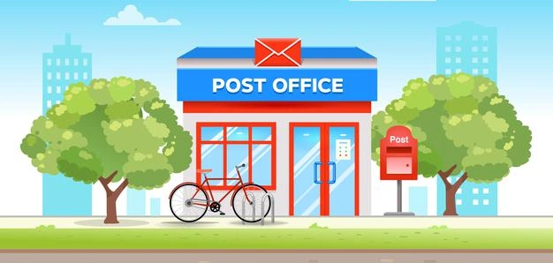
Warm-up
Guessing the places
A place you can buy stamps or post letters.

Slide 7
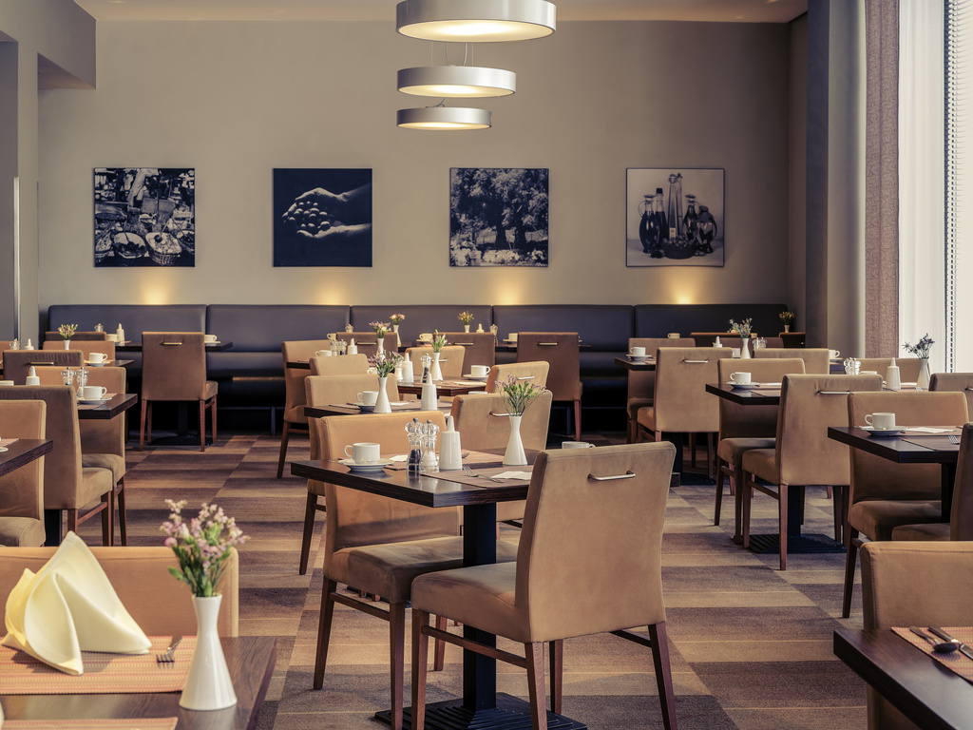
Warm-up
Guessing the places
A place where you can buy and eat a meal.
restaurant

Slide 8
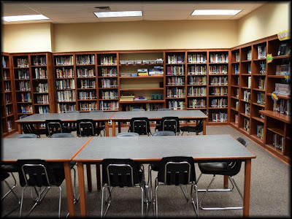
Warm-up
Guessing the places
A place you can come to read books and borrow books from.
library

Slide 9
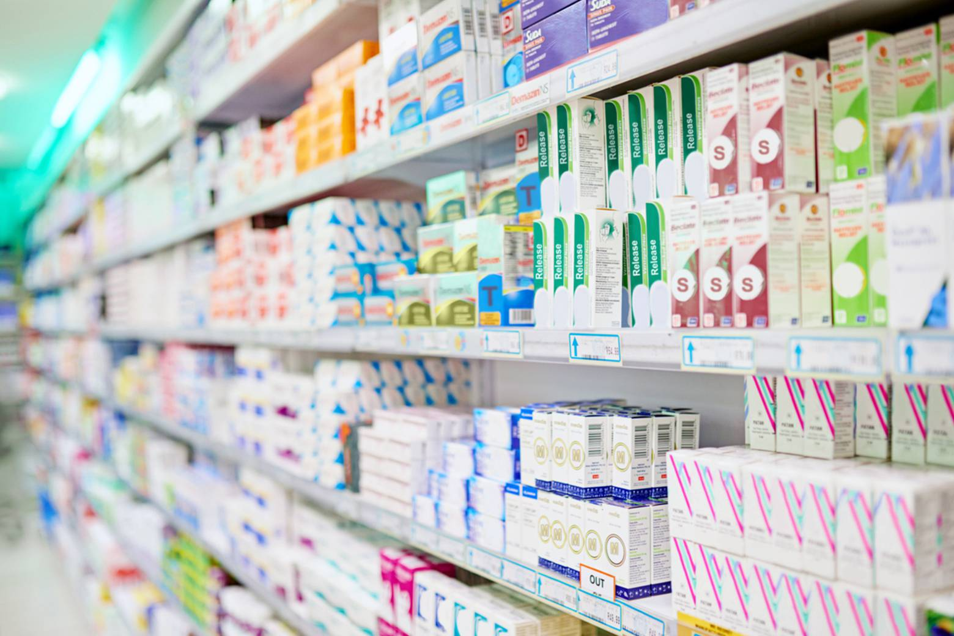
Warm-up
Guessing the places
A shop that sells medicines and also other types of goods, for example shampoo
drugstore

Slide 10
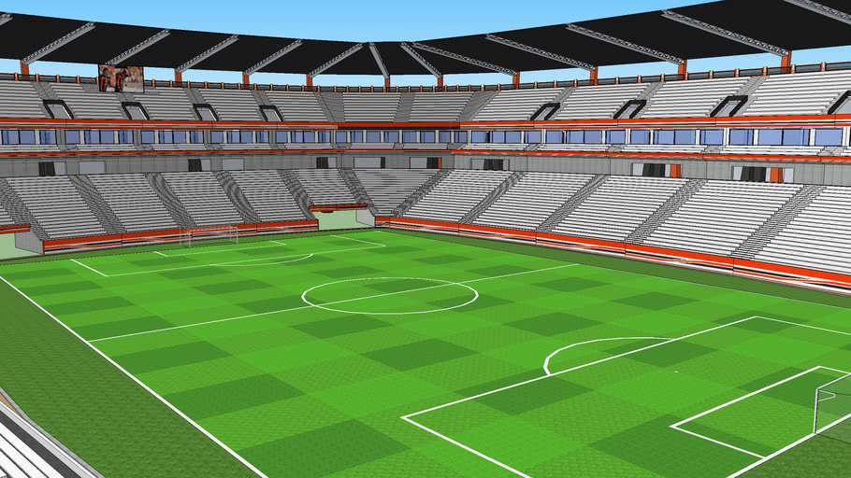
Warm-up
Guessing the places
A place we can see football matches.
stadium

Slide 11
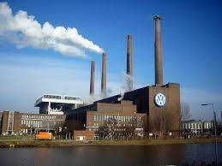
Warm-up
Guessing the places
A place where people can make machines like TV.
factory

Slide 12

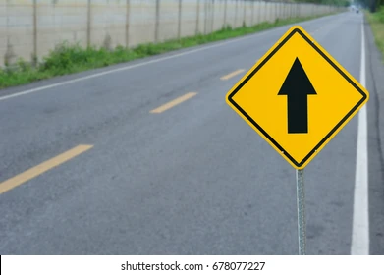
Vocabulary
go straight ahead

Slide 13
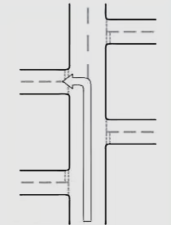
Vocabulary
Take the second street on the left

Slide 14
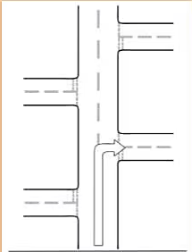
Vocabulary
Take the first street on the right

Slide 15
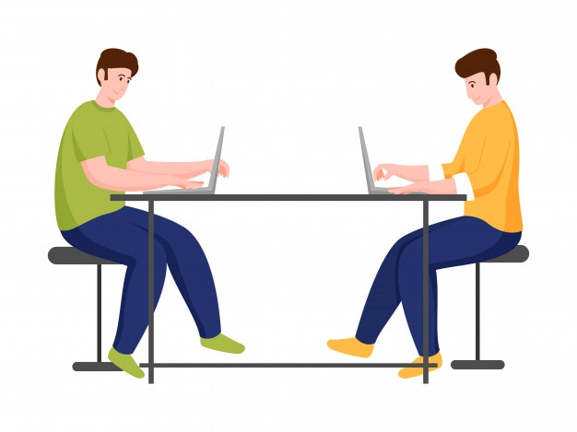
Vocabulary
opposite /ˈɑːpəzɪt/

Slide 16
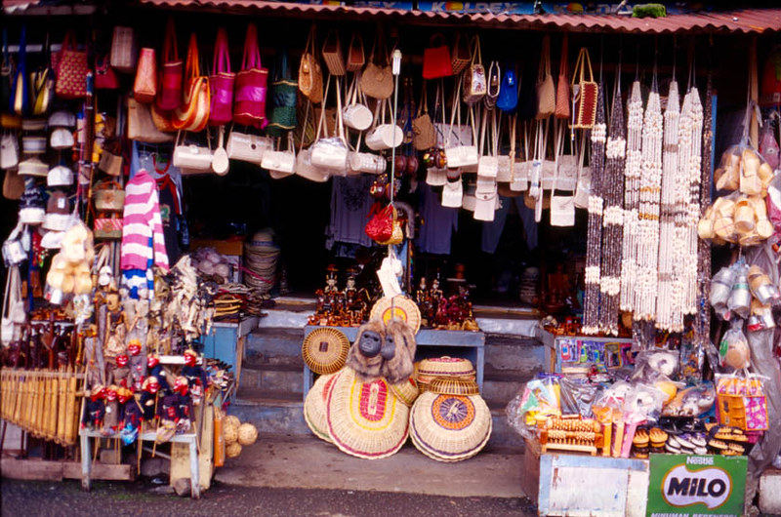
Vocabulary
Souvenir shop (n): a place you buy something to help you remember a holiday or special event.

Slide 17
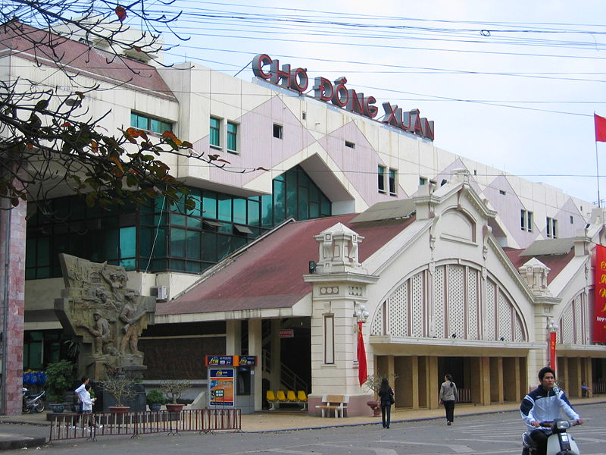
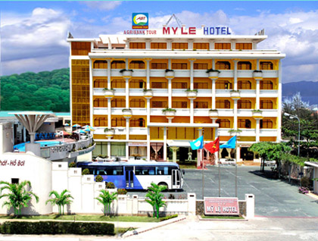
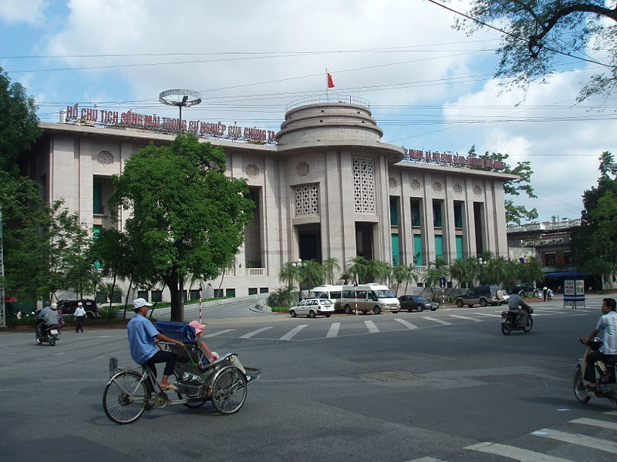
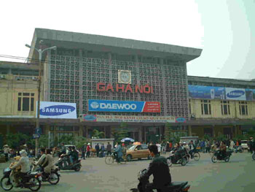
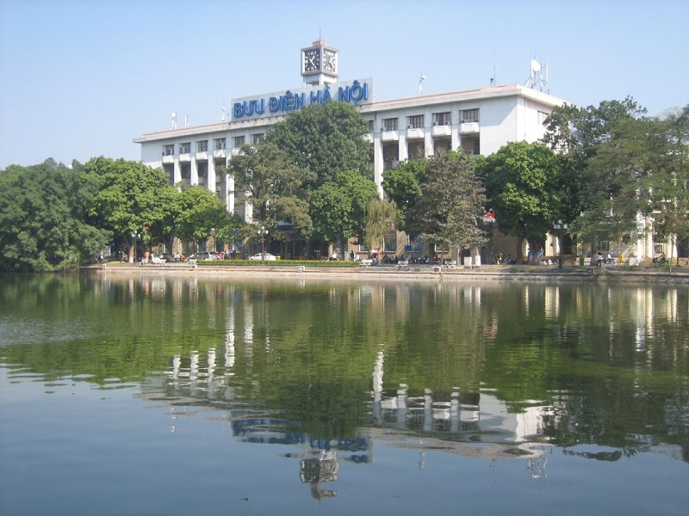
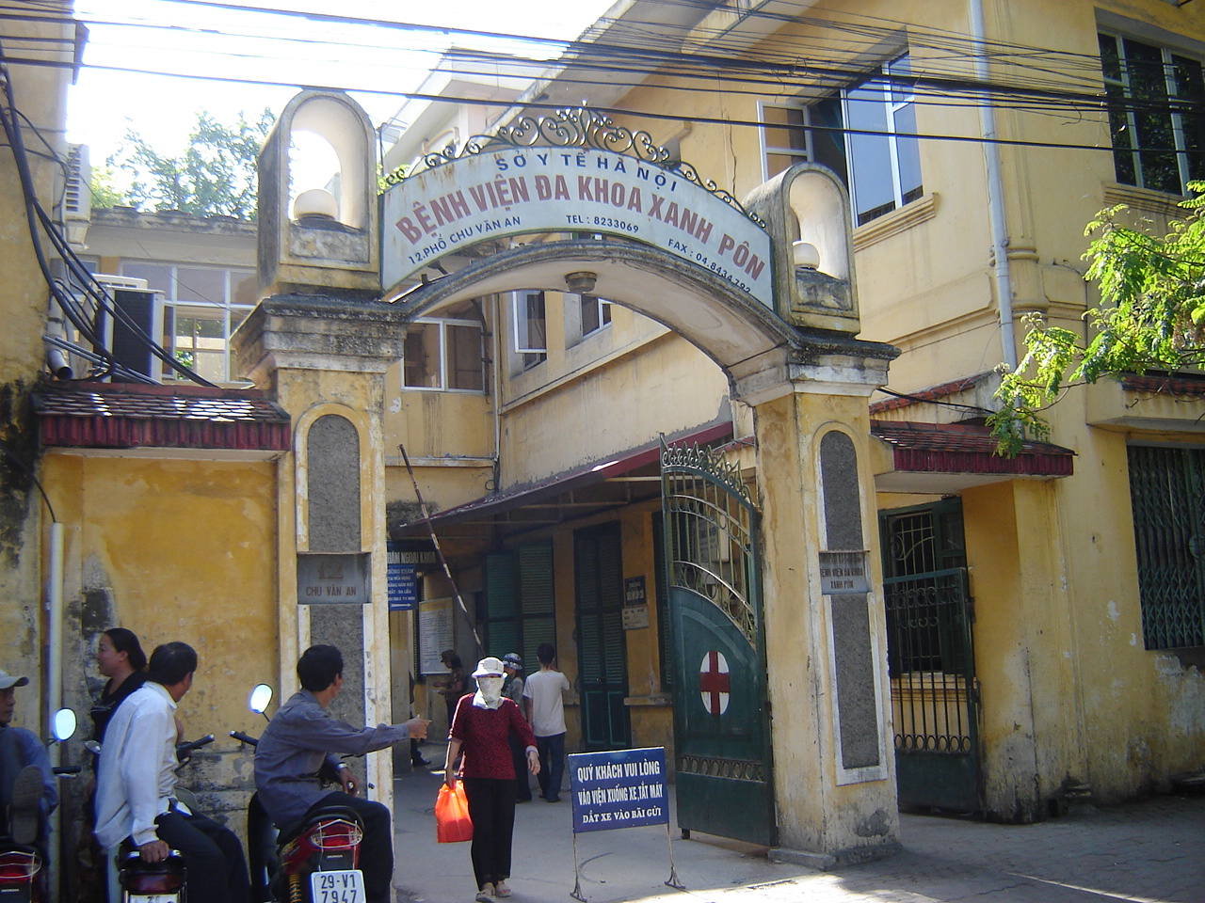
Presenting
A. Hanoi Railway Station
D. Saint Paul Hospital
Matching
B. Hotel
E. National Bank of Vietnam
C. The Central Post Office
F. Dong Xuan Market
1
2
3
4
5
6

Slide 18
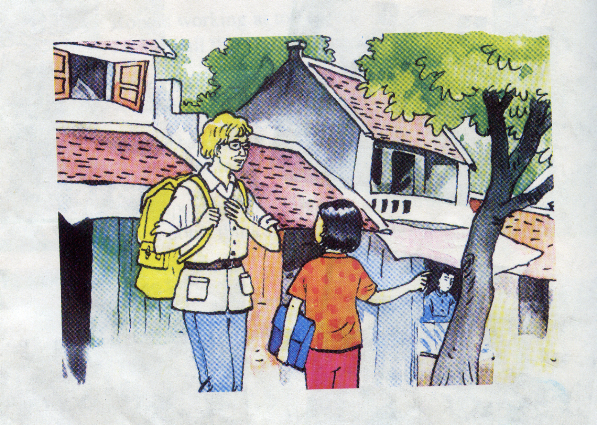
Presenting
Listen and repeat.
a) Tourist: Excuse me. Is there a souvenir shop near here?
Nga: Yes. There is one on Hang Bai street.
Tourist: Could you tell me how to get there?
Nga: Go straight ahead. Take the second street on the left. The souvenir shop is on the right, opposite the post office.
Tourist: Thank you.
Nga: You’re welcome.
What does the 1st tourist want to ask Nga?

Slide 19
Presenting
b) Tourist: Excuse me. Could you show me the way to the supermarket, please?
Nga: The supermarket? OK. Go straight ahead. Take the first street on the right. The supermarket is in front of you.
Tourist: Thanks a lot.
Nga: You’re welcome.
What does the 2nd tourist want to ask Nga?

Slide 20
Presenting
Let’s listen and repeat.
a) Tourist: Excuse me. Is there a souvenir shop near here?
Nga: Yes. There is one on Hang Bai street.
Tourist: Could you tell me how to get there?
Nga: Go straight ahead. Take the second street on the left. The souvenir shop is on the right, opposite the post office.
Tourist: Thank you.
Nga: You’re welcome.
b) Tourist: Excuse me. Could you show me the way to the supermarket, please?
Nga: The supermarket? OK. Go straight ahead. Take the first street on the right. The supermarket is in front of you.
Tourist: Thanks a lot.
Nga: You’re welcome.

Slide 21
Presenting
Let’s practice the dialogue with a partner.
a) Tourist: Excuse me. Is there a souvenir shop near here?
Nga: Yes. There is one on Hang Bai street.
Tourist: Could you tell me how to get there?
Nga: Go straight ahead. Take the second street on the left. The souvenir shop is on the right, opposite the post office.
Tourist: Thank you.
Nga: You’re welcome.
b) Tourist: Excuse me. Could you show me the way to the supermarket, please?
Nga: The supermarket? OK. Go straight ahead. Take the first street on the right. The supermarket is in front of you.
Tourist: Thanks a lot.
Nga: You’re welcome.

Slide 22
Presenting
a) Tourist: Excuse me. Is there a souvenir shop near here?
Nga: Yes. There is one on Hang Bai street.
Tourist: Could you tell me how to get there?
Nga: Go straight ahead. Take the second street on the left. The souvenir shop is on the right, opposite the post office.
Tourist: Thank you.
Nga: You’re welcome.
How do the tourists
ask for the directions?
b) Tourist: Excuse me. Could you show me the way to the supermarket, please?
Nga: The supermarket? OK. Go straight ahead. Take the first street on the right. The supermarket is in front of you.
Tourist: Thanks a lot.
Nga: You’re welcome.

Slide 23

Presenting
- Could you tell me how to get there ?
- Could you show me the way to the supermarket, please ?
+ Go straight ahead. Take the first/second street on the right/left. It’s in front of you….
Asking for the directions:
Could you tell/show me how to get there/to...?
the way to .......?
Giving directions:
- Go straight ahead.
Take the first/second… street on the right/ left.
…. opposite/in front of ….
Supermarket

Slide 24
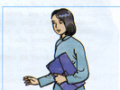
Presenting
PARK
BAKERY
HOSPITAL
RESTAURANT
SUPERMARKET
Look at this street map. Ask for and give directions to these place .
TOY
STORE
BANK
SHOE
STORE
FACTORY
MOVIE THEATER
DRUGSTORE
HOTEL
MARKET
SOUVENIR
SHOP
POST OFFICE
STADIUM
SCHOOL
POLICE
STATION
BOOKSTORE
MUSEUM
Example:
S1: Where is the bank?
S2: The bank is between the hotel and the restaurant. It’s opposite the hospital.

Slide 25
Presenting
PARK
BAKERY
HOSPITAL
RESTAURANT
SUPERMARKET
Listen and write the places.
TOY
STORE
BANK
SHOE
STORE
FACTORY
MOVIE THEATER
DRUGSTORE
HOTEL
MARKET
SOUVENIR
SHOP
POST OFFICE
STADIUM
SCHOOL
POLICE
STATION
BOOKSTORE
MUSEUM
a. souvenir shop
b. shoe store
c. hotel
d. drugstore
e. hospital
Notes:
25

Slide 26

Homework
Review the Vocabulary (spelling & meaning)
Review structures for asking for and giving directions and distance
Do assignments.

Slide 27

Thank you

