Slide 1


Slide 2
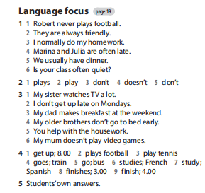
Homework

Slide 3
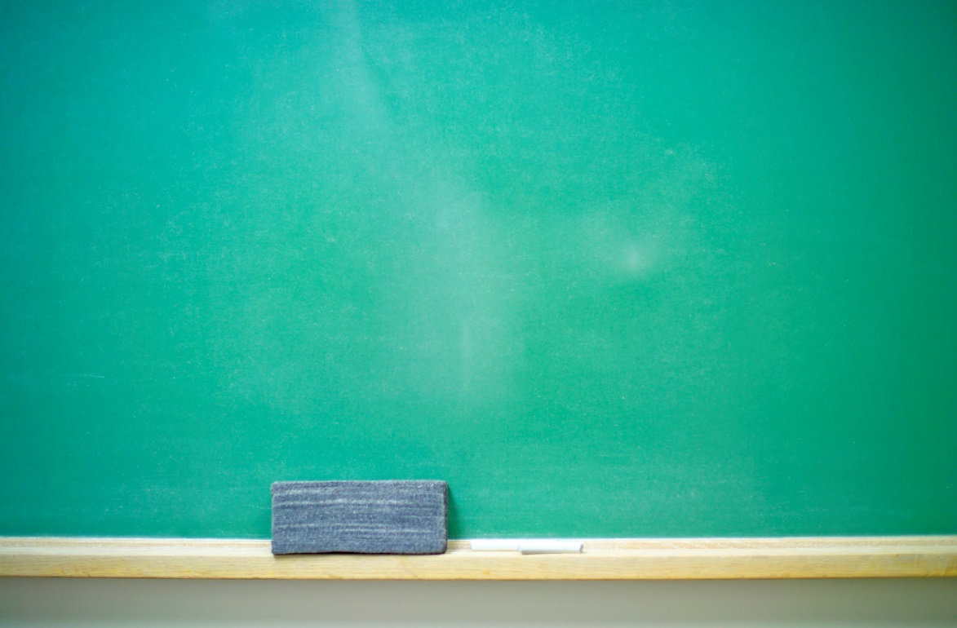
UNIT 2: days
Lesson 5: language focus

Slide 4
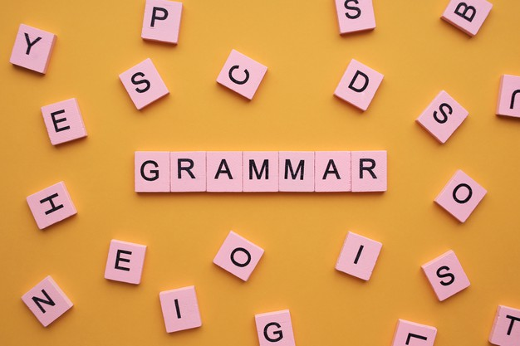
Match questions 1–5 with answers a–e
What presents do you prefer? | a) No, I don’t
2) Where do you eat? | b) I prefer lucky money
3) Who does she invite? | c) At my grandmother’s house
4) Does the lion stop at all of the restaurants? | d) Yes, it does
5) Do you like fireworks? | e) All the family

Slide 5
PRESENT SIMPLE TENSE (cont)
QUESTIONS
WH-QUESTIONS
YES-NO QUESTIONS

Slide 6
☞ Yes - no Questions:
TOBE:
Am/ Is/ Are + S + O ?
Short answer:
Yes, S + am/ is / are.
No, S + am/ is /are + NOT.
Ex: Are you a student?
Yes, I am. / No, I’m not.

Slide 7
b) Ordinary Verbs:
Do / Does + S + V + O?
Short answer:
Yes, S + do/ does.
No, S + do/ does + NOT.
Ex: Do you like this celebration?
Yes, I do. / No, I don’t.

Slide 8
WH-QUESTIONS:
TOBE:
Wh- question word + am/ is/ are + S ?
Ex: Where are you from?
Who is he?
b) Ordinary Verbs:
Wh - question word + do / does + S + V-_{inf} + O?
Ex: Where do you come from?
What does she do?

Slide 9

1) We use
do and does
/ is and are
when we make
present simple questions with regular verbs.
2) We
add /
don’t add
-s to the he, she and it forms of
regular verbs in questions.
3) We put question words (Where, What, Who, When, etc.) at the
beginning
/ end
of the question.
4) We use forms of
be /
do
in short answers with regular
verbs.

Slide 10
Exercise 2: Choose the correct words – page 29.
1) Do / Does you get up at 6 a.m.?
2) Who are / do you see at the weekend?
3 ) Does / Do your dad watch TV in the evening?
4 ) What do you has / have for breakfast on weekdays?
5 ) Where is / does your family go in the holidays?

Slide 11
Exercise 3 – page 29: Complete the Key Phrases
Time expressions
1) ___ the holidays / the summer / the evening / May…
2) ________ 6 a.m. / 2.30 p.m. 3) ________ weekdays / Monday / Tuesday … 4) ________ the weekend, New Year …
In
At
On
At

Slide 12
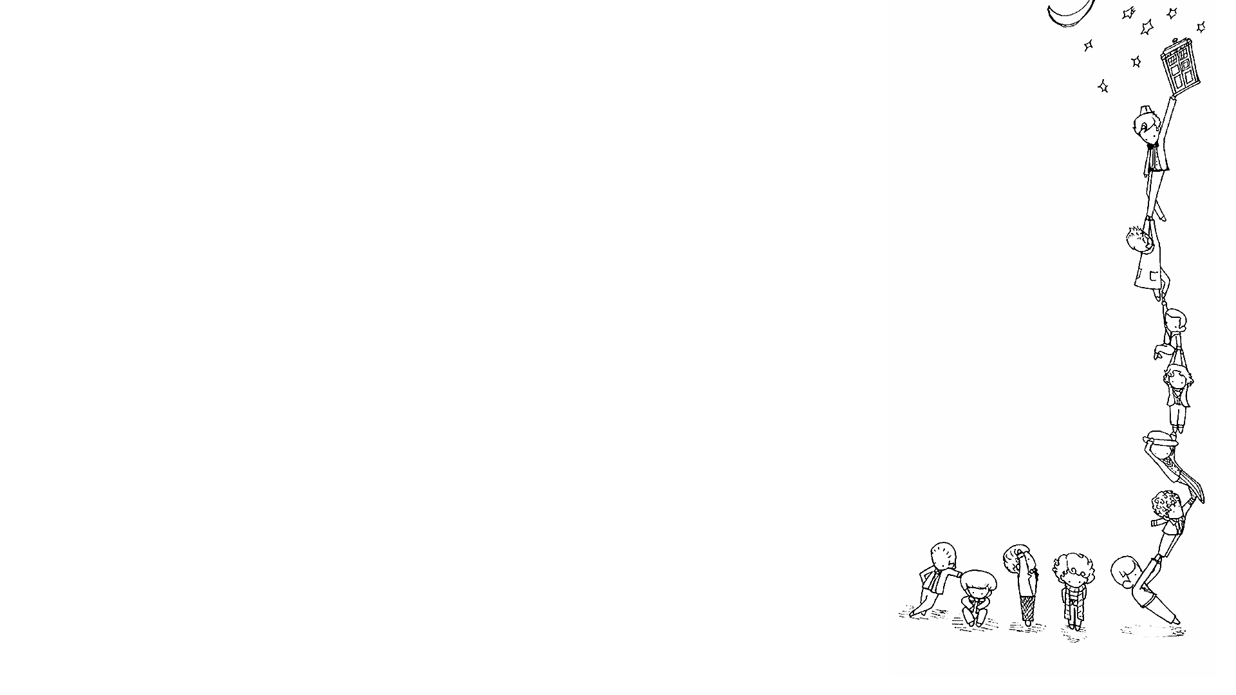
5 p.m, 12 o’clock,….
At
breakfast, lunch,….
night, Christmas, weekend,….
Sunday, Sunday morning, Christmas Day….
On
22nd September 2020, ….
October, 2012, …
In
the summer / winter / ….
3 minutes, 2 weeks, ….

Slide 13

Page 29
1. I prefer lucky money. _____ 2. I like reading, but she likes chatting online. _____ 3. She loves oranges but hates apples. _____ 4. She and I eat apples. _____ 5. She plays football, and he likes it. _____
√
A compound predicate
√
A compound subject
√

Slide 14
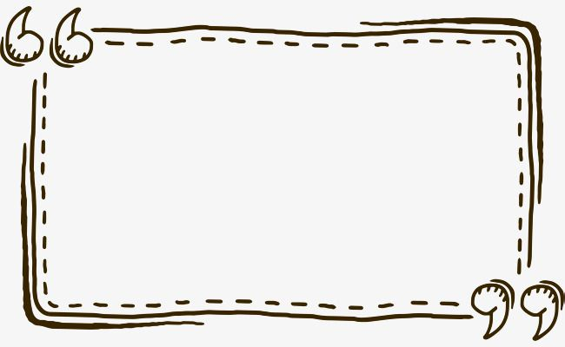
Homework
- Learn by heart all structures.
- Prepare for the next lesson: Speaking - page 30.

Slide 15



