Slide 1


Slide 2

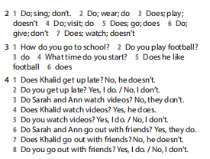
Homework

Slide 3

UNIT 2: days
Lesson 6: SPEAKING

Slide 4
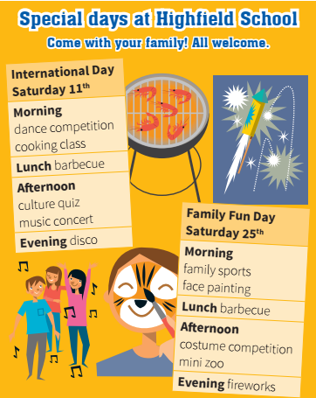
Which activities interest you?
Which don’t interest you?

Slide 5
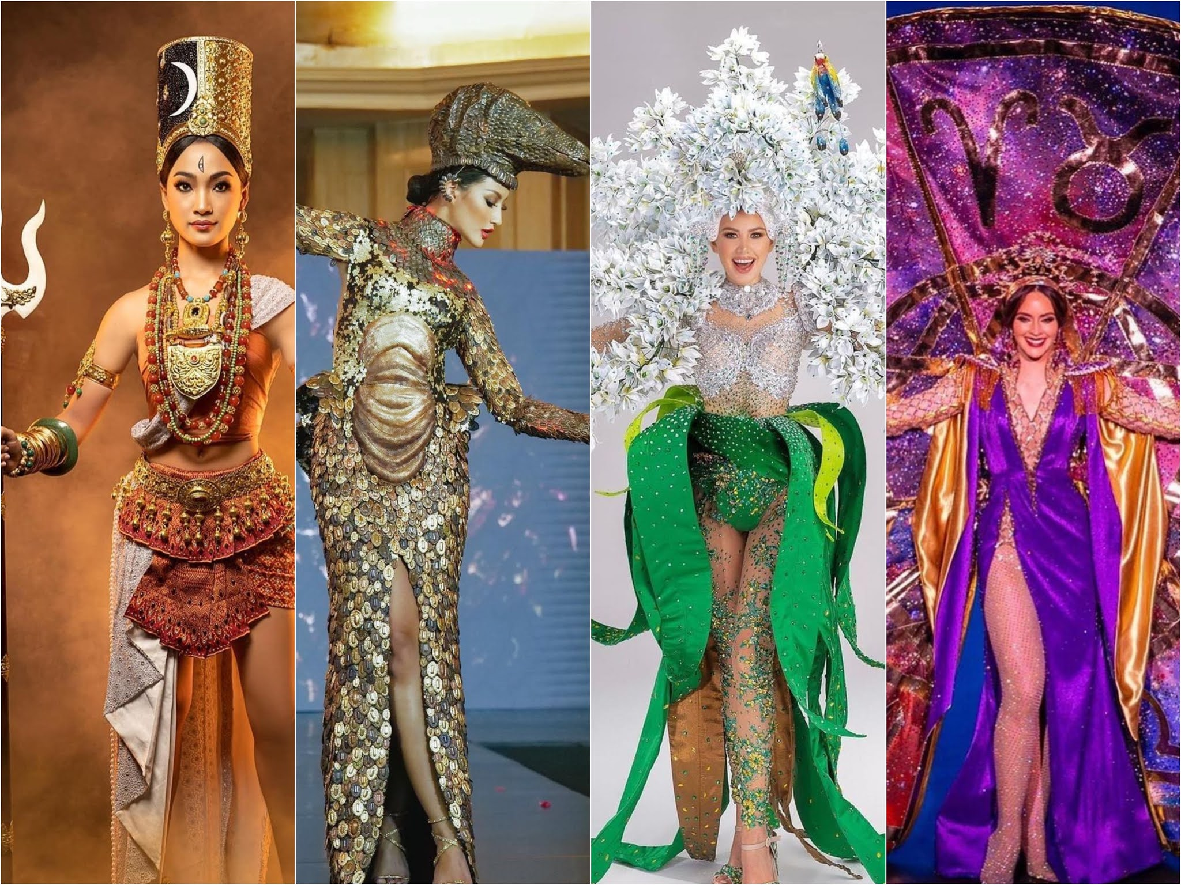
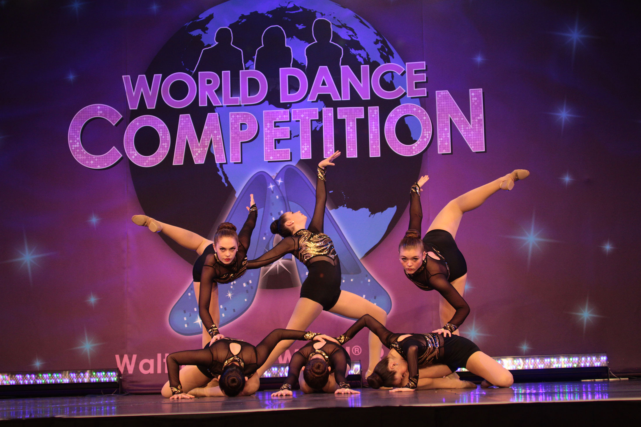

New words:
- competition (n) /ˌkɒmpəˈtɪʃn/
: cuộc thi
dance competition (n)
: cuộc thi múa, khiêu vũ
costume competition (n)
: cuộc thi trang phục
- culture (n) /ˈkʌltʃə(r)/
: văn hóa
: the beliefs, way of life, art, and customs that are shared and accepted by people in a particular society.

Slide 6
Daisy : Hi. It’s International Day at the school on Saturday. Gareth : Oh yes. What’s on? Daisy : A lot of things. Look! Gareth : Mmm. What do you want to do? Daisy : Well, I’m not really interested in the (1) ______________
Gareth : No? I like the sound of the (2) __________ in the evening.
Daisy : Right, and what about the ________?
Gareth : Yes, OK. Let’s go to the (4) ____________________ and the
concert. Then we can go to (5) _______ in the evening.
Daisy : OK. Great.
cooking class
concert
disco
dance competition
disco

Slide 7
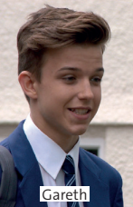
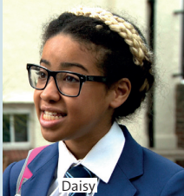
“What do Daisy and Gareth decide to do?”
➔ They decide to go to the dance competition and the concert, and the disco in the evening.

Slide 8

Find the words/ phrases with the same meanings in the dialogue
1) Which ones show that you agree?
Right ; Yes, OK.
2) Which ones do you use while you think?
Mmm ; Well.
3) Which do you use when you’re surprised?
No?

Slide 9

Key Phrases: Making plans and suggestions
What’s on? What do you want to do / see? I’m not really interested in (the) … . I like the sound of (the) … . What about (the) … ? Let’s go to (the) … .

Slide 10
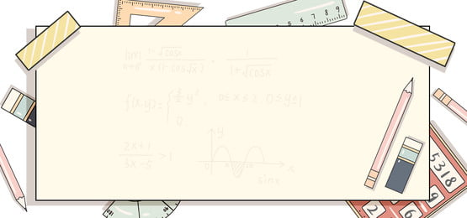
Homework
- Learn by heart all structures.
prepare the next lesson:
Writing – page 31.

Slide 11


