Slide 1


Slide 2
UNIT 3: WILD LIFE
Lesson 7
WRITING
• Animals in danger

Slide 3
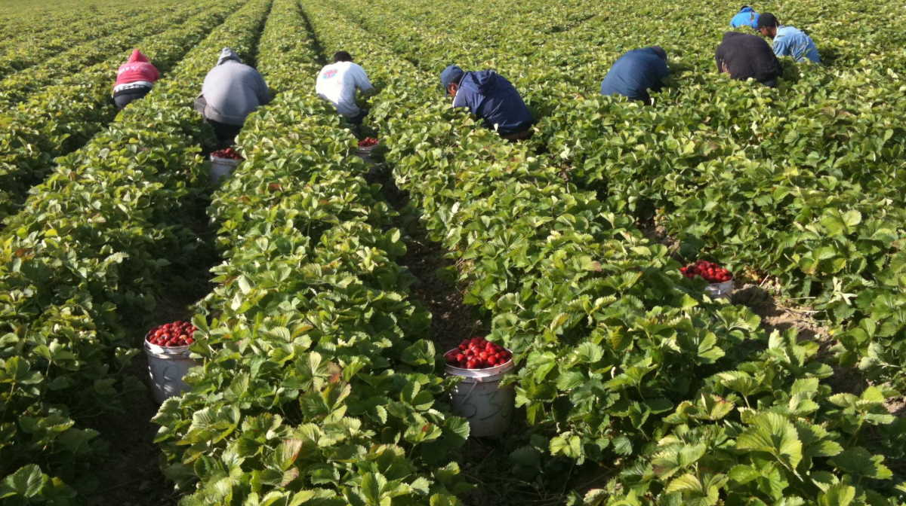
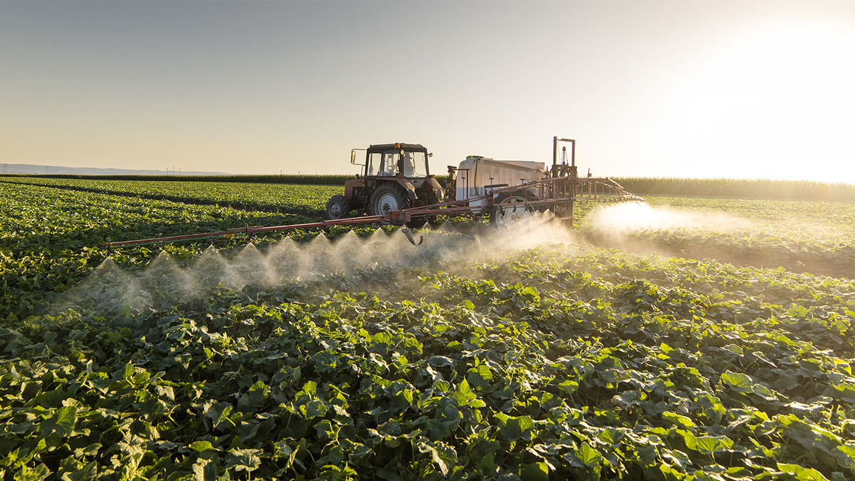
farming(n) /ˈfɑːmɪŋ/

Slide 4
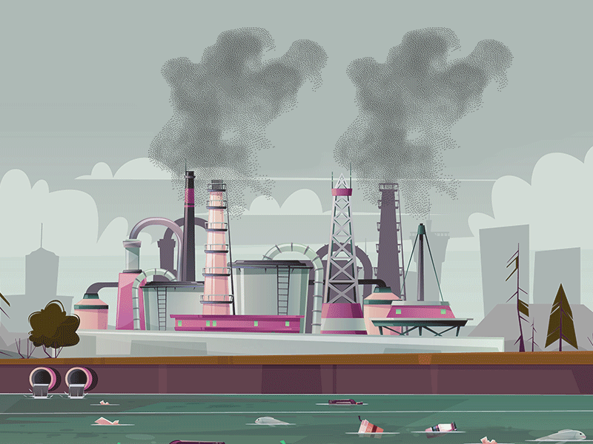
pollution(n) /pəˈluːʃən/

Slide 5
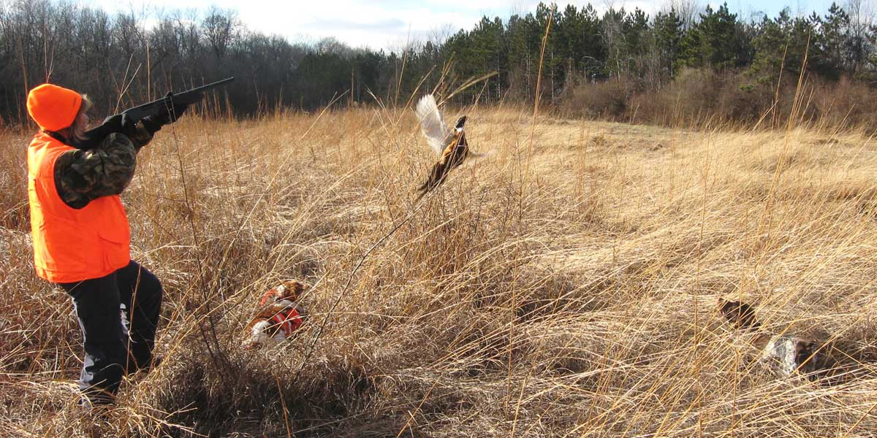
hunting(n) /ˈhʌntiŋ/

Slide 6

New words
explain(n) /ɪkˈspleɪn/
Ex: Teacher explains how to do this exercise.
adopt(n) /əˈdɒpt/

Slide 7
- such as = like:
- For example:
We can use such as, like, For example to introduce an example or examples of something we mention.

Slide 8
New words:
- farming(n) /ˈfɑːmɪŋ/ : nông nghiệp, canh tác
- pollution(n) /pəˈluːʃən/: sự ô nhiễm
- hunting(n) /ˈhʌntiŋ/ : sự săn bắn
explain(n) /ɪkˈspleɪn/ : giải thích
adopt(n) /əˈdɒpt/ : nhận nuôi
- such as = like:
- For example:

Slide 9
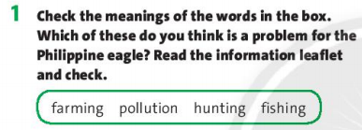
=> Farming is a problem for the Philippine eagle.

Slide 10

It’s one of the biggest birds in the world, and it’s in danger and very rare.
It eats snakes and small animals such as bats, rats and small monkeys.

Slide 11
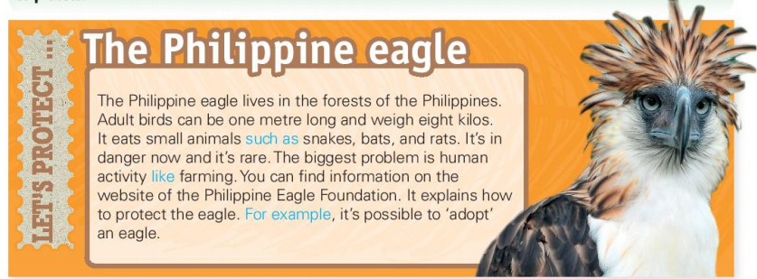
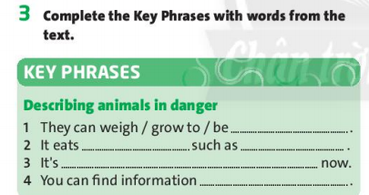

Slide 12
eight kilos / one metre long
small animals snakes, bats and rats
in danger
on the website
(of the Philippine Eagle Foundation)

Slide 13
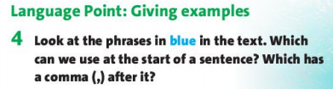
We can use For example at the start of a sentence. For example has a comma after it.

Slide 14
such as + Noun = like + Noun
For example, S + V + O.

Slide 15
1. Eagle eats small animals such as snakes, bats, and rats.
Noun
2. The biggest problem is human activity like farming.
Noun
3. For example, it is possible to ‘adopt’ an eagle.
S
V
O

Slide 16
homework
- Learn new words by heart.
- Do exercise in workbook page 29.
- Prepare for the next lesson:
CLIL • Natural science: animals – page 46.

