Slide 1
UNIT 4:
LEARNING WORLD
Lesson 7:
WRITING • An email about your school
- Page 55.

Slide 2


EXERCISE:
Page 55.
There are about 500 students.

Slide 3
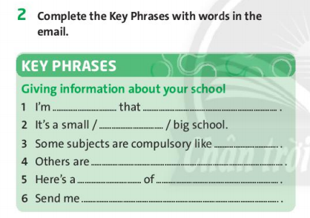
Page 55.
happy you can study here next month.
medium-sized
maths and English.
optional.
photo my classmates.
a photo of yours.

Slide 4
EXERCISE 3:
Page 55.
Example: I like languages, so I study French.
So expresses the result of something stated on the previous clause.

Slide 5
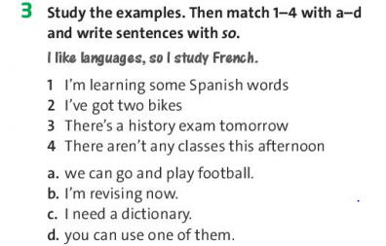
Page 55.
c
d
b
a
1. I’m learning some Spanish words, so I need a dictionary.
2. I’ve got two bikes, so you can use one of them.
3. There’s a history exam tomorrow, so I’m revising now.
4. There aren’t any classes this afternoon, so we can go and play football.

Slide 6
EXERCISE 4:
Page 55.
THINK AND PLAN
1 Who is the visitor and when is the visit?
2 How big is your school?
3 Where is your school?
4 When are the lessons? What are the subjects?
5 What is in the photo you are emailing?

Slide 7
EXERCISE 4:
The reason
you write
The information
you need
Name

Slide 8
OUTLINE
Hi/ Hey …,
I’m happy that …
… is a small / medium-sized / large school …
Classes are … Some subjects are …. Others …
Here’s ………… Send me …
Write soon,
….
The reason
you write
The information
you need
Name

Slide 9
HOMEWORK
Learn new words and Key phrases by heart.
Do exercise in Workbook page 35.
Students prepare for the next lesson:
CULTURE • Digital learning – page 56.

Slide 10


Slide 11
New words:
/ˈmiːdiəm saizd/
: between small and large in size
medium-sized (adj)
→ A medium-sized school
/kəmˈpʌlsəri/
compulsory (adj)
# optional (adj)
/ˈɑpʃənl/
Ex: Math is compulsory at my school.

Slide 12


