Slide 1

Pham Van Chieu Secondary School Welcome to English 9.

Slide 2

METHOD OF LEARNING ENGLISH 9

Slide 3
A. WHAT TO DO TO STUDY ENGLISH 9 WELL
B. CONTENT OF THE BOOK
C. TEACHER’S GUIDELINES

Slide 4
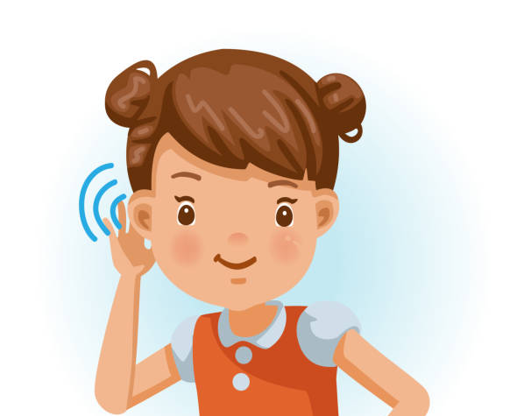
A. WHAT TO DO TO STUDY ENGLISH 9 WELL
I. At school / Online
1. Listen to the teacher attentively.

Slide 5
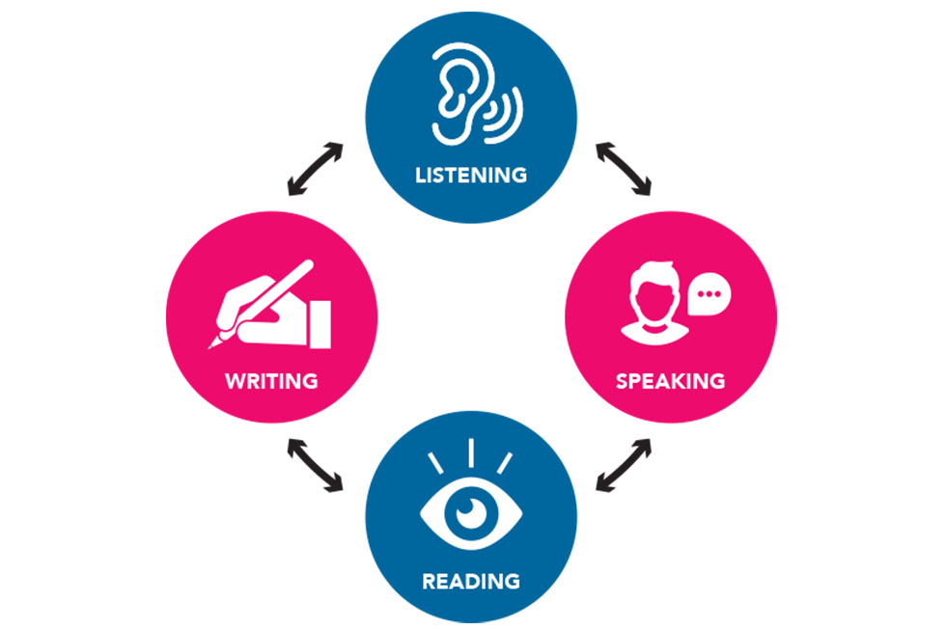
I. At school / Online
2. Practice listening, speaking, reading and writing skills actively.

Slide 6

I. At school / Online
3. Write lessons carefully.

Slide 7
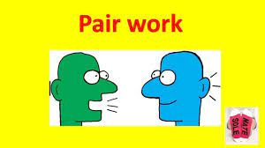

I. At school /Online
4. Take part in class activities, especially working in pairs or in groups.

Slide 8
A. WHAT TO DO TO STUDY ENGLISH 9 WELL
I. At school / Online
1. Listen to the teacher attentively.
2. Practice listening, speaking, reading and writing skills actively.
3. Write lessons carefully.
4. Take part in class activities, especially working in pairs or in groups.

Slide 9

A. WHAT TO DO TO STUDY ENGLISH 9 WELL
II. At home
1. Study online regularly.

Slide 10

II. At home
2. Review the old lessons (learn vocabulary, word families and practice grammar).

Slide 11

II. At home
3. Do exercises after reviewing the old lessons.

Slide 12
II. At home
4. Practice 4 skills (listening, speaking, reading and writing).

Slide 13

II. At home
5. Prepare new lessons(new words, new structures).

Slide 14
II. At home
1. Study online regularly.
2. Review the old lessons (learn vocabulary, word families and practice grammar).
3. Do exercises after reviewing the old lessons.
4. Practice 4 skills (listening, speaking, reading and writing).
5. Prepare new lessons (new words, new structures).

Slide 15

B. CONTENT OF THE BOOK
- 10 units
- Each unit has 7 parts.
1. Getting Started
2. Listen and Read
3. Speak
4. Listen
5. Read
6. Write
7. Language focus

Slide 16
C. TEACHER’S GUIDELINES
1. How to study online effectively:
2. What to prepare: a textbook, 2 notebooks (lessons, exercises), a blue pen, a red pen, a pencil, a ruler, an eraser, a highlighter, a folder
3. How to write lessons
4. How to learn vocabulary and word families
5. What to do to develop 4 skills (listening, speaking, reading and writing)

Slide 17
HOMEWORK
Prepare Unit 1: A Visit From A Pen Pal
Getting Started – Listen and Read (p. 6-7)
New words:
Nouns: pen pal, mausoleum, mosque
Verbs: correspond, impress, pray, depend, keep in touch

Slide 18


