Slide 1
Unit 1: A VISIT FROM A PEN PAL
Lesson 1: Getting started
Listen and read

Slide 2
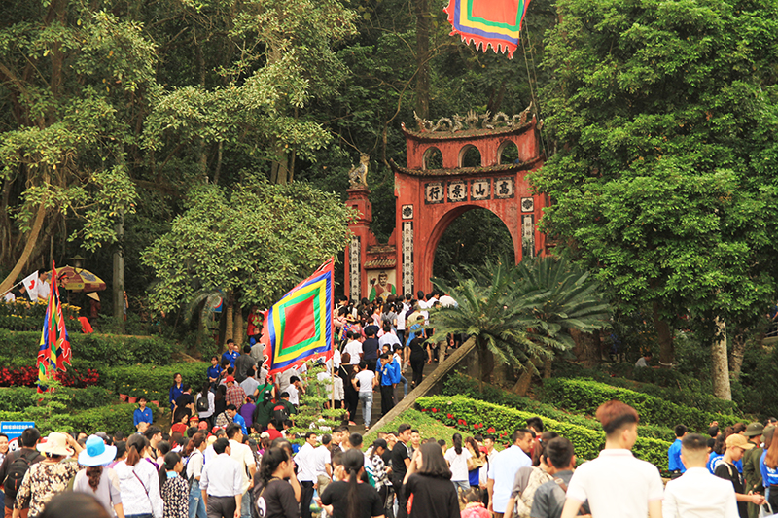
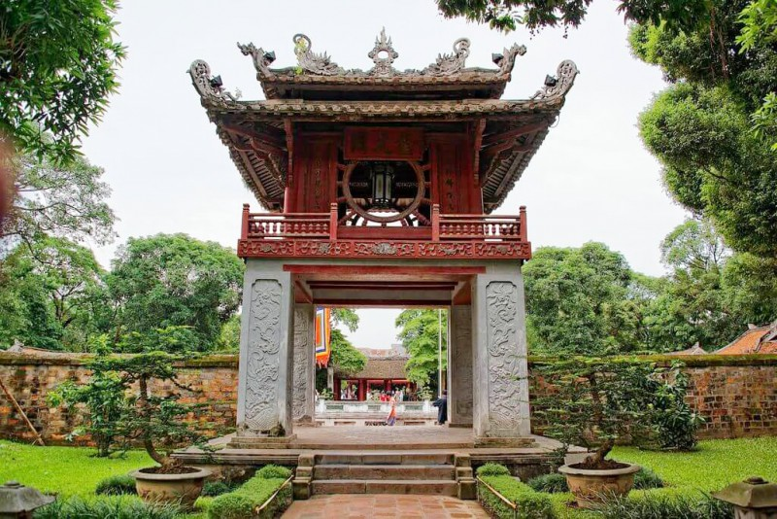
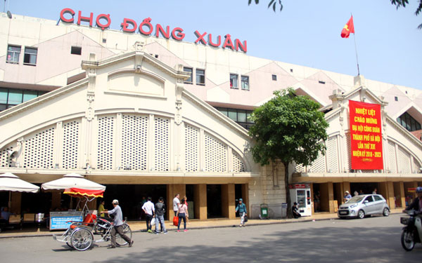
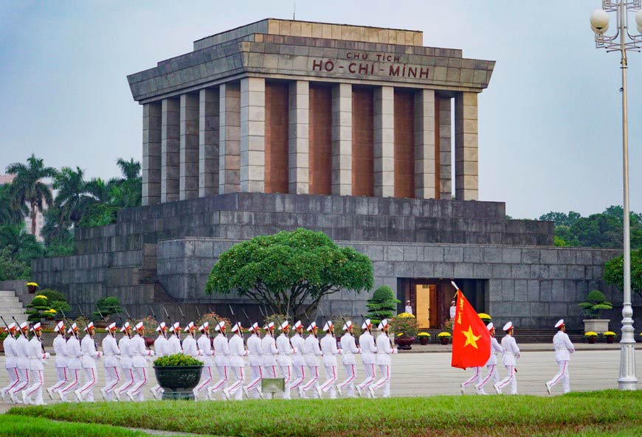
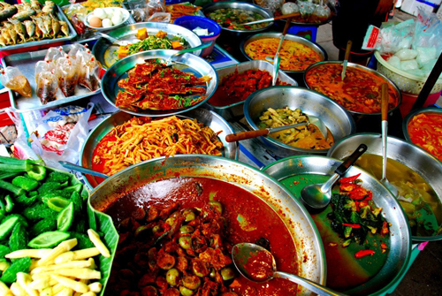
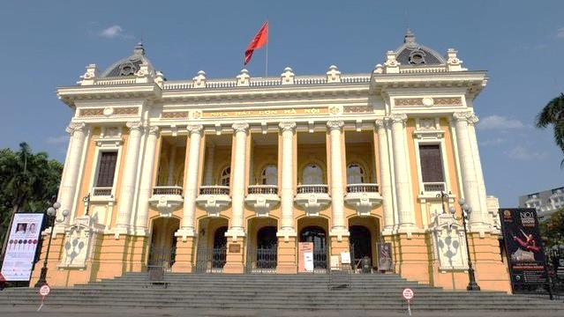
The Temple of Literature
Dong Xuan Market
Ho Chi Minh’s Mausoleum
Ha Noi
Opera House
a
b
c
The temple of Hung Kings
The Temple of Literature
Dong Xuan Market
d
e
f
Ho Chi Minh’s Mausoleum
Ha Noi
Opera House
Street food stall
The temple of Hung Kings
Street food stall

Slide 3

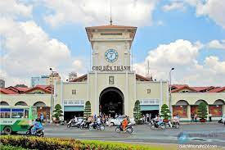
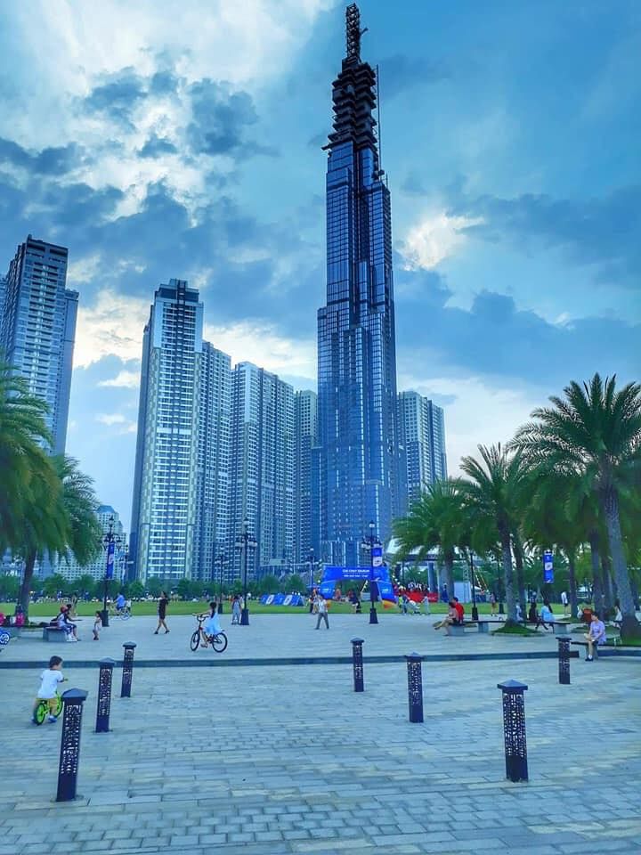
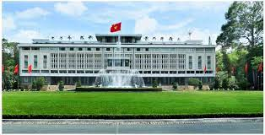
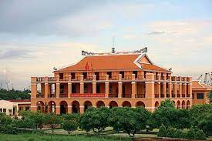
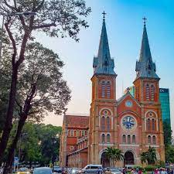
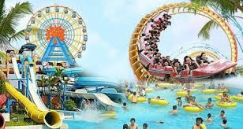
I. Getting started
You have a foreign pen pal. He /She is coming to stay with you for a week in Ho Chi Minh city. What activities would you do during the visit?
I think I would ………………

Slide 4


II. Listen and read
Lan
Maryam

Slide 5
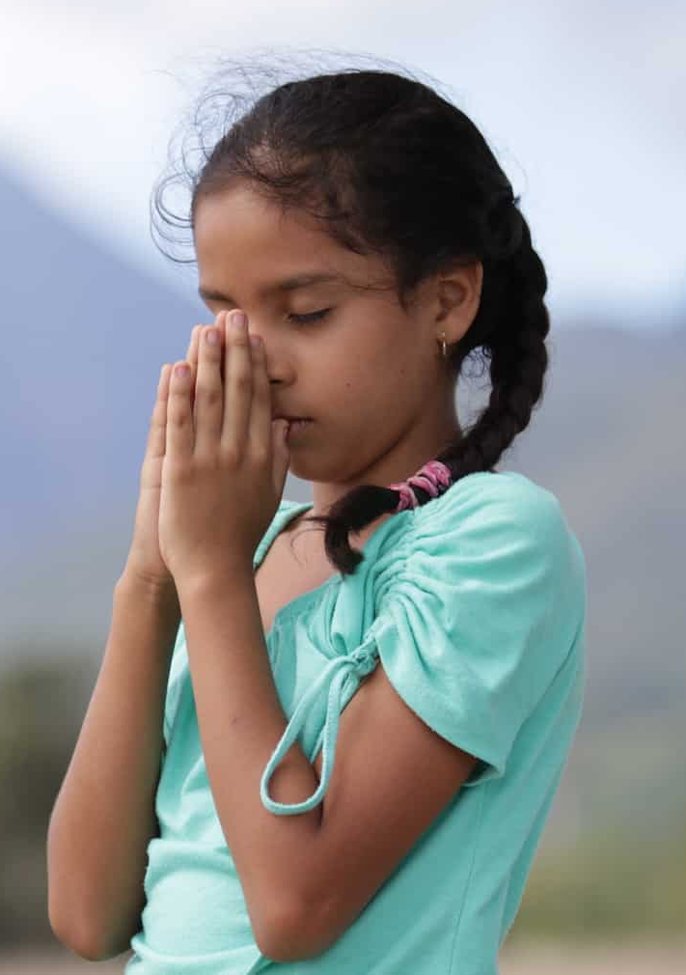
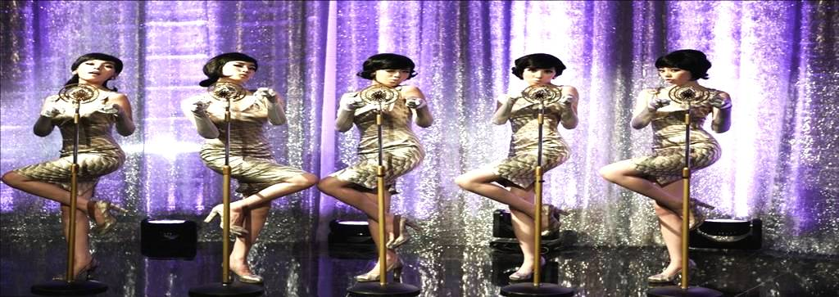
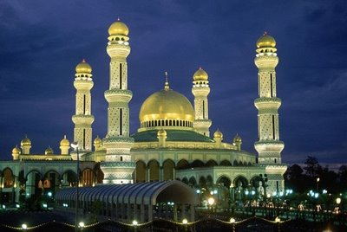
New words
correspond (v)
impress (v)
→ impression (n), impressive (adj), to be impressed by
friendliness (n)
mausoleum (n)
mosque (n)
peaceful (adj.)
atmosphere (n)
pray (v)
abroad (adv)
depend on (v)
keep in touch (v)
trao đổi thư từ
gây ấn tượng
sự thân thiện
lăng mộ
nhà thờ Hồi giáo
yên bình
bầu không khí
cầu khẩn, cầu nguyện
ra / ở nước ngoài
phụ thuộc, lệ thuộc vào
giữ liên lạc
We are impressed by beautiful singers.

Slide 6
New words
make a deep/ strong / good impression on s.o
gây ấn tượng sâu sắc / mạnh / tốt cho ai
on the way to
as well as
used to + V
be used to + V – ING
be used + to V
visit (v) = pay a visit to
a place of worship
trên đường đến
cũng như là
đã từng làm gì
quen với việc gì
được dùng để làm gì
thăm, viếng
nơi thờ cúng

Slide 7

II. Listen and read
True or false
1. Lan’s pen pal comes from Malaysia.
2. Kuala Lumpur is an old city.
3. The girls visited Hang Luoc Street on Monday.
4. They will write letters to each other again.
Answer: 1. True 2. False 3. False 4. True

Slide 8
Choose the correct option to complete the sentences
1. Lan and Maryam usually write to one another every …
A. two years B. months C. two weeks D. day
2. Maryam was impressed because …
A. Ha Noi was big and modern.
B. Ha Noi people were friendly.
C. Ha Noi was different from Kuala Lumpur.
D. Ha Noi and Kuala Lumpur were the same.
3. The girls went to see …
A. famous places in Ha Noi. C. a place of worship.
B. areas for recreation. D. all the above.
4. Maryam wanted to …
A. visit Ha Noi the next summer. C. stay in Ha Noi.
B. invite Lan to Kuala Lumpur. D. visit Ho Chi Minh City.
C. two weeks
B. Ha Noi people were friendly.
D. all the above.
B. invite Lan to Kuala Lumpur.

Slide 9
What did Lan say to Maryam at the end of the week?
“I wish you had a longer vacation.”
What did Maryam say
to Lan?
“I wish I had more time to get to know your beautiful country better.”

Slide 10
* THE PAST SIMPLE WITH “WISH”
E.g: I don’t have a computer
→ I wish I had a computer.
(be → were for all the subjects)
or we can use BE as in the past simple tense
I’m not tall.
→I wish I was/were taller.
My father has to work on the weekend.
→I wish my father didn’t have to work on the weekend.
S + wish(es) + S + V (past simple)

Slide 11

Make sentences with “wish”
a) I don’t understand what the man says.
b) My relatives live far from me.
c) My sister eats little food.
d) Nam always draws on the wall.
e)The Covid-19 pandemic is spreading rapidly now.
a) I wish I understood what the man says.
b)I wish my relatives didn’t live far from me.
c) I wish my sister ate more food.
d) I wish Nam didn’t draw on the wall.
e) I wish The Covid-19 pandemic ended now.

Slide 12
HOMEWORK
 Learn new words and structures.
 Prepare lesson 2: Speak and listen.

Slide 13
Thank you
FOR YOUR ATTENTION

