Slide 1



WELCOME
ALL grade 8 STUDENTS
Notes:
1

Slide 2
UNIT 7: MY NEIGHBORHOOD
LANGUAGE FOCUS (P. 69-71)

Slide 3
1. Match each verb to its past participle.
1. be
2. go
3. eat
4. live
5. attend
1-d
2-a
3-e
4-b
5-c
a. gone
b. lived
c. attended d. been
e. eaten

Slide 4
Exercise 1. Match each verb to its past participle.
6. see
7. do
8. write
9. work
10. collect
6-g
7-h
8-i
9-j
10-f
f. collected
g. seen
h. done
i. written
j. worked

Slide 5
1) Present perfect with for and since (Cách sử dụng for và since ở thì hiện tại hoàn thành)
GRAMMAR:
for + a period of time (1 khoảng thời gian)
since + a point of time (1 mốc thời gian)
Ex:
for five months
for eight weeks
for a long time
since Tuesday
since 2012
since he went to America

Slide 6

Exercise 2. Complete the expressions. Use for or since.
1) ______ five minutes
2) ______ January
3) ______ 1990
4) ______ the summer
5) ______ three hours
6) ______ two weeks
7) ______ Friday
8) ______ 20 years
for
for
since
for
since
since
since
for

Slide 7
2) Present perfect tense (Thì hiện tại hoàn thành)
a) Formation:
* Positive:
I/ We/ You/ They + have + V3/Ved
He/ She/ It + has + V3/Ved
Note: p.p = past participle (quá khứ phân từ): V_ed/ V3
Ex:
- They have lived here since 2017.
- I have lost my keys. I don’t know where they are.
- Lan has learned English for five years.

Slide 8
2) Present perfect tense (Thì hiện tại hoàn thành)
a) Formation:
* Negative:
I/ We/ You/ They + haven’t + V3/Ved
He/ She/ It + hasn’t + V3/Ved
Note: haven’t = have not; hasn’t = has not
Ex:
- They haven’t arrived yet.
- I haven’t told him yet.
- Laura has bought a new dress, but she hasn’t worn it yet.

Slide 9
2) Present perfect tense (Thì hiện tại hoàn thành)
a) Formation:
* Interrogative:
Have + I/ We/ You/ They + V3/Ved …?
Has + He/ She/ It + V3/Ved…?
Ex:
- Have Paul and Laura arrived yet?
- Have you ever been to Australia?
- I can’t find Susan. Where has he gone?

Slide 10
2) Present perfect tense (Thì hiện tại hoàn thành)
b) Usage:
We use present perfect:
to talk about something that began in the past and still continues now.
for new or recent happenings.
c) Signals:
for ever recently
since never lately
yet just already

Slide 11
Exercise 3. Complete the sentences. Use the present perfect form of the verbs in brackets.
a. I _____________ here since last week. (live)
b. We _____________ in that restaurant for two weeks. (not eat)
c. I _____________ her since yesterday. (not see)
d. They _____________ Quang Trung School since last year. (attend)
e. My Dad _____________ for this company for 20 years. (work)
f. Ba _____________ stamps since 1995. (collect)
have lived
haven’t eaten
haven’t seen
have attended
has worked
has collected

Slide 12
Exercise 4. Complete the conversation. Use the correct form of the verbs in the box.
hope be (3) live see look want
Ba: Hi. My name’s Ba.
Tom: Nice to meet you, Ba. I'm Tom.
Ba: Are you a newcomer here?
Tom: Yes. I (1) ___________ here since last week.
Ba: I’m sure you’ll love this place.
Tom: I (2) _______ so. How long _____ you (3) _______ here?
have been
hope
have
been

Slide 13
Exercise 4. Complete the conversation. Use the correct form of the verbs in the box.
hope be (3) live see look want
Ba: For 15 years.
Tom: So you must know the area very well. (4) _______ there a post office near here?
Ba: Yes. There's one next to my house. Why?
Tom: Ah! I (5) ________ to send this postcard to my parents.
Is
want

Slide 14
Exercise 4. Complete the conversation. Use the correct form of the verbs in the box.
hope be (3) live see look want
Ba: Let me have a look. Oh! It (6) ________ very beautiful. Where's your house?
Tom: In London. _______ you ever (7) ________ there? Ba: Not yet. But I (8) _______ it through films and magazines. I’m going there with my father next summer. Tom: That’s great. I hope to see you again there.
looks
Have
been
saw

Slide 15
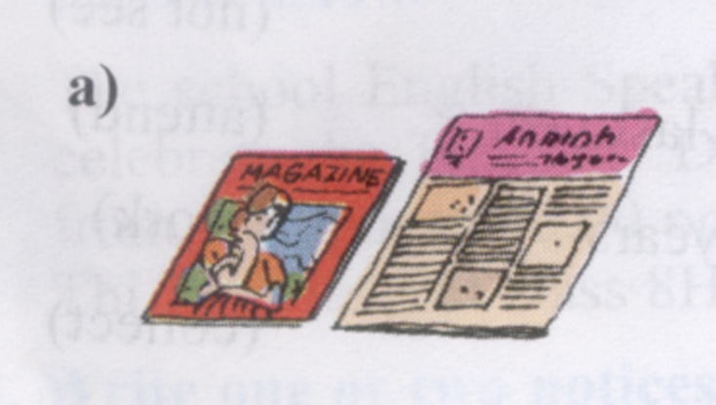
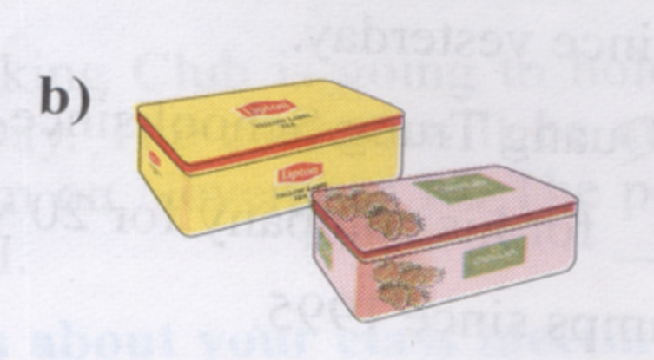
3) Comparison with like, (not) as … as, (not) the same as , different from
The magazine is not as large as the newspaper.
Lipton tea is different from Dilmah tea.

Slide 16
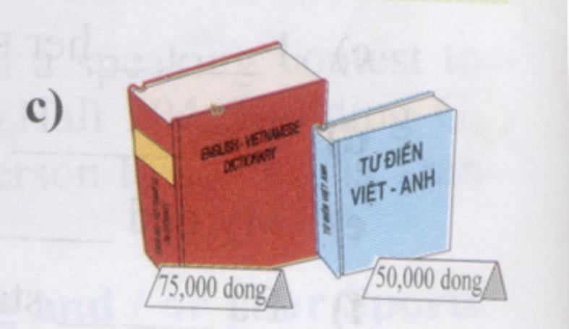
Exercise 5. Look at the pictures. Complete the sentences. Use the words in the box. You will have to use some words more than once.
different expensive cheap
modern long same large
The red dictionary is ____________________ the blue dictionary.
more expensive than

Slide 17
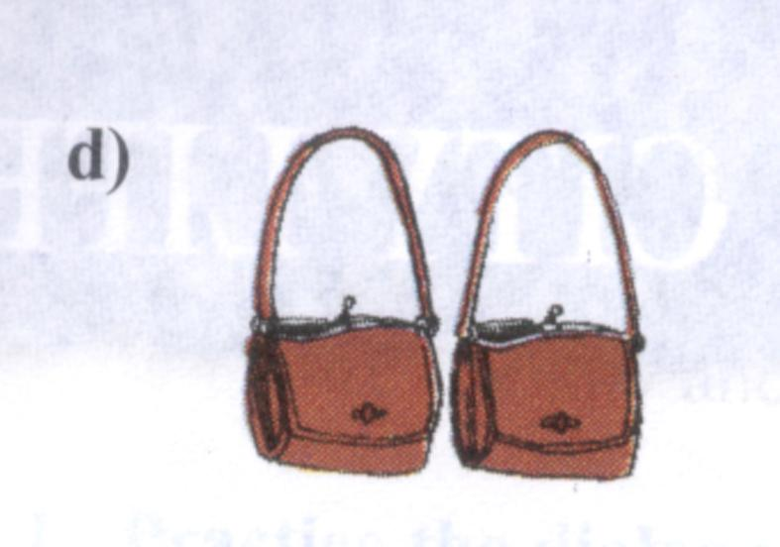
Exercise 5. Look at the pictures. Complete the sentences. Use the words in the box. You will have to use some words more than once.
different expensive cheap
modern long same large
The bag on the left is ___________ the bag on the right.
the same as

Slide 18
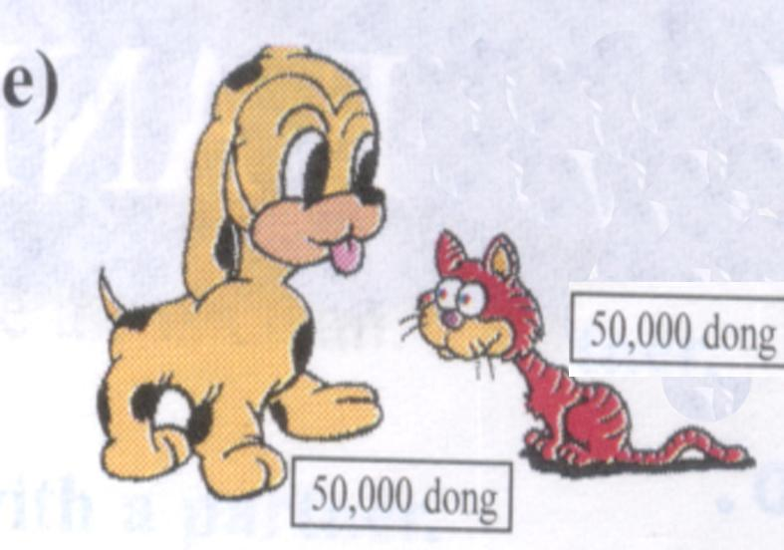
Exercise 5. Look at the pictures. Complete the sentences. Use the words in the box. You will have to use some words more than once.
different expensive cheap
modern long same large
The toy cat is ______________ the toy dog.
the same price as

Slide 19
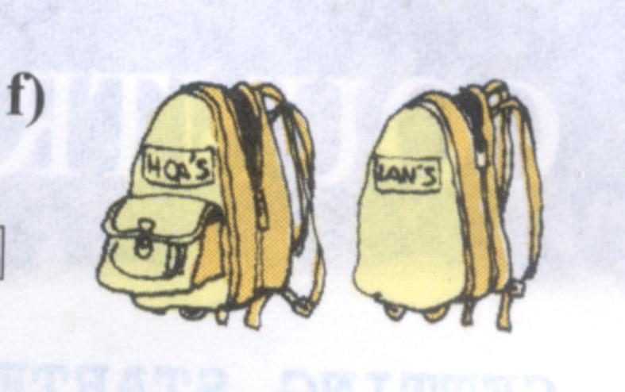
Exercise 5. Look at the pictures. Complete the sentences. Use the words in the box. You will have to use some words more than once.
different expensive cheap
modern long same large
Hoa’s backpack is _____________ Lan's backpack.
different from

Slide 20
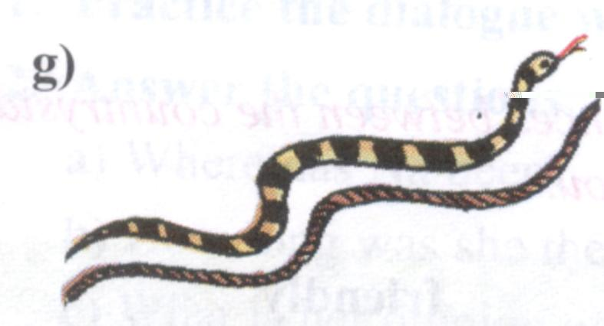
Exercise 5. Look at the pictures. Complete the sentences. Use the words in the box. You will have to use some words more than once.
different expensive cheap
modern long same large
The snake is ____________ the rope.
as long as

Slide 21
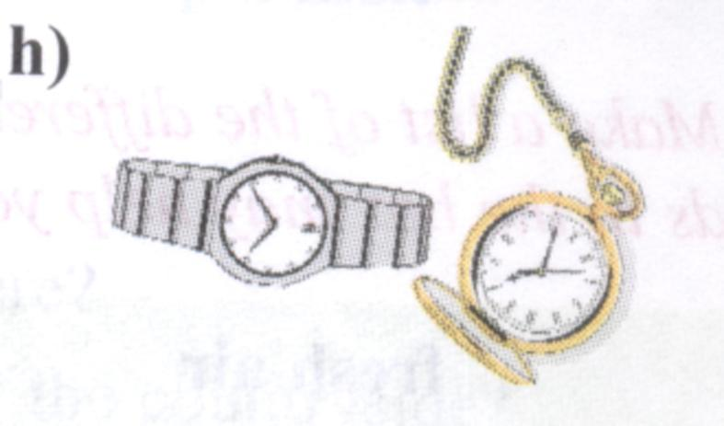
Exercise 5. Look at the pictures. Complete the sentences. Use the words in the box. You will have to use some words more than once.
different expensive cheap
modern long same large
The pocket-watch is _______________ the wristwatch.
not as modern as

Slide 22
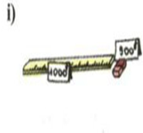
Exercise 5. Look at the pictures. Complete the sentences. Use the words in the box. You will have to use some words more than once.
different expensive cheap
modern long same large
The ruler is ____________________ the eraser.
not as cheap as

Slide 23

Homework
1. Learn grammar notes by heart.
2. Prepare Unit 8: Country Life And City Life (Listen and read)

