Slide 1

WELCOME TO OUR CLASS

Slide 2

Greeting the teachers are coming today

Slide 3
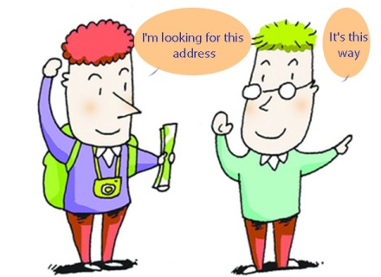

Unit 8 : Places
Part A: Asking the way.

Slide 4
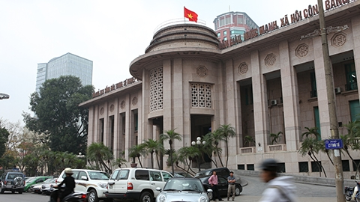
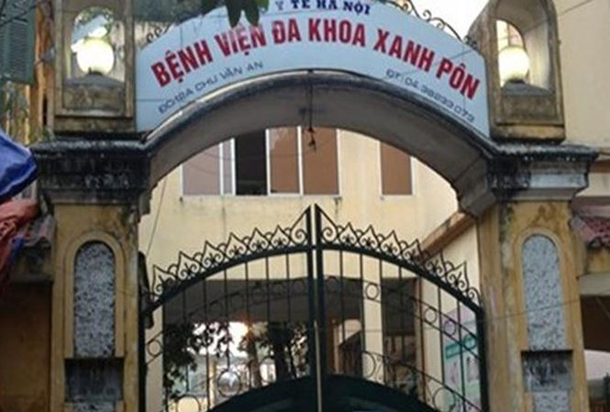
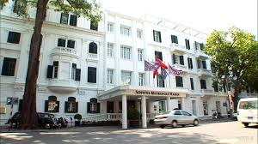
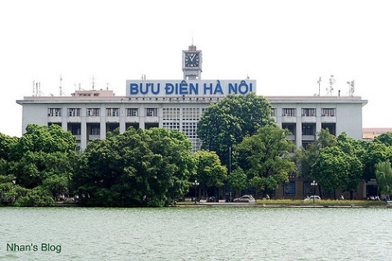
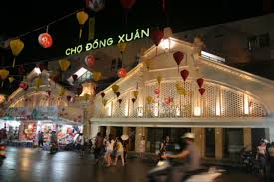
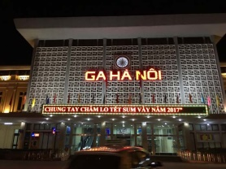
Match the names to correct pictures :
1. The central Post office
2. Đông Xuân market
3. Ha Noi Railway Station.
4. National Bank of Viet Nam
5. Hotel
6. Saint Paul Hospital.
Page 79
a)
b)
c)
d)
e)
f)

Slide 5
Answer key
1. – (d) The central Post office.
2. - (f) Đong Xuan market.
3. – (e) Ha Noi railway station.
4. – (a) National Bank of Viet Nam.
5. –(c) Sofitel Metropole Hotel.
6. – (b) Saint Paul Hospital.

Slide 6
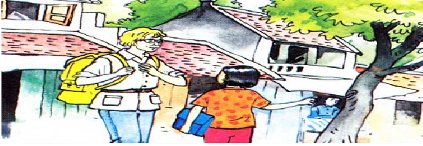

Part A: Asking the way.
Tourist
Nga
Where does the tourist want to go?
A souvenir shop

Slide 7
Tourist
Excuse me
a)Tourist: Excuse me. Is there a souvenir shop near here?
Nga: Yes. There is one on Hang Bai Street.
Tourist: Could you tell me how to get there?
Nga: Go straight ahead. Take the second street on the left. The souvenir shop is on the right, opposite the post office.
Tourist: Thank you.
Nga: You're welcome.
a souvenir shop
Go straight ahead
Take the second street

Slide 8
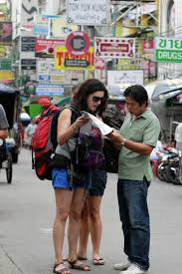
A tourist is asking the way.
A tourist is the one who travels somewhere

Slide 9
Ex: Excuse me. Is there a souvenir shop near here?
Excuse me : is the polite way to get someone’s attention.

Slide 10
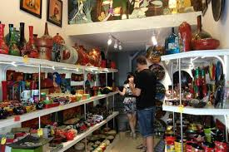
The souvenir shop

Slide 11

Giving directions
Go straight ahead

Slide 12

Take the second street on the left.

Slide 13

Take the first street on the right.

Slide 14
New words:
Tourist / ˈtʊrɪst / (n)
Excuse me. / ɪkˈskjuːz/ (exp)
Souvenir shop / ˈsuːvənɪr / / ʃɑːp / (n)
Go straight ahead.
Take the second street on the left .
Take the first street on the right.

Slide 15
a)Tourist: Excuse me. Is there a souvenir shop near here?
Nga: Yes. There is one on Hang Bai Street.
Tourist: Could you tell me how to get there?
Nga: Go straight ahead. Take the second street on the left. The souvenir shop is on the right, opposite the police station.
Tourist: Thank you.
Nga: You're welcome.

Slide 16
b)Tourist: Excuse me. Could you show me the way to the supermarket, please?
Lan: The supermarket? OK. Go straight ahead. Take the first street on the right. The supermarket is in front of you.
Tourist: Thanks a lot.
Lan: You're welcome

Slide 17
Ask for and give directions
Ask for directions
Could you show me the way to the…..?
Could you tell me how to get…..?
Đông Xuân market.
Ha Noi railway station.
Post office.

Slide 18

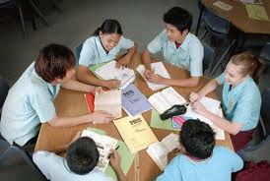


Work in groups
11
30
60
59
58
57
56
55
54
53
52
51
50
49
48
47
46
45
44
43
42
41
40
39
38
37
36
35
34
33
32
31
29
28
27
26
25
24
23
22
21
20
19
18
17
16
15
14
13
12
10
9
8
7
6
5
4
3
2
1
Stop
Start

Slide 19



Review some giving directions
Turn right
Turn left
Opposite

Slide 21
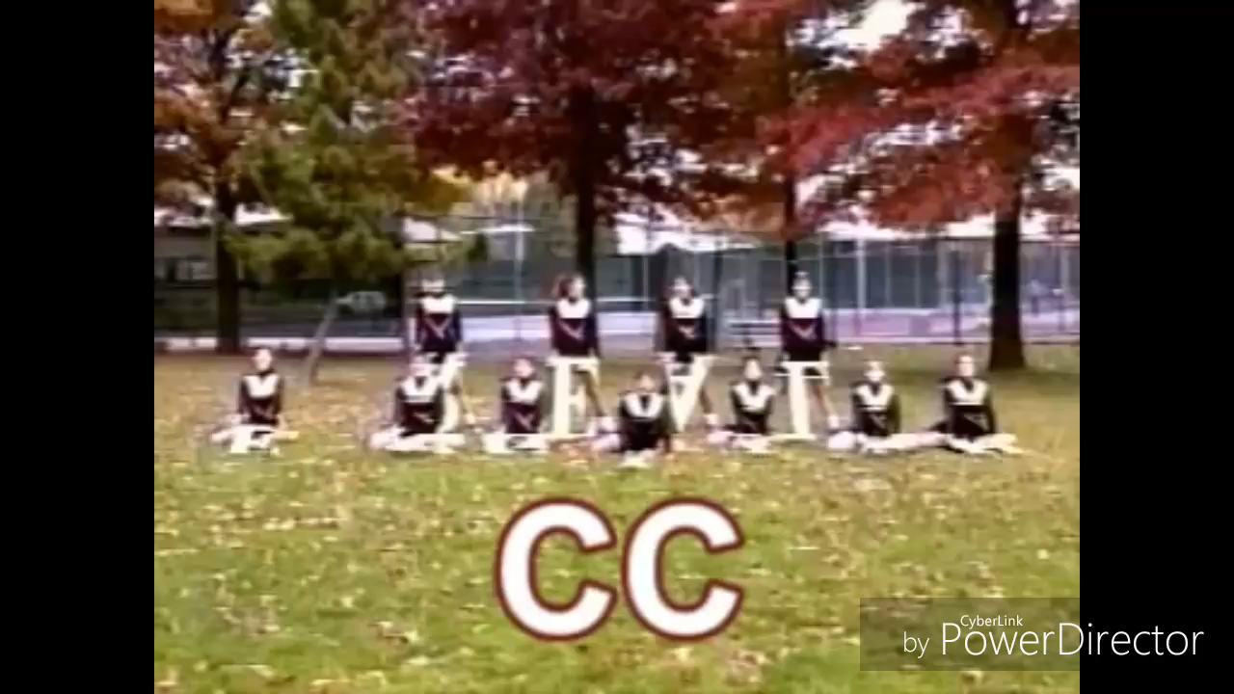

Slide 22


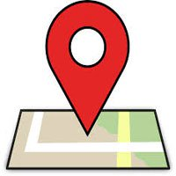
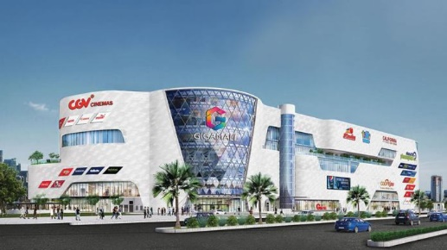



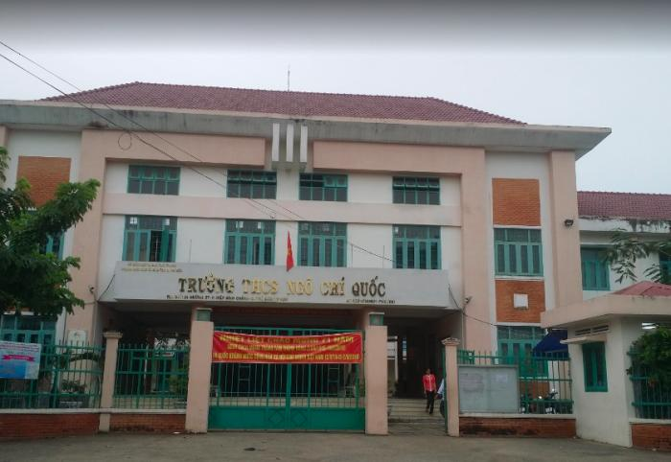

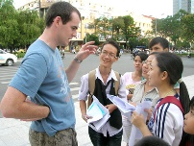
Practice asking and giving directions
ƯU ĐÀM pagoda
Pham Van Dong Street
GIGA MALL
Pham Van Dong Street
Street 27

Slide 23

Homework:
1. Learn by heart new words
2. Practice asking and giving directions.
3 . Prepare next lesson A3 page 81
A4,5 (hs tự học và tự thực hiện)

Slide 24

Thanks for your attendance
Have a happy weekend.

