Slide 1


Slide 2
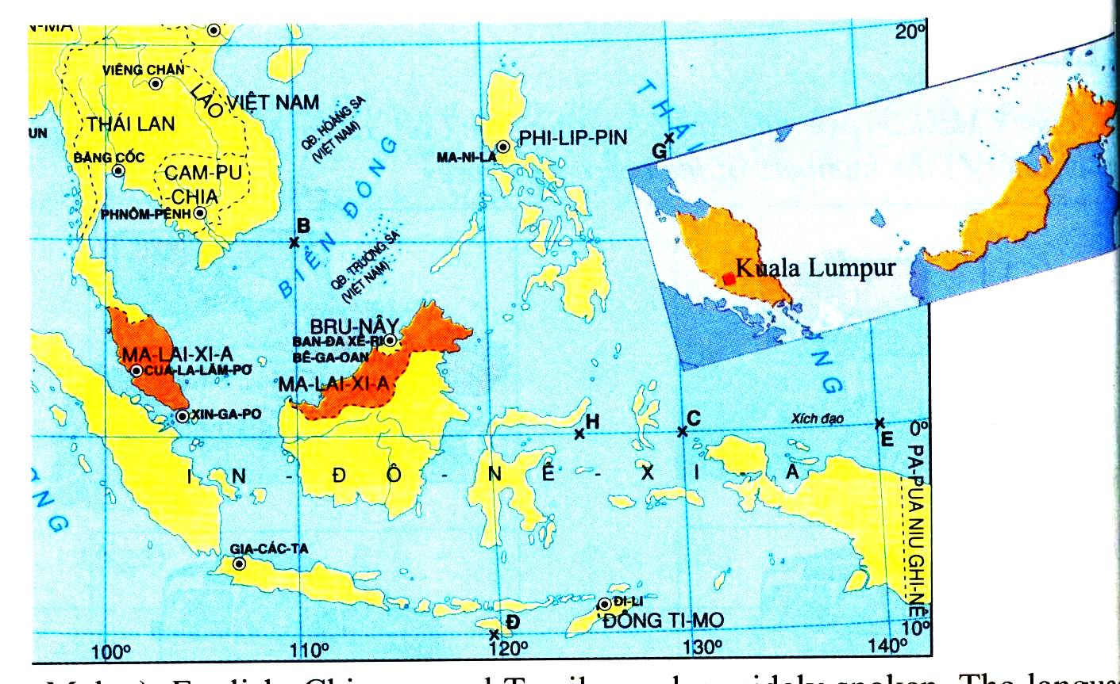
LOOK AT THE MAP. NAME THE COUNTRY.
MALAYSIA

Slide 3

Unit 1 : A VISIT FROM A PEN PAL
LESSON 3: READ

Slide 4

LISTEN AND ANSWER THE QUESTION.
What do you know about Malaysia?
Suggested answers:
→ It is a member country of ASEAN, the Association of South East Asian Nations.
→ The capital city is Kuala Lumpur.
→ The population in 2001 was over 22 million.
→ It has tropical climate.
→ ...

Slide 5
NEW WORDS:
1. divide (into) /dɪˈvaɪd / (v):
chia, chia ra
2. region /ˈriːdʒən/ (n):
vùng, miền
3. separate /ˈsepəreɪt/ (v):
tách ra, phân chia
4. comprise /kəmˈpraɪz/ (v):
bao gồm
= consist of /kənˈsɪst əv/ (phr. v):
5. tropical climate /ˈtrɑːpɪkl ˈklaɪmət/ (n):
khí hậu nhiệt đới
6. unit of currency /ˈjuːnɪt əv ˈkɜːrənsi / (phr.):
đơn vị tiền tệ
7. population /ˌpɑːpjuˈleɪʃn/ (n):
dân số
8. religion /rɪˈlɪdʒən/ (n):
tôn giáo
- Islam /ˈɪzlɑːm//ɪzˈlɑːm/ (n):
đạo Hồi
- Buddhism /ˈbuːdɪzəm/ (n):
đạo Phật
- Hinduism /ˈhɪnduːɪzəm/ (n):
đạo Hindu, đạo Ấn
→ official religion /əˈfɪʃl rɪˈlɪdʒən/ (n)
tôn giáo chính thức
9. compulsory /kəmˈpʌlsəri/ (adj.)
bắt buộc
≠ optional /ˈɑːpʃənl/ (adj.):
tùy ý, không bắt buộc

Slide 6

Listen again. Then read the text silently to do the tasks in the book.

Slide 7
Malaysia is one of the countries of the Association of South East Asian Nations (ASEAN). It is divided into two regions, known as West Malaysia and East Malaysia. They are separated by about 640 km of the sea and together comprise an area of 329,758 sq km. Malaysia enjoys tropical climate. The Malaysian unit of currency is the ringgit, consisting of 100 sen.
The capital of Malaysia is Kuala Lumpur and it is also the largest city in the country. The population in 2001 was over 22 million. Islam is the country’s official religion. In addition, there are other religions such as Buddhism and Hinduism. The national language is Bahasa Malaysia (also known simply as Malay). English, Chinese, and Tamil are also widely spoken. The language of instruction for primary school children is Bahasa Malaysia, Chinese, or Tamil. Bahasa Malaysia is the primary language of instruction in all secondary schools, although some students may continue learning in Chinese or Tamil. And English is a compulsory second language.

Slide 8
Fill in the table with the right information about Malaysia:
Area:
Population:
Climate:
Unit of currency:
Capital city:
Official religion:
National language:
Compulsory second language:
329,758 sq km
over 22 million (in 2001)
tropical climate
ringgit
Kuala Lumpur
Islam
Bahasa Malaysia
English

Slide 9
True or False? Check (✓) the boxes. Then correct the false statements.
T
F
1. Malaysia is a member country of ASEAN.
2. There are two religions in Malaysia.
3. People speak only Malay in Malaysia.
4. Primary school children learn three languages at school.
5. All secondary school children learn in English.
✓
✓
→There are more than two religions.
✓
→ English, Chinese, and Tamil are also widely spoken.
✓
→ One of the three: Malay, Chinese, Tamil.
✓
→ English is a compulsory second language, not primary language of instruction.

Slide 10

SUMMARY:
over 22 million
over 32 million
329,758 sq km
in 2001
tropical climate
now
Area
Population
Compulsory second language
Climate
MALAYSIA
Kuala Lumpur
English
Capital city
National language
Official religion
Bahasa Malaysia
Islam

Slide 11
Fill in the table with the right information about Vietnam:
Area:
Population:
Climate:
Unit of currency:
Capital city:
Religions:
National language:
Foreign languages:
331,212 sq km
over 98 million
tropical climate
dong
Ha Noi
Buddhism, Catholicism, …
Vietnamese
English, Chinese, French…

Slide 12
1. Learn new words by heart.
Homework
2. Prepare Unit 1 (cont.): Write (p. 11)
- Review: How to write a letter

Slide 13


