Slide 1
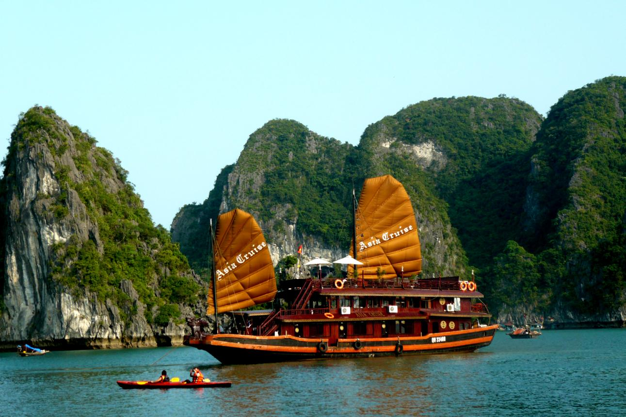
Unit 11: Traveling around Viet Nam
Lesson : READ
Teacher: Nguyễn Văn Thòn

Slide 2







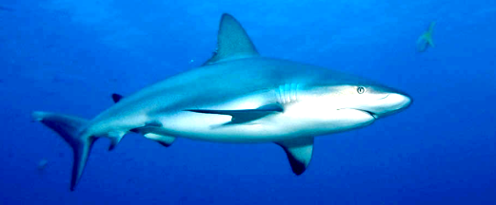
This is a famous beach in the central of Vietnam.
A
A
B
B
C
C
D
D
E
E
F
F
G
G
H
H
I
I
J
J
K
K
L
L
M
M
N
N
O
O
P
P
Q
Q
R
R
S
S
T
T
U
U
V
V
W
W
X
X
Y
Y
Z
Z

Slide 3
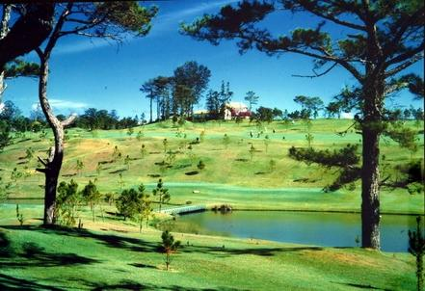
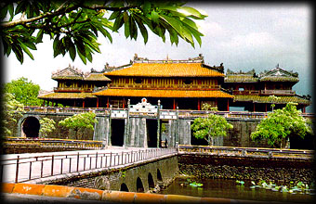
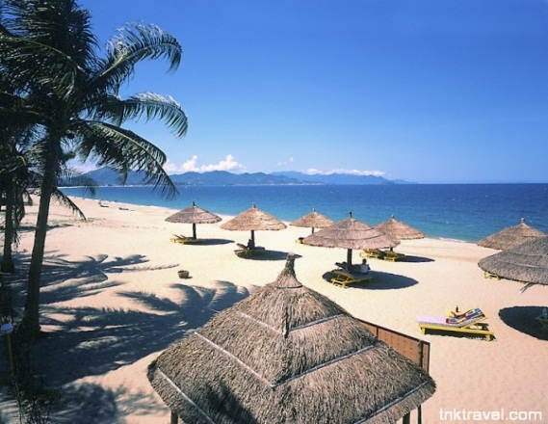
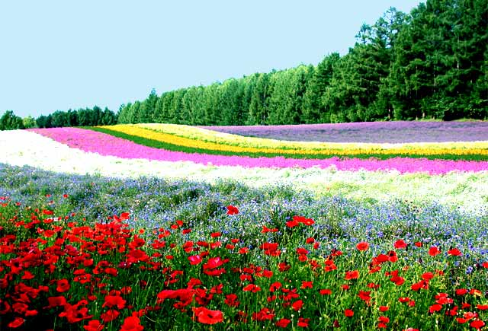
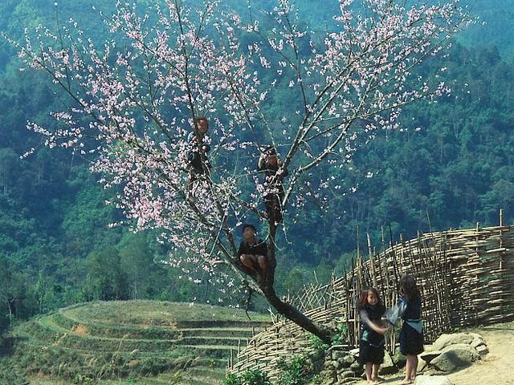
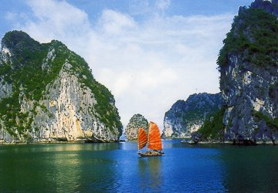
DA LAT
HUE
NHA TRANG
SA PA
HA LONG BAY

Slide 4
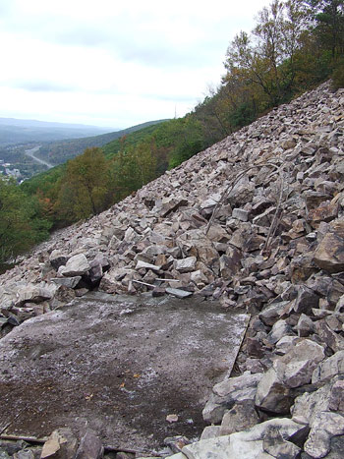
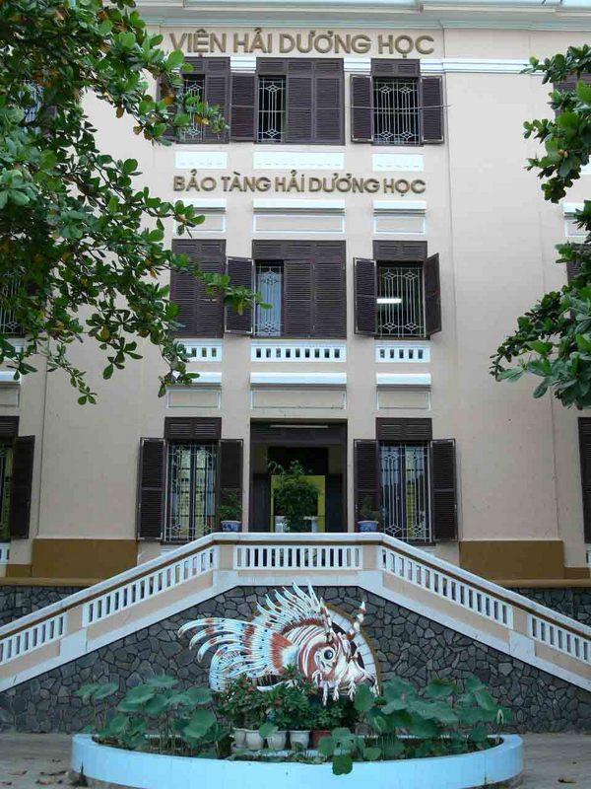
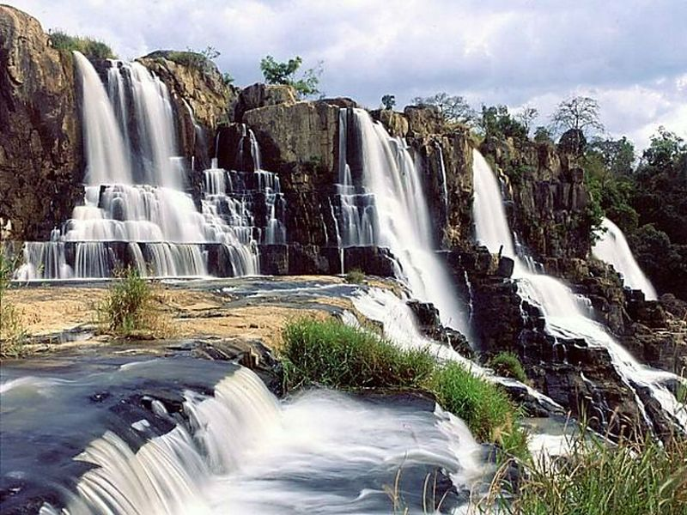
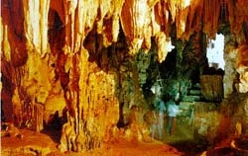
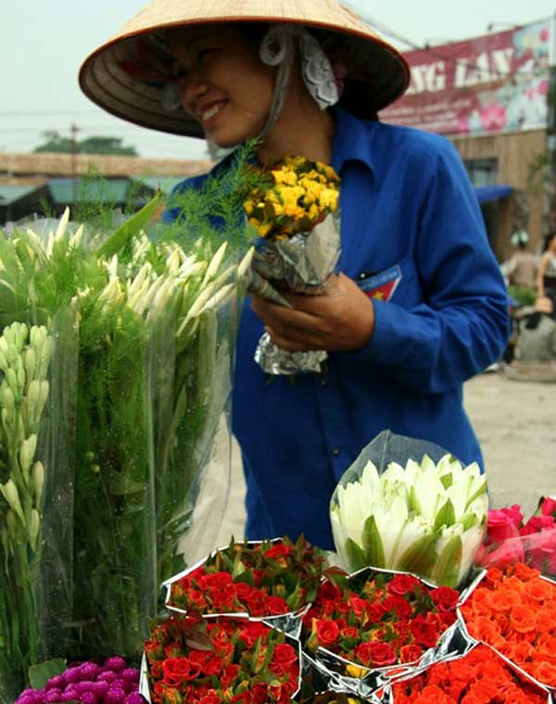
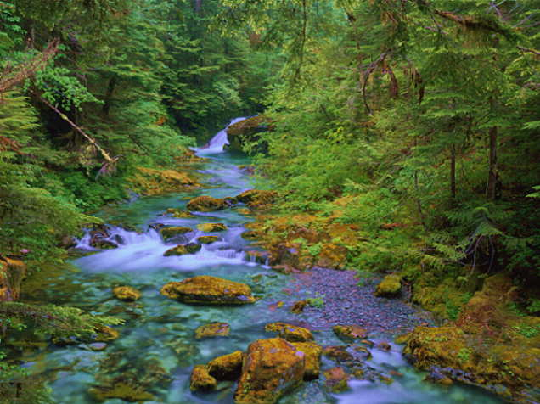
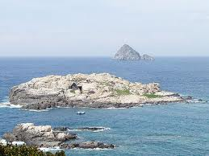
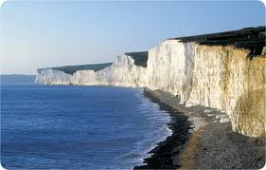
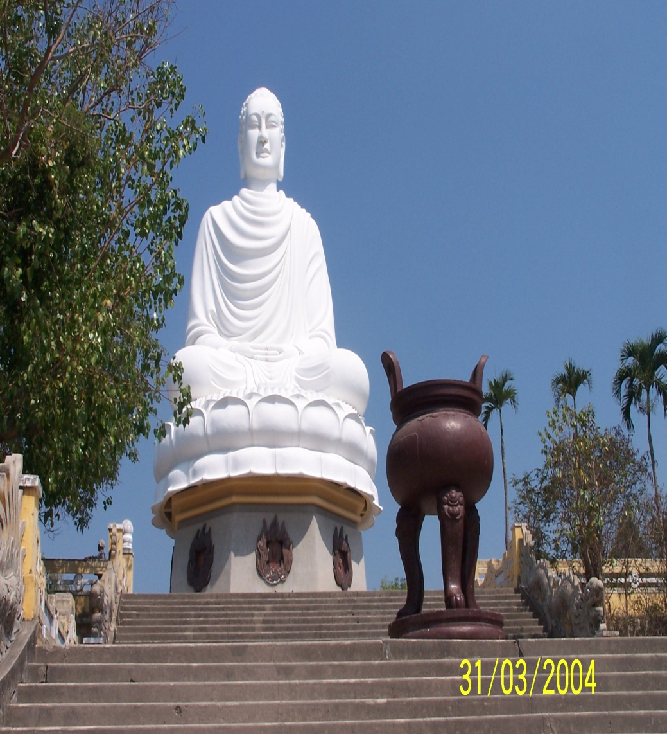
*Vocabulary:
viện hải dương học
- An Oceanic Institute:
- A giant Buddha:
tượng phật khổng lồ
- An offshore island:
đảo xa bờ
- A waterfall:
thác nước
dốc, sườn
- A slope:
- magnificent (adj):
hùng vĩ
- A cave:
hang động
- limestone (unc.):
đá vôi
người bán hoa
- A florist:

Slide 5

*Write true (T) or false (F) for the statements:
T
Nha Trang is a seaside resort. ………………..
Nha Trang is known as the city of Eternal Spring. ……….
Sa Pa is a mountainous resort. …………
Tourists can study tribes and climb mountains in Da Lat.
………………..
Ha Long Bay is a World Heritage Site. …………
In Ha Long Bay, you can see magnificent caves.
…………………
Da Lat
F
T
Sa Pa
F
T
T

Slide 6
*(1/p. 104) Check (✓) the topics:
 | Nha Trang | Da Lat | Sapa | Ha Long Bay
Caves
Flights to Ha Noi
Hotels
Local Transport
Mini-hotels
Mountain Slopes
Railway
Restaurants
Sand beaches
Tourist Attractions
Types of food
Villages
Waterfalls
World Heritage
✓
✓
✓
✓
✓
✓
✓
✓
✓
✓
✓
✓
✓
✓
✓
✓
✓
✓
✓
✓
✓
✓
✓
✓

Slide 7

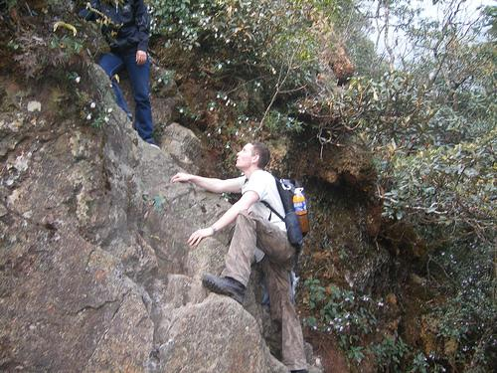

*(2/p.105) READ THE ADVERTISEMENTS AGAIN AND HELP THESE PEOPLE TO FIND THE SUITABLE PLACES.CHECK (√) THE BOXES:
Where should Andrew go?
a
Andrew studies tribes around the world. He likes mountain- climbing.
Nha Trang
Da Lat
Sa Pa
Ha Long Bay
Nha Rong Harbor

1
2
3
4
5

Slide 8
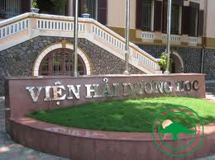
Where should Mary go?
b
Mary loves Viet Nam and she wants to travel by train to see as much of the country as possible. She also wants to visit oceanic institute in Viet Nam.
Nha Trang
Da Lat
Sa Pa
Ha Long Bay
Nha Rong Harbor

1
2
3
4
5

Slide 9
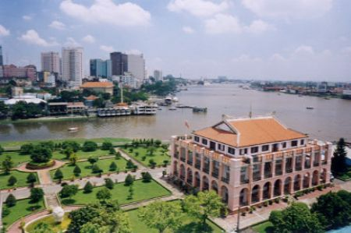
c
Where should John go?
John is interested in the history of Viet Nam. He wants to visit the places where President Ho Chi Minh left Viet Nam in 1911
Nha Trang
Da Lat
Sa Pa
Ha Long Bay
Nha Rong Harbor

1
2
3
4
5

Slide 10
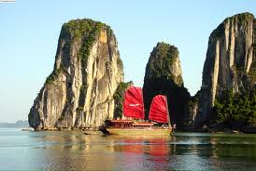
d
Where should Joanne go ?
Joanne likes swimming and sunbathing. She has been to Viet Nam twice and she has visited Nha Trang already
Nha Trang
Da Lat
Sa Pa
Ha Long Bay
Nha Rong Harbor

1
2
3
4
5

Slide 11
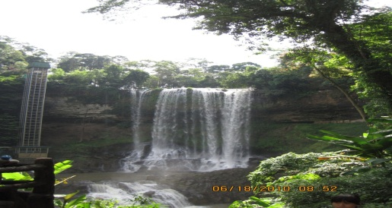
e
Where should Donna go ?
Donna is a florist. She has a flower shop in Los Angeles. She is thinking of importing flowers from Viet Nam.
Nha Trang
Da Lat
Sa Pa
Ha Long Bay
Nha Rong Harbor

1
2
3
4
5

Slide 12
*Talk about Where these people should go?, and why?:
Name | Place | Reason
Andrew
Mary
John
Joanne
Donna
Sa Pa
He studies tribes, and he likes mountain-climbing.
Nha Trang
She wants to visit an oceanic institute in Viet Nam.
Nha Rong Harbor
He wants to visit the place where President HCM left Viet Nam in 1911.
Ha Long Bay
She likes swimming and sunbathing and she has visited Nha Trang already.
She is a florist and she is thinking of importing flowers from Viet Nam.
Da Lat
1/Andrew
A: Where should Andrew go ?
B: He should go to Sa Pa.
A: Why ?
B: Because he studies tribes and he likes mountain-climbing.

Slide 13
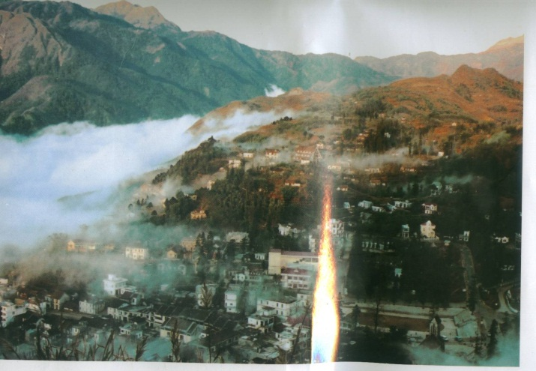
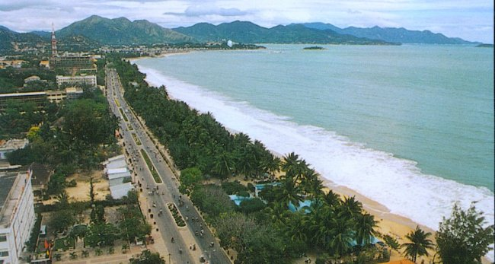
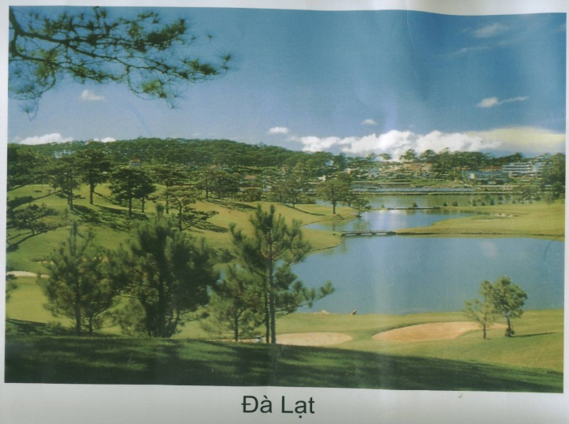
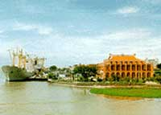
Sapa
About you :
Nha Trang
Which place do you like to visit this summer vacation? Why?
I like to visit Da Lat because I want to see flowers and waterfalls.
Ha Long Bay
Da Lat
Nha Rong Harbor

Slide 14

MATCHING:
florist
cave
limestone
Oceanic Institute
waterfall
giant Buddha

Slide 15
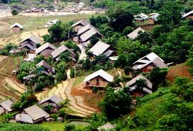
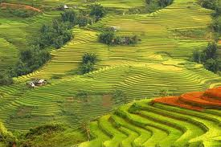
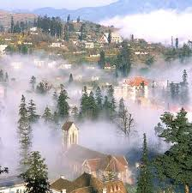
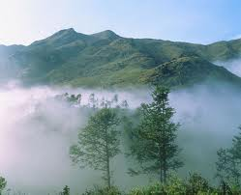

Slide 16

HOMEWORK
Learn vocabulary
Make plans for your
summer vacation.

Slide 17










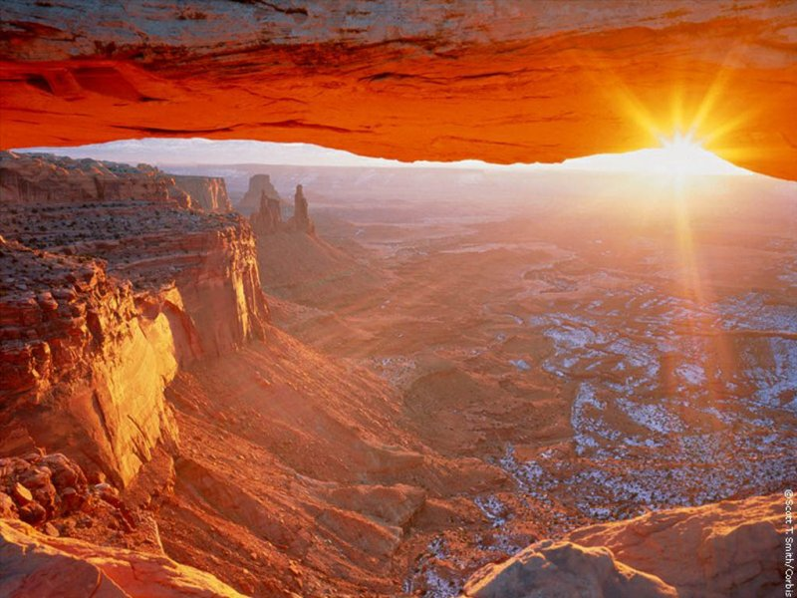
THE END

