Slide 1


Slide 2
UNIT 1: BACK TO SCHOOL
B4
B5
B6

Slide 3

Vocabulary
1. from …. to ….. : từ … đến …..
from your house to school : từ nhà bạn đến trường.
2. far (adj) : xa
3. How far : bao xa
4. about : khoảng, tầm
5. kilometer : ki-lô-mét (km)

Slide 4

Structure
We use “Where” to know a place.
(Hỏi nơi chốn)

Slide 5


Structure
Your house
Pham Van Chieu Street
Where do you live?
I live on Pham Van Chieu street.

Slide 6
Structure
Your house
Pham Van Chieu Street
Where do you buy food?
I buy food (at the supermarket) on Pham Van Chieu street.

Slide 7

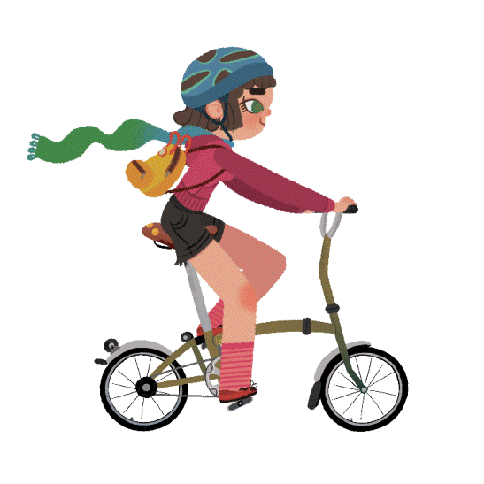
Structure
Hỏi về phương tiện
How do you go to school?
I go to school by bike.

Slide 8
Structure
We use “How far” about distance.
(Hỏi về khoảng cách)

Slide 9



Structure
Lan’s school
Lan’s house
three kilometers
How far is it from Lan’s house to Lan’s school?
It’s three kilometers.

Slide 10


PRACTICE
Where
__________ does she come from?
She comes from Japan.

Slide 11
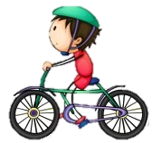
PRACTICE
How
__________ does he get to school?
He gets to school by bike.

Slide 12
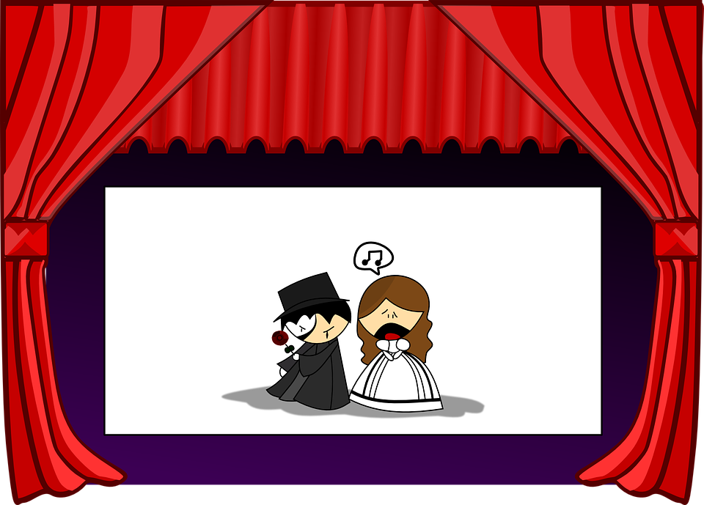
PRACTICE
How far
__________ is it from your house to the movie theater?
It’s about 3 kilometers

Slide 13

B4 Listen. Then practice with a partner.
Nam: Where do you live, Hoa?
Hoa: I live at 12 Tran Hung Dao Street.
Nam: How far is it from your house to school?
Hoa: It’s not far – about one kilometer.
Nam: How do you go to school?
Hoa: I go to school by bike.
Practice – B5

Slide 14

HOMEWORK
Learn the new words by heart.
Make 4 or 5 sentences to ask and answer about the distance from your house to your neighborhood.

