Slide 1
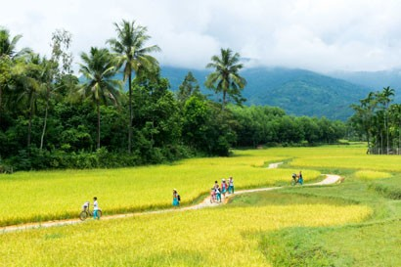
UNIT 3: A TRIP TO THE COUNTRYSIDE
LESSON 3: READ

Slide 2
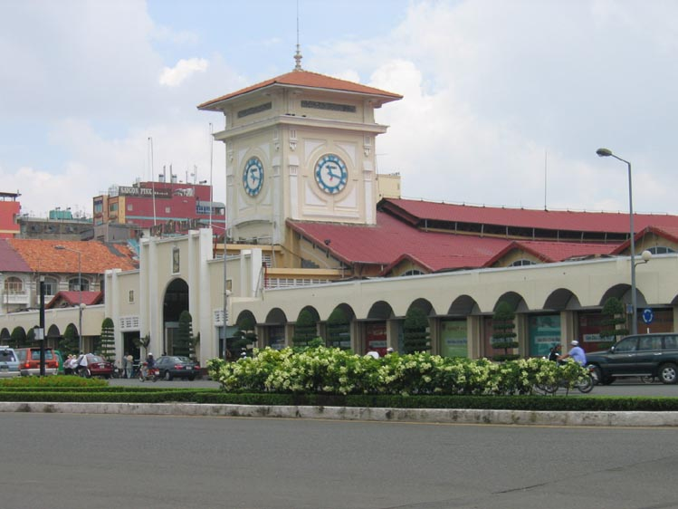
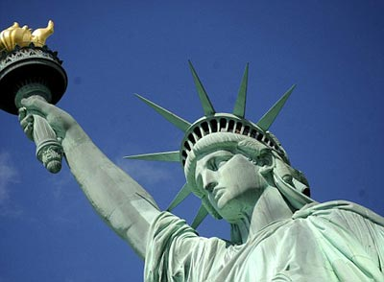


Vietnam
USA
VAN

Slide 3
exchange student (n): du học sinh, học sinh đi du học

Slide 4

part-time job (n): công việc bán thời gian
→ do a part-time job: làm việc bán thời gian
→ work part-time: làm việc bán thời gian

Slide 5
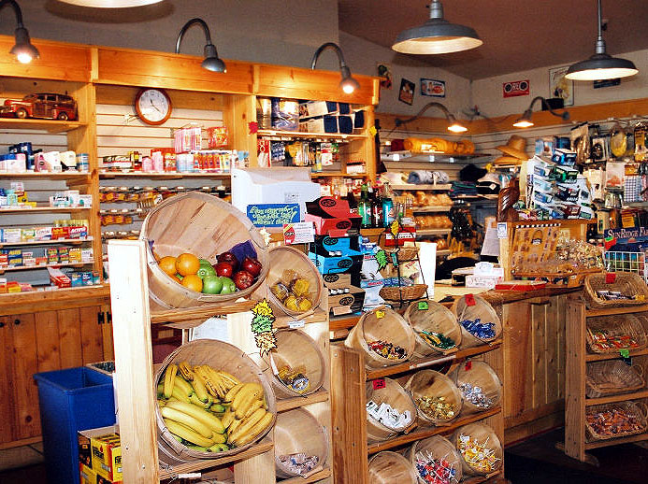
grocery store (n): cửa hàng tạp hóa

Slide 6
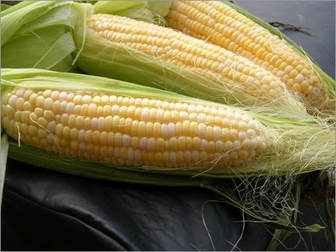
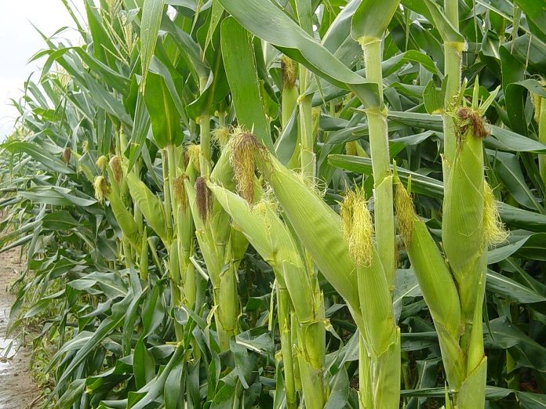
maize (n): ngô, bắp
→ grow maize: trồng ngô, bắp

Slide 7
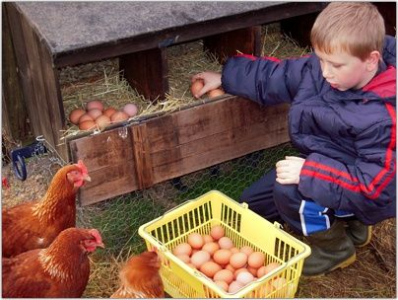
collect (v): thu gom
→ collect the eggs: thu gom trứng

Slide 8
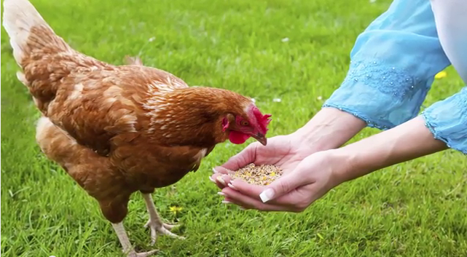
feed – fed – fed (v): cho ăn
→ feed the chickens: cho gà ăn

Slide 9
I. New words:
exchange student (n): du học sinh, học sinh đi du học
part-time job (n): công việc bán thời gian
→ do a part-time job: làm việc bán thời gian
→ work part-time: làm việc bán thời gian
grocery store (n): cửa hàng tạp hóa
maize (n): ngô, bắp
→ grow maize: trồng ngô, bắp
collect (v): thu gom
→ collect the eggs: thu gom trứng
feed – fed – fed (v): cho ăn
→ feed the chickens: cho gà ăn

Slide 10
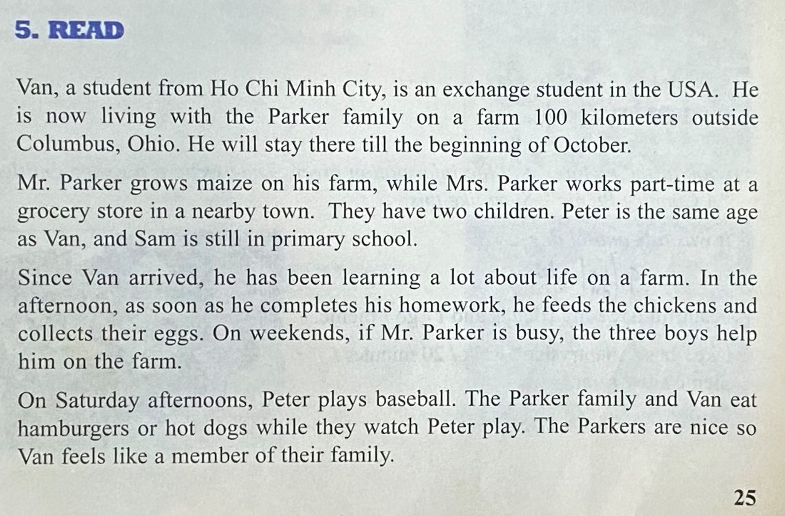


Slide 11
CONTENT THE PASSAGE
collect the eggs
THE COUNTRYSIDE
Van
exchange student
grow maize
feed the chickens
Parker family
Mr. Parker
Mrs. Parker
Peter
Sam
farmer
part-time
primary school
grocery store

Slide 12
MATCHING (a/26)
bring things together
where people buy food and small things
give food to eat
corn
shorter or less than standard time
maize
feed
grocery store
part - time
collect

Slide 13
GAP-FILLING (b/26)
A Vietnamese boy named Van is living with the Parker family in the American state of (1) ......... Mr. Parker is a (2)...................and Mrs.Parker (3)..................................................................in a nearby town. They have two children, (4) .......... and (5) ........ . Van often does chores (6).......... school. Sometimes he also helps on the
(7) ......... .The family relaxes on Saturday afternoons and (8)......................Peter play
(9)................. Van likes the Parkers, and he enjoys being a (10)............... of their family.
Ohio
farmer
works part – time at a grocery store
Peter
Sam
after
farm
they watch
baseball
member

Slide 14
II. GRAMMAR
ADVERB CLAUSES OF RESULT
EX : The Parkers are nice so Van feels like a member of their family.
→ The Parkers are nice , so Van feels like a member of their family.
Main clause
Adv. clause of result
“SO” → to express the result of the statement before.
S ₁ + V ….. , so + S₂ + V …..
→ Because the Parkers are nice, Van feels like a member of their family.

Slide 15
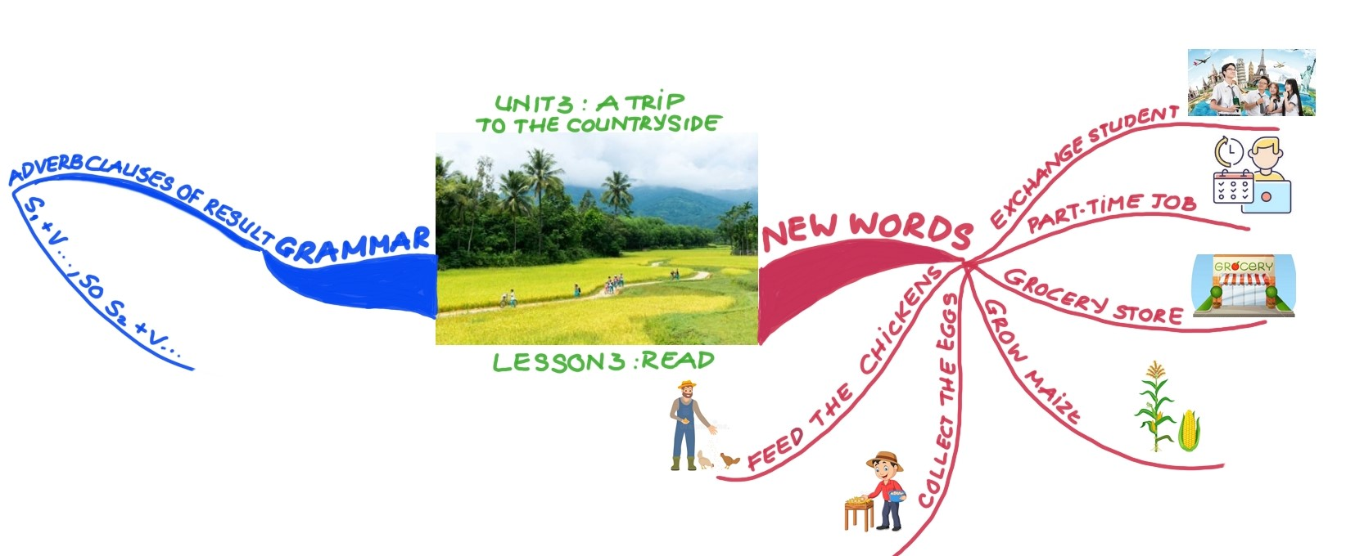

Slide 16
HOMEWORK
Learn new words.
Review grammar.
Prepare Unit 3: Write – Language focus

