Slide 1


Slide 2

Warm - up

Slide 3
KIM’S GAME
SUBJECTS AT SCHOOL

Slide 4

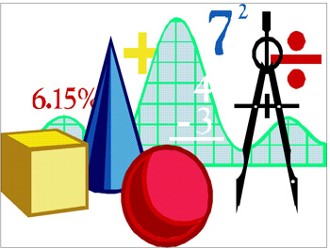

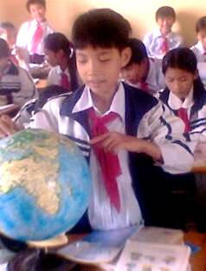
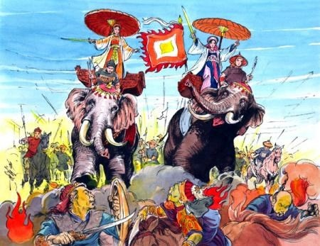
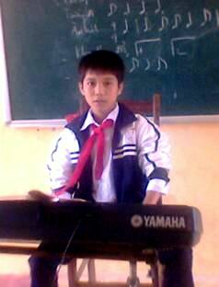
KIM’S GAME

Slide 5
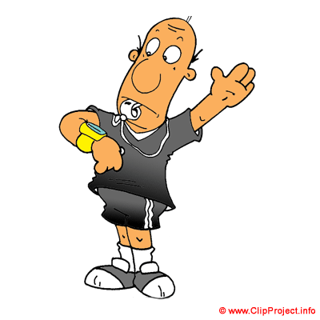
KIM’S GAME
0:00
0:01
0:02
0:03
0:04
0:05
0:06
0:07
0:08
0:09
0:10
0:11
0:12
0:13
0:14
0:15
0:16
0:17
0:18
0:19
0:20
0:21
0:22
0:23
0:24
0:25
0:26
0:27
0:28
0:29
0:30
0:31
0:32
0:33
0:34
0:35
0:36
0:37
0:38
0:39
0:40
0:41
0:42
0:43
0:44
0:45
0:46
0:47
0:48
0:49
0:50
0:51
0:52
0:53
0:54
0:55
0:56
0:57
0:58
0:59
1:00

Slide 6


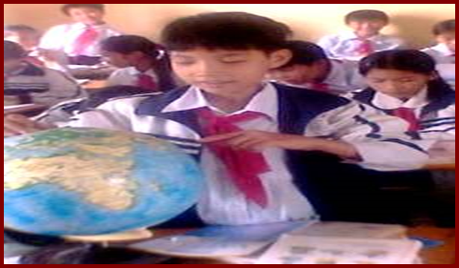

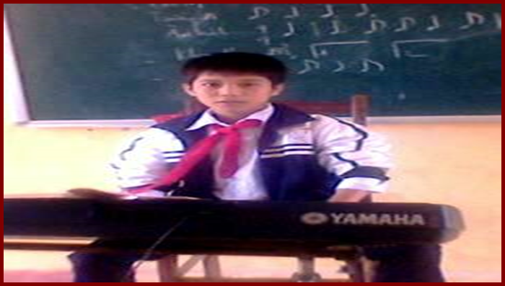

KIM’S GAME
0:00
0:01
0:02
0:03
0:04
0:05
0:06
0:07
0:08
0:09
0:10
0:11
0:12
0:13
0:14
0:15
0:16
0:17
0:18
0:19
0:20
0:21
0:22
0:23
0:24
0:25
0:26
0:27
0:28
0:29
0:30
0:31
0:32
0:33
0:34
0:35
0:36
0:37
0:38
0:39
0:40
0:41
0:42
0:43
0:44
0:45
0:46
0:47
0:48
0:49
0:50
0:51
0:52
0:53
History
Math
Geography
English
Music
Literature

Slide 7
Unit 4:
AT SCHOOL
A- Schedules
A4,5

Slide 8
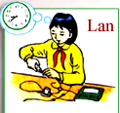


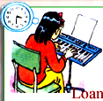
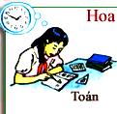
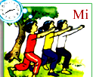
A4: Look at pictures and write subjects:
10.10
9.20
Physics
Geography
English
3.30
1.50
2.40
Music
Math
Physical Eduacation

Slide 9
Look at the pictures. Ask and answer questions:
8.40
- What is Lan studying?
-> Lan is studying physics.
- What time does Lan have her physics class?
-> She has her physics class at 8.40

Slide 10
10.10
Binh
What is …………studying ?
..……. is studying………………..
What time does …… have ……...............................?
………has …………………………..at…………
Binh
Geography
he
his Geography class
He
his Geography class
10.10

Slide 11
9.20
What is …………….studying ?
………. is studying……………
What time does ………… have ….............. ..........?
…………has …………………. .at…………
Hung
He
English
he
his English class
He
his English class
9.20

Slide 12
3.30
What is …………….studying ?
……………. is studying……………
What time does ………… have …........................?
…………has …………………..at…………
Loan
She
Music
she
her Music class
She
her Music class
3.30

Slide 13
1.50
Hoa
What is ………….studying ?
………. is studying…………
What time does ………… have …........................?
…………has …………………..at…………
She
Math
she
her Math class
She
her Math class
1.50

Slide 14
2.40
What is …………….studying ?
……. is studying…………………………
What time does ….. have……. …..............................?
……has ……………………………………at…………
She
Mi
Physical Education
she
her Physical Education class
She
her Physical Education class
2.40

Slide 15
Grammar
Review: The present progressive tense:
* Hỏi một ai đó đang làm gì:
Ex : What is Lan studying ?
She is studying Physics.
* Hỏi một ai đó thường làm gì vào lúc mấy giờ:
Ex : What time does Lan have her Physics class ?
She has her Physics class at 8.40
What + is / are + S + V-ing….?
S + is / am / are + V-ing…
What time + do / does + S + V…?
S + Vbare/ V(s/es) +…. + at + (time).

Slide 16

A5/ Listen and read.
Hoa: When do you have English?
Thu: I have English classes on Wednesday and Thursday.
Hoa: What time do they start?
Thu: My first English class is on Wednesday at 8.40.
On Thursday I have English at 9.40.
Hoa: What other classes do you have on Thursday?
Thu: I have Math, Geography, Physical Education and Music.
Hoa: What’s your favorite subject, Thu?
Thu: I like History. It ‘s an interesting and important
subject.
Hoa: Yes, I like it, too.
Thu: What’s your favorite subject?
Hoa: Oh, Math. It’s difficult, but fun.

Slide 17
* Answer the questions:
a. When does Thu have English classes?
- She has English classes on Wednesday and Thursday
b. What classes does Thu have on Thursday?
- She has Math, English, Geography, Physical Education and Music
c. What is Thu’s favorite subject? Why?
Her favorite subject is History.
(She likes History). Because it is interesting and important.
d. What is Hoa’s favorite subject? Why?
- Her favorite subject is Math. Because it is difficult but fun

Slide 18
GRAMMAR:
- Hỏi khi nào ai đó có môn học?
Ex : When do you have English ?
I have English classes on Wednesday and Thursday.
When + do / does + S + have + (names of subjects) ?
* S + have / has +…………..on………..
- Hỏi về môn học yêu thích:
Ex : What’s your favorite subject ?
I like English ( My favorite subject is English )
- What + be + one’s favorite subject ?
S + like(s) + (noun of subject).
(One’s favorite subject + be + Noun of subject. )

Slide 19


Practice: Ask and answer questions about schedule with a partner
 | Math | Literature | English | Literature
Math | Literature | Biology | Math | Math
Math | Literature | History | Geography | Music
Art | PE | English | PE | History
Music | English | English | Music | Class meeting
MONDAY
TUESDAY
WEDNESDAY
THURSDAY
FRIDAY
SATURDAY
School
assemble
I have English classes on Tuesday, Wednesday and Thursday.
When do you have English?
What other classes do you have on Thursday?
I have Math, Geography, Physical Education and Music.
What’s your favorite subject?
I like History and Math

Slide 20

Homework
Learn GRAMMAR by heart.
Practice asking and answering structures at home.
Prepare A6 (page 44. )

Slide 21


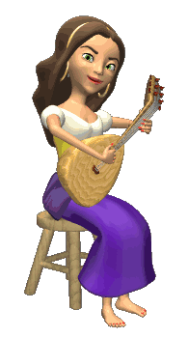

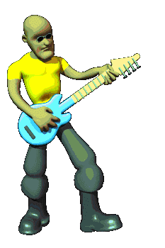
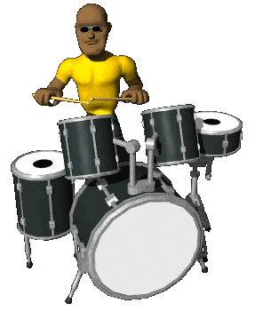

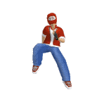



THANK YOU FOR ATTENTION!
GOOD BYE!
the end

