Slide 1
WARM UP
DO YOU LIKE PLAYING GAME?

Slide 2
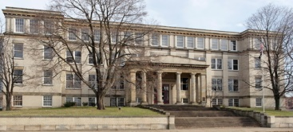
History
English
Math
Computer Science
Physical Education
Subjects
biology
Physics
Literature
Music
Chemistry
Geography
3:47

Slide 3
Wednesday, October 15th 2021
Period 26
Unit 4
AT SCHOOL
Lesson: B4

Slide 4
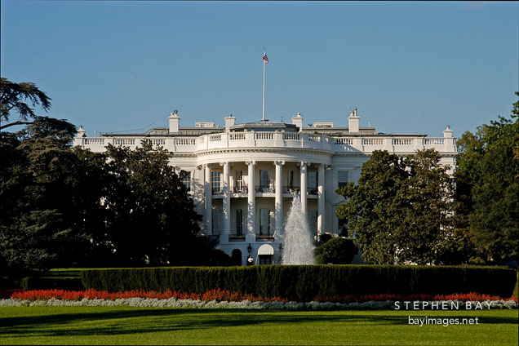
II. B4:READ.Then answer (P. 49) (hs nghiên cứu trưóc bài giảng để học trực tuyến với GV)
I. Vocabulary
Congress (n)( The United
States of Congress)
Quốc Hội(Hoa Kỳ)
Capital(n)
thủ đô
nhận
receive (v)
bản sao
copy (n)
contain (v)
chứa
The White House. Washington, D.C., USA

Slide 5
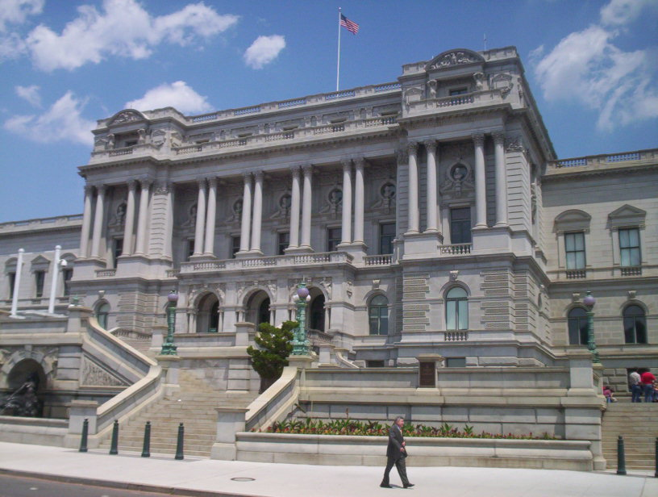
The Library of Congress

Slide 6
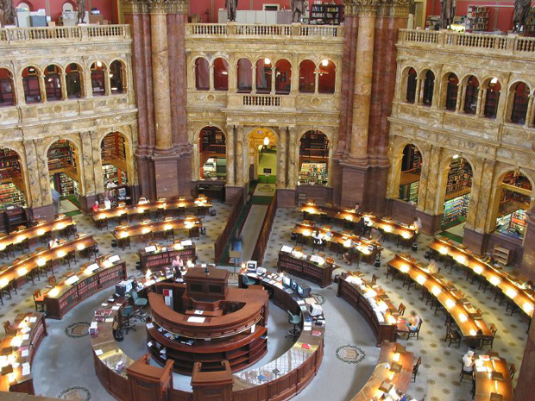
the reading room

Slide 7

The Library of Congress
One of the world’s largest libraries is the United State’s Library of Congress. It is in Washington D.C, the capital of the USA. It receives copies of all American books. It contains over 100 million books. It has about 1,000 km of shelves. It has over 5,000 employees.

Slide 8

True ( T ) or False ( F ) ?
T
F
1. The Library of Congress is in the capital of the USA.
V
2. It receives copies of all English books.
V
→ It receives copies of all American books.
3. There are over 100 million books in this library.
V
4. The shelves are about 800 km long.
V
→ The shelves are about 1,000 km long.
5. Over 5,000 people work in the library.
V

Slide 9
* Answer the questions:
Where is the Library of Congress?
How many books does it have?
How long are its shelves?
How many people work there?
Why is it so large?

Slide 10
ANSWERS:
a) Where is the Library of Congress?
- It’s in Washington D.C, the capital of the USA.
b) How many books does it have ?
- It has over 100 million books.
c) How long are its shelves?
-It has about 1,000 km of shelves.
d) How many people work there?
- There are over 5,000 people.
e) Why is it so large?
- Because it receives copies of all American books.

Slide 11

Choose the best option to complete the sentences.
1.Our school library………a lot of good books.
a. takes b. brings c. contains d. is
2. The books at the back of the library are in……….
a. History b. English c. Biology d. newspapers
3. The math books are …… the shelves …..the left
a. on/on b. at/at c. to/ to d. in/ in
4. The library ……two employees.
a. are b. is c. have d. has
5. Put the magazines on the racks in the…….of the room.
a. back b. left c. center d. right

Slide 12
Groupwork:
Discuss and describe your school library.
* Use the prepositions of place :
On / In / Behind / Next to
On the left / On the right
In the middle of
At the back of …

Slide 13

Homework
Learn by heart the new words.
Do exercises
Describe your school library ( 6-8 sentences ).
Prepare Unit 5-A 1,2(page 51 )

