Slide 1
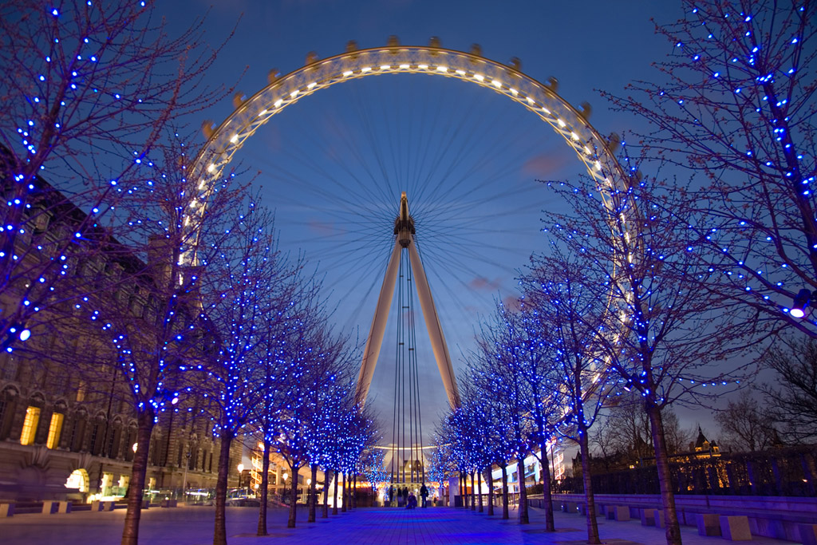
Welcome
Designed by : TA THI THU HA
OCTOBER. 2009

Slide 2

Warm - up
Look at some pictures. Say the names of the subjects.

Slide 3
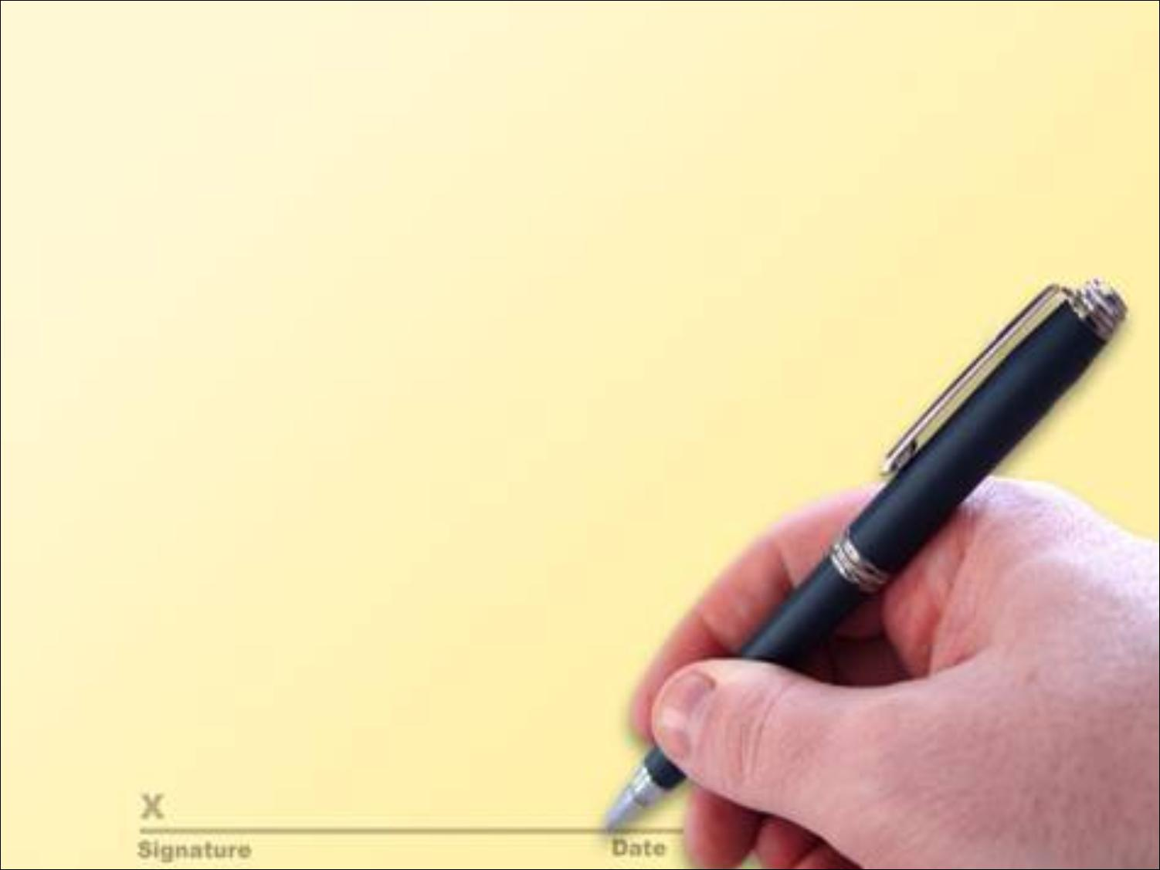

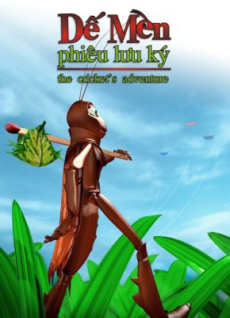
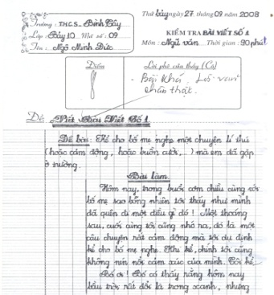
Literature

Slide 4
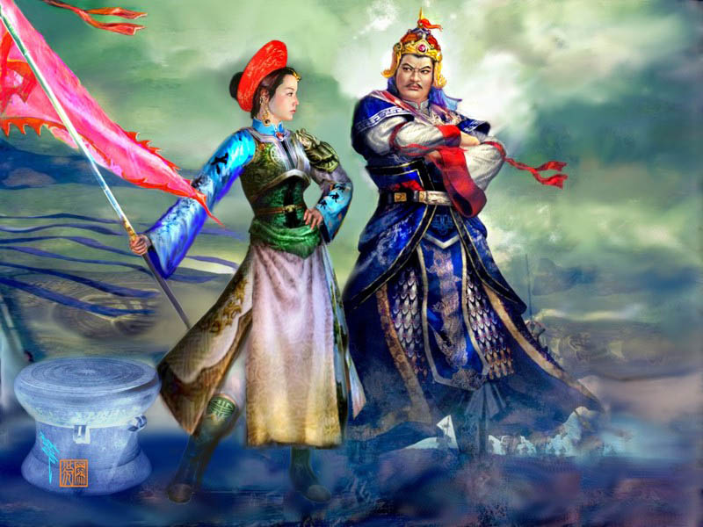
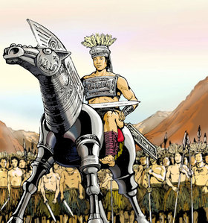
History

Slide 5

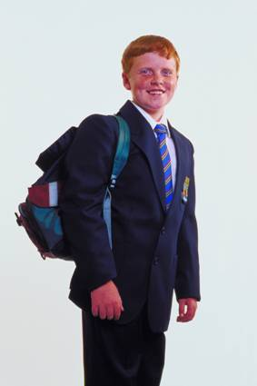
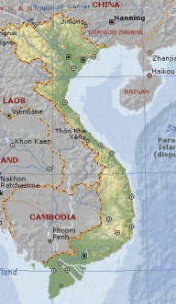
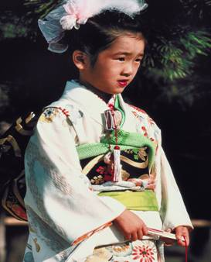
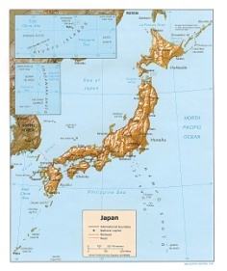
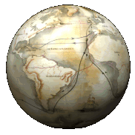
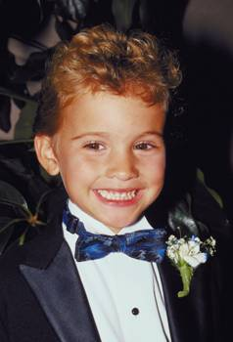
Geography
people
COUNTRIES

Slide 6
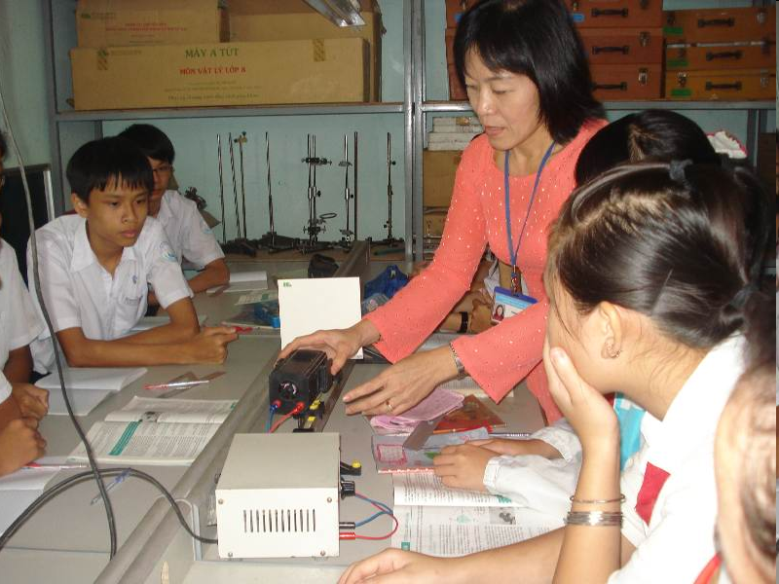
Physics

Slide 7
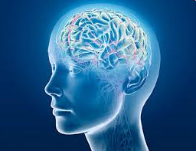
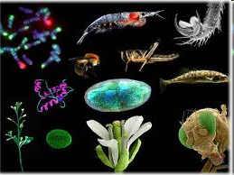
Biology

Slide 8
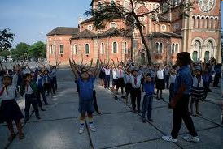
Physical education

Slide 9
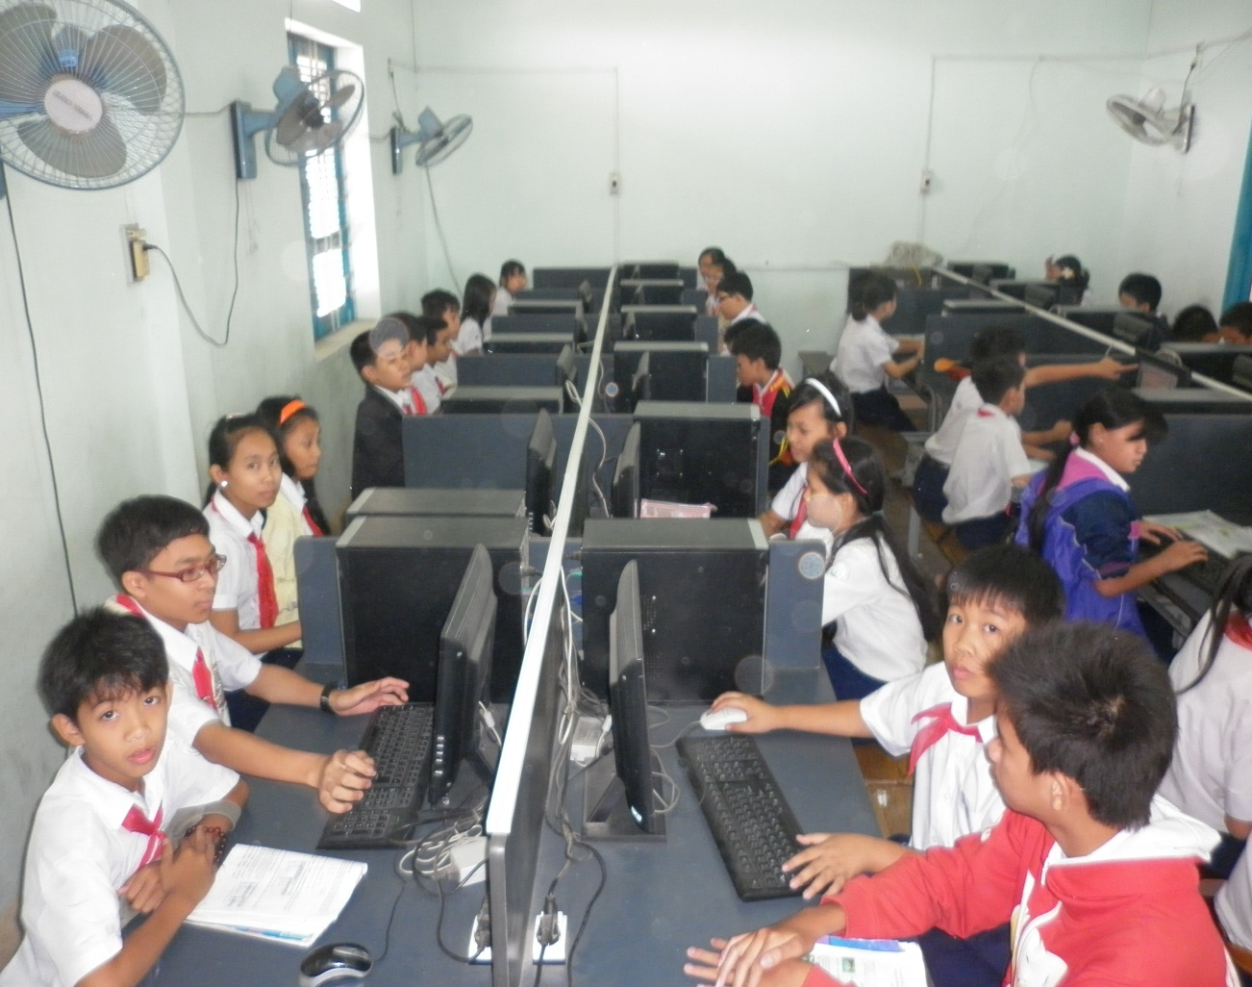
Computer science

Slide 10

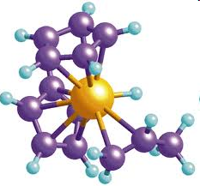
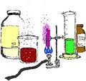
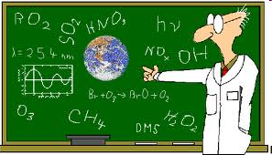
Chemistry

Slide 11


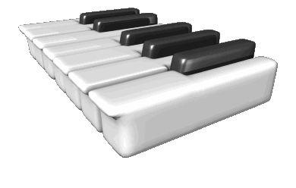
Music

Slide 12
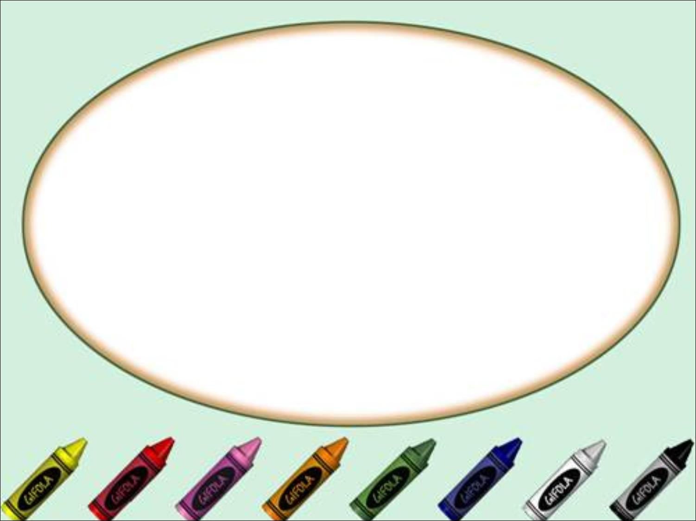
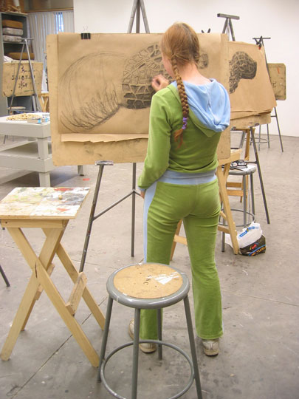
Art

Slide 13
Section A: In class (A4,5)
Unit 5: work and play

Slide 14
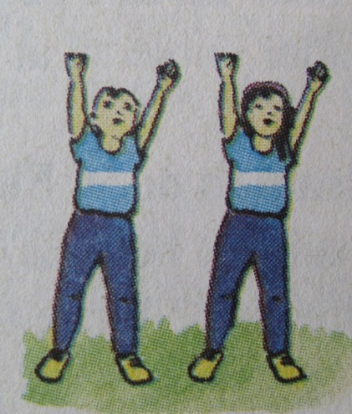
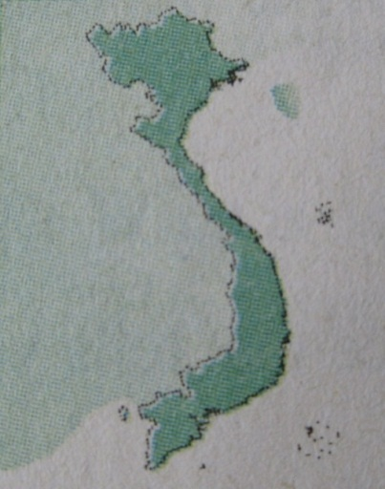
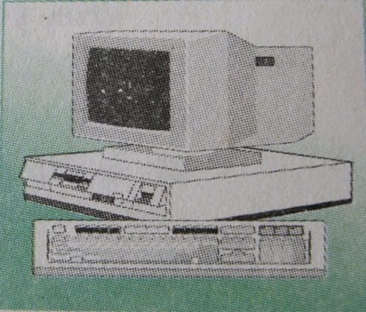
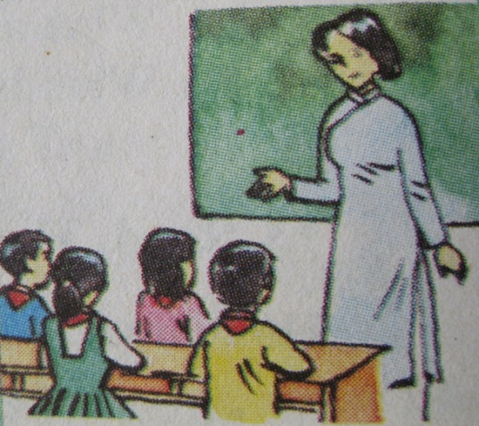
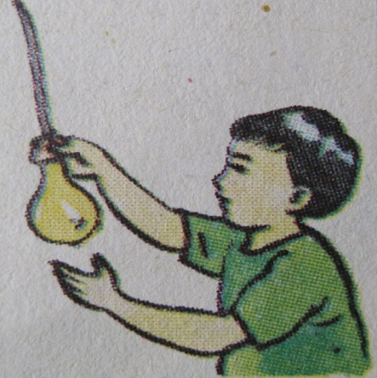
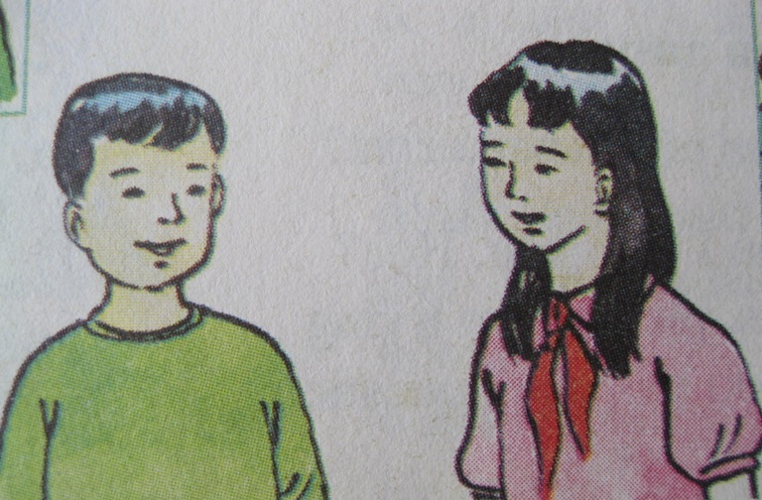
Unit 5
A4. Listen. Then write the correct letters next to the names.
c
b
a
d
e
Ba
Hoa

Slide 15

Unit 5
Work and play
SECTION A:
IN CLASS
A4. Read
New words
technology /tekˈnɒl.ə.dʒi/ (n): công nghệ học
Technology helps students learn better in COVID– 19.

Slide 16

Unit 5
A4. Listen. Then write the correct letters next to the names.
c
a
b
Ba
Hoa
d
e
Ba : a, d, e
Hoa : b, c, e

Slide 17
Unit 5
A4. Listen
Complete the sentences:
On Saturday morning, Ba and Hoa go to school.
Some of the ................. they do on Saturday are the................, but some of them are different.
At seven o’clock, Ba has ................. and Hoa has Computer Science.
These classes last for two periods.
At 8:40, Ba has......................
Hoa does not have Geography on Saturday.
She has ........................... .........instead.
In the last period, they have the same class.
Hoa and Ba both have ......................................then.
subjects
same
technology
Geography
Physical Education
class activities

Slide 18
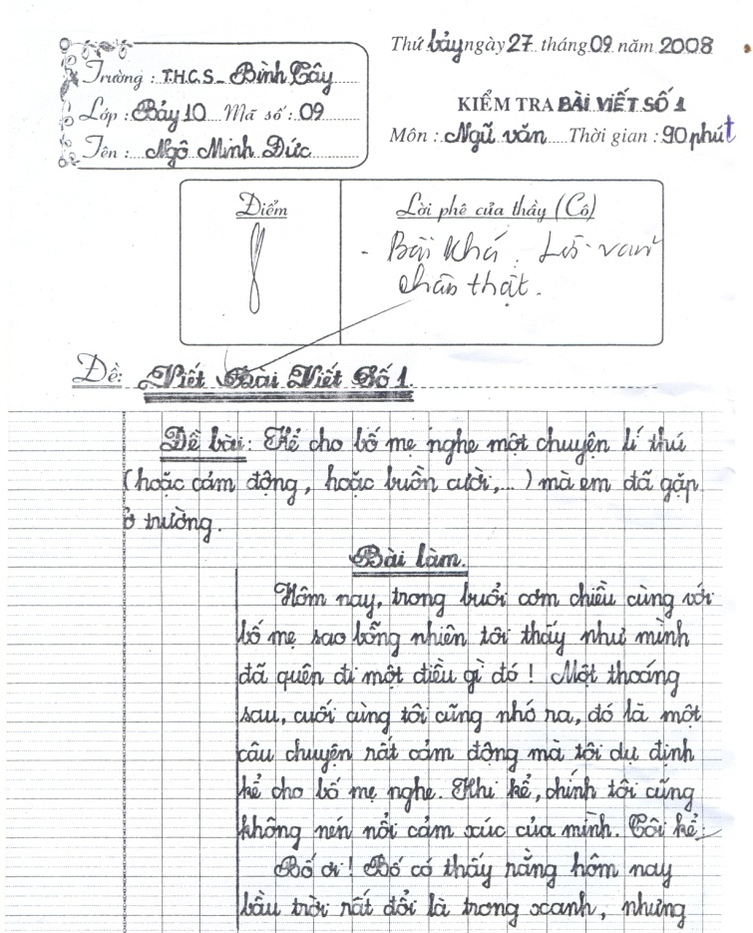
Unit 5
Work and play
SECTION A:
IN CLASS
A5. Read
I. New words
essay /ˈes.eɪ/ (n):
bài luận/ bài văn

Slide 19
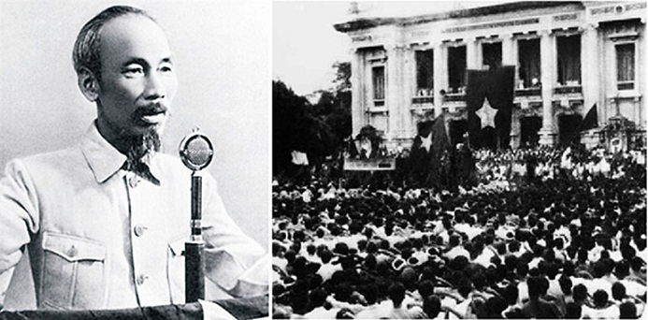
Unit 5
Work and play
SECTION A:
IN CLASS
A5. Read
I. New words
event/ɪˈvɛnt/ (n) :
Sự kiện
This is an important event of Vietnamese history.

Slide 20
Unit 5
Work and play
SECTION A:
IN CLASS
A5. Read
I. New words
author /ˈɔː.θər/ (n):
Tác giả

Slide 21
II. GRAMMAR
The present simple tense
What do you study at school?
I study many things at school.
Form:
-Form
+ Verb to be am/is/are
(+)S +am/is/are…..
(-) S +am/is/are + not……
(?) Be(am/is/are) +s + …….?
+ Ordinary verb:
(+) S +V/V_{s}/V-_{es}
(-) S +do/does + not +V.
(?) Do/Does + S + V?

Slide 22
Unit 5 – Section A: A4-A5 - Reading
Listen and predict the subjects
that will appear in the text .
How many subjects are there in the text?

Slide 23
There are eight subjects in the text.
Unit 5 – Section A: A4-A5 - Reading
1. Literature
5. Language
2. History
6. Music
3. Geography
7. Sports
4. Physics
8. Art

Slide 24
Read the passage again. Then say True or False
Unit 5 – Section A: A4-A5 - Reading
At school we study many things. In Literature, we learn about books and write essays. In History, we study past and present events in Viet Nam and around the world. In Geography, we study different countries and their people. In Physics, we learn about how things work. In the Language class, we study English. We study many other things as well, such as Music, Sports and Art. We enjoy all our classes.

Slide 25
TRUE OR FALSE
True
False
We learn different subjects when we are at school.
✓
2. We write essays in History .
✓
Literature
3. In History, we study past events in Vietnam as well as different countries.
✓
4. In Physics , we learn about maps, different countries and their people.
Geography
✓
✓
5. We are interested in all our classes.

Slide 26

Ask and answer the questions:
1. What do you study at school?
- At school we study many things.
2. What do you learn in Literature?
- In Literature, we learn about books and write essays.
3. Do you study past and present events in History?
-Yes, we do.
4. What subject do you learn about different countries and their people?
- Geography.
5. Do you speak English in language class?
-Yes, we do.
6. What other things do you study?
-We study many other things, such as Music, Sports & Art.

Slide 27
Discuss with a partner to find the Odd one out.
Literature
author
writing
paintings
stories

Slide 28
Discuss with a partner to find the Odd one out.
History
famous people
basketball games
world events
important days

Slide 29
Discuss with a partner to find the Odd One out.
SCIENCE
experiments
meter
preposition
temperature

Slide 30
Discuss with a partner to find the Odd one out.
English
words
verbs
England
pronouns

Slide 31

Further practice:
Write about the subjects you learn at school.

Slide 32
HOMEWORK
Learn the new words by heart.
Reread passage A5
Prepare Unit 5: Section B (B1 – B2)

Slide 33

Thank you very much!
See you again.

