Slide 1


Slide 2
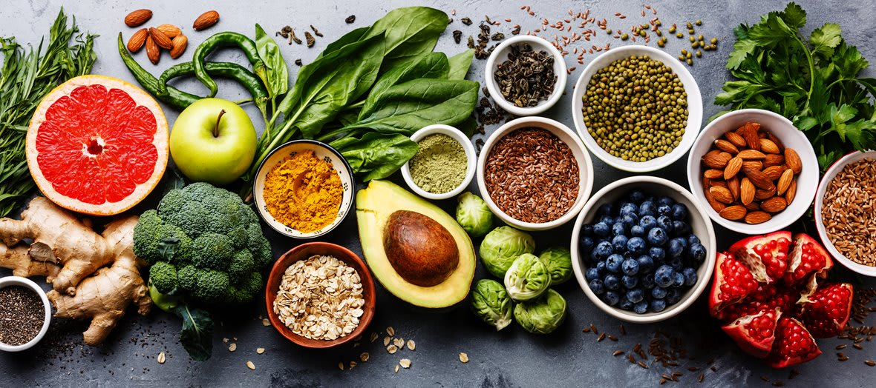
UNIT 5:
FOOD AND HEALTH
Lesson 4
VOCABULARY AND LISTENING

Slide 3
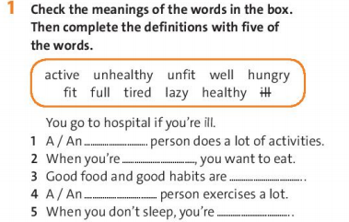
- Page 66.
active
hungry
healthy
fit
tired

Slide 4
News words
1. active (adj) /ˈæktɪv/
→ E.g: An active person does a lot of activities.
2. fit (adj) /fɪt/
≠ unfit (adj) /ʌnˈfɪt/
→ E.g: A fit person exercises a lot.

Slide 5
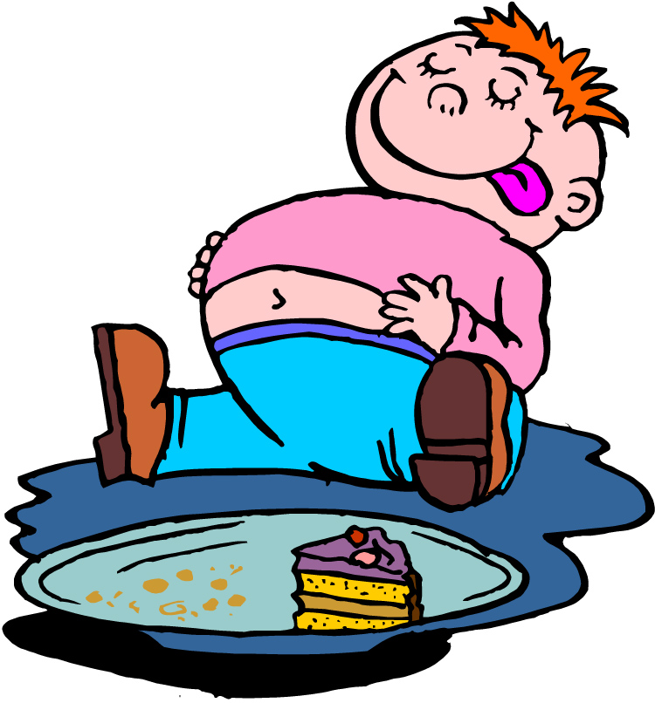
News words
3. tired (adj) /ˈtaɪəd/
4. full (adj) /fʊl/

Slide 6
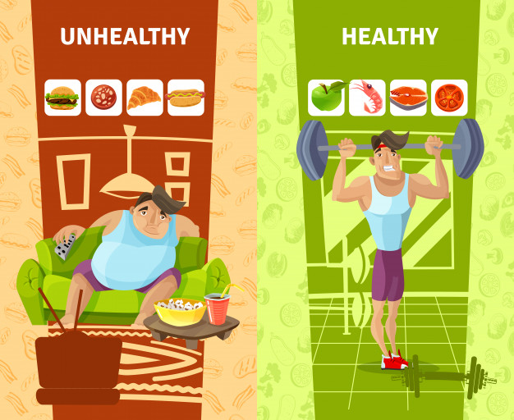
News words
5. healthy (adj) /ˈhelθi/
≠ unhealthy (adj) /ʌnˈhelθi/

Slide 7
News words
6. ill (adj) /ɪl/
→ E.g: You go to hospital if you’re ill.
≠ well (adj) /wel/ healthy, not ill

Slide 8


- page 66
active –
2. hungry -
3. healthy –
4. fit -
lazy
full
unhealthy
unfit

Slide 9
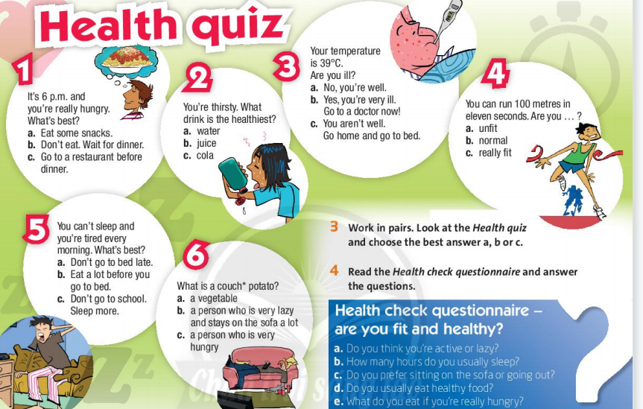

Slide 10
Vocabulary check

Slide 11
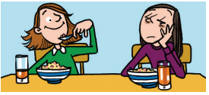
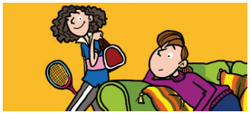
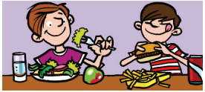
1. I’m OK today,
but my sister is very t _ _ _ _
2. Julie is very a _ _ _ _ _,
but her sister is l _ _ _.
c t i v e
i r e d
a z y
e a l t h y
3. Ollie eats h _ _ _ _ _ _ food, but
Martin eats u _ _ _ _ _ _ _ _ food.
n h e a l t h y

Slide 12
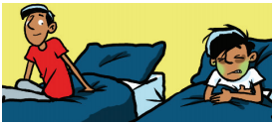
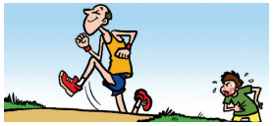
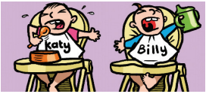
e l l
n f i t
4. Murat is w _ _ _, but his brother is i _ _ today
5. Oscar is u _ _ _ _, but his dad is very f _ _.
l l
i t
u n g r y
6. Katy is h _ _ _ _ _ , but Billy is thirsty.

Slide 13
Homework
Learn by heart all new words.
- Workbook: Exercises page 38.
- Prepare the new lesson: Reading - page 64.

Slide 15
What can you do
if you want to be healthy?
sit on the sofa
play video games
eat vegetables
drink fizzy drinks
drink juice
do exercise

Slide 16

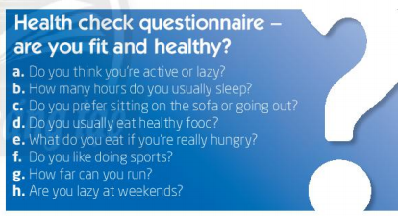
- page 66
b, h, c
- b
- f, g, d

Slide 17
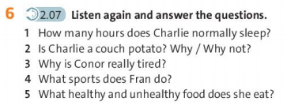
- page 66
=> Eight or nine hours
=> No, he isn’t.
He likes going out and doing sport.
=> He’s studying for exams.
=> She runs and swims.
=> Healthy foods: pasta, chicken;
Unhealthy foods: desserts and chocolate

Slide 18
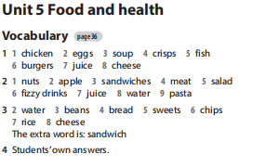
Homework

