Slide 1



Slide 2


Slide 3


Slide 4
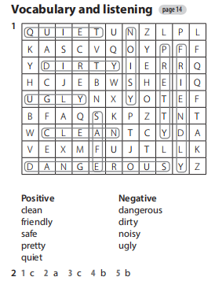

Workbook – page 14

Slide 5

UNIT 1
TOWNS AND CITIES
Lesson 5: language focus – comparative adjectives – page 19.

Slide 6

COMPARATIVE ADJECTIVES
Short adjectives
Long adjectives

Slide 7
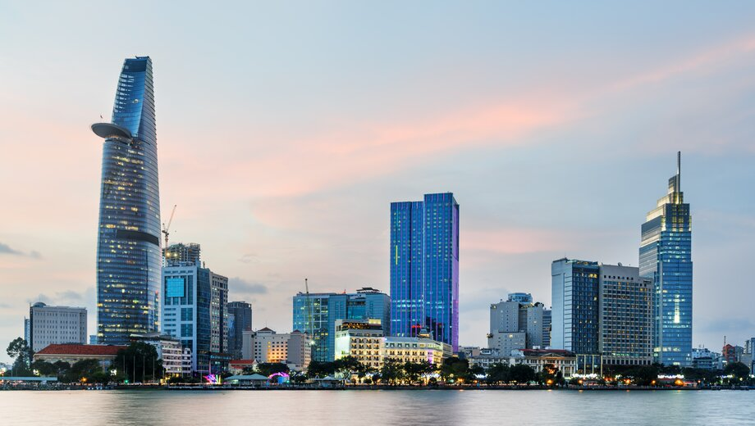
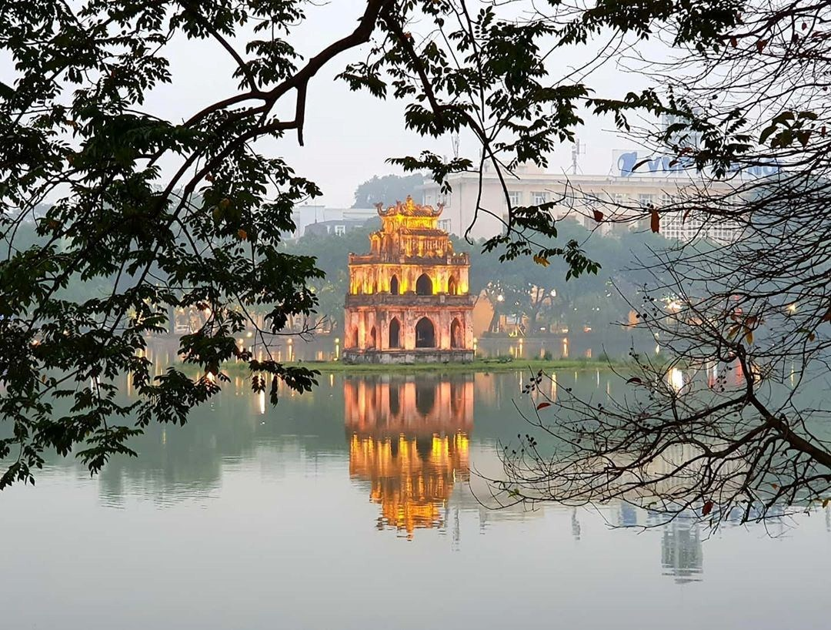
☞ Remember: Short adjectives
be + short Adj-ER + than…
Ex: Ho Chi Minh City is bigger than Ha Noi.

Slide 8

☞ Remember: Long adjectives
be + more + long Adj + than…
Ex: French is more difficult than English.

Slide 9
❀ Remember: Special cases
good →
better
bad →
worse
far →
farther / further
much / many →
more

Slide 10
❀ Remember: Special cases
With some 2-syllable adjectives, we can use "-ER" or "MORE"
Ex:
quiet → quieter / more quiet
clever → cleverer / more clever
narrow → narrower / more narrow
simple → simpler / more simple
If the adjective ends in -E, we add -R.
( safe → safer )
Final -Y changes to -IER.
(pretty → prettier)
One – syllable adjective endings with vowel and one consonant, we double the consonant.
(big → bigger)

Slide 11
Exercise 1 – page 19: Write the comparative form of the adjectives in the table.
SHORT ADJECTIVES
 | Adjective | Comparative
Regular | quiet clean , slow
End in –e | nice, safe
End in consonant + y | friendly, pretty
End in consonant + vowel + consonant | big , hot
quieter
cleaner , slower
nicer , safer
friendlier , prettier
bigger , hotter

Slide 12
Exercise 1 – page 19: Write the comparative form of the adjectives in the table.
LONG ADJECTIVES
Adjective | Comparative
dangerous
modern, expensive
more dangerous
more modern, more expensive
IRREGULAR
Adjective | Comparative
good
bad
far | farther / further
better
worse

Slide 13
Exercise 2 – page 19: Write sentences using the correct comparative form of the adjectives in brackets.
1) It’s / here / than / in my country. (expensive)
=> It’s more expensive here than in my country.
2) The weather today / is / than / it was yesterday. (bad)
=> The weather today is worse than it was yesterday.
3) Why / is / this class / than / the other class? (quiet)
=> Why is this class quieter than the other class?
4) Are / the buildings / in New York / than / the buildings in Oxford? (modern)
=> Are the buildings in New York more modern than the buildings in Oxford?
5) This house / is / than / that house. (pretty)
=> This house is prettier than that house.

Slide 14

Exercise 3 – page 19:
1) cleaner
2 ) safer
3) It’s nicer than New York.
4) I think Gino’s is cheaper than Luigi’s

Slide 15
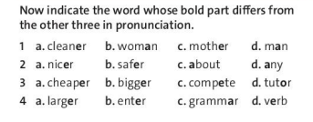
Exercise 3 – page 19:
/ə/
/ə/
/ə/
/æ/
/ə/
/ə/
/ə/
/e/
/ə/
/ə/
/iː/
/ə/
/ə/
/ə/
/ə/
/ɜː/

Slide 16
Exercise 4 – 19: Indicate the word whose bold part differs from the other three in pronunciation
1) A. sea B. square C. star D. cinemas
2) A. cabin B. comfortable C. café D. cinema
3) A. trees B. plants C. sports D. shops
4) A. work B. swimming C. twenty D. answer

Slide 17

Homework
- Learn by heart Remember.
- Finish the exercises in Workbook – page 15.
- Prepare for next lesson – Speaking and Writing of Unit 1.

