Slide 1


Slide 2

UNIT 4: LEARNING WORLD
LESSON 1: VOCABULARY – SCHOOL SUBJECTS – page 48.

Slide 3
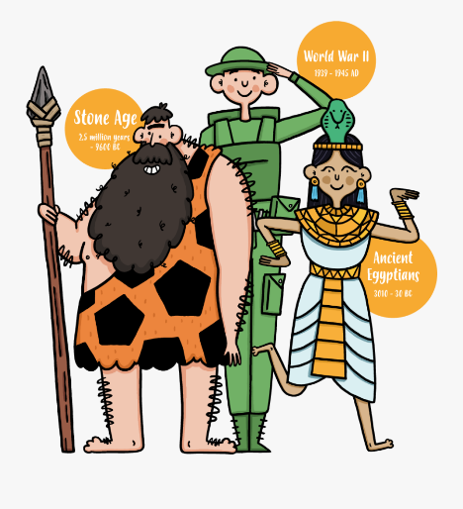


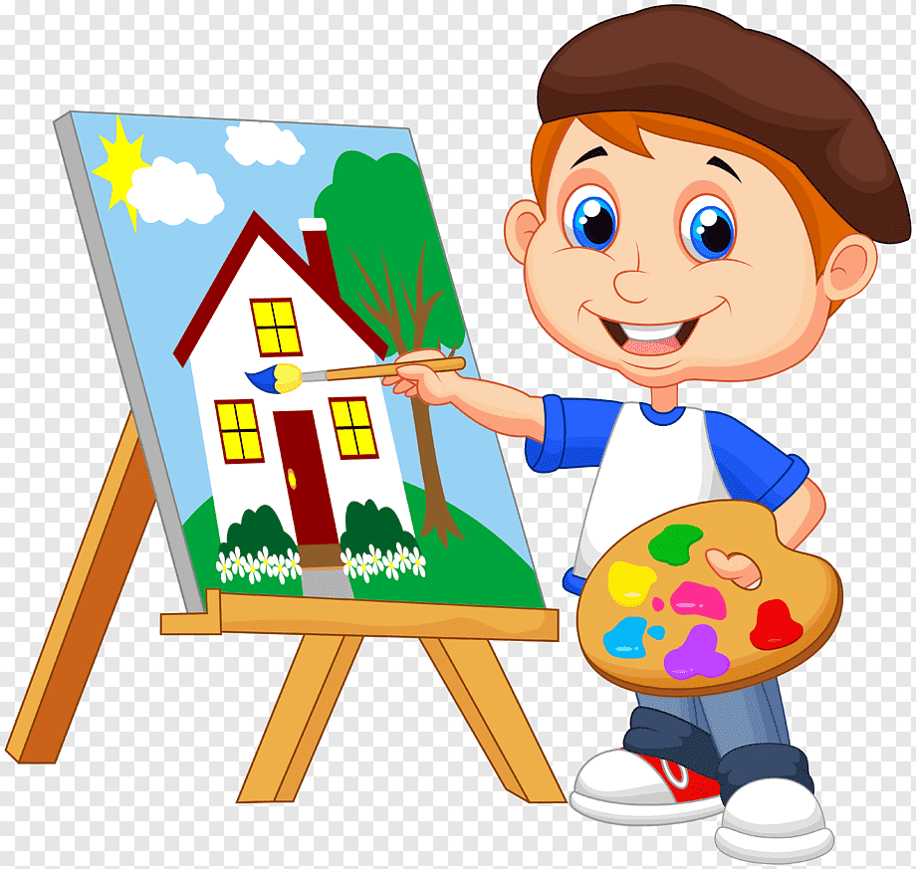

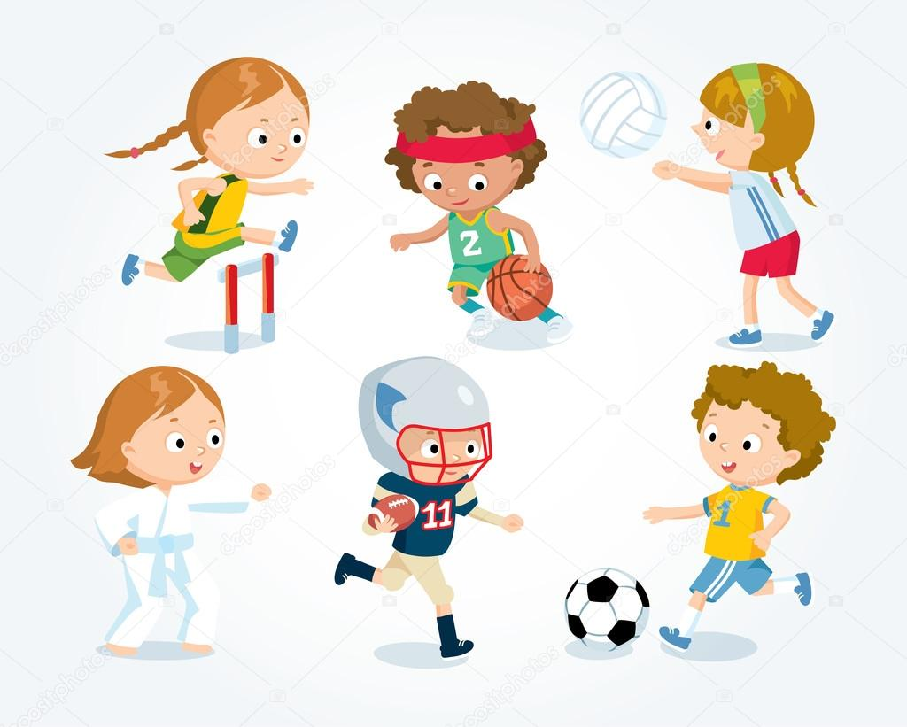


- New words:
geography (n) /dʒiˈɒɡrəfi/
history (n) /ˈhɪstri/
art (n) /ɑːt/
English (n) /ˈɪŋɡlɪʃ/
ICT (n) = Information and Communication Technology
/ˌɪnfəˈmeɪʃən/ /ænd/ /kəˌmjuːnɪˈkeɪʃən/ /tekˈnɒlədʒi/
PE (n) = Physical Education
/ˌfɪzɪkl edʒuˈkeɪʃn/
maths (n) /mæθs/
science (n) /ˈsaɪəns/

Slide 4

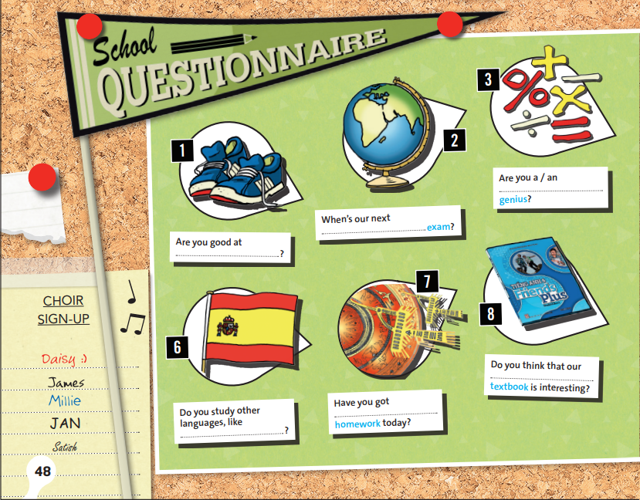
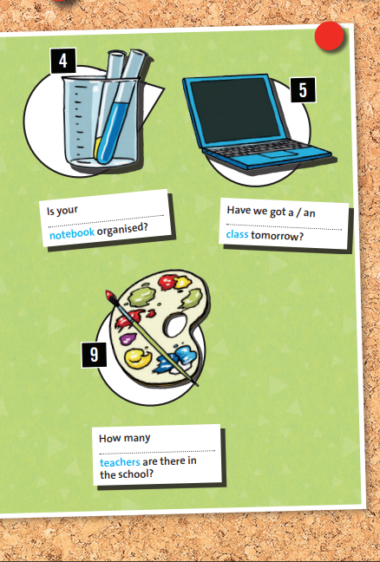
EXERCISE 1: Look at pictures 1–9. Then complete the questions with the words in the box. Listen and check your answers – page 48.
maths
science
ICT
geography
PE
English
art
history
Spanish

Slide 5
EXERCISE 3: Listen and answer the questions – page 49.
1. Why does Georgia like Wednesday?
→ Georgia likes Wednesday because she has her two favorite subjects: maths and geography.
2. What language does Ben prefer?
→ Ben prefers Spanish.

Slide 6
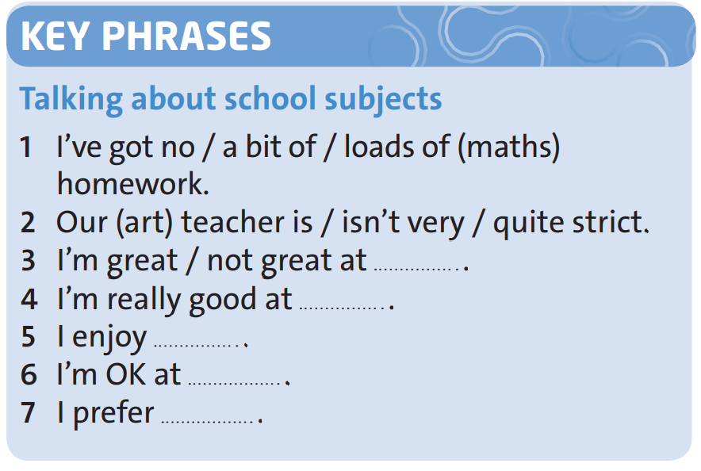
EXERCISE 4: Listen again and complete the Key Phrases – page 49.
science
history
French
French
Spanish

Slide 7

UNIT 4: learning world
Lesson 2:
vocabulary and listening-page 52.

Slide 8

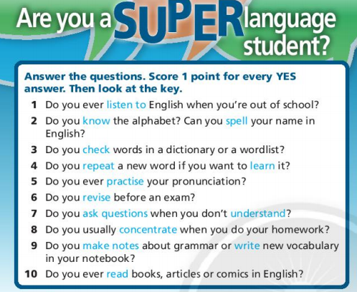
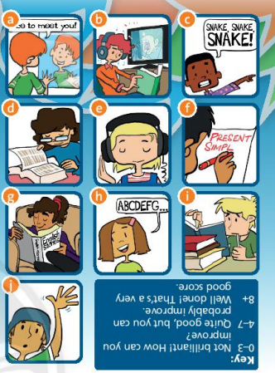
Page 52.
E
H
D
C
A
I
J
B
F
G

Slide 9
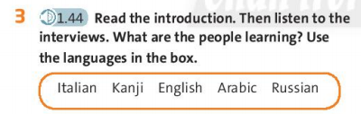
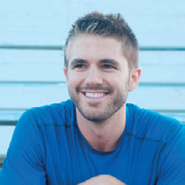

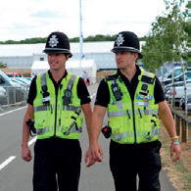
Interviews: Learning languages
Interviews with Londoners who are learning languages.
Mario:
English
Hannah:
Kanji
Mark and Peter:
Russian and Arabic

Slide 10
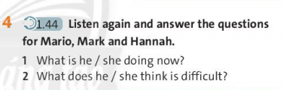
1) Mario is watching TV.
2) He thinks listening is difficult.
Mario

Slide 11
1) Mark is checking new vocabulary on the internet.
2) Mark thinks reading and writing are difficult.
Mark and Peter

Slide 12
1) Hannah is revising for her exams.
2) Hannah thinks pronunciation is difficult.
Hannah

Slide 13

Why is Mario watching TV? Because ____
A. He is bored.
B. It is good for his English.
C. He doesn’t want to miss the latest news.
2) Why are Mark and Peter learning languages? Because ______
A. They want to get a good job.
B. They are studying abroad.
C. A lot of people from different countries come to London.
3) Who is teaching Hannah?
A. A teacher from Japan.
B. A teacher from Spain.
C. A teacher from France.

Slide 14
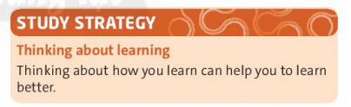


Slide 15

Make a table with your answers in exercise 2.
What good and bad learning strategies have you got?

Slide 16
I do these things | I don’t do these things
- I revise before an exam.
- I don’t listen to English when I’m out of school.
…
…

Slide 17

Homework
- Learn by heart new words.
- Do exercises in Workbook – page 30, 32.
- Prepare the new lesson: Reading: schools project – Student book - page 50.

Slide 18
Who are these people?
Hannah
Mario
Mark and Peter
Hannah

Slide 19
1) What is he / she doing now?
2) What does he / she think is difficult?

Slide 20
New words:
- spell
/spel/
(v) :
to say or write the letters of a word in the correct order.
Ex: C – A - T spells ‘cat’.
- repeat
/rɪˈpiːt/
(v) :
to say or write something again.
Ex: Can you repeat your question?
- revise
/rɪˈvaɪz/
(v) :
to study the lesson again, in preparation for an exam.
Ex: She’s revising for her history exam.
- concentrate
/ˈkɒnsntreɪt/
(v) :
to think very carefully about what you are doing.
Ex: I’m trying to concentrate on my work.
- make notes
(v) :
/meɪk nəʊts /
to write something down or remember it carefully

Slide 21


