Slide 1


Slide 2
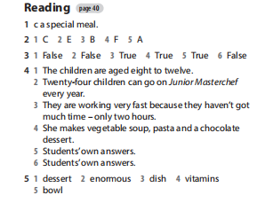
Homework

Slide 3
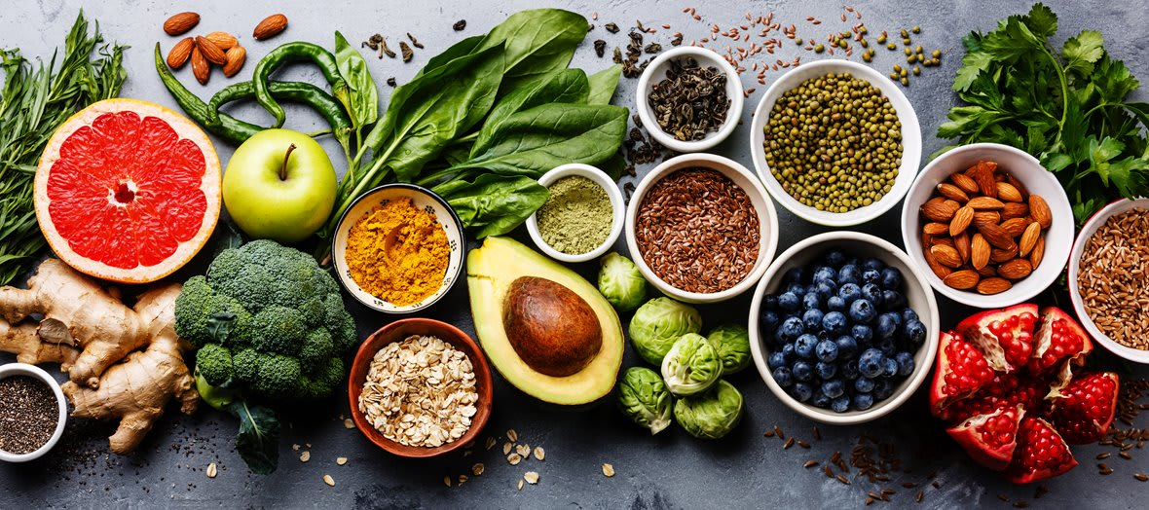
UNIT 5:
FOOD AND HEALTH
Lesson 4 – page 65
LANGUAGE FOCUS

Slide 4
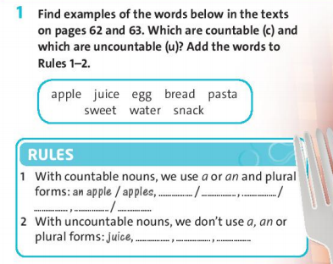
- Page 65
an egg eggs
a sweet
sweets
a snack
snacks
bread
pasta
water

Slide 5
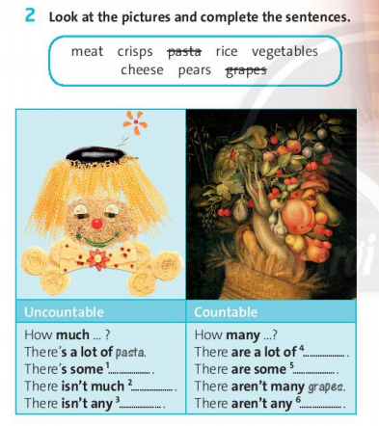
vegetables
rice
pears
cheese
meat
crisps

Slide 6
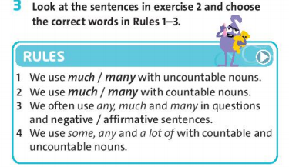
- Page 65

Slide 7

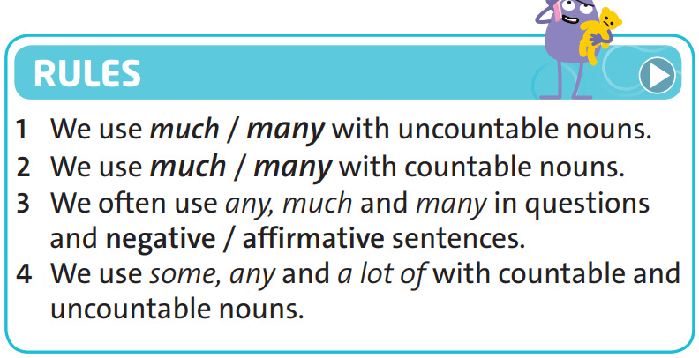

Slide 8
3. SOME / ANY
SOME / ANY: Plural countable nouns
& uncountable nouns
SOME | (+) Affirmative
ANY | (-) Negative (?) Question
We’ve got some cheese
We haven’t got any cheese.
Have we got any cheese?

Slide 9
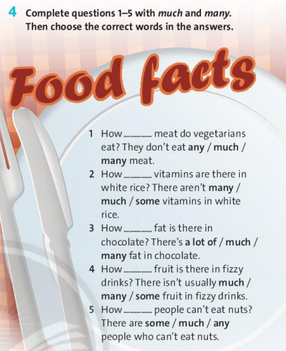
much
many
much
much
many

Slide 10
Homework
Learn by heart all Grammar point.
- Workbook: Exercises page 37.
- Prepare the new lesson:
Language focus – page 67.

Slide 11
MANY / MUCH
MANY : Plural countable nouns
MUCH : Uncountable nouns
Example: 1) How many eggs?
2) How much bread?

Slide 12
2. A LOT OF
A LOT OF: Plural countable nouns
& uncountable nouns
Example: 1) I need a lot of coffee.
2) She has a lot of friends.

Slide 13



Slide 14
A: Okey. How much chicken have we got?
B: Only a little, and not many sweets.
A: Right, we buy chicken and sweets. Have we got any salads?
B: Yes, but they aren’t enough.
A: Salads, Okey. What about juice and fizzy drinks?
B: We have got.
A: Okay, we don't need wine or juice a lot of juice and fizzy drinks
B: Right. Come on, let's go.

Slide 15



www.phuongnam.edu.vn

