Slide 1


Slide 2

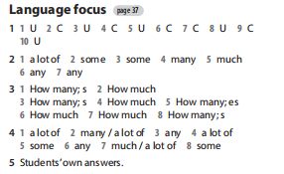

Slide 3

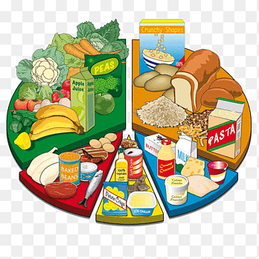
UNIT5: FOOD AND HEALTH
LESSON 2 : LESSON 5: LANGUAGE FOCUS – Page 67.
Verb + - ing
Imperatives
should / shouldn't

Slide 4
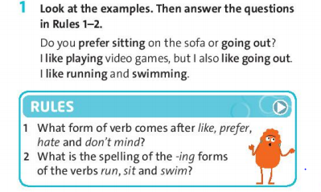
- Page 67.
=> the - ing form
running, sitting, swimming

Slide 5
Grammar point:
+) Common verbs followed by the -ing form are:
→ hate, like, dislike, love, prefer, detest,...
Eg: I love swimming but I hate jogging.
→ phrases with mind:
wouldn't mind (= would like)
don't mind (= I am willing to)
would you mind (= will you please …?)
Eg: I wouldn't mind having some fish and chips.
I don't mind waiting for a few minutes.
Would you mind holding this for me?

Slide 6
EXERCISE 3: Look at the examples of imperatives. How do we make the negative form? Find examples in the Health quiz on page 66.
→ Don't eat.
→ Don't go to bed late.
→ Don't go to school.
❖ Grammar point:
➔ We use "should" / "shouldn't" + the infinitive of the main verb (without "to")
(+) S+ should + main verb
(-) S + shouldn't + main verb
(?) Should + S + main verb?
Eg: You should do more exercise.
You shouldn't stay up late.

Slide 7
EXERCISE 4: Students use imperatives to write about the classroom rules (Dos and Don'ts). Check the answers with the whole class and see who got the most correct answers.
- Page 67.
DOS | DON'TS
1. Pay attention in class. | 1. Don't come to school late.
2. Keep the classroom clean. | 2. Don't litter in class.
3. Use kind words. | 3. Don't cheat in the exam.

Slide 8
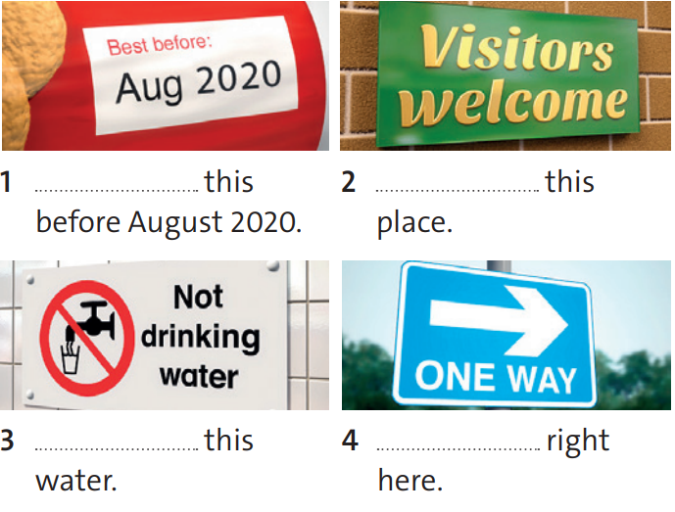
EXERCISE 5: Complete the sentences with the affirmative and negative imperative forms of the verbs in the box.
- Page 67.
drink visit ask play go eat
Eat
Visit
Don't drink
Go

Slide 9
EXERCISE 6: Look at the examples. Then choose the correct answers to complete the Rules.
- Page 67.
You should eat more vegetables.
You shouldn't go to bed late.
She shouldn't be lazy at school.
Rules:
We use should / shouldn’t to give advice / give an instruction.
The he / she / it forms of should / shouldn’t are different / the same

Slide 10
EXERCISE 7: Your friend wants to be healthy. Complete the advice using should / shouldn’t.
- Page 67.
stay up / late
eat / fruit and vegetables
do / exercise
drink / fizzy drinks
sit / on the sofa all day
→ You shouldn't stay up late.
→ You should eat fruit and vegetables.
→ You should do exercise.
→ You shouldn't drink fizzy drinks.
→ You shouldn't sit on the sofa all day.

Slide 11

- Learn by heart all structures.
- Workbook: Exercises page 39.
- Prepare the new lesson – Speaking – page 68.

Slide 12
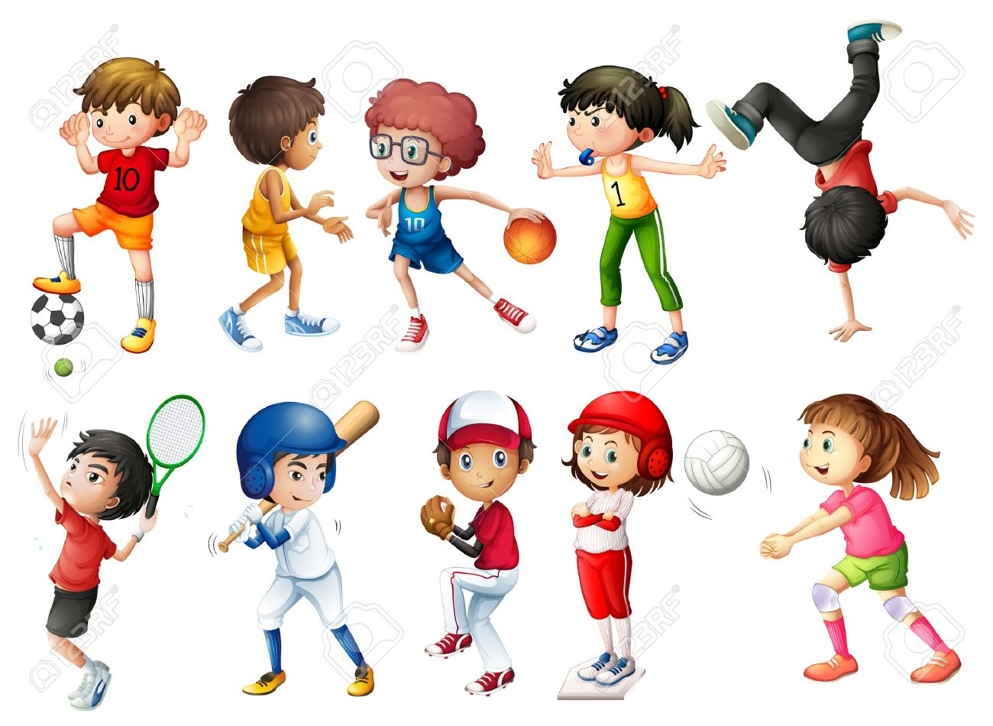
What sports do you like doing?
Which ones do you hate doing?
Eg: I like playing football.
I hate running.

Slide 13



www.phuongnam.edu.vn

