Slide 1


Slide 2


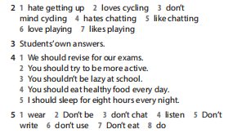

Slide 3

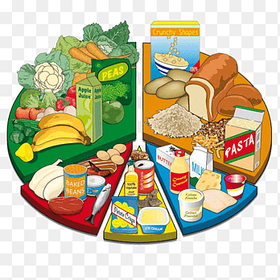
UNIT 5: FOOD AND HEALTH
LESSON 6: SPEAKING – page 68.

Slide 4

Page 68
EXERCISE 2: Listen and say the prices.
£4.50 four pounds fifty
£1.00 one pound
£1.20 one pound twenty
£4.95 four pounds ninety-five
£0.80 eighty pence
GLOSSARY
$ = dollar(s) and cents € = euro(s) and cents
£ = pound(s) and pence

Slide 5
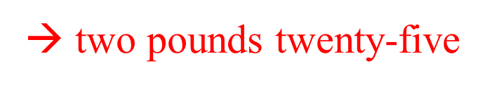

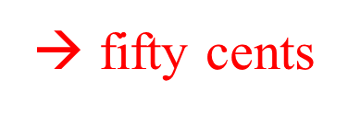
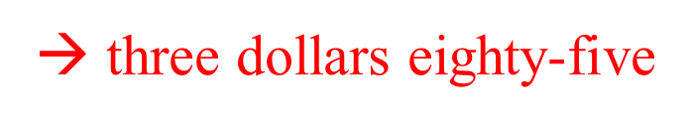
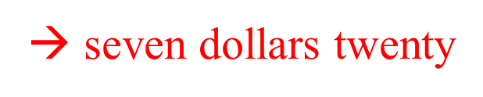
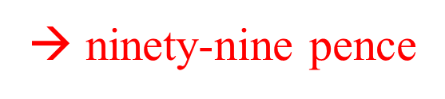
Page 68
EXERCISE 3: Read and say the prices. Listen and check.
1 £2.25
2 €1.00
3 €0.50
4 $3.85
5 $7.20
6 £0.99
GLOSSARY
$ = dollar(s) and cents € = euro(s) and cents
£ = pound(s) and pence

Slide 6
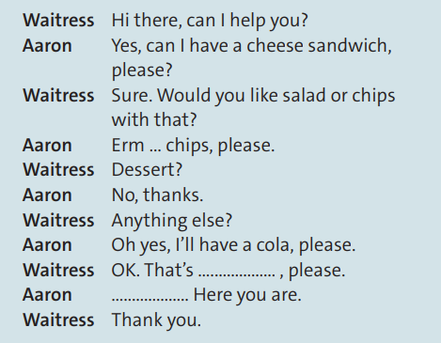
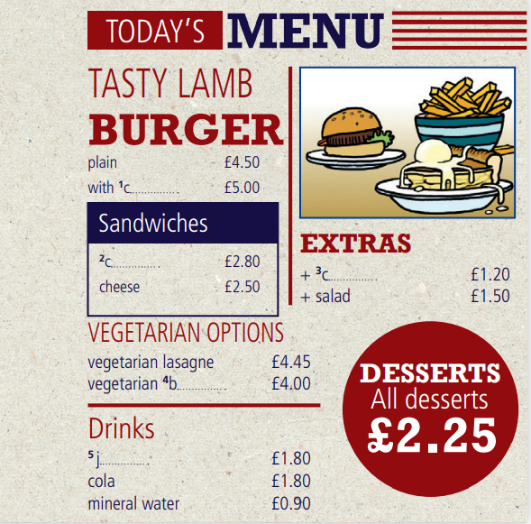
EXERCISE 4: Read the dialogue, look at the menu and calculate the total price. Then watch or listen and check. Is Aaron’s meal very healthy?
Page 68
→ £2.50 + £1.20 + £1.80 = £5.50
Is Aaron’s meal very healthy?
→ His meal isn't very healthy.

Slide 7
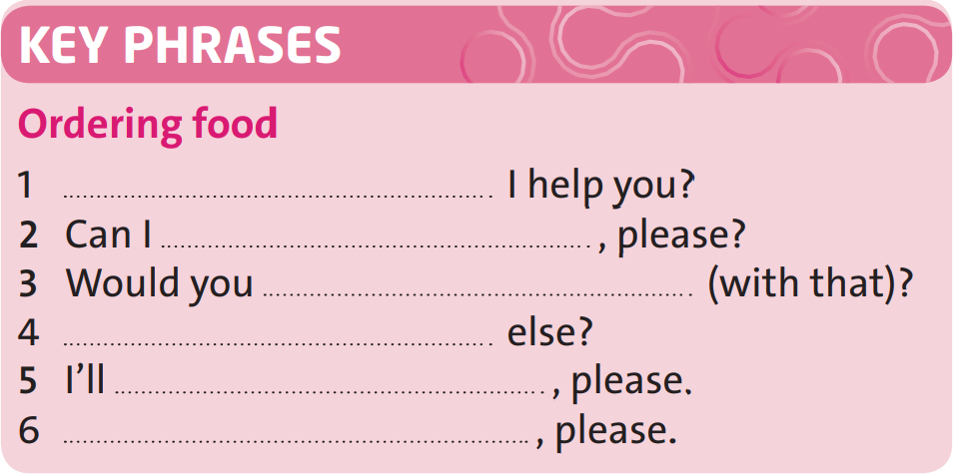
EXERCISE 5: Look at the dialogue and complete these Key Phrases. Then practise the dialogue with a partner. Use different items from the menu in exercise 1.
Page 68
Can
have a cheese sandwich
like salad or chips
Anything
have a cola
That's £5.50

Slide 8

-Learn by heart all structures.
-Write the own menu.
-Prepare the new lesson - Writing – page 69.

Slide 9
THINK:
WHAT IS YOUR FAVOURITE RESTAURANT OR CAFÉ?
WHAT KIND OF FOOD DO YOU USUALLY EAT THERE?
IS THE FOOD NICE?
HOW MUCH DO YOU USUALLY PAY?

Slide 10



www.phuongnam.edu.vn

Slide 12
EXERCISE 1: Complete the menu with the words in the box. Which things on the menu do you like or dislike?
Page 68
burger juice chicken chips cheese
1. cheese
2. chicken
3. chips
4. burger
5. juice

