Slide 1


Slide 2

UNIT 6
SPORTS
Lesson 5: language focus
Page77.

Slide 3
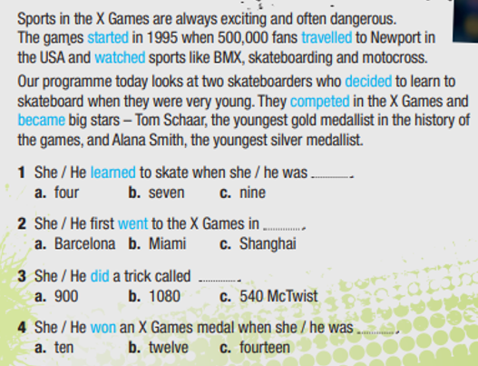
EXERCISE 1: Check the meaning of the verbs 1-10. Then read the text and sentences 1 - 4. Match verbs 1 - 10 with the past simple forms in blue. Listen and check - page 76.
learn
start
go
win
travel
become
watch
do
compete
decide
→ learned
→ started
→ went
→ won
→ travelled
→ became
→ watched
→ did
→ competed
→ decided

Slide 4

have got
1) Regular verbs _____________ past simple forms ending in -ed.
haven’t got
2) Irregular verbs ______________ past simple forms ending in -ed.
have got
3) Verbs in the past simple ___________ the same form for I, you, he, she, it, we and they.

Slide 5


Slide 6
SIMPLE PAST TENSE – AFFIRMATIVE
- Usage:
Simple past tense is used to talk about the action that happened in the past.
Ordinary verb
Regular verb (V_{ed})
Irregular verb (V₂)

Slide 7
Regular verb (Ved)
With most regular verbs, we add -ed to the base form of the verb.
Ex: play → played
start → started
call → called
With verbs ending in -e, we just add -d.
Ex: like → liked
compete → competed

Slide 8

FORM:
S + V_{2/ED} + O
Ex: I talked to him yesterday.

Slide 9
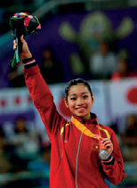
Complete the YOUNG SPORTS SUPERSTARS text with the past simple form of the verbs in blue
Phan Thị Hà Thanh (1) (start) ___________ gymnastics when she was six. She (2) (go) __________ to an athletic training centre in Hải Phòng. In 2011, she was the first Vietnamese gymnast who (3) (win) _________ a world medal for Việt Nam and she (4) (compete) ____________ in the Olympic Games in 2012 and 2016.
started
went
won
competed

Slide 10
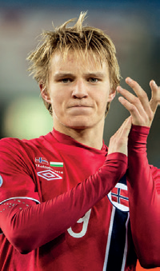
Martin Odegaard, from Norway, (5) (become) ___________ a professional footballer at fifteen and (6) (score) ____________ great goals for his club. He first (7) (play) ___________ international football before he was sixteen. A lot of famous clubs were interested in him and he (8) (train) ____________ with some of them. Finally, in 2015, Real Madrid (9) (give) ___________ him a contract.
became
scored
played
trained
gave

Slide 11


Slide 12

Listen and repeat the words
1) /t/: practised, watched 2) /d/: travelled, played 3) /ɪd/: started, decided

Slide 13

PRONUNCIATION “-ED”
- /id/: /t, d/
Ex: wanted, ended
- /t/: /p, f, s, k, ʃ, ʧ/
Ex: talked, watched, brushed
- /d/: all other sounds
Ex: lived, played

Slide 14
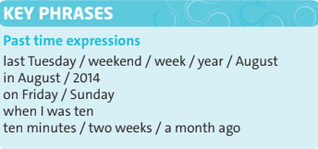
Read the Key Phrases

Slide 15
Look at the examples and answer the questions
He first competed when he was twelve. She last competed in 1981. He was on this programme two years ago.
1) How do you say the words in blue in your language? 2) Do we put “ago” before or after a past time expression?
after

Slide 16
UNIT 6
SPORTS
Lesson 6: SPEAKING - Page 78.

Slide 17
Complete the dialogue. Then watch or listen and check. Why was Alfie happy on Saturday?
Alfie : Hey, Lois. How are things? Lois : Oh hi, Alfie. Good, thanks. How (1) _______ your weekend? Alfie : It (2) _______ great, thanks. I (3) ________ to a football match on Saturday.
Lois : Really? (4) ________ it good?
Alfie : Yes, it was brilliant. There (5) _______ a lot of goals. United (6) _______ 3–2 in the end.
Lois : That’s good news! Who (7) ________ you with?
Alfie : My brother. Why don’t you come next time?
Lois : Sure. Why not? Text me when you’re going, OK?
Alfie : OK then. Bye, Lois.
Lois : Bye.
was
was
went
Was
were
won
were

Slide 18
KEY PHRASES
Talking about the weekend
1) __________ was your weekend? 2) __________ good / bad news! 3) __________ were you with? 4) __________ don’t you come next time? 5) Sure. _________ not? 6 ) Text me __________ you’re going.
How
That’s
Who
Why
Why
when

Slide 19

Homework
- Learn by heart all structures.
- Workbook: Exercises .

Slide 20



www.phuongnam.edu.vn

Slide 21



Thank you!
CTCP ĐẦU TƯ VÀ PHÁT TRIỂN GIÁO DỤC PHƯƠNG NAM

