Slide 1

Welcome to our class
English 8

Slide 2
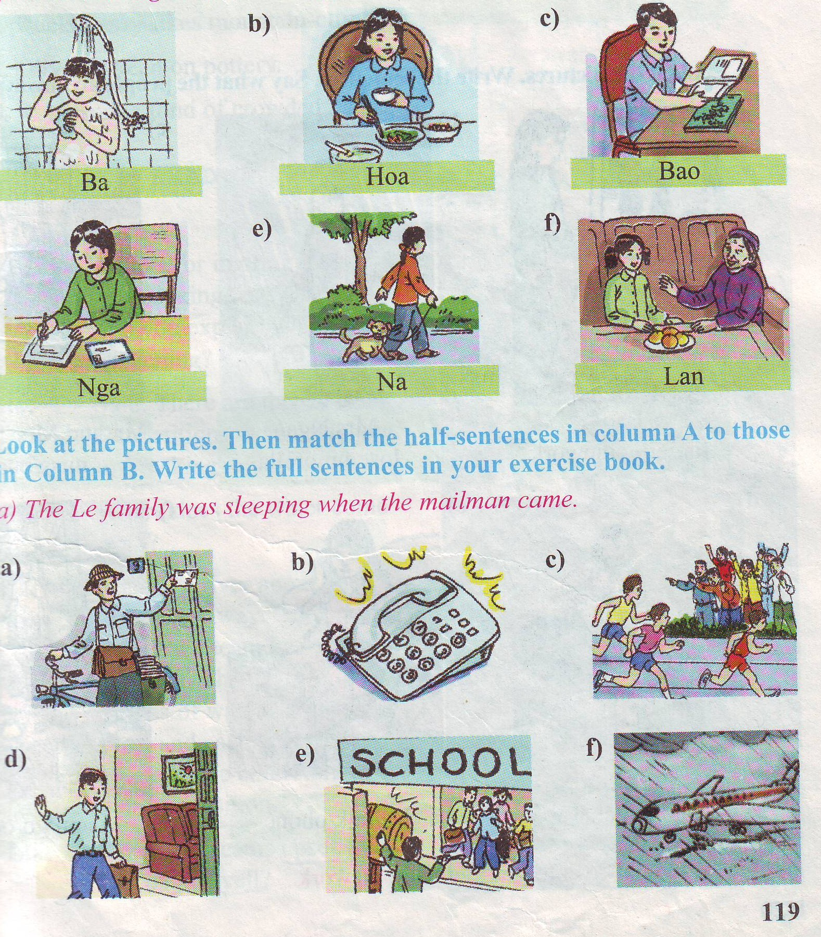
Warm up
Look at the pictures and say what the people are doing
She is writing a letter
They are talking to each other

Slide 3
Language focus
I. The present progressive tense
Ex: She is writing a letter
Form: S + am/is/are + V-ing…
Use : thì hiện tại tiếp diễn dùng để diễn tả một hành động đang xảy ra ở hiện tại, trong câu thường có các trạng từ như : now, at the moment……
She is always talking on the phone
always
S + be + always + V-ing…
: diễn tả lời phàn nàn

Slide 4
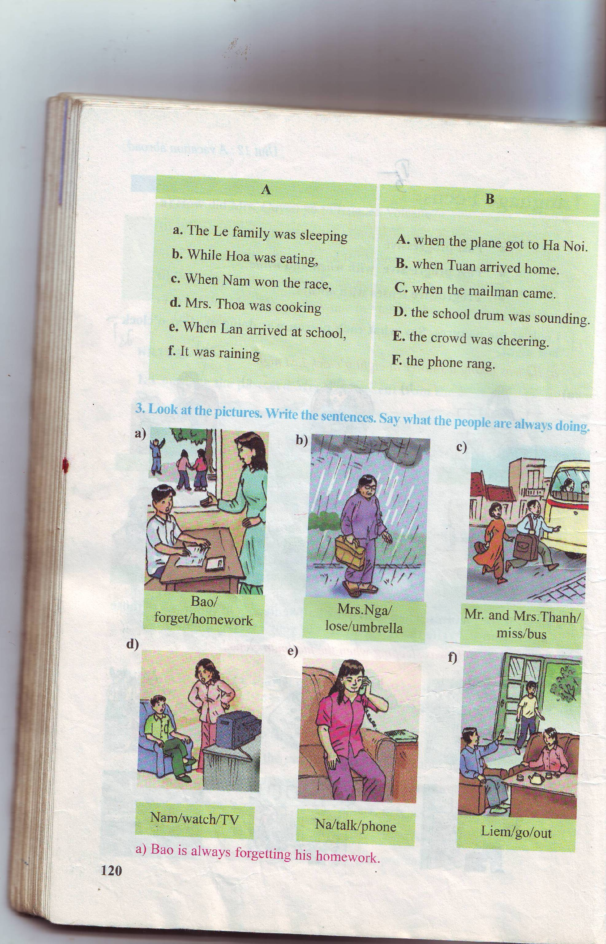
Bao/ forget/ homework
Mrs.Nga/lose/umbrella
Mr. and Mrs.Thanh/miss/bus
Bao is always forgetting his homework
Mrs Nga is always losing her umbrella
Mr and Mrs Thanh are always missing bus
Nam/watch/TV
Na/ talk/phone
Liem/go/ out
Nam is always watching TV
Na is always talking on the phone
Liem is always going out

Slide 5
unit 12 : A vacation abroad
Language focus
Ba is taking a shower now
Ba was taking a shower at 8’oclock last night
Hoa was eating dinner at that time

Slide 6
unit 12 : A vacation abroad
Language focus
II. The past progressive tense: (thì quá khứ tiêp diễn)
Ex 1: Ba is taking a shower now
Ex 2: Ba was taking a shower at 8 o’clock last night
Ex 3: Hoa was eating dinner at that time
Form: S + was/ were + V-ing… .

Slide 7
Cách dùng:
1. Một hành động đang xảy ra tại một thời điểm xác định trong quá khứ có thời gian xác định rõ ràng.
Ex: my mother was cooking dinner at 5 pm yesterday
Was/ were + V-ing
2. Hai hành động xảy ra song song.
Ex: I was washing my clothes while my sister was doing her homework.
Was/ were + V-ing ...... was/ were + V-ing
3. Một hành động đang xảy ra thì có một hành động khác xảy đến.
Ex: I was listening to music when my father came back.
Was/ were + V-ing... V2/ed

Slide 8
at 8 o’clock last night
a)
d)

Slide 9
II: Exercise 2:
at 8 o’clock last night
a)
Ba was taking a shower
Hoa was eating dinner
Bao was reading a comic
d)
Nga was writing a letter
Nga was walking with her dog
Lan was talking with her grandmother

Slide 10
unit 12 : A vacation abroad
Language focus
Exercise 3. Look at the pictures and answer
Who came while the Le family was sleeping?
What happened while Nga was eating?
The Le family was sleeping when the mailman came
The phone rang while Nga was eating

Slide 11
Look at the picture and match
Mrs.Thoa/cook

Slide 12
B
unit 12 : A vacation abroad
Language focus
Matching
a. The Le family was sleeping
A. when the plane got to Ha Noi
b. While Hoa was eating ,
B. when Tuan arrived home
c. When Nam won the race,.
C. when the mailman came
d Mrs Thoa was cooking.
D.the school drum was sounding
E. the crowd was cheering
e.When Lan arrived at school,
f .It was raining
F. the phone rang.

Slide 13
unit 12 : A vacation abroad
Language focus
Complete the sentence:
Mai/always/watch/TV
Mai is always watching TV

Slide 14
unit 12 : A vacation abroad
Language focus
Find and correct the mistake:
They are learning English at 8.15 yesterday morning
Were

Slide 15
unit 12 : A vacation abroad
Language focus
Put the verb into correct form:
The phone (ring) .................while I (cook)...................
The phone rang while I was cooking

Slide 16
unit 12 : A vacation abroad
Language focus
Complete the sentence:
Nam/take a shower/at 6 o’clock yesterday afternoon
Nam was taking a shower at 6 o’clock yesterday afternoon

Slide 17


Listen to the song: happy new year
unit 12 : A vacation abroad
Structures
Homework
I. The present progessive tense
S +am/is/are + always + V-ing
II.The past progressive tense
Remember the vocabulary and some structures
S + was/ were + V-ing
III. Past progressive with
when and while
Was/ were + Ving when V2/ed
Was/ were + Ving While was/ were + Ving

Slide 18
THANK YOU

Slide 19
It's enough for today.
Thank you for your joining us
It's enough for today.
Thank you for your joining us
Good bye for now. See you again
Good bye for now. See you again

