Slide 1

TAM THON HIEP SECONDARY SCHOOL
Welcome everybody
english 8
School year: 2019 - 2020

Slide 2
Unit 13:
festivals
Getting started – Listen and read

Slide 3
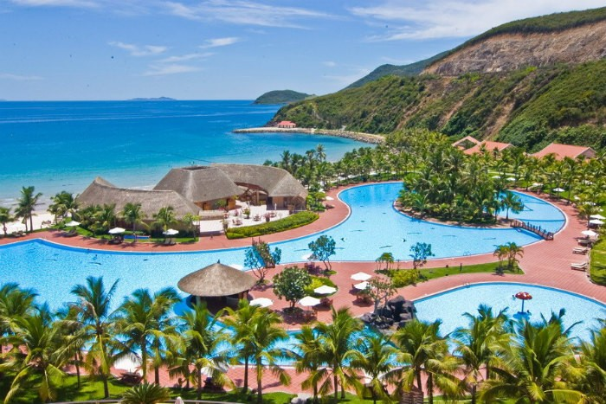
Look at the picture. Where is this place?
Nha Trang beach

Slide 4
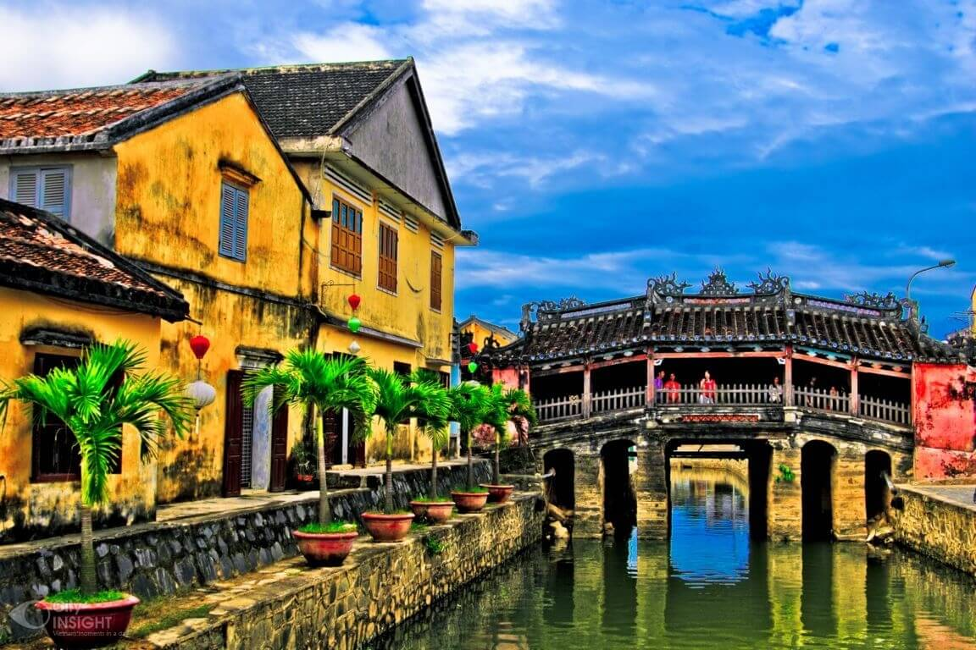
Look at the picture. Where is this place?
Hoi An ancient city

Slide 5
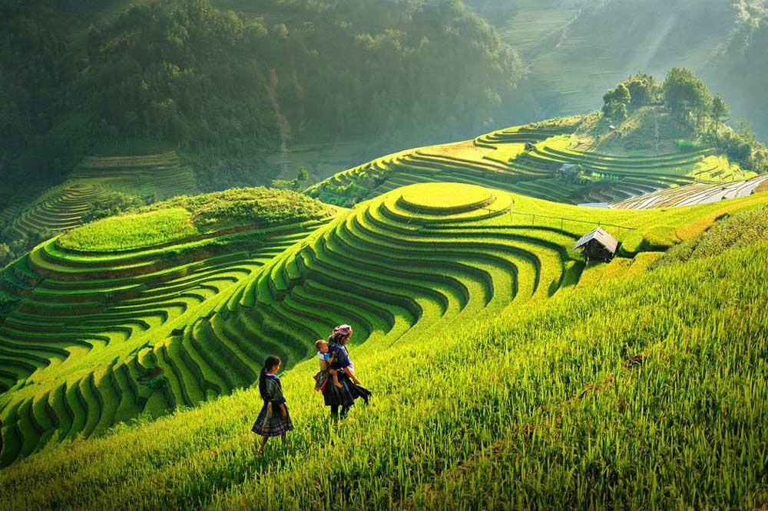
Look at the picture. Where is this place?
Sa Pa mountain

Slide 6
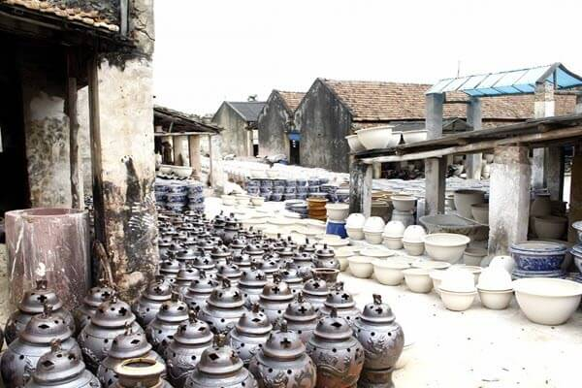
Look at the picture. Where is this place?
Bat Trang village

Slide 7
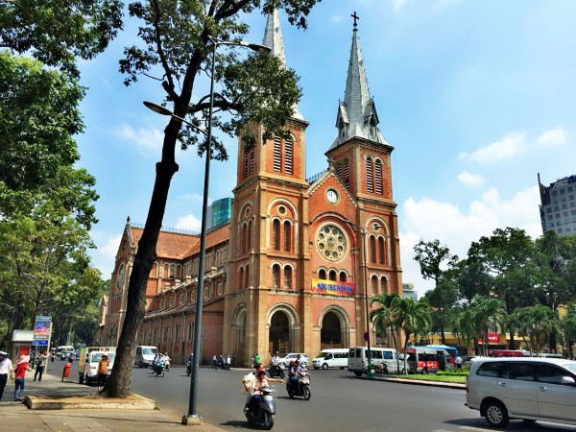
Look at the picture. Where is this place?
Ho Chi Minh city

Slide 8
Unit 13: festivals
GETTING STARTED
Work with a partner. Where should these people go on their visits in Viet Nam? (Use the words in the box)
1. Tom likes swimming and sunbathing.
=> He should go to
Nha Trang beach
2. David is interested in ancient cities.
=> He should go to
Hoi An city
3. Huckleberry likes mountain-climbing.
=> He should go to
Sa Pa mountain
4. Oliver is keen on pottery.
=> He should go to
Bat Trang village
5. Robinson is found of crowded places.
Ho Chi Minh city
=> He should go to
Ho Chi Minh city Hoi An city Bat Trang village
Nha Trang beach Sa Pa mountain

Slide 9
Unit 13: festivals
LISTEN AND READ

Slide 10
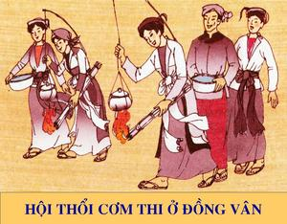
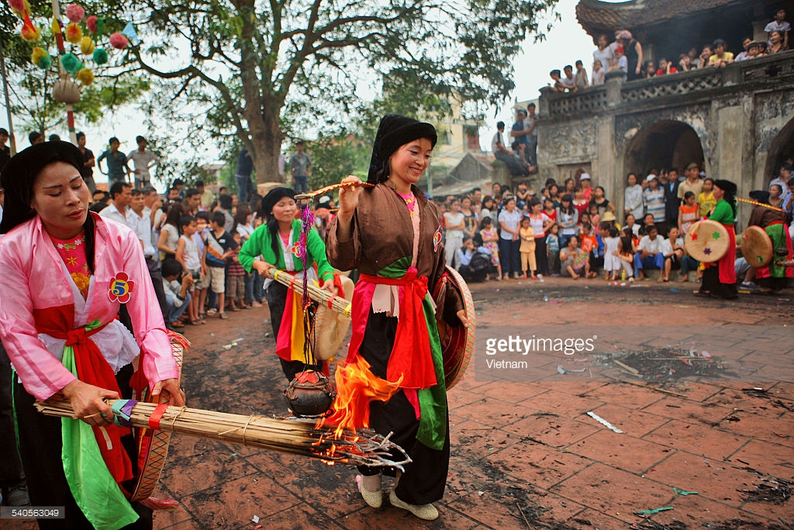
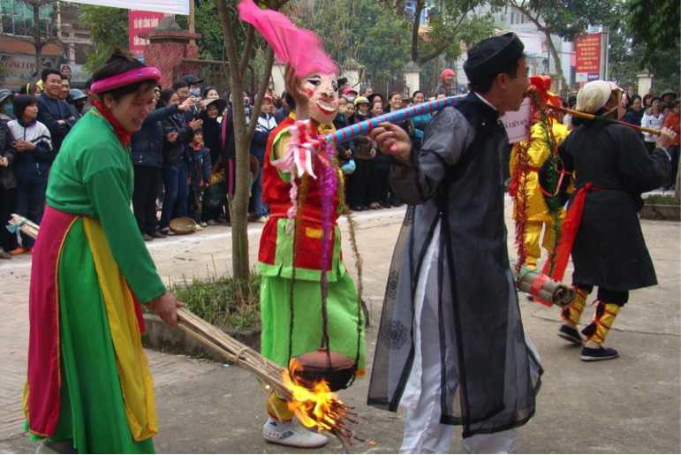
Look at the pictures. What are these activities?
THE RICE COOKING
FESTIVAL

Slide 11
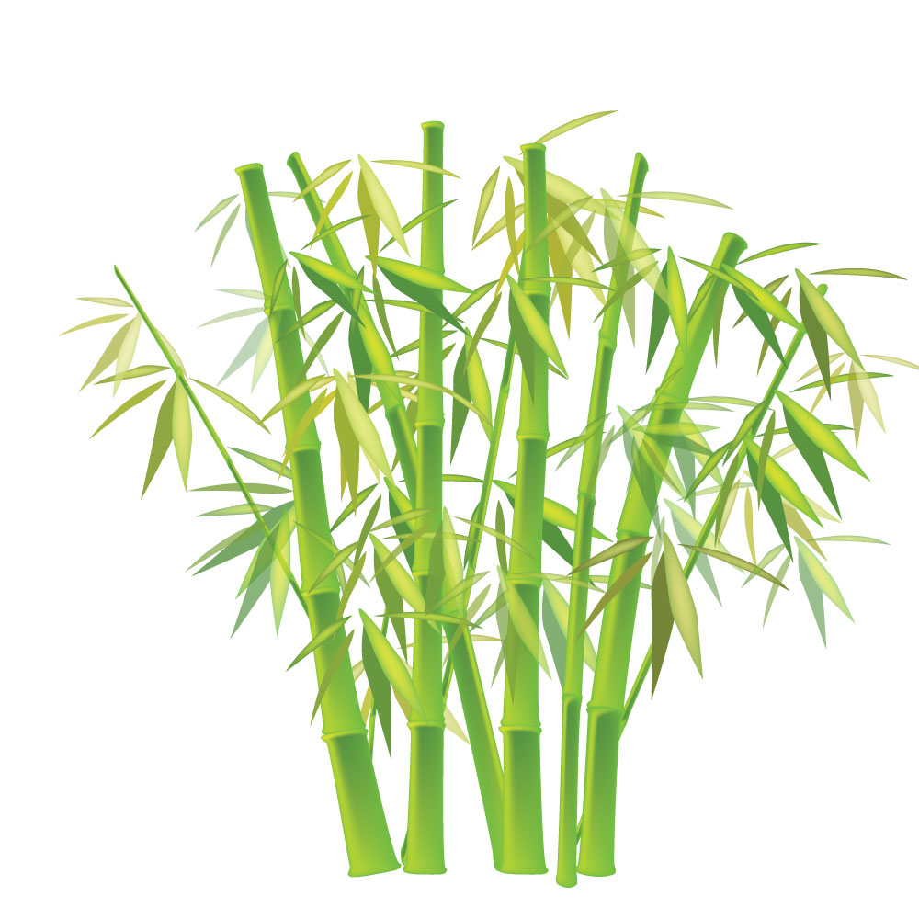
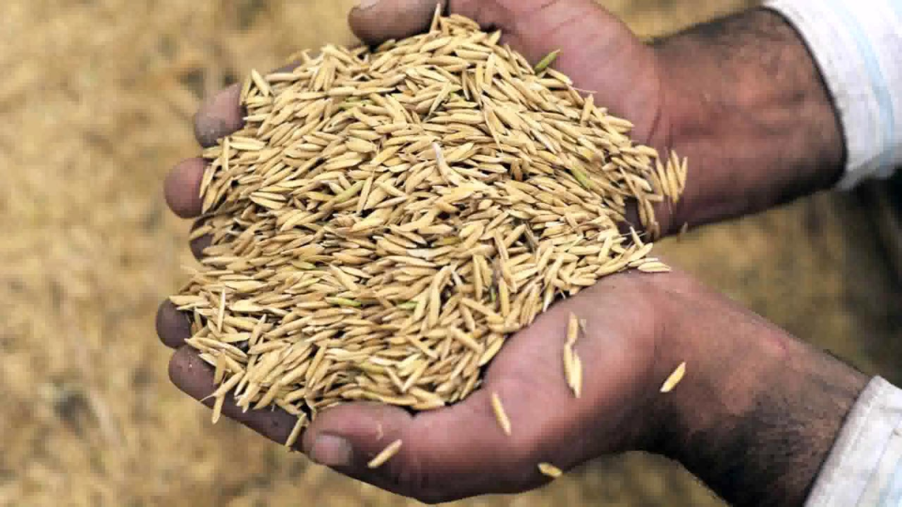
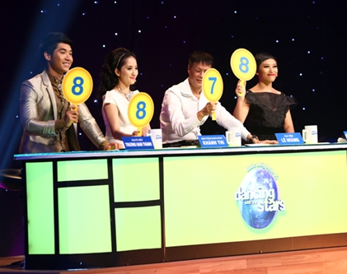
VOCABULARY
- competition (n):
cuộc thi, phần thi
- fetch (v):
đi lấy, mang về
thúc giục
- urge (v):
- teamate (n):
bạn đồng đội
- rub (v):
chà xác
- bamboo (n):
tre
- separate (v):
tách rời ra
- husk (n):
vỏ trấu
- judge (n):
ban giám khảo
- award (n):
phần thưởng

Slide 12
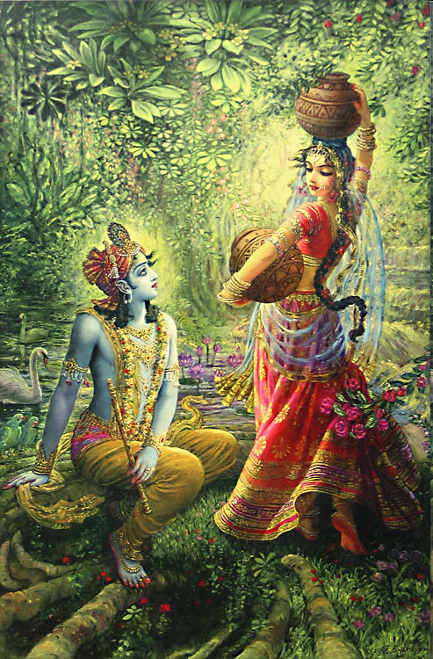
- water-fetching (n)
: việc lấy nước

Slide 13
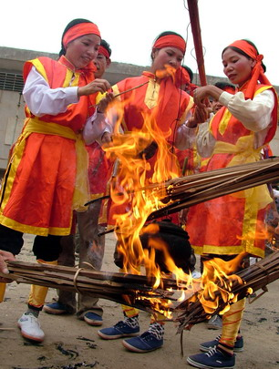
- fire – making (n)
: việc nhóm lửa

Slide 14
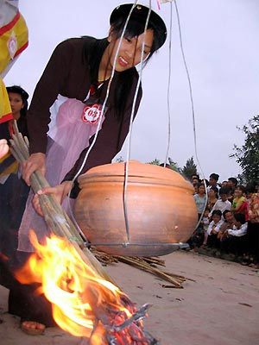
- rice – cooking (n)
: việc nấu cơm

Slide 15
* Grammar: Compound noun (Danh từ ghép)
Example
Thanks for inviting me to the rice–cooking festival.
Noun
– V-ing
Compound noun
Danh từ ghép

Slide 16
water-fetching
Noun
– V-ing(Gerund)
Compound Noun

Slide 17


Work in group. Then answer the questions.
A. Who invited Liz to the rice-cooking festival?
B. How many competitions are there in the rice-cooking festival?
C. How did they make the fire?
D. In the conversation, which team had the grand prize?

Slide 18
Who invited Liz to the rice-cooking festival?
=>Ba invited Liz to the rice-cooking festival.

Slide 19
How many competitions are there in the rice-cooking festival?
=> There are three competitions: water-fetching, fire-making and rice-cooking.

Slide 20
How did they make the fire?
=> They made the fire by rubbing pieces of bamboo to together.

Slide 21
In the conversation, which team had the grand prize?
=> The Thon Trieu team had the grand prize.

Slide 22
Choose the correct answer in the following sentence.
a) The rice-cooking festival is a tradition of China.
b) In the festival, rice is cooked in modern way.
c) The winner is the team with the most delicious rice.

Slide 23
TRUE OR FALSE
TRUE
FALSE
a.Two team members take part in the water-fetching contests.

One team member takes
b. One person has to collect four water bottles.

one water
bottle.
c. The fire is made without matches or lighters.

d. Pieces of wood are used to make the fire.
bamboo

e. In the final contest, the team members taste the rice.
the judges

f. The grand prize is given to the team with the most points.


Slide 24
Consolidation

Slide 25

1. Who invited Liz to the rice- cooking festival?
.Ba invited Liz.

Slide 26
2.How many competitions are there in the rice- cooking festival ?
1.There are three: water- fetching, fire- making and rice- cooking.
2. There are two: water- fetching, fire-making.
3. There is one: water- fetching.

Slide 27
3. How did they make a fire ?
1. They made a fire by paper.
2. They made a fire by pieces of wood.
They made a fire by rubbing pieces of bamboo together.
3.They made a fire by rubbing pieces bamboo together.
They made a fire by rubbing pieces of bamboo together.

Slide 28
4. Which team had the grand prize ?
.The Thon Trieu team had the grand prize.

Slide 29
- Learn the vocabulary
HOMEWORK

Slide 30

GOOD BYE

