Slide 1



TĂNG BẠT HỔ SECONDARY SCHOOL
WELCOME TO OUR CLASS !
CLASS : 7 A 10
TEACHER : OÂNG THÒ ÑOAN THUØY

Slide 2

Multiple Choice
1. The weather …… awful today.
a. is b. was c. were
2. Lan ……. to school last Monday
a. wasn’t go b. doesn’t go c. didn’t go
3. What …. wrong with you yesterday?
a. is b. was c. were
4. ….. her mother ……. a sick note for her two days ago?
a. Does / write b. Did / wrote c. Did / write

Slide 3

Unit 12: LET’S EAT
A. WHAT SHALL WE EAT?
A1-2 / page 114-115

Slide 4


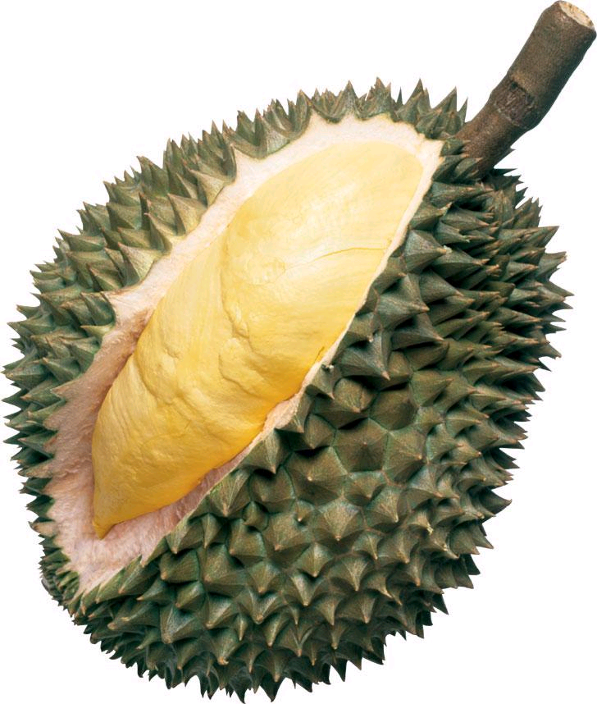
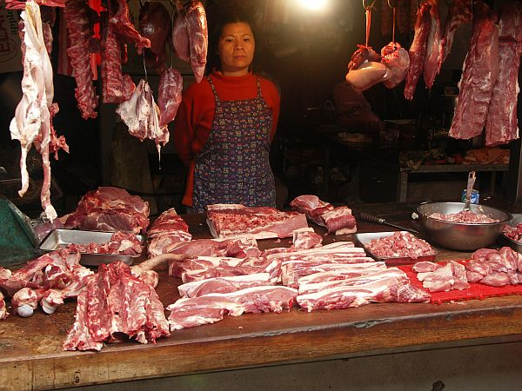
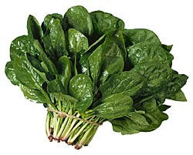
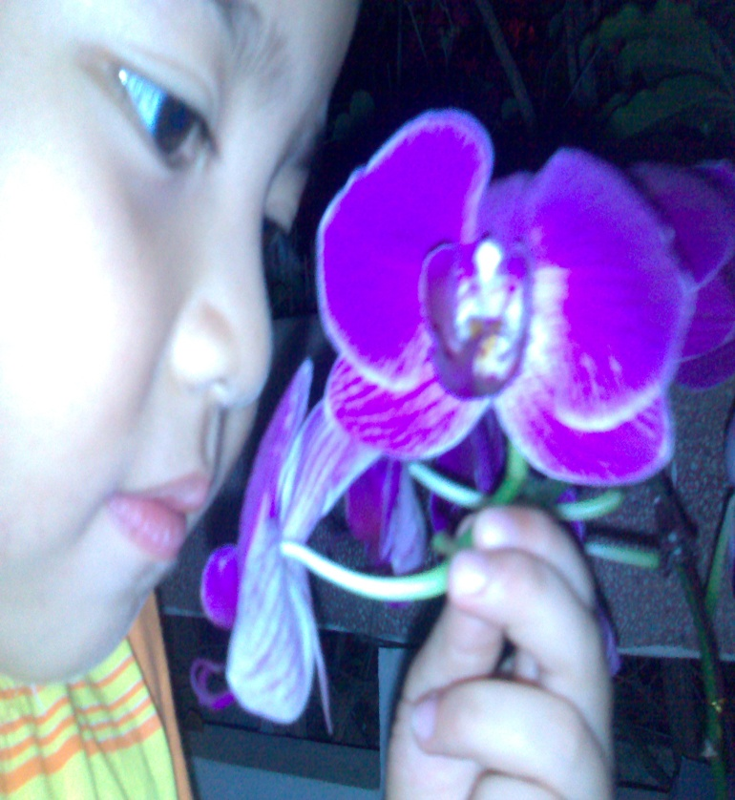
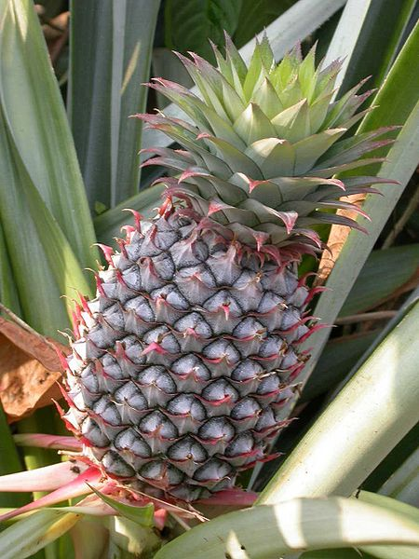
Unit 12: LET’S EAT
A1
Vocabulary:
quầy bán hàng
Stall (n):
pork (n) :
Spinach (n) :
Cucumber (n) :
Papaya (n):
Pineapple (n) :
Durian (n):
Smell (v):
Ripe (adj):
Display (n) = show:
Selection (n):
thịt lợn
What is another word of “show”?
rau chân vịt
quả dưa chuột
quả đu đủ
quả dứa
quả sầu riêng
ngửi
chín
sự trưng bày
sự lựa chọn

Slide 5

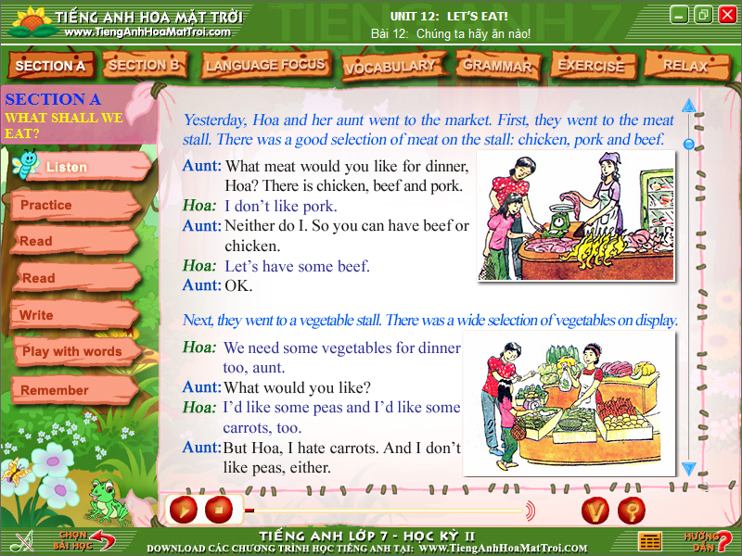
Who are they ?
They are Hoa and her aunt.
They were at the market. What did they buy ? Let’s predict.

Slide 6
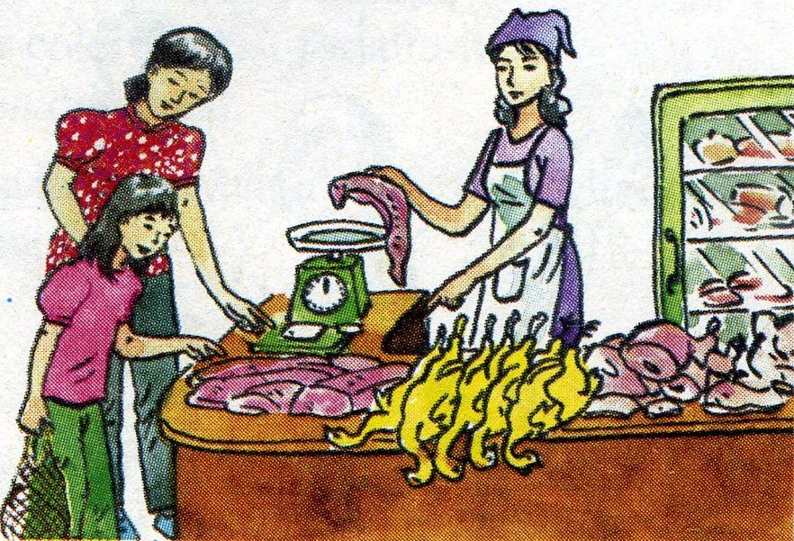
A1. Listen and read. Then practice with a partner:
Yesterday, Hoa and her aunt went to the market. First, they went to the meat stall. There was a good selection of meat on the stall: chicken, pork and beef.
Aunt: What meat would you like for dinner, Hoa?
There is chicken, beef and pork.
Hoa: I don’t like pork.
Aunt: Neither do I. So you can have beef or chicken.
Hoa: Let’s have some beef.
Aunt: OK.

Slide 7
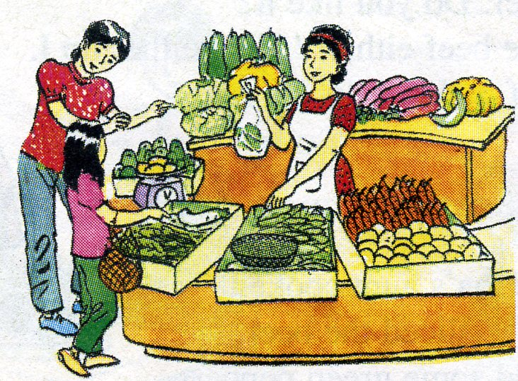
A 1. Listen and read. Then practice with a partner:
Next, they went to a vegetable stall. There was a wide selection of vegetables on display.
Hoa: We need some vegetables for dinner too, aunt.
Aunt: What would you like?
Hoa: I’d like some peas and I’d like some carrots, too.
Aunt: But Hoa, I hate carrots. And I don’t like peas, either.
Hoa: What about spinach and cucumbers? I like them.
Aunt: So do I. They’re my favorite vegetables.
OK. Let’s get some of those.

Slide 8
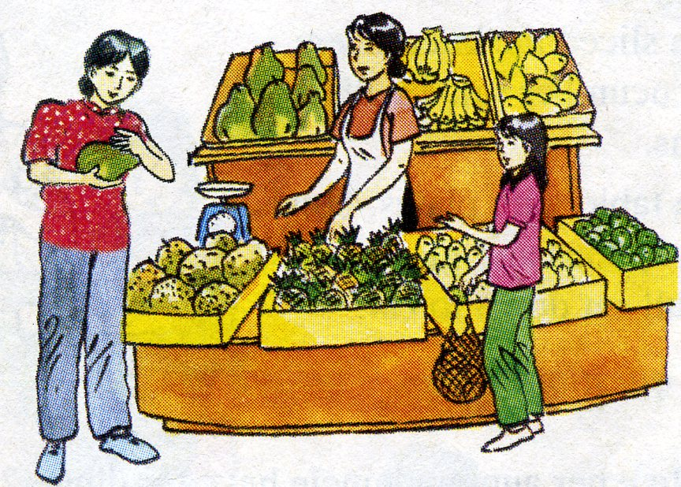
A 1. Listen and read. Then practice with a partner:
Finally, Hoa and her aunt stopped at a fruit stall.
Hoa: We need some fruits, aunt.
Aunt: What shall we buy?
Hoa: Let’s buy a papaya and a pineapple.
Aunt: They aren’t ripe. Neither are the bananas.
Hoa: Let’s buy some oranges then.
Aunt: OK. Can you smell the durians? I don’t like them.
Hoa: Neither do I. I hate durians.

Slide 9
Grammar
1. Hoa: I like spinach.
Hoa’s aunt: So do I. ( I do, too.)
I like spinach, too.
      *So, too : cũng vậy
      - Form: So + Trợ ĐT + S
      S + do/does + too
      (V/V(es).. , too
      Use: đồng tình với câu nói khẳng định.

Slide 10
2. Hoa: I don’t like pork.
Hoa’s aunt: Neither do I
I don’t either
I don’t like pork, either
      * Neither = not + either: cũng không
      - Form: Neither + Trợ ĐT + S
      S + don’t/doesn’t + either
      don’t/doesn’t + V…., either
      - Use: đồng tình với câu nói phủ định.

Slide 11

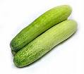

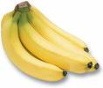

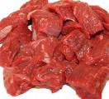


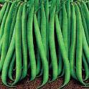


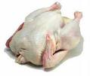
Food
UNIT 12
Meat
Fruits
Vegetables
Chicken
carrot
orange
beef
pea
banana
Pork
spinach
papaya
cucumber
pineapple
durian

Slide 12
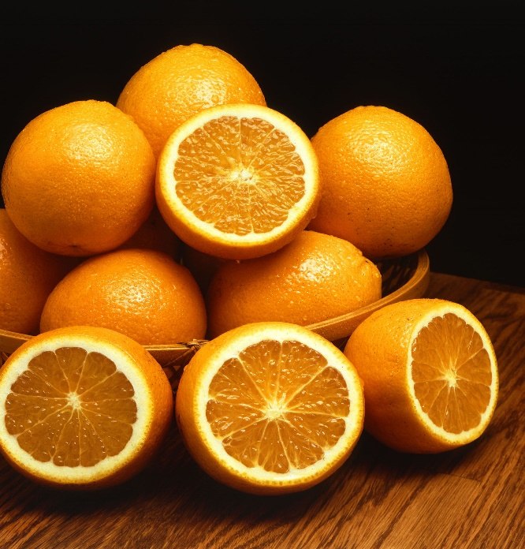
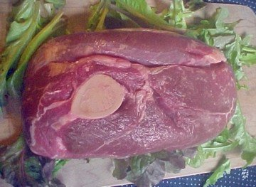
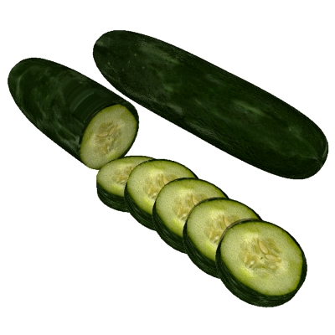
What did Hoa and her aunt buy at the market?
*. Write a list they bought:
beef
spinach, cucumbers
oranges

Slide 13
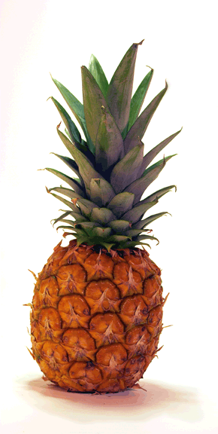
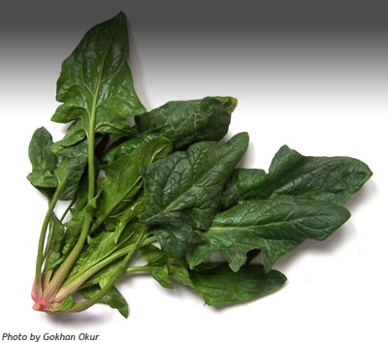
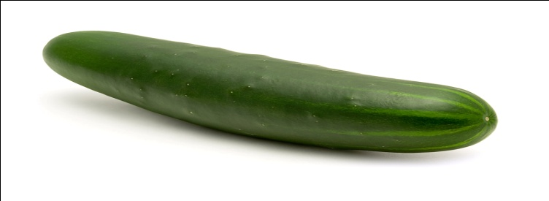
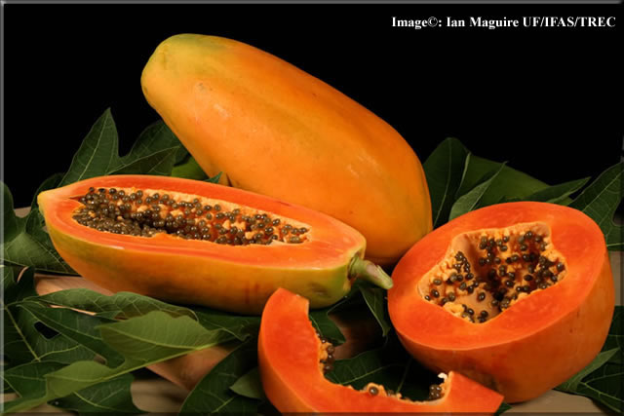
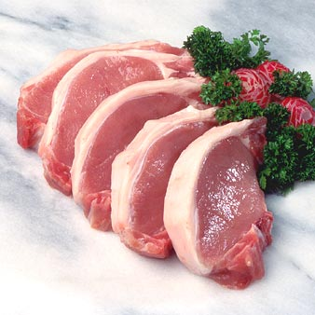

A
MATCHING
G
1. spinach
2. cucumber
3. papaya
B
F
4. pineapple
5. durian
6. pork
7. smell
C
D
E

Slide 14
True/ False statements
chicken
1. At the meat stall . They bought chicken.
2. Hoa ‘s aunt doesn’t like peas.
3. At a vegetable stall, they bought papaya and cucumbers.
4. They need some vegetables for dinner.
5. A papaya and a pineapple are ripe.
6. At a fruit stall, they bought some oranges.
False
(pork)
True
papaya
False
(spinach)
True
are
False
(aren’t)
True

Slide 15
Complete the passage.
Market -
Oranges -
vegetables -
Beef -
meat
Yesterday, Hoa and her aunt went to the (1)_______. First, they went to the (2)_____ stall. There was a lot of meat but they only bought (3)_____.Next, they bought some spinach and cucumbers at the (4)____________stall. Finally, they stopped at a fruit stall and they decided to buy some (5)_________.

Slide 16
Working in group
The conversation about Hoa and her aunt.

Slide 17





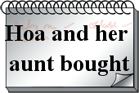


MIND MAP

Slide 18
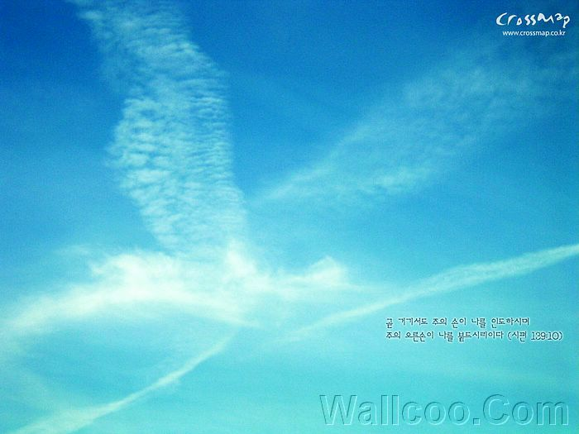


Homework
Learn by heart UNIT 12 A 1, A2
Prepare UNIT 12 A 3, A4
Copy each new word 3 times

Slide 19
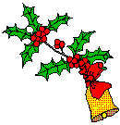



Thanks for
your joining.

