Slide 1
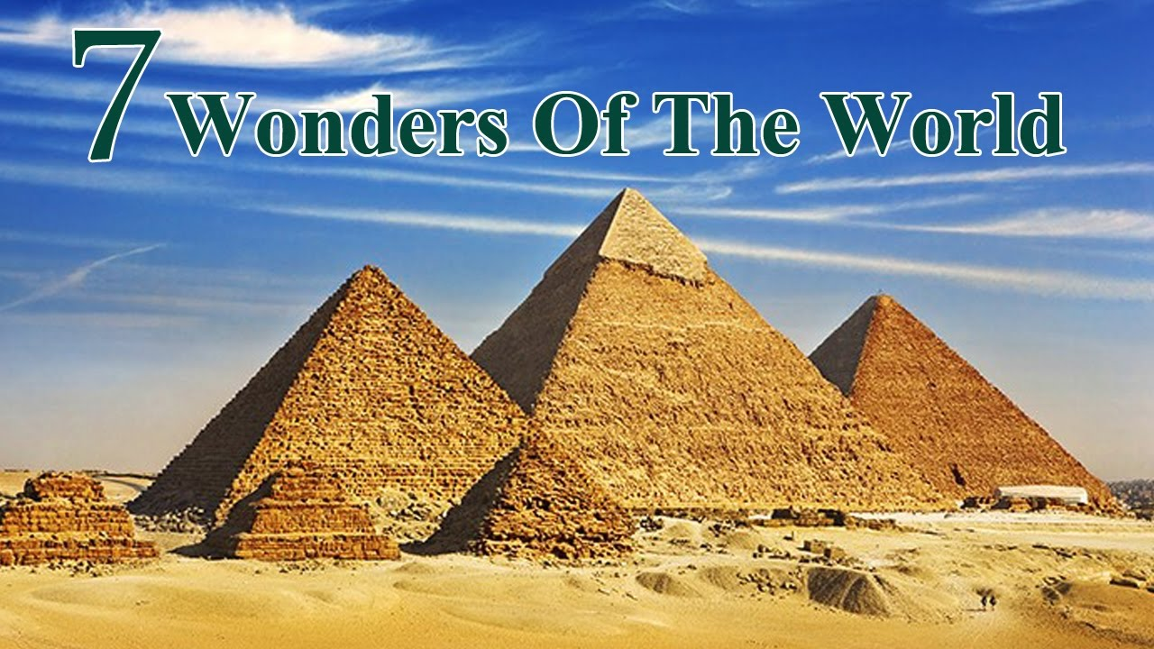
Tang Bat Ho Middle School
ENGLISH 8
Unit 14: WONDERS OF THE WORLD
Lesson: READ
Teacher: Nguyen Pham Linh Tam

Slide 2
Let’s watch a video!

Slide 3


Slide 4
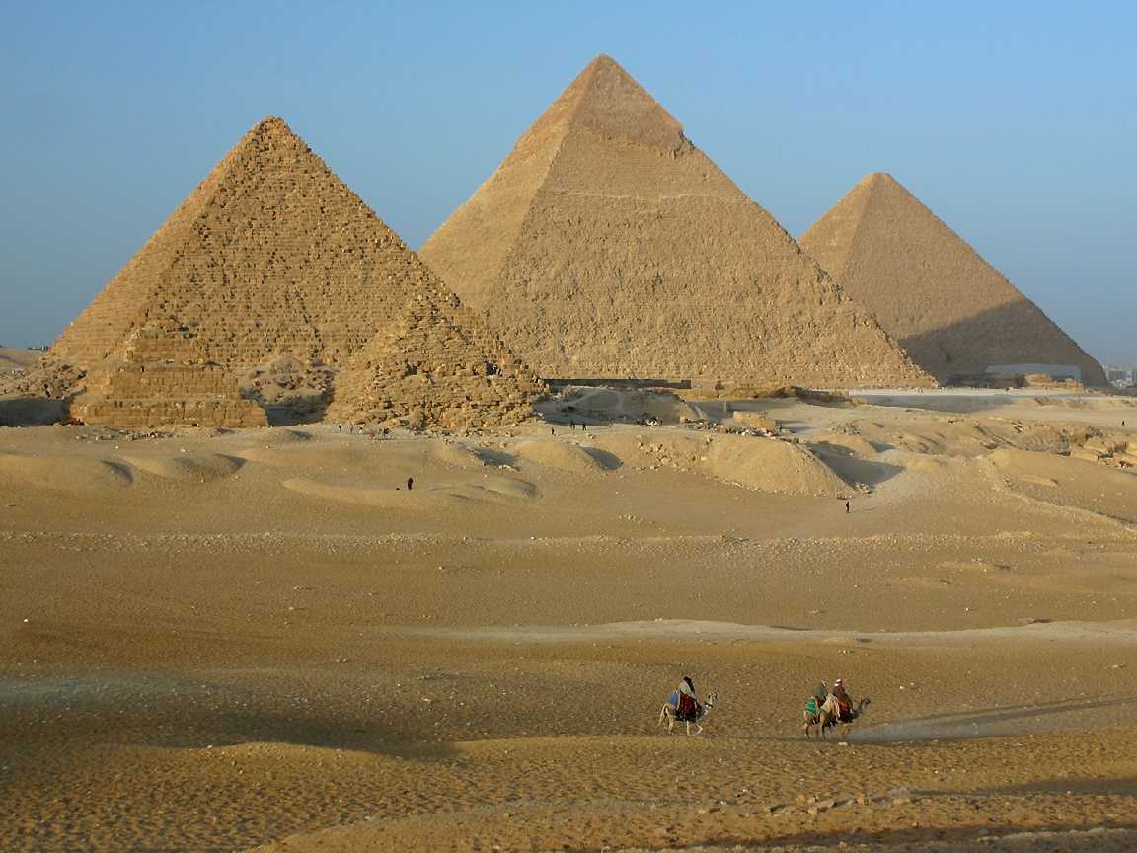
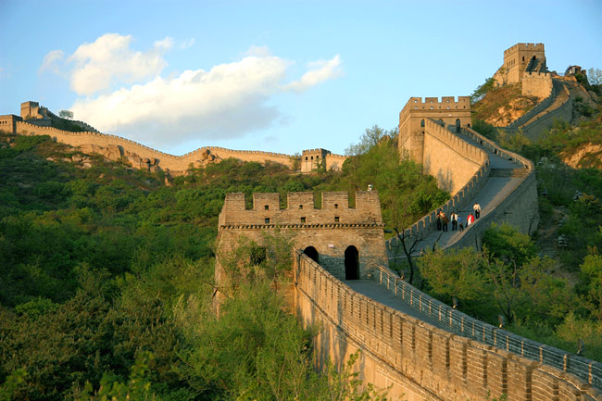
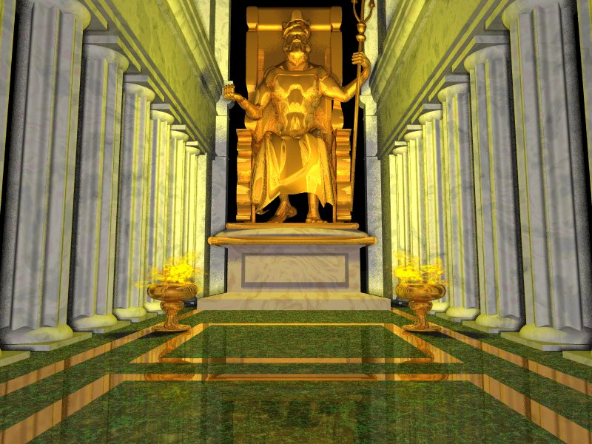
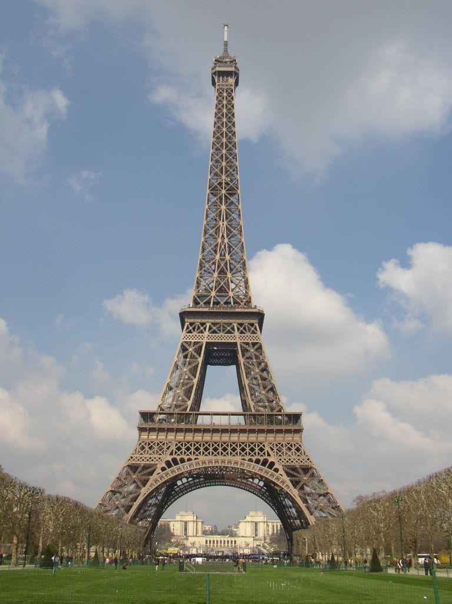
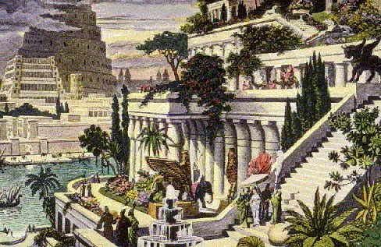
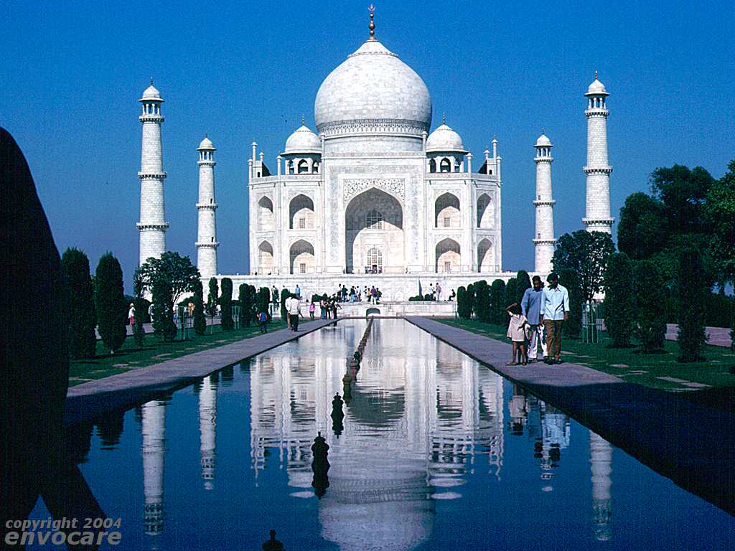
MATCHING
1
2
3
a.The Great Wall
b.Taj Mahal
c.The Statue of Zeus
d.The Pyramid
e.Hanging Garden of Babylon
f. Eiffel Tower
4
5
6

Slide 5
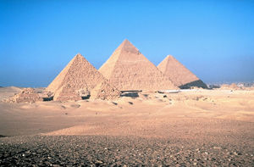
PICTURES

Slide 6

UNIT 14:
WONDERS OF THE WORLD
READ- P. 134
NEW WORDS:
1. (to) compile
biên soạn
2. surviving (adj)
còn lại
3. (to) claim
khẳng định
4. (to) honor
tôn thờ, tôn kính
5. citizen
công dân
r_ya_
thuộc về hoàng gia
6. royal
(adj)

Slide 7

UNIT 14:
WONDERS OF THE WORLD
READ- P. 134
NEW WORDS:
1. (to) compile
biên soạn
2. surviving (adj)
còn lại
3. (to) claim
khẳng định
4. (to) honor
tôn thờ, tôn kính
5. citizen
công dân
6. royal
(adj)
thuộc về hoàng gia

Slide 8
MATCHING
1. (to) compile
A. khẳng định
2. surviving (adj)
B. hoàng gia
3. (to) claim
C. biên soạn
4. (to) honor
D. công dân
5. citizen
E. tôn thờ, tôn kính
6. royal (adj)
F. còn lại

Slide 9

THE TEXT
Centuries ago in Ancient Greece, a man by the name of Antipater of Sidon compiled a list of what he thought were the seven wonders of the world. The seven included the Hanging Garden of Babylon in present-day Iraq, the Statue of Zeus in Greece, and the Pyramid of Cheops in Egypt. The pyramid is only wonder you can still see today.
Many people claim that there were other wonders, which the ancient Greeks knew nothing about. These include the Great Wall of China, the Taj Mahal in India and Angkor Wat in Cambodia.
Angkor Wat should really be known as a wonder because it is the largest temple in the world. The temple was built around the year 1100 to honor a Hindu God, but over the next three centuries it became a Buddhist religious ceenter. The area surrounding the temple, Angkor Thom, used to be the royal capital city.
In the early 15th century, The Khmer rulers moved to Phnom Penh and Angkor was quiet. It now is a famous tourist attraction.

Slide 10
CHECK TRUE/ FALSE STATEMENTS
An Egyptian man compiled a list of what he thought were the seven wonders of the world.
Today we can still see the Hanging Garden of Babylon in Present-day Iraq.
The Great Wall of China first wasn’t in the list of the seven wonders of the world.
In the early 15th century, the Khmer King chose Angkor Wat as the new capital.
1
F
2
F
3
T
4
F

Slide 11
Centuries ago in Ancient Greece, a man by the name of Antipater of Sidon compiled a list of what he thought were the seven wonders of the world. The seven included the Hanging Garden of Babylon in present-day Iraq, the Statue of Zeus in Greece, and the Pyramid of Cheops in Egypt. The pyramid is only wonder you can still see today.
1. An Egyptian man compiled a list of what he thought were the seven wonders of the world.
F

Slide 12
Centuries ago in Ancient Greece, a man by the name of Antipater of Sidon compiled a list of what he thought were the seven wonders of the world. The seven included the Hanging Garden of Babylon in present-day Iraq, the Statue of Zeus in Greece, and the Pyramid of Cheops in Egypt. The pyramid is the only wonder you can still see today.
2. Today we can still see the Hanging Garden of Babylon in present Iraq.
F

Slide 13
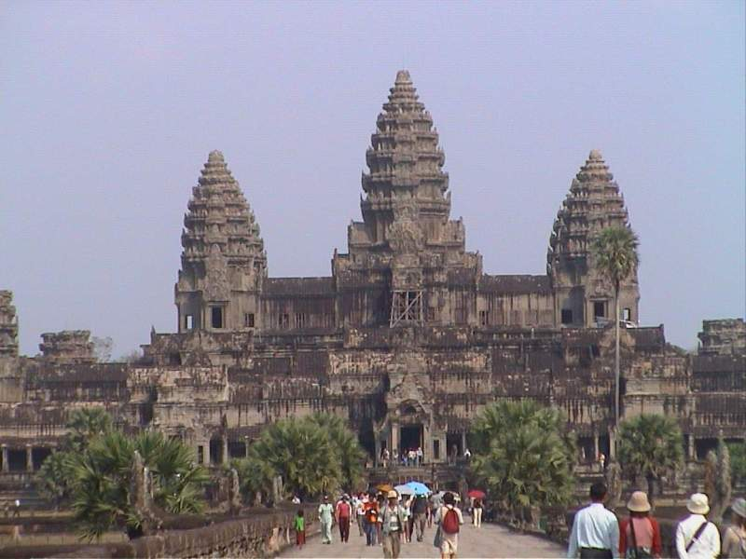
Many people claim that there were other wonders, which the ancient Greeks knew nothing about. These include the Great Wall of China, the Taj Mahal in India and Angkor Wat in Cambodia.
3. The Great Wall of China first wasn’t in the list of the seven wonders of the world.
T

Slide 14
Angkor Wat should really be known as a wonder because it is the largest temple in the world. The temple was built around the year 1100 to honor a Hindu God, but over the next three centuries it became a Buddhist religious ceenter. The area surrounding the temple, Angkor Thom, used to be the royal capital city.
In the early 15th century, The Khmer rulers moved to Phnom Penh and Angkor was quiet. It now is a famous tourist attraction.
4. In the early 15th century, the Khmer King chose Angkor Wat as the new capital.
F

Slide 15

COMPLETE THE SENTENCES
a) The only surviving wonder on Antipater’s list is__________.
A. the Great Wall of China C. the Pyramid of Cheops
B. the Statue of Zeus D. Angkor Wat
b) Angkor Wat was originally built for ___________.
A. Hindus C. kings
B. Buddhist D. the citizens of Phnom Penh
c) Angkor Wat ___________.
A. was a small temple C. is a pyramid
B. is one of the seven wonder of the world
D. was a part of a royal Khmer city a long time ago
d) In the 1400s, the Khmer King _____________.
A. built Angkor Wat
B. chose Phnom Penh as a capital city
C. turned Angkor Wat into a Buddhist center
D. moved the temple to Phnom Penh

Slide 16

Centuries ago in Ancient Greece, a man by the name of Antipater of Sidon compiled a list of what he thought were the seven wonders of the world. The seven included the Hanging Garden of Babylon in present-day Iraq, the Statue of Zeus in Greece, and the Pyramid of Cheops in Egypt. The pyramid is only wonder you can still see today.
Many people claim that there were other wonders, which the ancient Greeks knew nothing about. These include the Great Wall of China, the Taj Mahal in India and Angkor Wat in Cambodia.
Angkor Wat should really be known as a wonder because it is the largest temple in the world. The temple was built around the year 1100 to honor a Hindu God, but over the next three centuries it became a Buddhist religious ceenter. The area surrounding the temple, Angkor Thom, used to be the royal capital city.
In the early 15th century, The Khmer rulers moved to Phnom Penh and Angkor was quiet. It now is a famous tourist attraction.
a) The only surviving wonder on Antipater’s list is__________.
A. the Great Wall of China C. the Pyramid of Cheops
B. the Statue of Zeus D. Angkor Wat

Slide 17
Centuries ago in Ancient Greece, a man by the name of Antipater of Sidon compiled a list of what he thought were the seven wonders of the world. The seven included the Hanging Garden of Babylon in present-day Iraq, the Statue of Zeus in Greece, and the Pyramid of Cheops in Egypt. The pyramid is only wonder you can still see today.
Many people claim that there were other wonders, which the ancient Greeks knew nothing about. These include the Great Wall of China, the Taj Mahal in India and Angkor Wat in Cambodia.
Angkor Wat should really be known as a wonder because it is the largest temple in the world. The temple was built around the year 1100 to honor a Hindu God, but over the next three centuries it became a Buddhist religious ceenter. The area surrounding the temple, Angkor Thom, used to be the royal capital city.
In the early 15th century, The Khmer rulers moved to Phnom Penh and Angkor was quiet. It now is a famous tourist attraction.
b) Angkor Wat was originally built for ___________.
A. Hindus C. kings
B. Buddhist D. the citizens of Phnom Penh

Slide 18
Centuries ago in Ancient Greece, a man by the name of Antipater of Sidon compiled a list of what he thought were the seven wonders of the world. The seven included the Hanging Garden of Babylon in present-day Iraq, the Statue of Zeus in Greece, and the Pyramid of Cheops in Egypt. The pyramid is only wonder you can still see today.
Many people claim that there were other wonders, which the ancient Greeks knew nothing about. These include the Great Wall of China, the Taj Mahal in India and Angkor Wat in Cambodia.
Angkor Wat should really be known as a wonder because it is the largest temple in the world. The temple was built around the year 1100 to honor a Hindu God, but over the next three centuries it became a Buddhist religious ceenter. The area surrounding the temple, Angkor Thom, used to be the royal capital city.
In the early 15th century, The Khmer rulers moved to Phnom Penh and Angkor was quiet. It now is a famous tourist attraction.
c) Angkor Wat ___________.
A. was a small temple C. is a pyramid
B. is one of the seven wonder of the world
D. was a part of a royal Khmer city a long time ago

Slide 19

Centuries ago in Ancient Greece, a man by the name of Antipater of Sidon compiled a list of what he thought were the seven wonders of the world. The seven included the Hanging Garden of Babylon in present-day Iraq, the Statue of Zeus in Greece, and the Pyramid of Cheops in Egypt. The pyramid is only wonder you can still see today.
Many people claim that there were other wonders, which the ancient Greeks knew nothing about. These include the Great Wall of China, the Taj Mahal in India and Angkor Wat in Cambodia.
Angkor Wat should really be known as a wonder because it is the largest temple in the world. The temple was built around the year 1100 to honor a Hindu God, but over the next three centuries it became a Buddhist religious ceenter. The area surrounding the temple, Angkor Thom, used to be the royal capital city.
In the early 15th century, The Khmer rulers moved to Phnom Penh and Angkor was quiet. It now is a famous tourist attraction.
d) In the 1400s, the Khmer King _____________.
built Angkor Wat B. chose Phnom Penh as a capital city
C. turned Angkor Wat into a Buddhist center
D. moved the temple to Phnom Penh

Slide 20
HOMEWORK
Learn new words by heart
Prepare : WRITE – P. 135

