Slide 1
TANG BAT HO SECONDARY SCHOOL
Welcome to our class
ENGLISH 6
I - LEARN SMART WORLD
TEACHER: NGUYEN BINH THANH NGA

Slide 2


UNIT 8: THE WORLD
AROUND US
Lesson 3: Reading+ Speaking

Slide 3
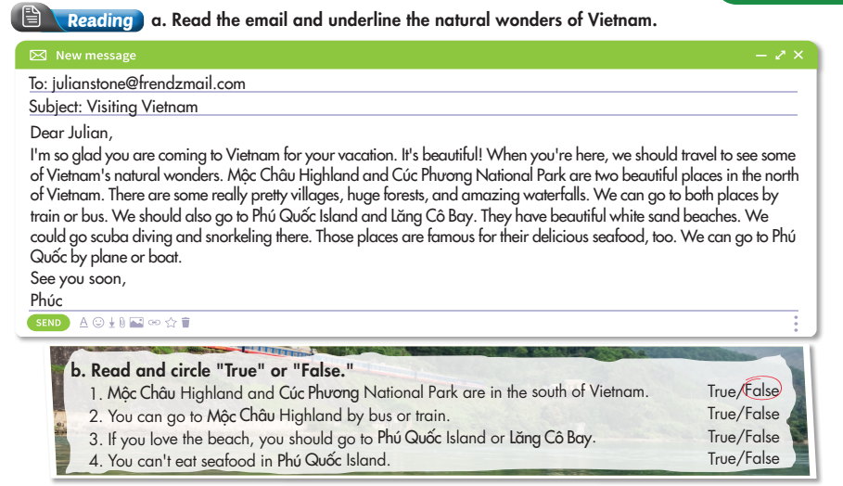
Lesson 3

Slide 4
Lesson 3

Slide 5
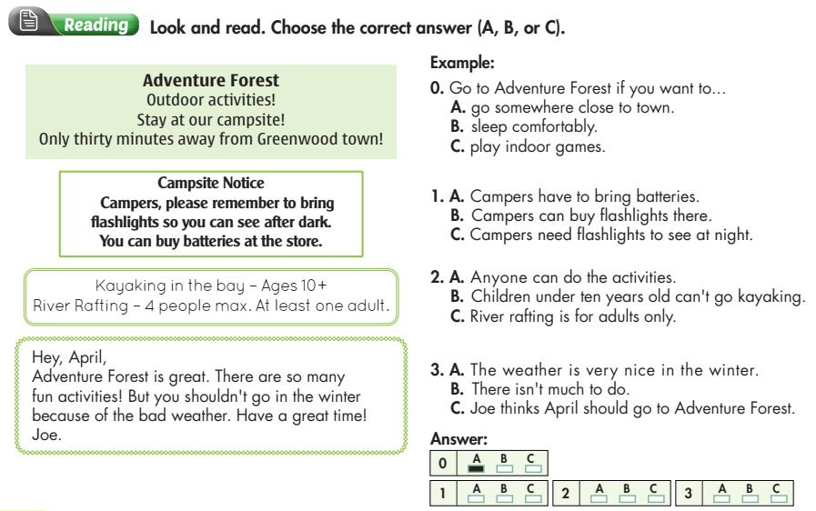
Review

Slide 6
Review

Slide 7
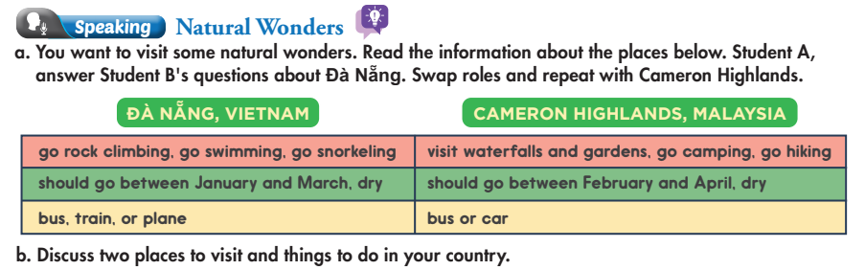
Lesson 3

Slide 8
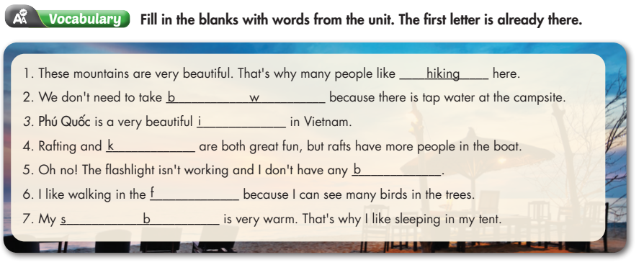
Review

Slide 9
Review
ottled
ater
sland
ayaking
atteries
orest
leeping
ag

Slide 10


Unit 11: What do you eat ? Period 70 Lesson 2: A: At the store (A2, 3)
Homework
I/ Vocabulary:
Salesgirl (n)
cô bán hàng
anything else
bất cứ điều gì khác
need ( v)
cần
How much ? = How many?
Bao nhiêu?
II/Structure
S1:
How many +
N (plural count ) +
do/ does + S + want?
How much +
N (uncount) +
do/ does +S+ want?
S2:
Từ chỉ số lượng (N)
-Finish the exercise above
-Exercises in workbook
-Prepare Unit 9

