Slide 1
Unit 4: LEARNING A FOREIGN LANGUAGE

Slide 2
Vocabulary
GETTING STARTED – LISTEN AND READ:
Foreign language (n) : ngoại ngữ
Examine(v): kiểm tra
Examinee = candidate (n): thí sinh
Examiner (n): giám khảo
Examination (n): kỳ thi
3. go on = continue (v): tiếp tục
4. Aspect (n): mặt, khía cạnh
5. Attend (v): tham dự
Attendance (n): sự có mặt
6. Oral examination = spoken examination (n): kỳ thi vấn đáp
7. Written examination (n): kỳ thi viết
8. Course (n): khoá học

Slide 3
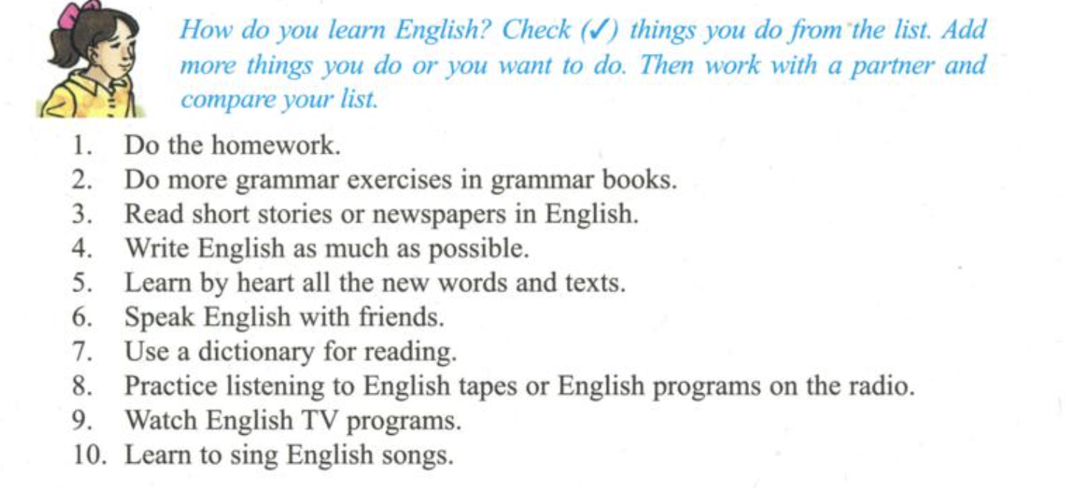
1. Getting started (Trang 32 SGK Tiếng Anh 9)

Slide 4
2. LISTEN AND READ
Paola : Hey, Lan ! Have you finish your exam ? Lan : Yes …., I have . Paola : Were the questions difficult ? Lan : Well, they are quite hard Paola :Did you pass ? Lan : I’m not sure . The examiner didn’t tell me Paola : What questions did she ask you ? Lan : First she asked me what my name was , and where I came from Paola : They were easy for you , weren’t they ? Lan : …then she asked me why I was learning English , … and if I smoke other languages Paola : Go on Lan : ….. Then she asked me when I learned English in my country . …... And she asked how I would use English in the future Paola : What else did she ask you ? Lan : Oh , Paola ! Let me try to remember ! …. Ah , she asked me what aspects of learning English I found most difficult . Paola : Is that all , Lan ? Lan : Oh . There were a lot of other questions. She also asked me to read a passage Paola : What did she say in the end ? Lan : I’m trying to to remember …. Oh ,yes ! Exactly she said “ If you want to attend the course , you must pass the written examination . Good luck ! Paola : It’s terrible , Lan . I don’t think I will be able to pass the exams Lan : Don’t worry , Paola . Everything will be all right .

Slide 5
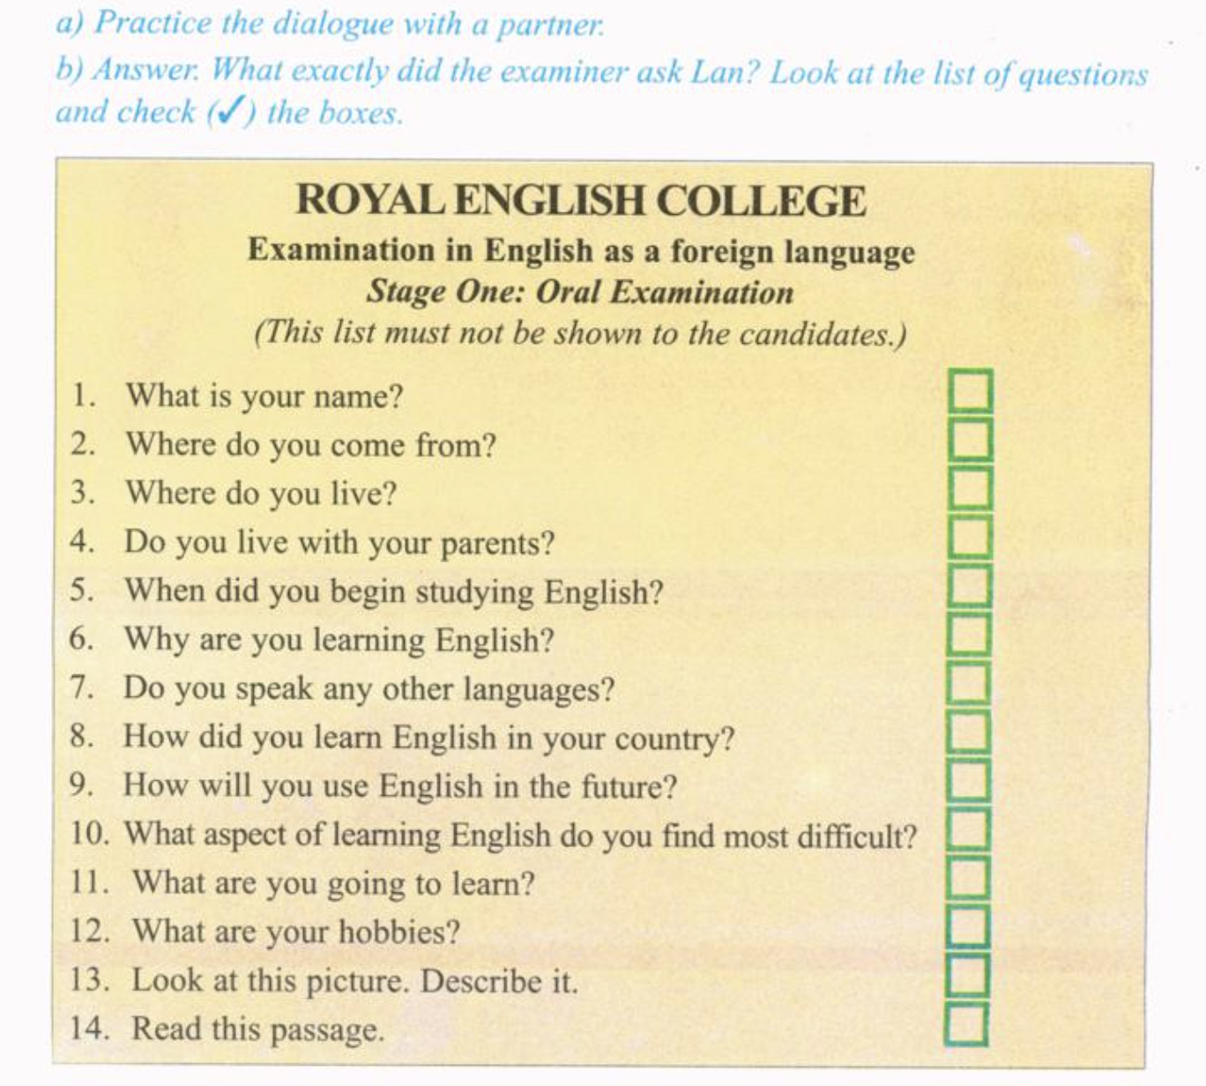
V
V
V
V
V
V
V
V

Slide 6
Grammar
I. CÂU ĐIỀU KIỆN LOẠI 1
IF CLAUSE | MAIN CLAUSE
S + V ( S/ES) (BE → AM/IS/ARE) | S + WILL + V
EX: If I’m free, I will shopping with you.
are’t
If you …. a student , you won’t get a discount on books. (not be)
Hoa’ll have to walk home if she …. the last bus. (miss)
misses

Slide 7
NEW WORDS : SPEAK – LISTEN
Dormitory (n): ký túc xá
Agree (v): đồng ý # disagree : không đồng ý
Campus (n): khuôn viên trường
Repute ( n): tiếng tăm
Reputation (n): danh tiếng
5. Institute (n): học viện
6. Fee (n): học phí
7. Approximate (adj): gần đúng
Approximately (adv)
8. Native speaker (n): người bản xứ

Slide 8
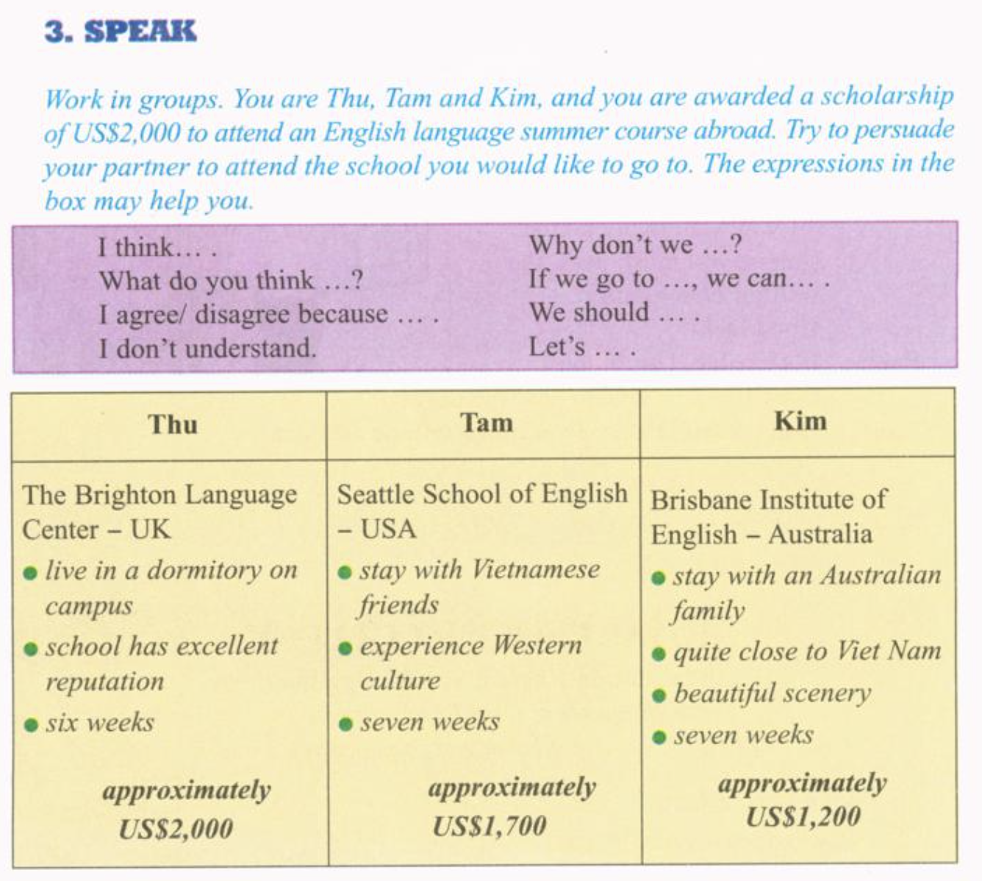
3. sPEAK

Slide 9
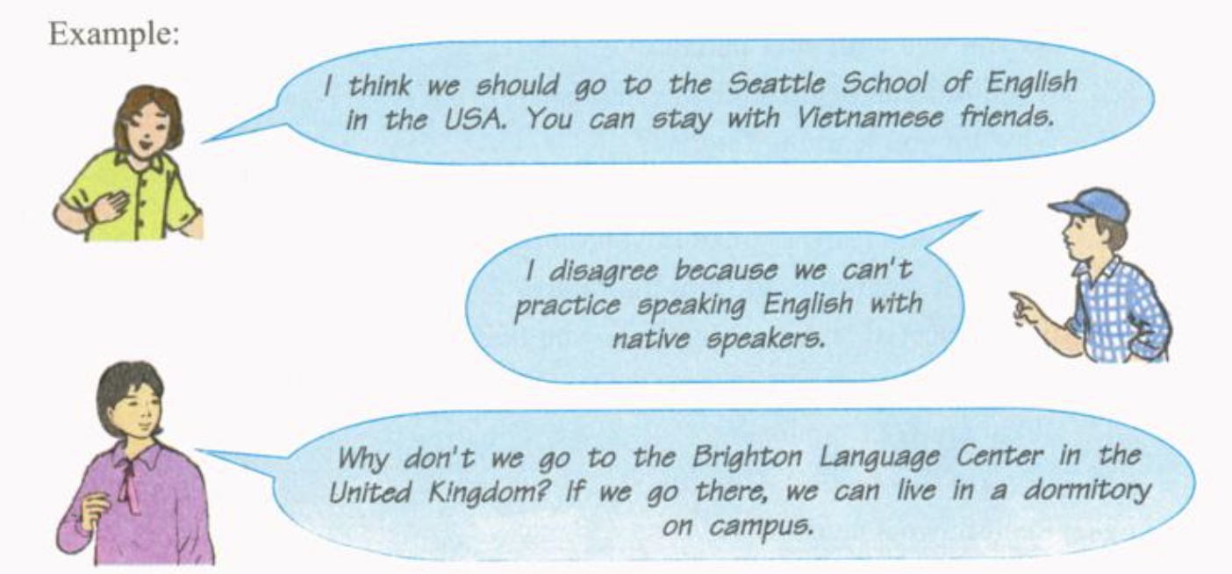
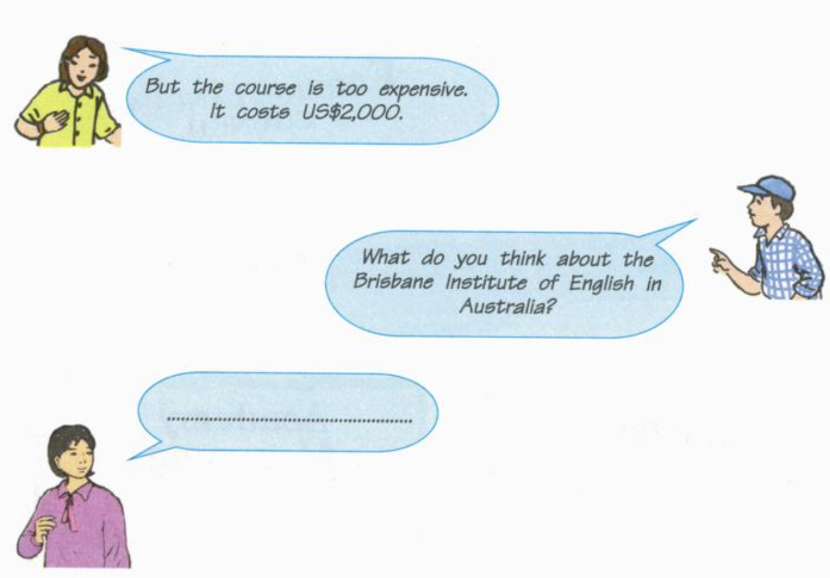

Slide 10
GỢI Ý:
You: Congratulation! Thu. How wonderful you are!
Thu: Thanks.
You: I think you should take the scholarship to the Brighton Language Center. It's the best way to learn English there.
Thu: I don't understand.
You: If we go to study English in England, we can study the traditional standard English and we can learn the English culture, too.
Thu: I agree. What do you think about the language center in Brighton?
You: Congratulation! Thu. How wonderful you are!
Thu: Thanks.
You: I think you should take the scholarship to the Brighton Language Center. It's the best way to learn English there.
Thu: I don't understand.
You: If we go to study English in England, we can study the traditional standard English and we can learn the English culture, too.
Thu: I agree. What do you think about the language center in Brighton?
You: You may be right

Slide 11
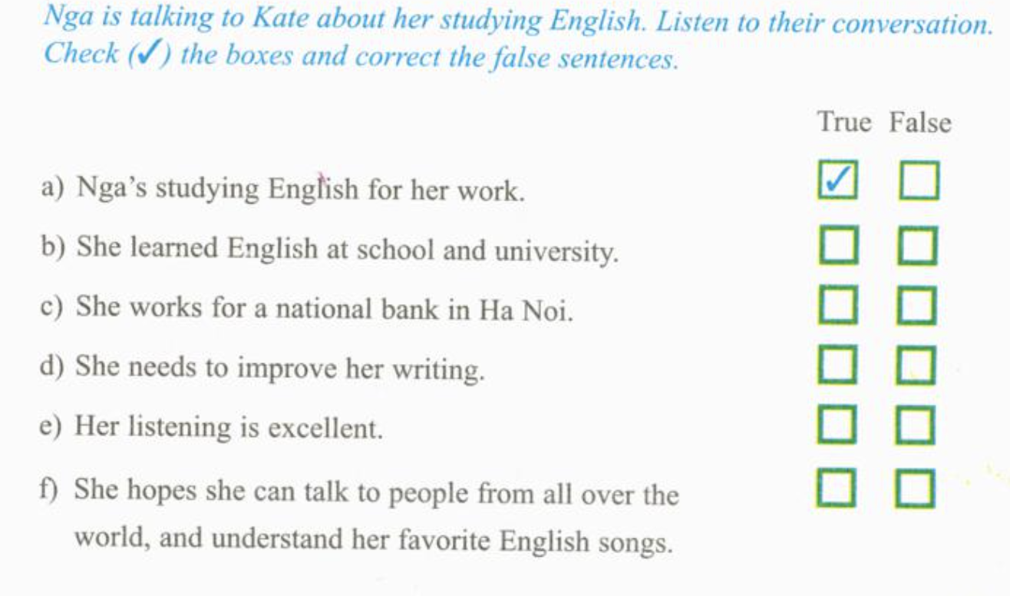
4. Listen
V
V
=> She works for an international bank in Ha Noi.
V
V
=> Her listening is terrible.
V

Slide 12
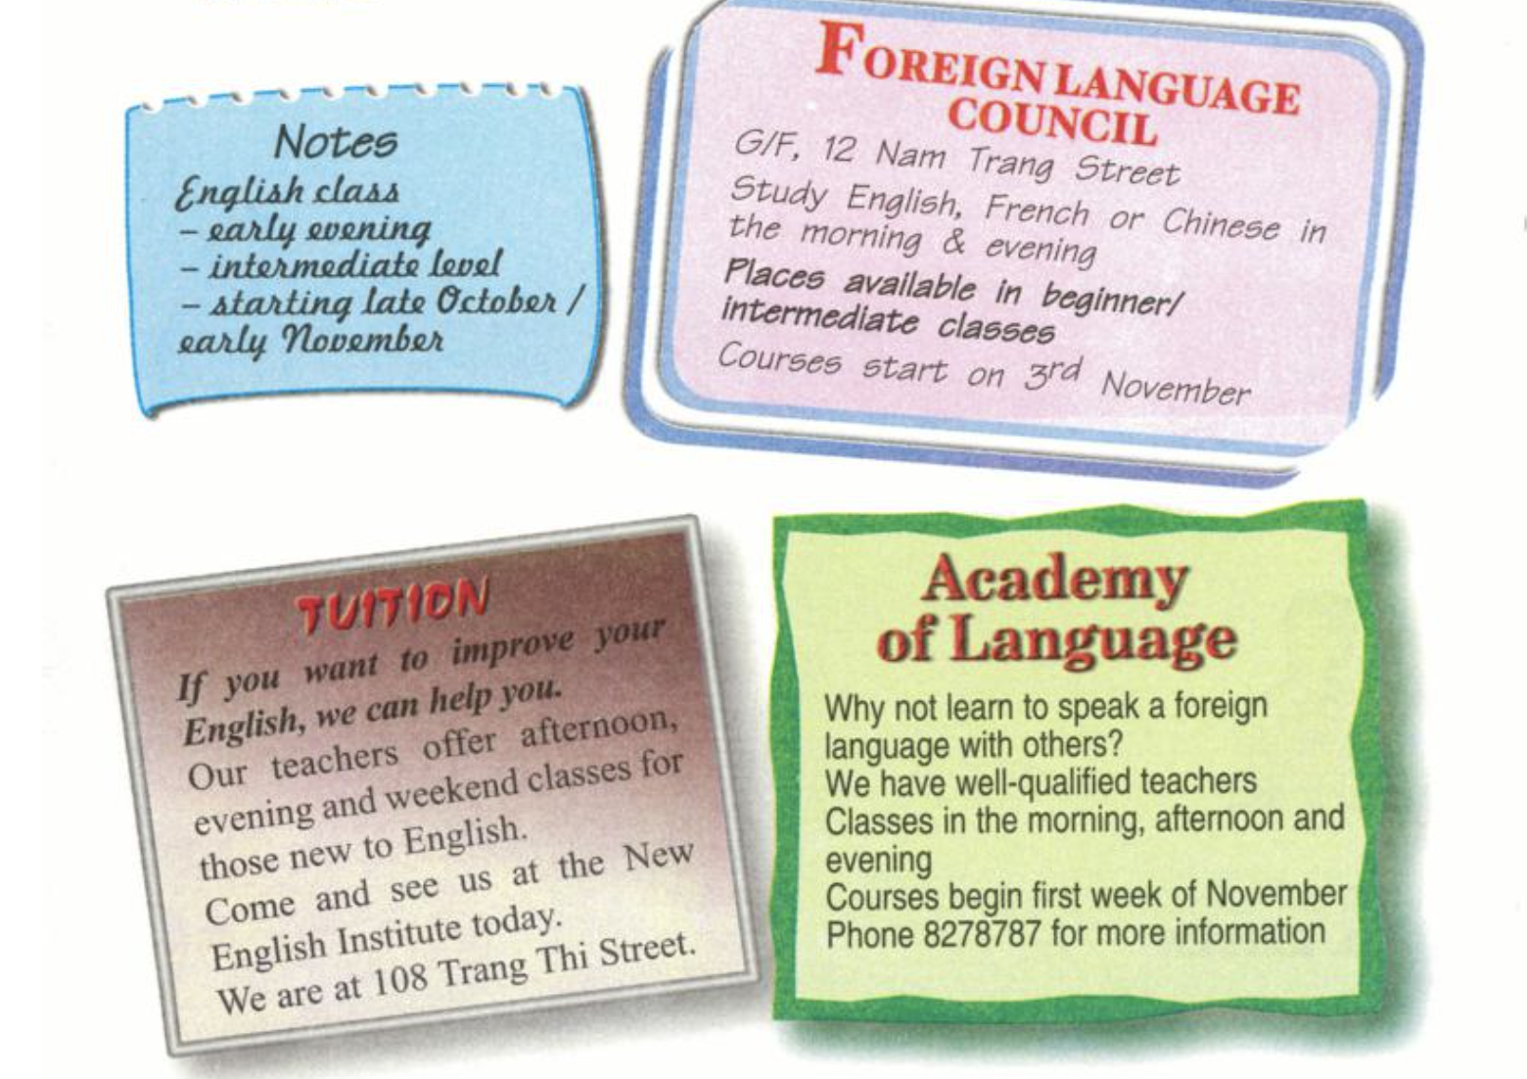
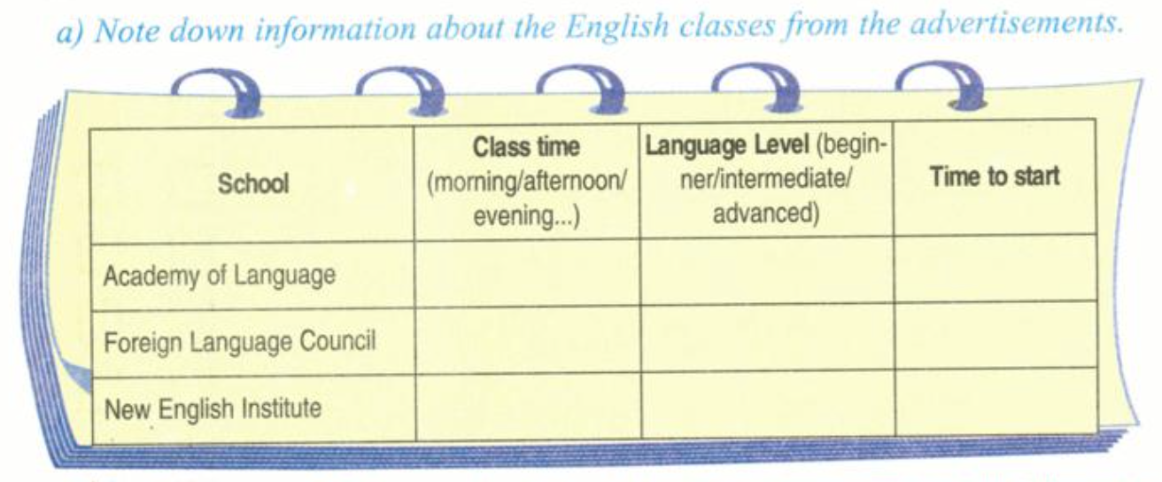
5. Read

Slide 13
New words – Read:
Intermediate (a): trung cấp
Advanced (a): cao cấp
Advance (v/n): sự tiến bộ
3. tuition (n): sự dạy kèm
4.well- qualified (a): có trình độ chuyên môn
5. Academy (n): học viện
6. Advertised (v): quảng cáo
Advertisement (n): mục quảng cáo
Advertising (v): sự quảng cáo

Slide 14
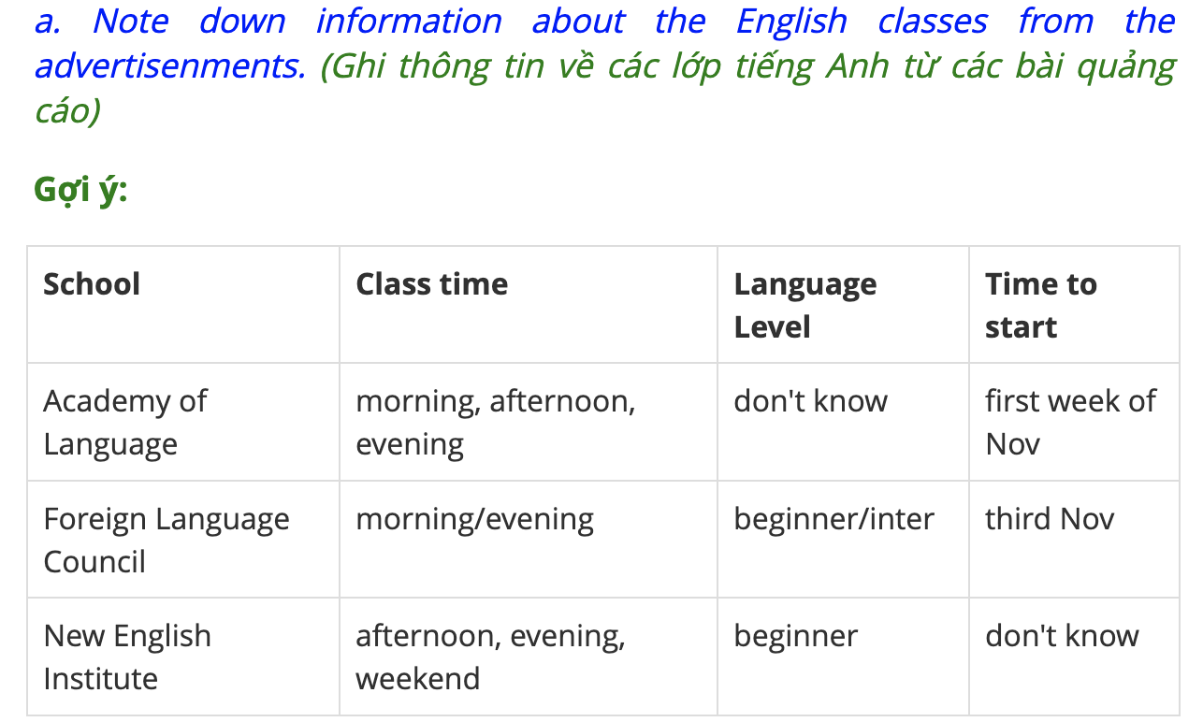

Slide 15
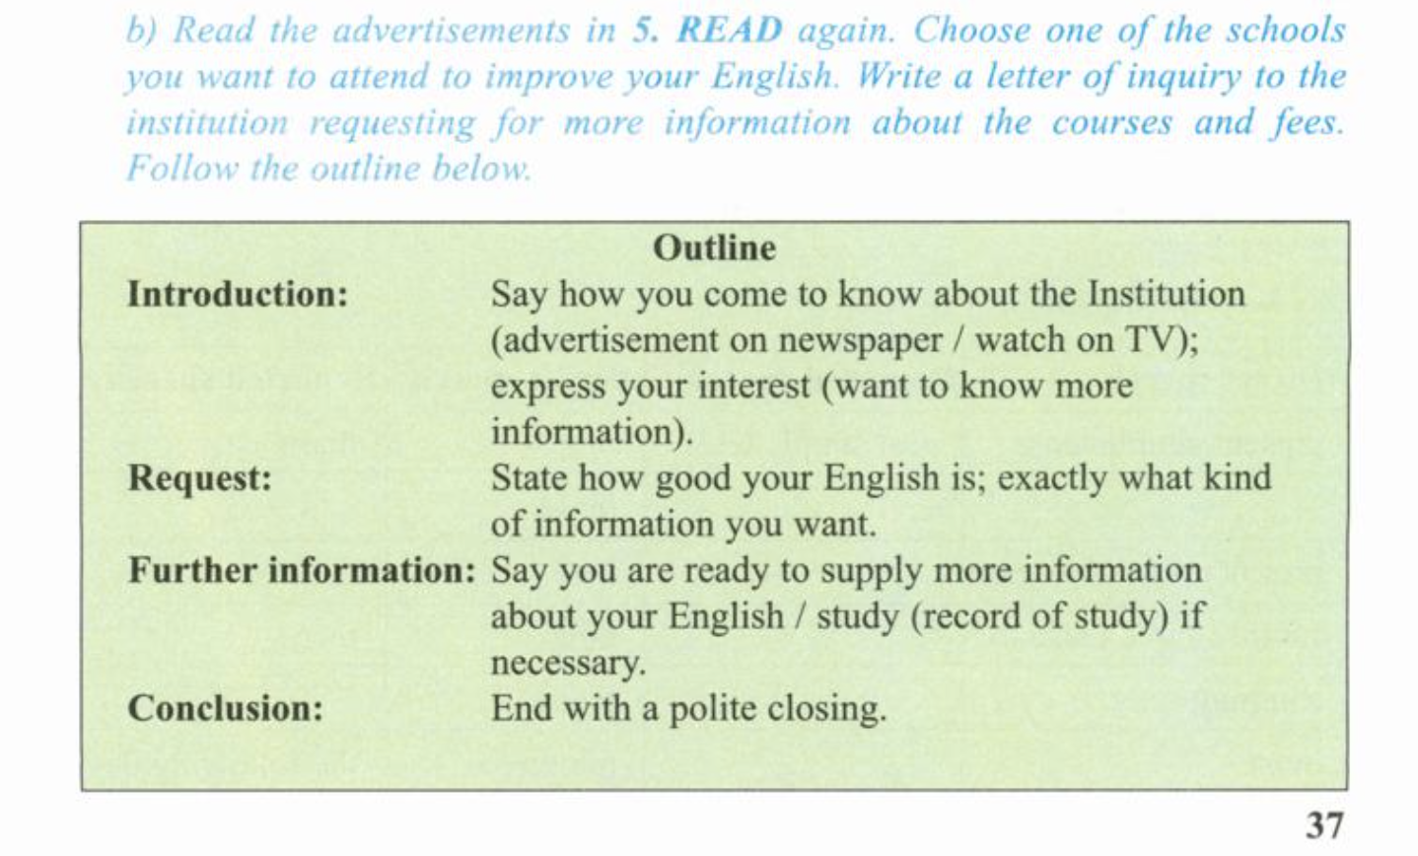
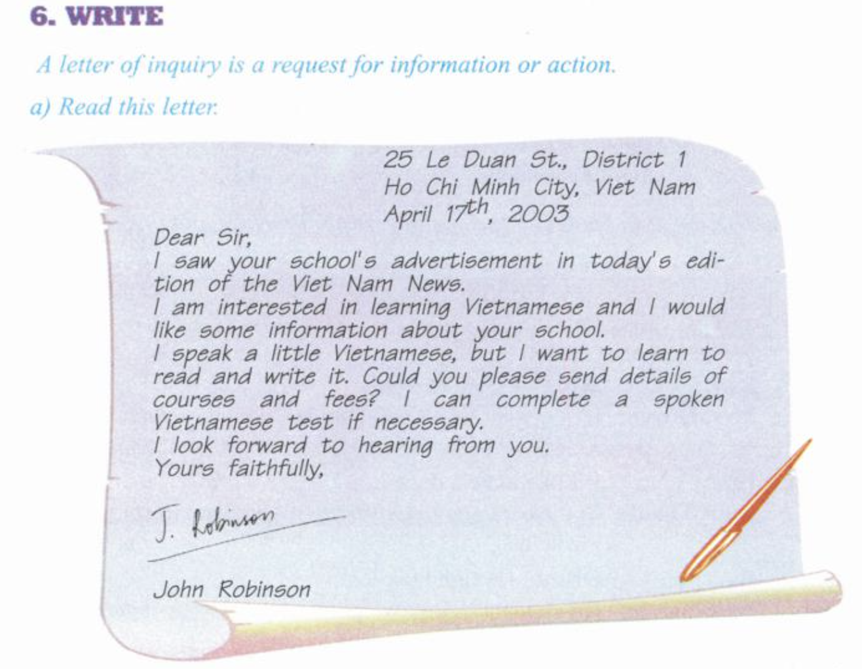
6. WRITE

Slide 16
grammar :
I. Câu tường thuật (Reported Speech) là gì?
Reported Speech hay còn gọi là câu tường thuật, câu gián tiếp, được sử dụng để thuật lại lời nói trực tiếp của một người khác.
Khi chuyển từ một lời nói trực tiếp sang gián tiếp chúng ta cần lưu ý một số vấn đề sau:
1/ Nếu động từ tường thuật (reporting verb) chia ở các thì hiện tại chúng ta giữ nguyên thì (tense) của động từ chính, đại từ chỉ định và các trạng từ chỉ nơi chốn cũng như trạng từ chỉ thời gian trong câu trực tiếp khi chuyển sang gián tiếp.
Ví dụ: He says: “I’m going to Ha Noi next week.” ⇒ He says he is going to Ha Noi next week.

Slide 17
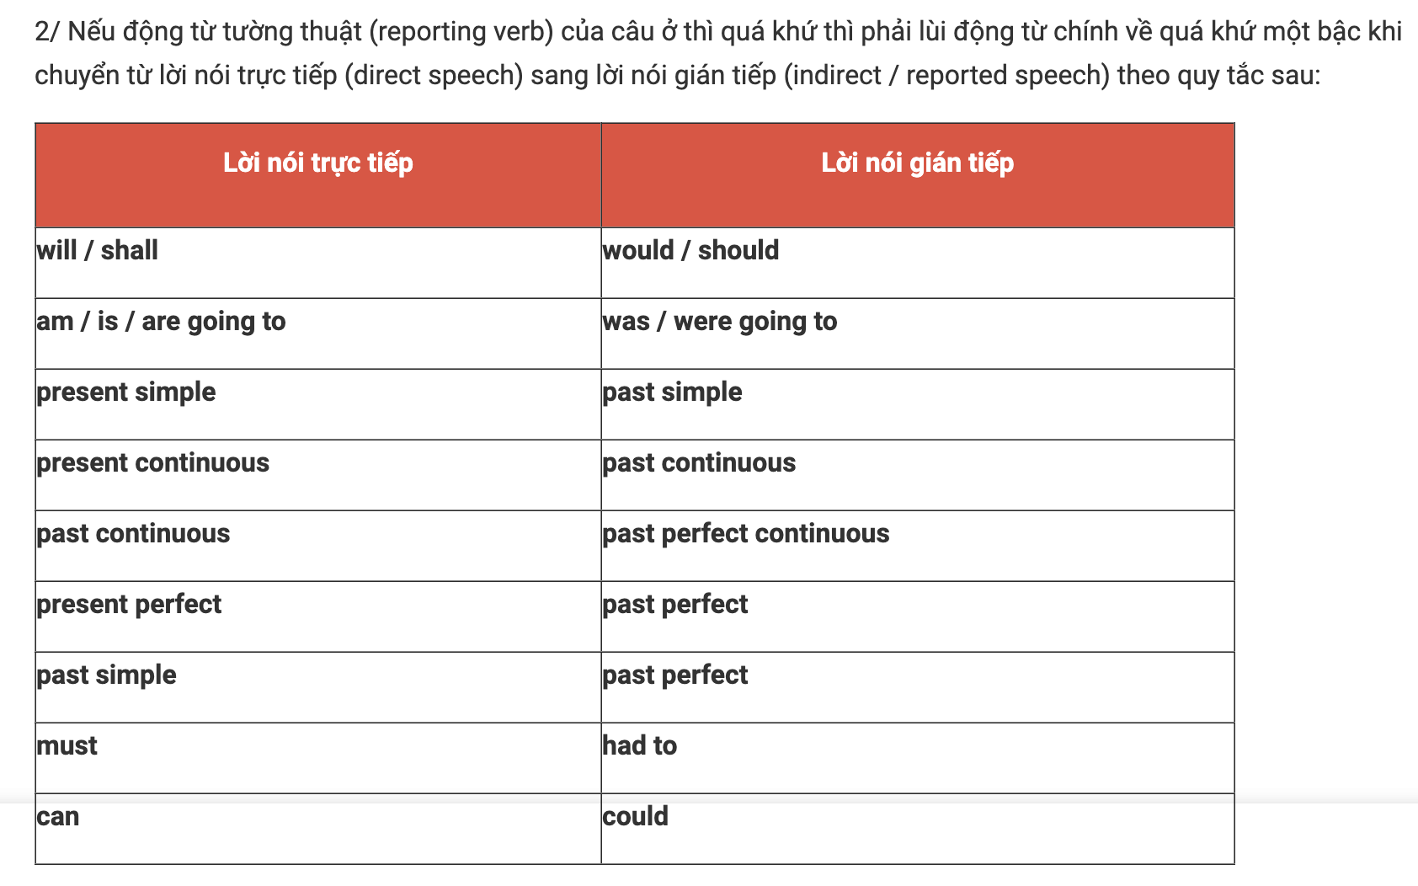
Ví dụ: Direct speech: “I’ll talk to Mr Jones,” said he. Reported speech: He said he would talk to Mr Jones.
Một số động từ không thay đổi khi chuyển sang lời nói gián tiếp : would => would, could => could, might => might, should => should, ought to => ought to

Slide 18
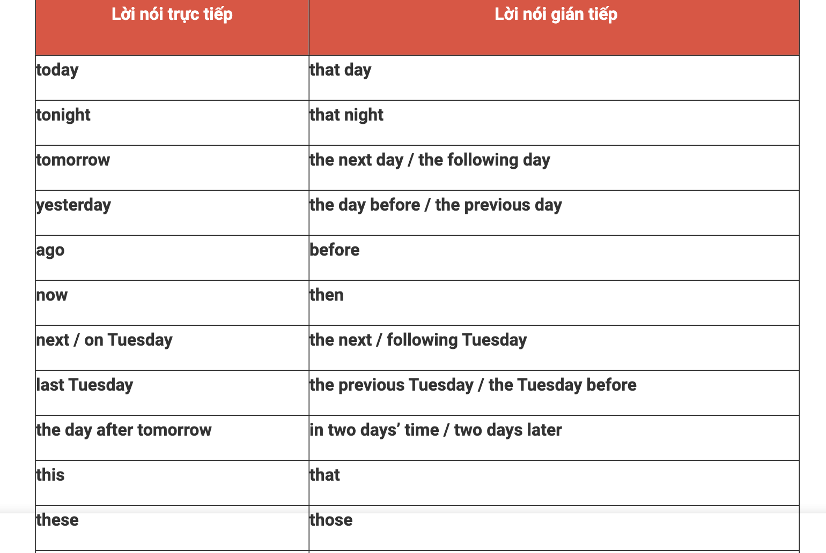
Khi chuyển từ lời nói trực tiếp sang gián tiếp mà động từ tường thuật ở thì quá khứ thì các trạng từ chỉ thời gian và nơi chốn và đại từ chỉ định được chuyển đổi theo quy tắc sau:
Ví dụ: Direct speech: “I’m leaving here tomorrow,” said Mary. Reported speech: Mary said (that) she was leaving there the next day.

Slide 19
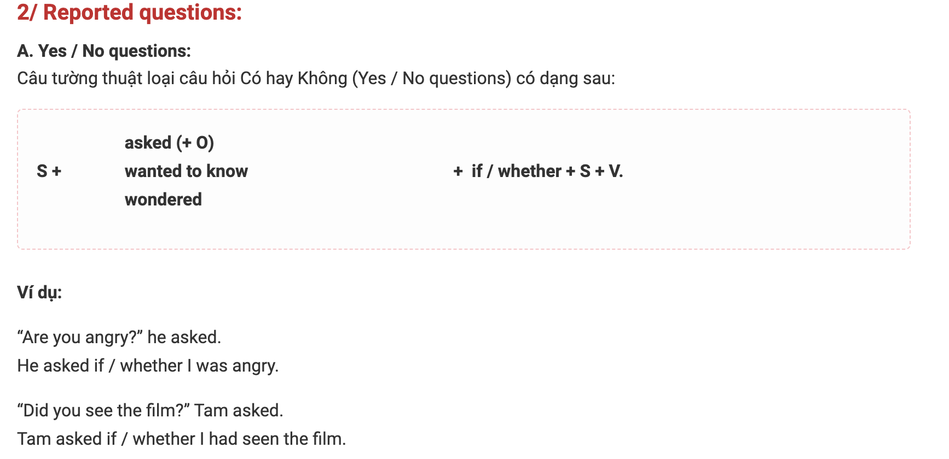
II. Các loại câu tường thuật cơ bản:
1/ Reported statements:
Cấu trúc câu: S + say(s) / said + (that) + S + V
says / say to + O => tells / tell + O said to + O => told + O
Ví dụ: - He said to me: “I haven’t finished my work.”  He told me he hadn’t finished his work.

Slide 20
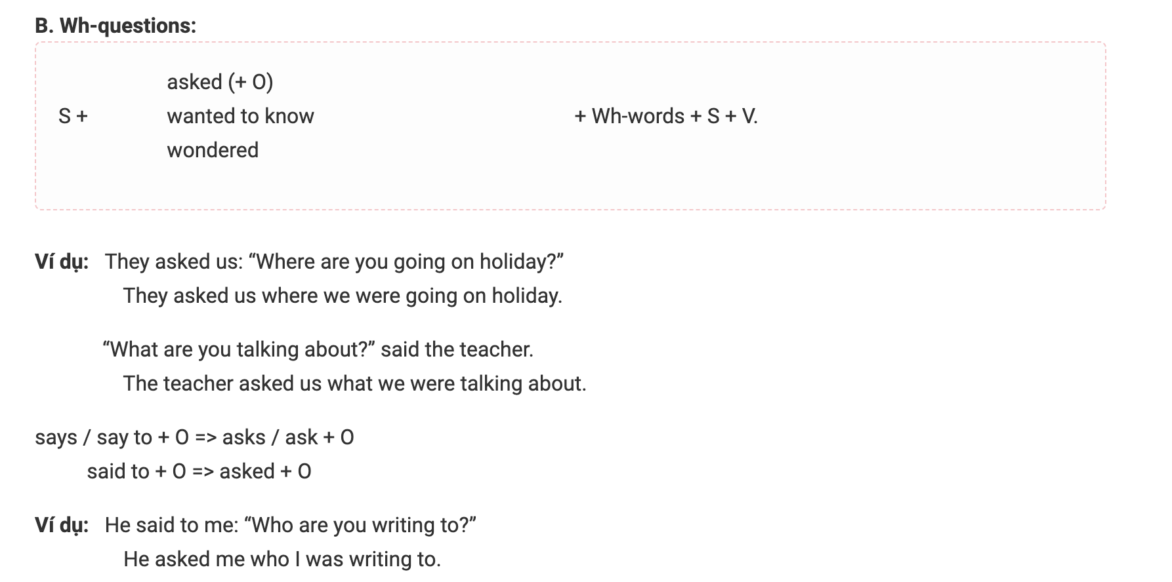

Slide 21
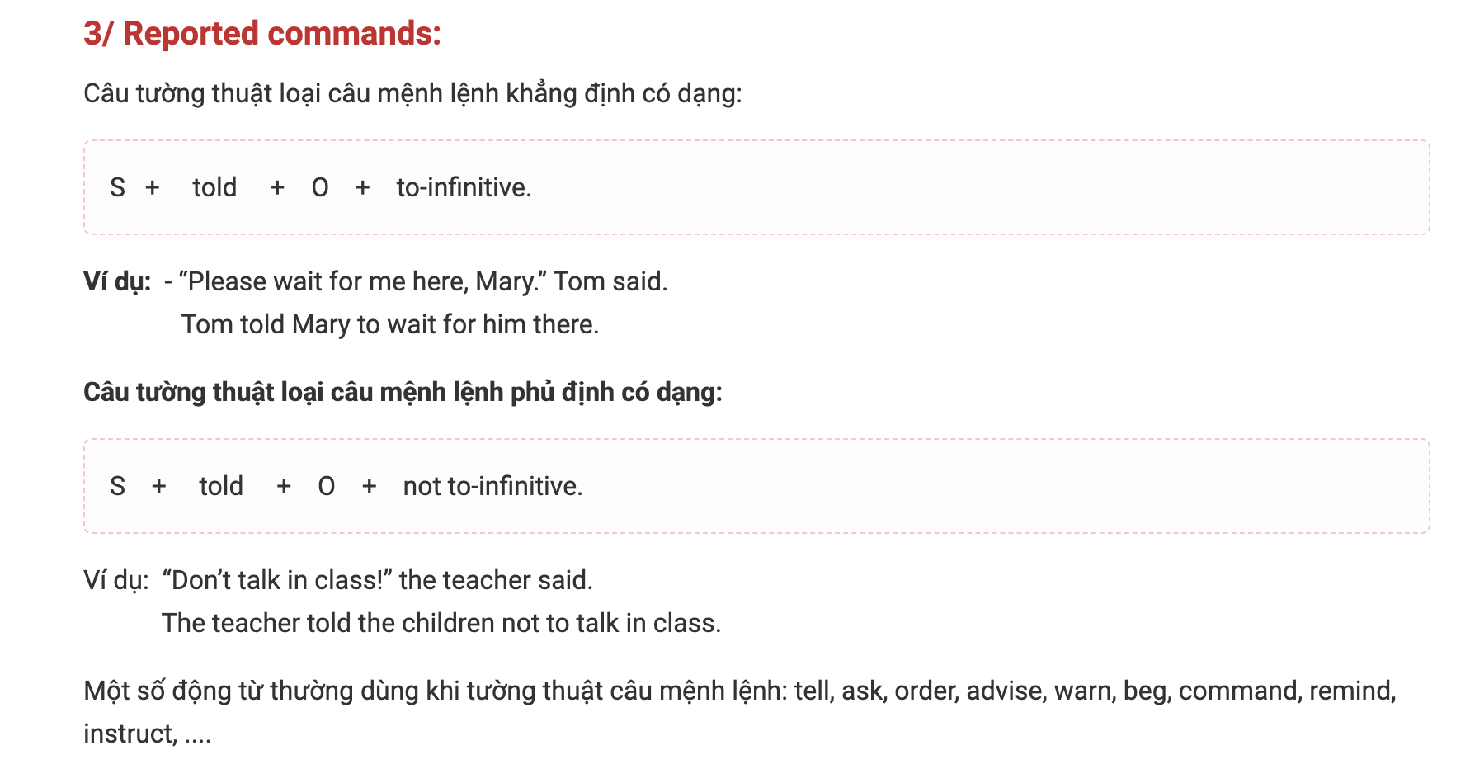

Slide 22
Exercise 1: Chuyển các câu sau về dạng câu trần thuật
1. “If the weather is fine, I will go on a picnic with my friends,” she said.
.......................................................................................................................................................
2. “What would you do if you had three days off ?” I asked him.
.......................................................................................................................................................
3. “I would have come to see you if I had known your address, Jim” she said.
.......................................................................................................................................................
4. “I’m sure she will help you if you ask her.” , he told me.
.......................................................................................................................................................
5. “If Today were Sunday, we wouldn’t go to school.” They said to me.
.......................................................................................................................................................
6. She said to me, “If I were you, I wouldn’t tell her about this.”
.......................................................................................................................................................
7. “There would not be enough seats if a lot of guests came.”, they said.
.......................................................................................................................................................
8. “You will be surprised if you meet him.” , Peter said to Linda.
.......................................................................................................................................................
9.The boy said : “I won’t be strong if I don’t swim everyday.”
.......................................................................................................................................................
10. “What would you do if you saw a snake ?” Nam asked Nga.
.......................................................................................................................................................

