Slide 1

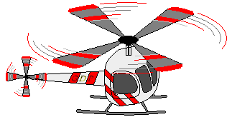
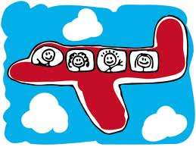
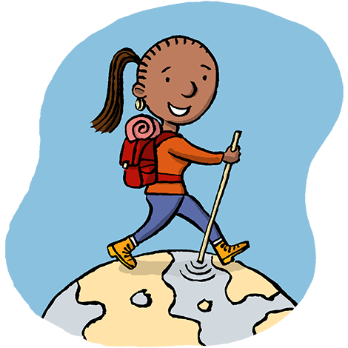
UNIT 11:
TRAVELING AROUND VIET NAM
WRITE

Slide 2


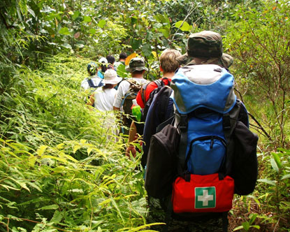
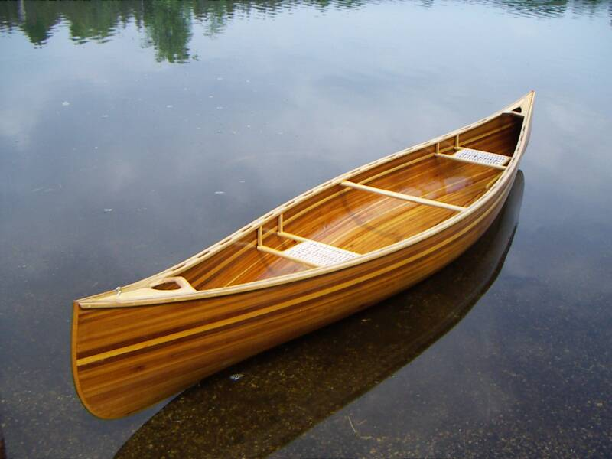
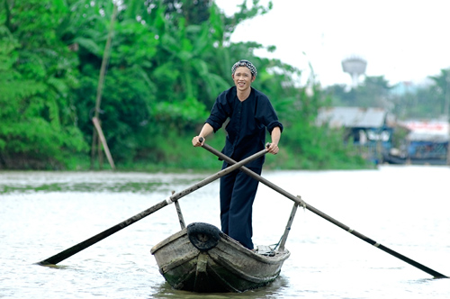
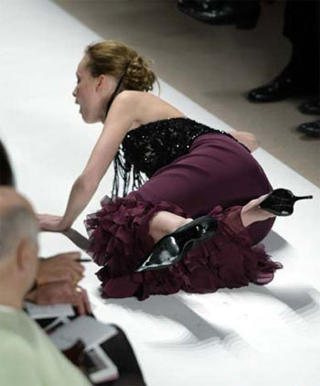
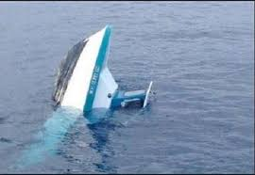
Unit 11: Traveling around Viet Nam
WRITE.
Vocabulary:
adventure (n) :
canoe (n) :
overturn (v) :
paddle(v/ n):
stumble (v) :
rescue (v) = save:
cuộc phiêu lưu
What is an other word of “save”?
chiếc xuồng, ca nô
lật úp
chèo(xuồng), mái chèo
trượt chân, vấp ngã
cứu, cứu nguy

Slide 3

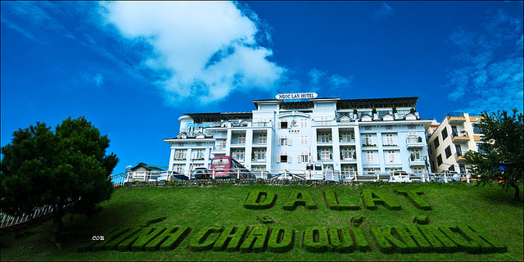
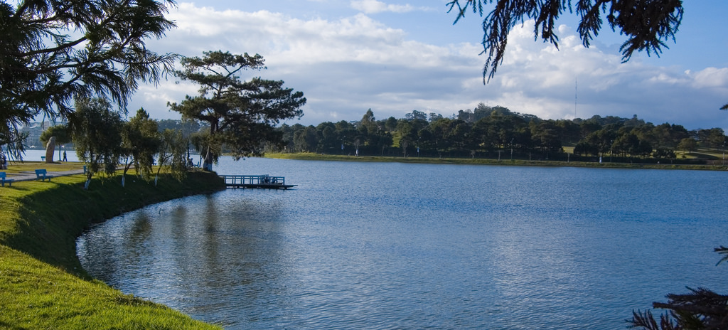
Unit 11: Traveling around Viet Nam
WRITE.
Xuan Huong Lake
We are reading the first part of an adventure of the Browns family on Xuan Huong Lake in Da Lat.

Slide 4

Unit 11: Traveling around Viet Nam
WRITE.
Read the first part of a story about traveling around Viet Nam.
Last week, while on vacation in Da Lat, the Browns had quite an adventure. One afternoon, they decided to paddle around Xuan Huong Lake in a canoe. After hiring the canoe, the family climbed in and paddled out to of the middle of the lake. Unfortunately, dark clouds soon appeared and it began to rain.

Slide 5

Unit 11: Traveling around Viet Nam
WRITE.
Now, put the sentences below in the correct chronological order to complete the story.
The canoe moved up and down the water.
A boat appeared and rescued them.
The wind started to blow and the rain became heavier.
She leaned over and tried to pick it up.
The family was very lucky.
The canoe overturned and everyone fell into the deep and dangerous water.
Shannon dropped her paddle.
Keys: c, a, g, d, f, b, e

Slide 6
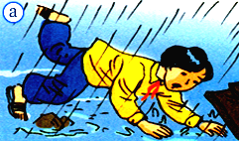
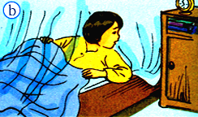
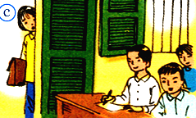
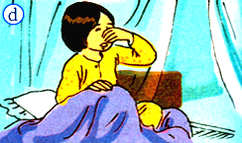
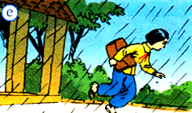
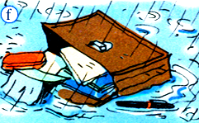
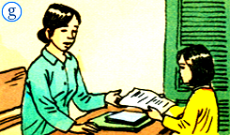
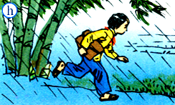
Unit 11: Traveling around Viet Nam
WRITE.
2. Put the event below in the correct chronological order and write the story. Start with the sentence below.

Slide 7

Answer keys:
1- d 2- b  3- e  4- h  5- a  6- f  7- c  8- g

Slide 8

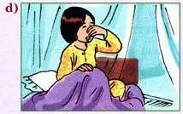
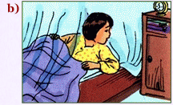
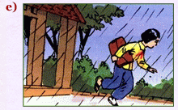
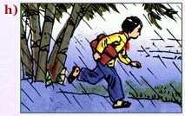
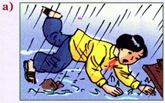
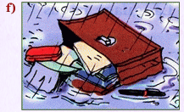
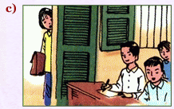
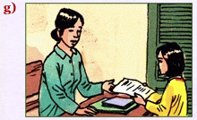
1. She / math exam / Friday / and she / get up / late.
She had a math exam on Friday and she got up late.
2. She / realize / her alarm clock / not / go off (báo thức).
She realized her alarm clock did not go off.
3. As she / leaving / it /start / rain / heavily.
As she was leaving home it started to rain (raining) heavily.
4. Uyen / try / run / fast / she could.
Uyen tried to run as fast as she could.
5. Suddenly / she / stumble / rock /and fall.
Suddenly, she stumbled against a rock and fell (onto the road).
6. Schoolbag / pool / and everything / get wet.
Her schoolbag went into a pool and everything got wet.
7. Strangely / rain / stop / as she / get / her classroom.
Strangely, the rain stopped as she got to her classroom.
8 Luckily, Uyen / enough time / finish.
Luckily, Uyen had enough time to finish her exam.

Slide 9

Unit 11: Traveling around Viet Nam
WRITE.
A Completed story about Uyen
Uyen had a day to remember last week. She had a math exam on Friday and she got up late. She realized her alarm clock did not go off. As she was leaving home it started to rain heavily. Uyen tried to run as fast as she could. Suddenly, she stumbled against a rock and fell (onto the road). Her schoolbag went into a pool and everything got wet. Strangely, the rain stopped as she got to her classroom. Luckily, Uyen had enough time to finish her exam.

Slide 11
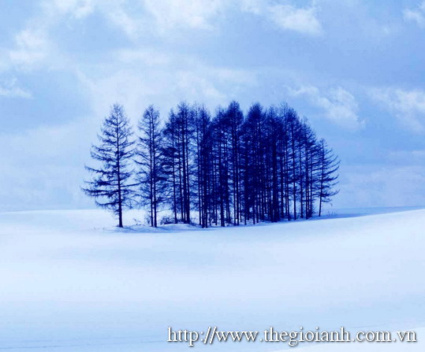

Thank you for your attention !

